Slide 1
HUMAN-CENTERED COMPUTING
Topic-2: Palindrome checker

Slide 2
What is Palindrome?
Palindrome is a word, number, phrase, or sequence of characters which reads the same backward as forward.
Sentence length palindromes ignore capitalization, punctuation, and word boundaries.
Examples of palindrome: “Madam” is a palindrome as it reads madam from both the forward and the backward. “2,1,4,1,2” is also a palindrome as the numbers are same from the forward and the backward.

Slide 3
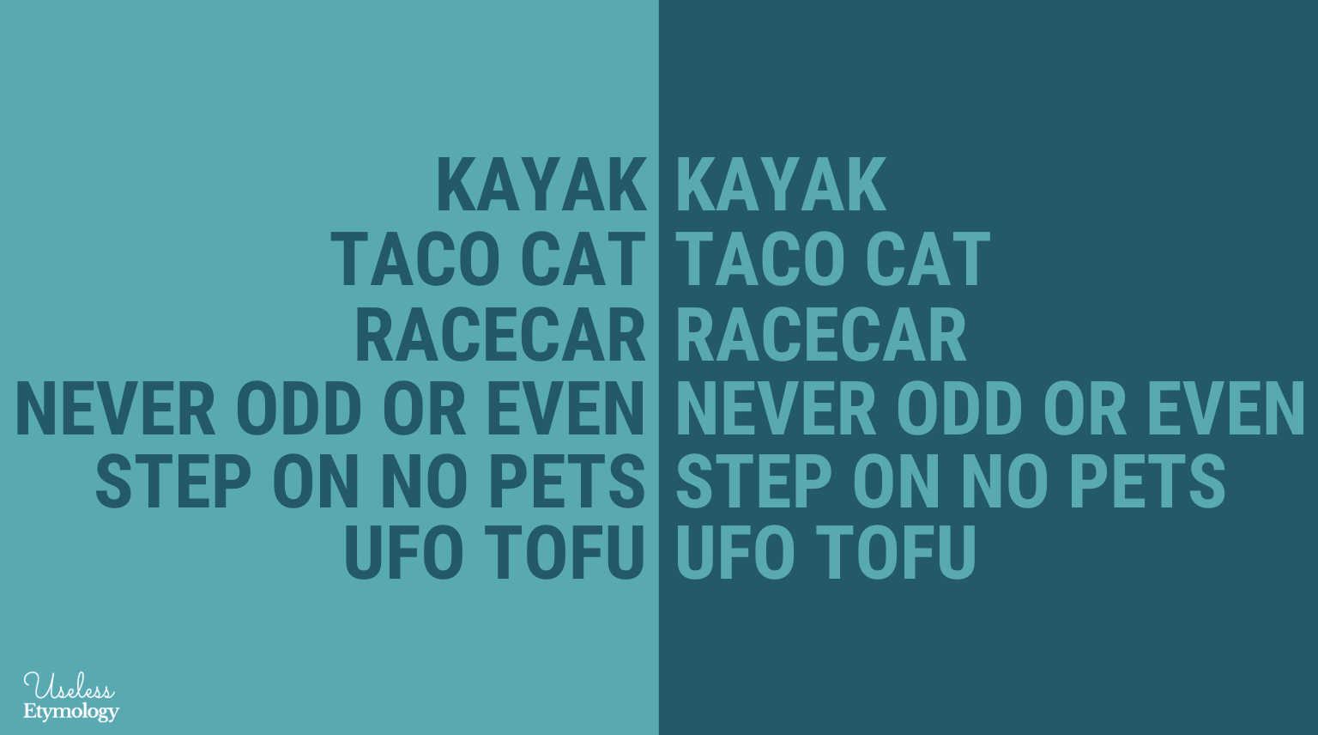
Use of Palindrome.
Palindrome recognition is important in computational biology.
Palindromic structures can frequently be found in proteins and identifying them gives researchers hints about the structure of nucleic acids.

Slide 4
Thank You

