Slide 1
HUMAN-CENTERED COMPUTING
Topic-3: Library management-system

Slide 2
What is a Library Management-System?
A Library Management-System is a software built to handle the primary housekeeping functions of a library.
Library Management-System helps libraries keep track of the books, and their checkouts, as well as members subscription and profiles.
Library Management-System also involves in maintaining the database for entering new books and recording books that have been borrowed with their respective due dates.
Library Management-System is also known as Integrated Library-System.

Slide 3
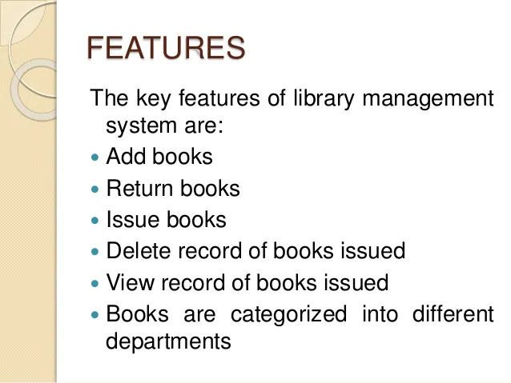
Applications and Uses of the Library Management-System.
By using the library management-system helps in maintaining inventory and complete records of the books.
It helps in search of the required book more flexible and keep track of the record.
It is very simple and easy to use.
Examples of the Library Management-System are Evergreen, OpenBiblio (Open Source).

Slide 4
Thank You

