Slide 1
Xeno Affordance Design
Bhumika
Likhitha
Manusha
Rahul

Slide 2
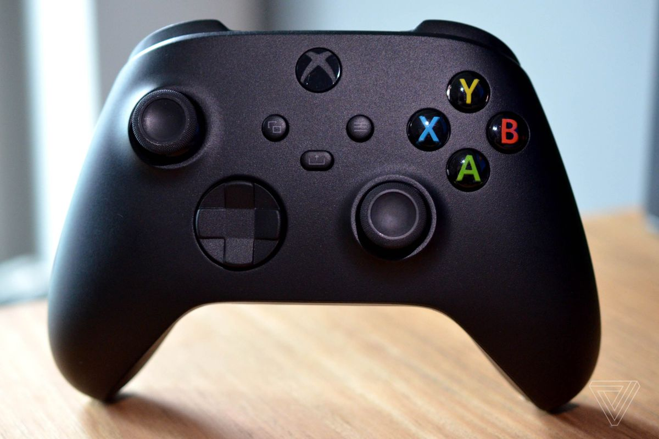
Tool and Task:
A game controller, gaming controller, or simply controller affordance is typically to control an object or a character in the game. The signifiers X, Y, A, B, and also Big ‘X’ in the middle help’s map what function is done when pressed.
The task is to play a game.

Slide 3
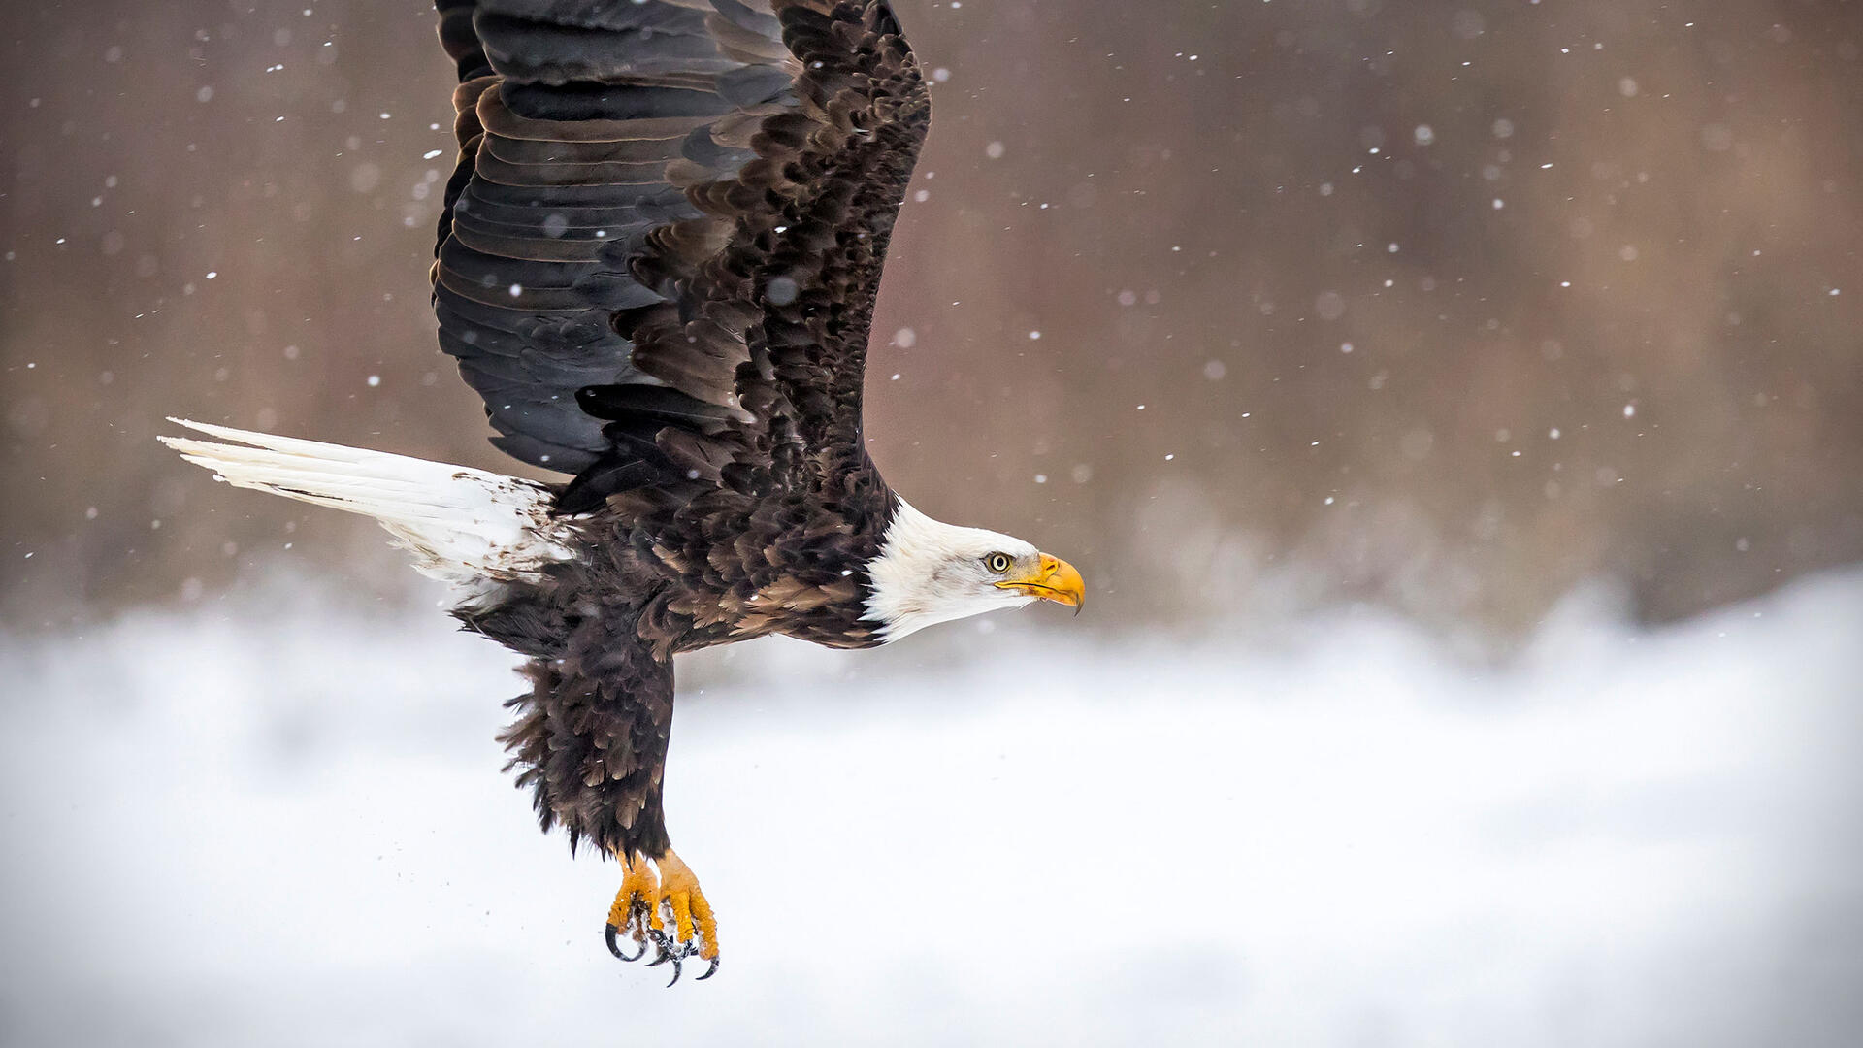
Name of the animal:
Eagles are large, powerfully built birds of prey, with heavy heads and beaks and strong, muscular legs.

Slide 4
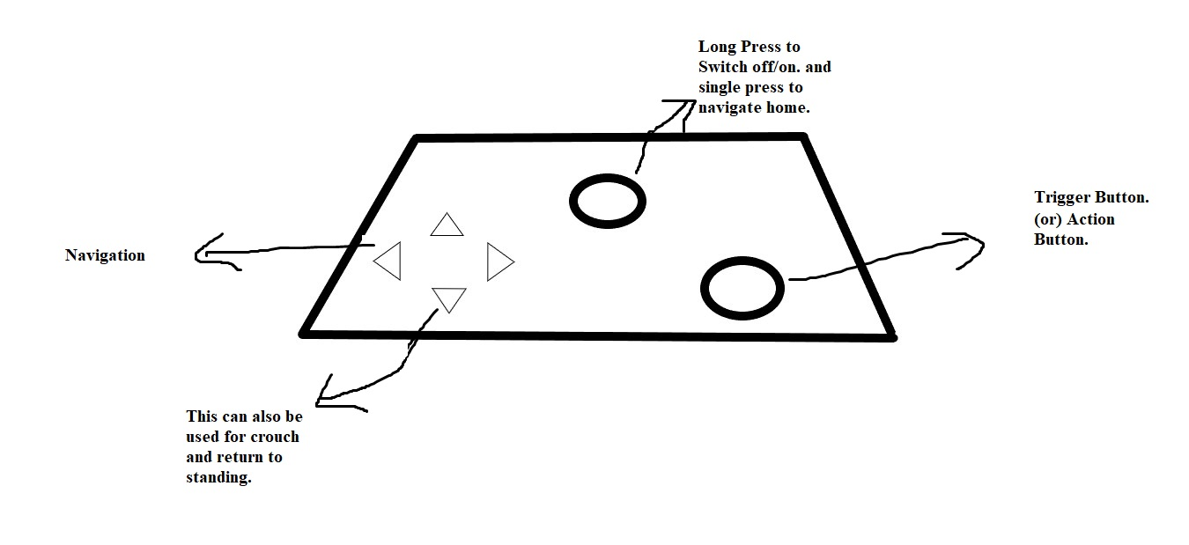
New design of the tool:
The new redesigned tool (layout or mapping) of the controller has all the basic functions of that humans use as in 1.) navigate keys, 2.) Switch off/on key (or) to navigate home button, 3.) Trigger (or) Action Button.
A flat game controller is designed so that the eagle can easily afford to use the controller with the help of its claws or even its beak. It can just simply hop on the feedback keys with the help of signifiers to use different functions in the controller to play the game.

Slide 5
Differences:
The affordance of the humans is that they can hold the controller with their hands and play the games with their fingers while holding the controller.
Whereas eagles can`t hold the controller since they don’t have hands or fingers to do so. So, the new designed controller (layout or mapping) is laid on a surface and the eagle can hop on to the feedback keys and use the controller or it can also use its beak to press the buttons on the controller. It presses the function button based on the signifiers of the new mapping of the controller.
As the new designed controller is flat and doesn`t have any joystick like features it can be easily be used by the different animals to use the controller.

Slide 6
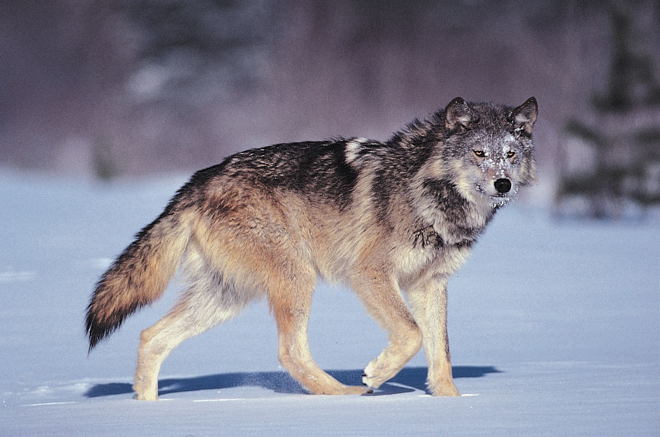
2nd animal able to use the tool:
A wolf can also use the same new tool with the help of its legs as the new layout or mapping of the controller is a flat with signifiers helping the wolf to understand on which button maps to which action.
It can just press the feedback key with its legs and be able to play the game.

Slide 7
Thank You

