Slide 1
FLAPPY BIRD
Preeti Maurya, MD Zaman, Rahul Garigipati

Slide 2


Updated Concept
ACCESSBILITY
COLLISION DETECTION
FLAPPYING BIRD
Successful implementation of the navigation of the bird through Keyboard up/down key Press
press and pitch.
Partial implementation of Collision Detection of the bird when it hits the obstacles.
Use of Bird Sprites to give flapping effect.

Slide 3
Updated Concept
GRAVITY MECHANIC
JUMP MECHANIC
Scrolling Background
Animation of bird sprite to show it falling after hitting the obstacle.
Implemented based on voice pitch and Up/Down keys press from keyboard
Halfway there

Slide 4
Updated Literature
2018 SIGCHI conference paper "Design Patterns for Voice Interaction in games" by Fraser Allison, Marcus Carter, and Wally Smith.​
As the paper depicts how the different design patterns for the voice interaction changes the game progress, actions.​
We focus on the design pattern that navigates from the voice interaction and how it effects the game.

Slide 5
COMPLETED COMPONENTS
FLAPPING BIRD
AUDIO INPUT
01
04
Random Pipe Sprites
02
05
BACKGROUND
JUMP MECAHNICS
SCORE COUNT
03
06
Bird sprite with flapping wings.
Audio input is given by a player.​
Moving and randomly scaled Pipe Sprites
Static background
Bird jumps by giving voice pitch or Keyboard keys Press as input.​
The counter counts till 7 as of now.

Slide 6

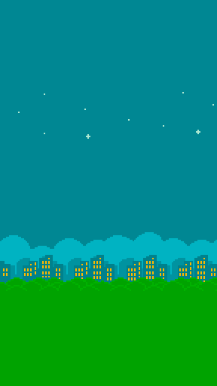
PROGRESS
80%
60%
50%
Accessibility
Background and obstacles
Jump and Gravity Mechanics

Slide 7
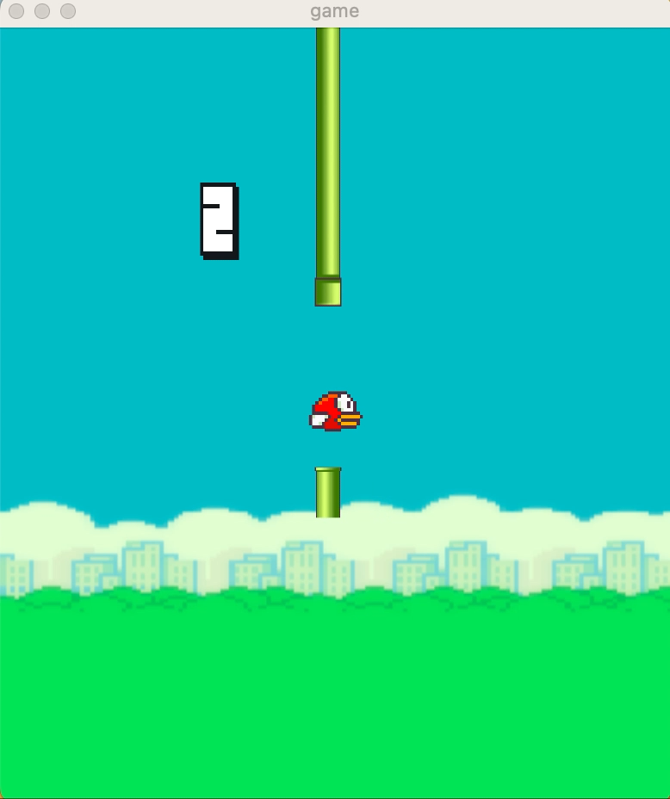
DEMO

Slide 8
COMPONETS TIME-LINE
April 24th
Score Counter/Collision
Preeti Maurya
April 24th
Side-scrolling Background
Rahul Garigipati
April 24th
Gravity Mechanics
MD Zaman
May 1st
Review and corrections
ALL

Slide 9
THANKS!
Any questions?

