Slide 1
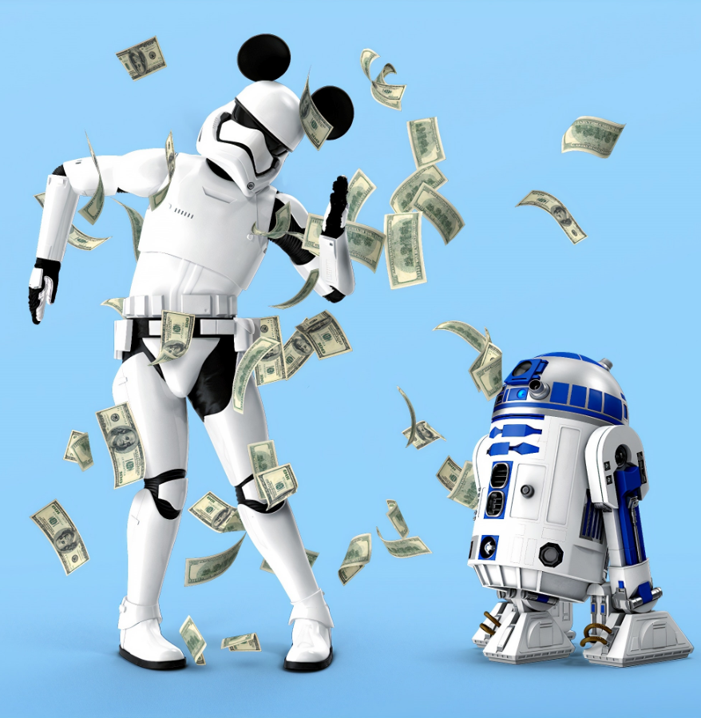
Algorithmic Trading using Deep Reinforcement Learning (DQN)
By:
Utkarsh Ujwal
Chakradhaar Viswatmula
Rahul Dhanasiri

Slide 2
Introduction

Slide 3
Problem Statement
We will use a reinforcement learning model to train an agent that will buy, sell or hold 2 stocks everyday, once a day, so that the long term capital increases.
Agent has an initial capital of $ X.
Environment has 2 equities that an agent can trade A and B.
Price of these equities are defined as PAt and PBt.
The agent can perform tasks: Buy-A, Sell-A, Do Nothing, Buy-B and Sell-B.
To make the problem simpler, there are no transaction costs considered in buying/selling stocks.

Slide 4
Metrics
Agent starts with a capital of $10,000 and stocks of Apple and Amazon with $2,500 each. At the end of episode, we calculate net PnL as follows:
Net PnL (Net Profit and Loss) for the whole period = (Portfolio Value) at the end of period - (Portfolio Value) at the start of the period.
Portfolio Value= (Quantity of Apple Stock* Price of Apple Stock) + (Quantity of Amazon Stock* Price of Amazon Stock) + Open Cash

Slide 5
Trading Strategy
The problem that we are trying to solve here is for a Day Trader and not a long-term Warren Buffett. So:
We are not looking at fundamental analysis of stock price, but at a daily small variation in stock price.
Dsfs
We are also not taking the risk that is involved in taking a big position in a stock (so buying/selling in lots of say 100, 1000, 500 stocks at the same time).
We are trying to find a daily buy/sell/hold strategy, with buying 1 stock a day out of the two available stocks and then trying to make profit from this.
Therefore, Profit and Loss metric is the best for this problem.

Slide 6
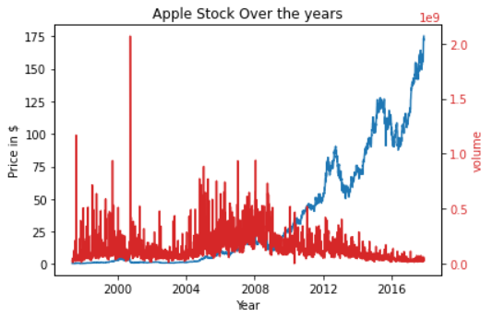
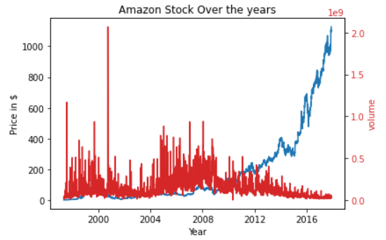
Exploratory Data Analysis
We have gathered the data from Kaggle.
We used the following columns from the data: Date, Open, Close, Volume.

Slide 7
DQN Implementation

Slide 8
Benchmark Model
No Agent, No Learning
At the start of the period: We buy stocks Apple and Stock Amazon, with half of half the amount invested in each stock. Open Cash remains the same throughout the period
Sell 10% of stocks in 10 intervals, thus increasing open cash
At the end of the period, we calculate the portfolio value as follows:
Portfolio Value= (Quantity of Apple Stock* Price of Apple Stock) + (Quantity of Amazon Stock* Price of Amazon Stock) + Open Cash

Slide 9
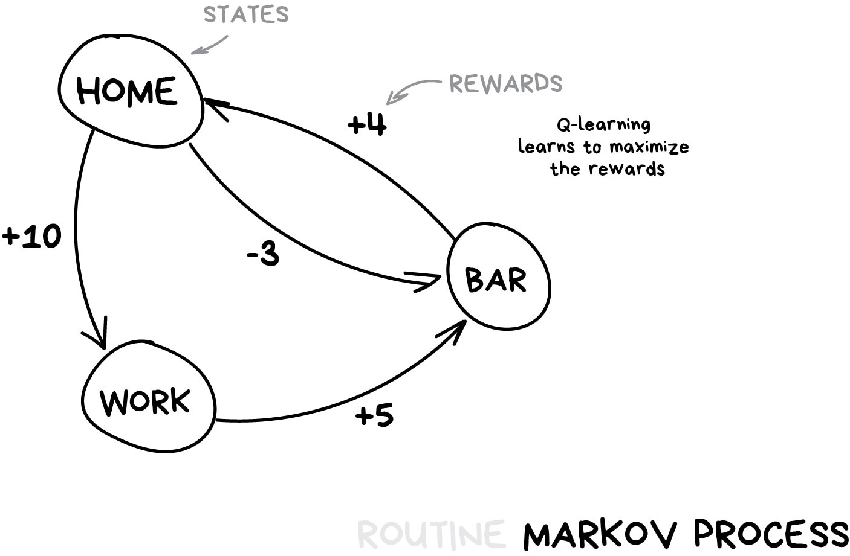
Reinforcement Learning
In our case, reinforcement learning agent can:
At every state S_{t} of environment (i.e. every day, with prices of Apple and Amazon stock given).
Take one action from possible actions A_{t} (Buy Apple, Buy Amazon, Sell Apple, Sell Amazon, Do nothing).
And Based on action taken, the agent gets a reward R_{t}.
Next State S_{(t+1)} gets defined (i.e. new prices for next day).

Slide 10
Design Choices for DQN Model
States: Stock1Price, Stock2Price, Stock1Balance, Stock2Balance, OpenCash, Stock1_5day_price, Stock2_5day_price and PortfolioValue
Actions: BuyStock1, BuyStock2, DoNothing, SellStock1 or SellStock2
Transitions: State, Action, Reward, Next State & done flag
Rewards: more on this later.

Slide 11
Main Functionality
State
Blnc_Stock1
Price_Stock1
Blnc_Stock2
Blnc_Stock2
Open cash
5-day Stock 1
5-day Stock 1
State (S_{t} )
Environment
Deep Q-Neural network
Input: States
Output: 5 Q-values for 5 actions
Agent
Deep Q-Network Experience replay
Exploration vs Exploitation
Actions
Action 0: Buy stock 1
Action 1: Sell stock 1
Action 3: Do nothing
Action4: Buy stock 2
Action 5: Sell stock 2
Reward (R_{t} )

Slide 12
Actions & Rewards
Action 0: This action buys the Apple stock if Cash is available
If Agent tries to buy Apple stock when it does not have enough Open Cash, then the agent gets bankrupt, the episode ends and the reward is a big negative number, -200000.
If Open cash is less than 500 and agent tries to sell it, then give negative reward -10000, this is to train agent to not go bankrupt
Also, if the stock price is only 2% less than the last 5-day trading price, then the reward is -10,000. This is to ensure that agent does not do trading for small gains
Otherwise, the agent gets a reward based on how much the buying price is less than 5-day trailing price.

Slide 13
Actions & Rewards
Action 1: This action program will sell the Apple stock
If Agent has 0 Apple Stocks and it tries to buy it, then the agent gets bankrupt, the episode ends and the reward is a big negative number -200000.
If Apple stocks are less than 10 and an agent tries to sell it, then give a negative reward -100000, this is to train the agent to not go bankrupt.
Also, if the stock price is only 2% less than the last 5-day trading price, then the reward is -10,000. This is to ensure that the agent does not do trading for small gains.
Otherwise, the agent gets a reward based on how much the buying price is less than 5-day trailing price.

Slide 14
Actions & Rewards
Action 2: Agent will do nothing
If an agent has less than 2 Apple and Amazon stocks, and it does nothing, then it is good and it gets a reward of 10000.
Else, it gets a reward of -100000 for not doing anything. This is to make the agent take an action.

Slide 15
Actions & Rewards
Action 3: This action buys the Amazon stock if Cash is available
If Agent tries to buy Amazon stock when it does not have enough Open Cash, then the agent gets bankrupt, the episode ends and the reward is a big negative number, -200000.
If Open cash is less than 500 and agent tries to sell it, then give negative reward -10000, this is to train agent to not go bankrupt
Also, if the stock price is only 2% less than the last 5-day trading price, then the reward is -10,000. This is to ensure that agent does not do trading for small gains
Otherwise, the agent gets a reward based on how much the buying price is less than 5-day trailing price.

Slide 16
Actions & Rewards
Action 4: This action program will sell the Apple stock
If Agent has 0 Amazon Stocks and it tries to buy it, then the agent gets bankrupt, the episode ends and the reward is a big negative number -200000.
If Apple stocks are less than 10 and an agent tries to sell it, then give a negative reward -100000, this is to train the agent to not go bankrupt.
Also, if the stock price is only 2% less than the last 5-day trading price, then the reward is -10,000. This is to ensure that the agent does not do trading for small gains.
Otherwise, the agent gets a reward based on how much the buying price is less than 5-day trailing price.

Slide 17
Experience Replay Memory
Our problem is that we have sequential samples from interactions with the environment to our neural network. And it tends to forget the previous experiences as it overwrites with new experiences.
For instance, if we are on Day 400, where stock is going up continuously for the last 30 days, it will forget the experience from day 250 to day 300 where stock had a very low valuation because of poor financial performance.
Correlation Problem: If our agent is learning only from experiences of the past few days then in the short term the agent can think that Amazon stock will go down, hence will SELL.
But, if we look at the long term view, stock might be a BUY.
As a consequence, it will be more efficient to make use of previous experience, by learning with it multiple times.
Hence replay buffer helps us to store experience tuples while interacting with the environment, and then we sample a small batch of tuple to feed our neural network.

Slide 18
Parameter Tuning
Parameters that were tuned are:
Exploration vs Exploitation parameter- Epsilon and its decay rate.
State definition: There are various values that can go in state and I will try with various inputs like 5 days stock price, volume etc.
Memory size
Action Size: What actions can the agent do? I decided to use 5 actions: Buy1, Sell1, Buy2, Sell2, Do nothing. I also evaluated the model using other actions like Buy1Sell2 and Buy2Sell1, but found that model performance did not change much with it.
Reward for various actions: Reward for not going bankrupt and to not go near bankruptcy were defined.
Neural network architecture:
Number of layers
Layer types (relu, Linear )
Layer parameters

Slide 19
Conclusion
The agent was trained over 50 episodes and the corresponding models ep10, ep20…ep50 were stored in the model's directory.
Final Architecture of the model is a deep Q-network with following layers in the neural network, Input to Neural network is states and the output is the Q-Values. Neural network has 3 layers with 64, 32 and 8 units. Output layer is the Q layer with units=action size (i.e. 5)
Experience replay is used to help the neural network to converge better.

Slide 20
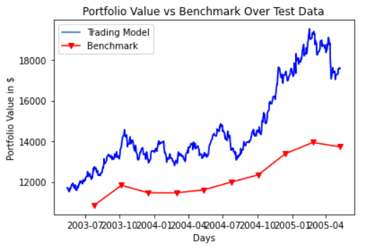
Results

Slide 21

Thanks!
Do you have any questions?

