Slide 1
Dimensionality reduction
PCA, MDS,
ISOMAP, SVD, ICA, sPCA
CSCE883

Slide 2
Why dimensionality reduction?
Some features may be irrelevant
We want to visualize high dimensional data
“Intrinsic” dimensionality may be smaller than the number of features

Slide 3
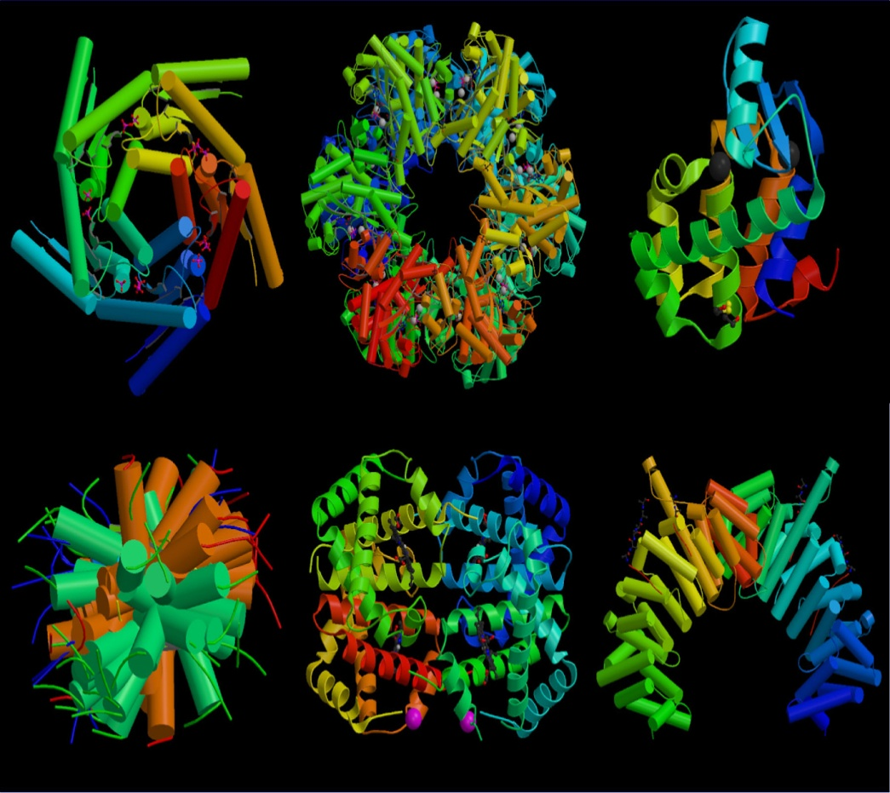
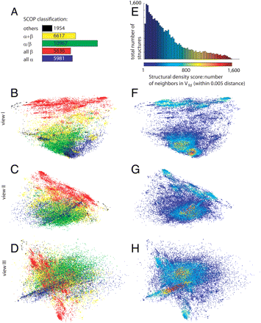
Global Mapping of Protein Structure Space

Slide 4
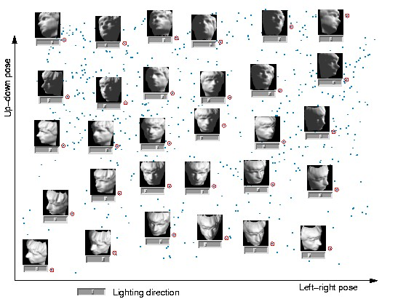
Isomap on face images

Slide 5
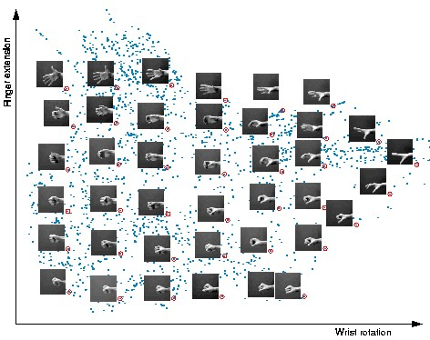
Isomap on hand images

Slide 6
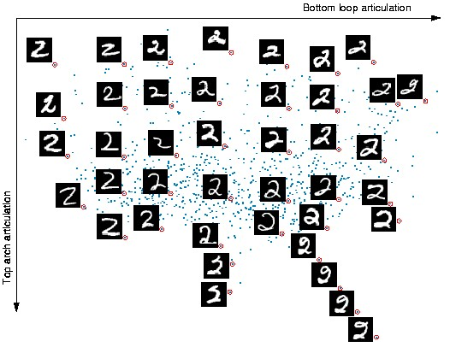
Isomap on written two-s

Slide 7
Supervised feature selection
Scoring features:
    Mutual information between attribute and class
    χ²: independence between attribute and class
    Classification accuracy
Domain specific criteria:
  E.g. Text:
    remove stop-words (and, a, the, …)
    Stemming (going → go, Tom’s → Tom, …)
    Document frequency

Slide 8
Choosing sets of features
Score each feature
Forward/Backward elimination
  Choose the feature with the highest/lowest score
  Re-score other features
  Repeat
If you have lots of features (like in text)
  Just select top K scored features

Slide 9
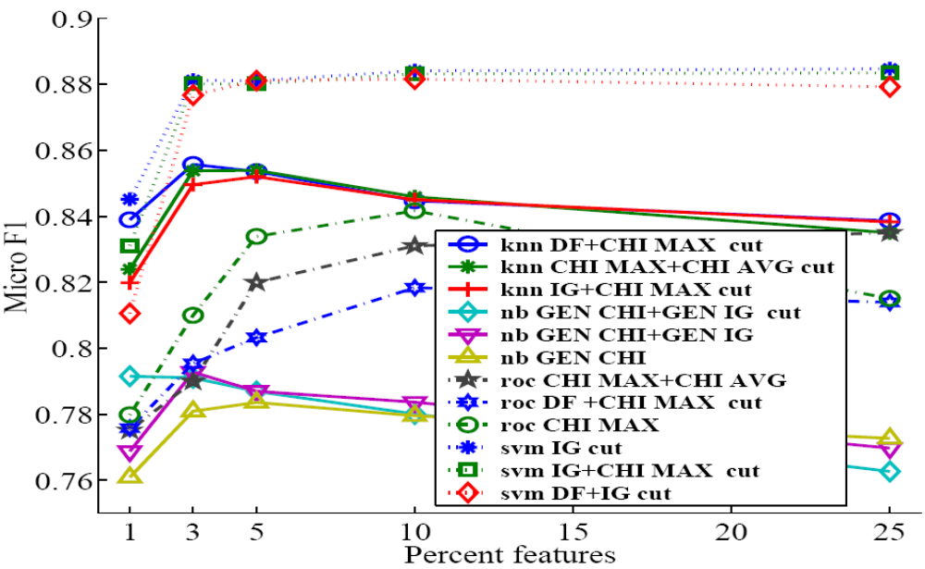
Feature selection on text
SVM
kNN
Rochio
NB

Slide 10
Unsupervised feature selection
Differs from feature selection in two ways:
  Instead of choosing subset of features,
  Create new features (dimensions) defined as functions over all features
  Don’t consider class labels, just the data points

Slide 11
Unsupervised feature selection
Idea:
  Given data points in d-dimensional space,
  Project into lower dimensional space while preserving as much information as possible
    E.g., find best planar approximation to 3D data
    E.g., find best planar approximation to 104D data
  In particular, choose projection that minimizes the squared error in reconstructing original data

Slide 12
PCA
Intuition: find the axis that shows the greatest variation, and project all points into this axis
f2
e1
e2
f1

Slide 13
Principal Components Analysis (PCA)
Find a low-dimensional space such that when x is projected there, information loss is minimized.
The projection of x on the direction of w is: z = w^{T}x
Find w such that Var(z) is maximized
Var(z) = Var(w^{T}x) = E[(w^{T}x – w^{T}μ)²]
= E[(w^{T}x – w^{T}μ)(w^{T}x – w^{T}μ)]
= E[w^{T}(x – μ)(x – μ)^{T}w]
= w^{T} E[(x – μ)(x –μ)^{T}]w = w^{T} ∑ w
where Var(x)= E[(x – μ)(x –μ)^{T}] = ∑
Lecture Notes for E Alpaydın 2010 Introduction to Machine Learning 2e © The MIT Press (V1.0)

Slide 14
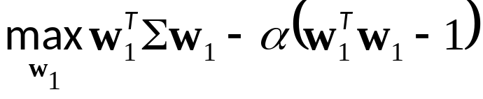
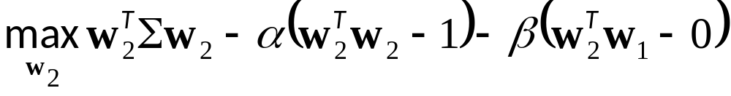
Maximize Var(z) subject to ||w||=1
  ∑w₁ = αw₁ that is, w₁ is an eigenvector of ∑
  Choose the one with the largest eigenvalue for Var(z) to be max
Second principal component: Max Var(z₂), s.t., ||w₂||=1 and orthogonal to w₁
  ∑ w₂ = α w₂ that is, w₂ is another eigenvector of ∑
and so on.
Lecture Notes for E Alpaydın 2010 Introduction to Machine Learning 2e © The MIT Press (V1.0)

Slide 15
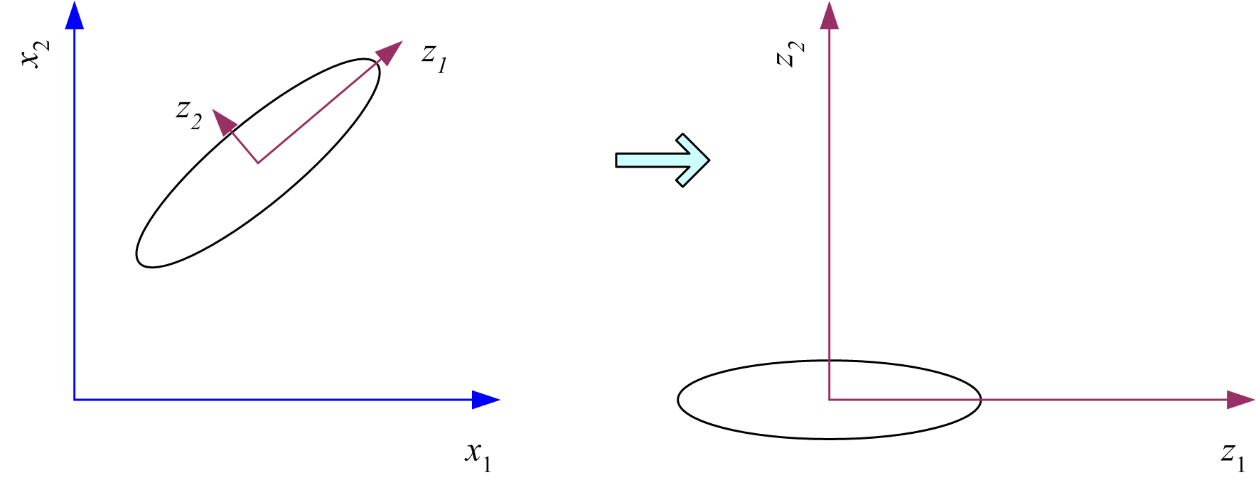
What PCA does
z = W^{T}(x – m)
where the columns of W are the eigenvectors of ∑, and m is sample mean
Centers the data at the origin and rotates the axes
Lecture Notes for E Alpaydın 2010 Introduction to Machine Learning 2e © The MIT Press (V1.0)

Slide 16
PCA Algorithm
PCA algorithm:
  1. X ← Create N x d data matrix, with one row vector x_{n} per data point
  2. X subtract mean x from each row vector x_{n} in X
  3. Σ ← covariance matrix of X
  Find eigenvectors and eigenvalues of Σ
  PC’s ← the M eigenvectors with largest eigenvalues

Slide 17
PCA Algorithm in Matlab
% generate data
Data = mvnrnd([5, 5],[1 1.5; 1.5 3], 100);
figure(1); plot(Data(:,1), Data(:,2), '+');
%center the data
for i = 1:size(Data,1)
Data(i, :) = Data(i, :) - mean(Data);
end
DataCov = cov(Data); %covariance matrix
[PC, variances, explained] = pcacov(DataCov); %eigen
% plot principal components
figure(2); clf; hold on;
plot(Data(:,1), Data(:,2), '+b');
plot(PC(1,1)*[-5 5], PC(2,1)*[-5 5], '-r’)
plot(PC(1,2)*[-5 5], PC(2,2)*[-5 5], '-b’); hold off
% project down to 1 dimension
PcaPos = Data * PC(:, 1);

Slide 18
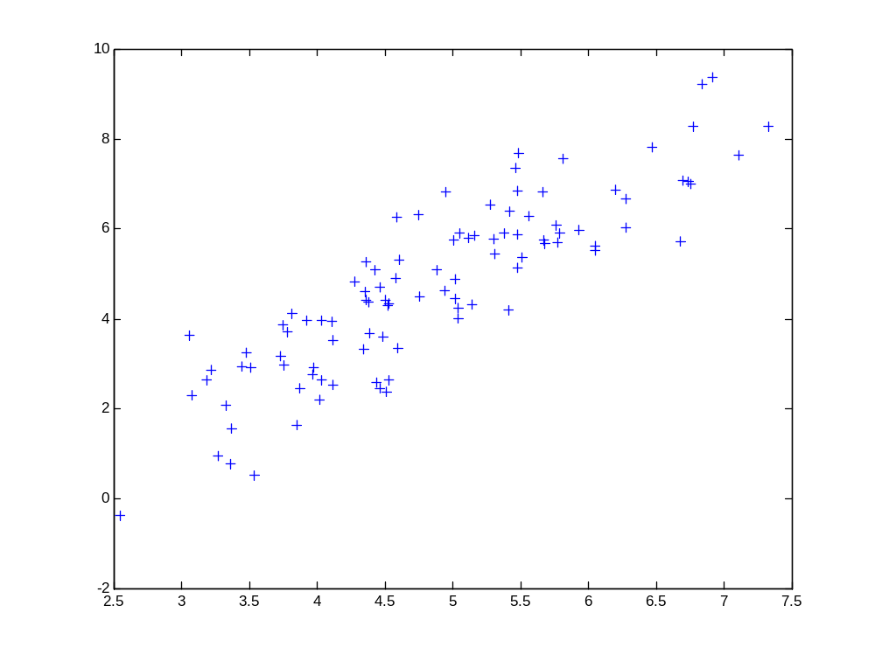
2d Data

Slide 19
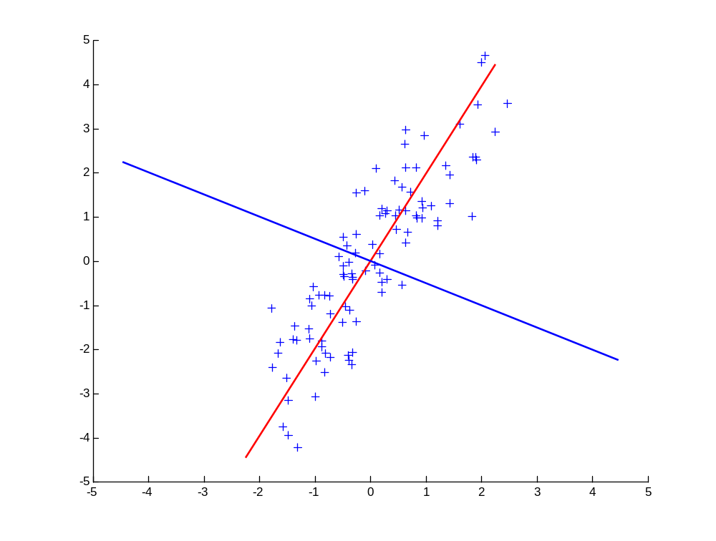
Principal Components
1st principal vector
Gives best axis to project
Minimum RMS error
Principal vectors are orthogonal
2nd principal vector

Slide 20
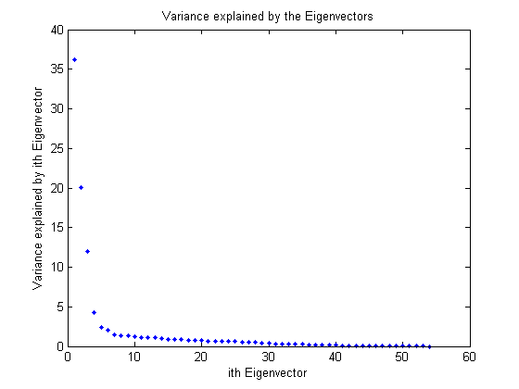
How many components?
Check the distribution of eigen-values
Take enough many eigen-vectors to cover 80-90% of the variance

Slide 21
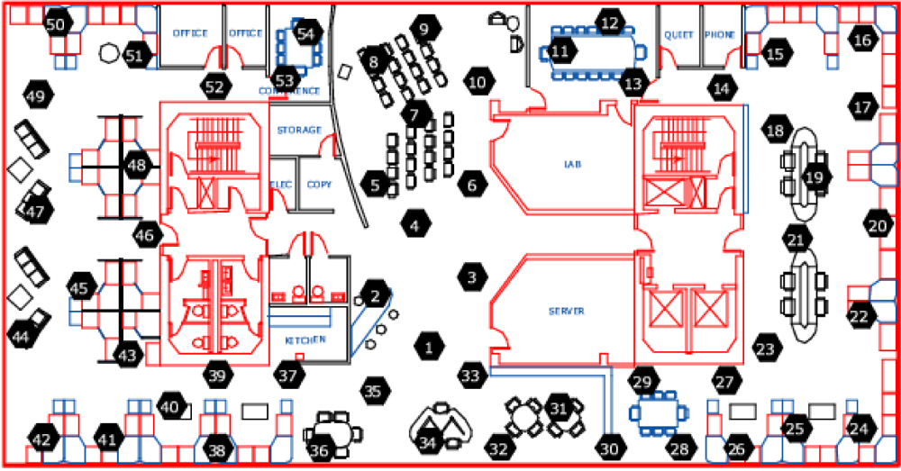
Sensor networks
Sensors in Intel Berkeley Lab

Slide 22
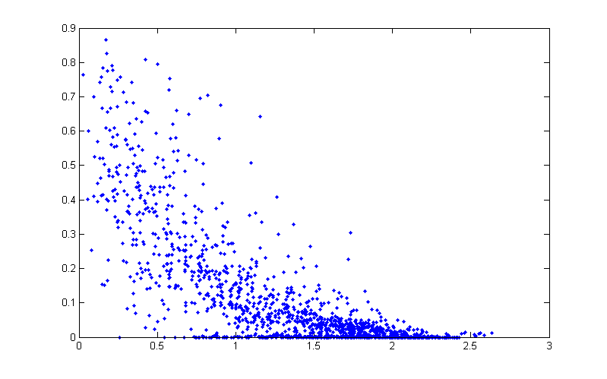
Pairwise link quality vs. distance
Link quality
Distance between a pair of sensors

Slide 23
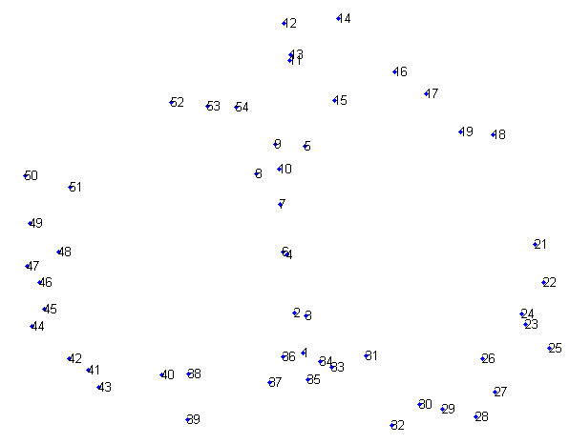
PCA in action
Given a 54x54 matrix of pairwise link qualities
Do PCA
Project down to 2 principal dimensions
PCA discovered the map of the lab

Slide 24
Problems and limitations
What if very large dimensional data?
  e.g., Images (d ≥ 10⁴)
Problem:
  Covariance matrix Σ is size (d²)
  d=10₄ → |Σ| = 10⁸
Singular Value Decomposition (SVD)!
  efficient algorithms available (Matlab)
  some implementations find just top N eigenvectors

Slide 25
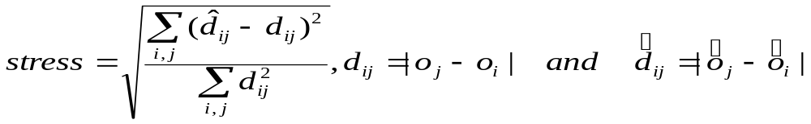
Multi-Dimensional Scaling
Map the items in a k-dimensional space trying to minimize the stress
Steepest Descent algorithm:
  Start with an assignment
  Minimize stress by moving points
But the running time is O(N²) and O(N) to add a new item

Slide 26
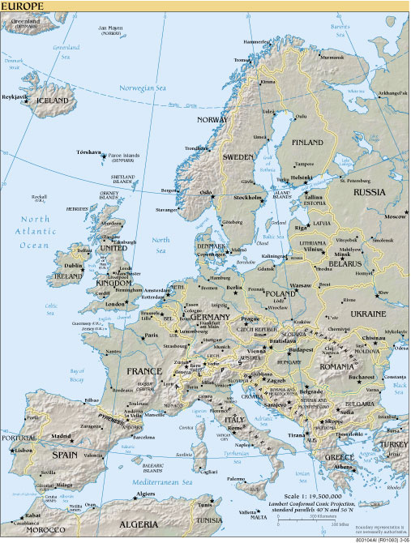
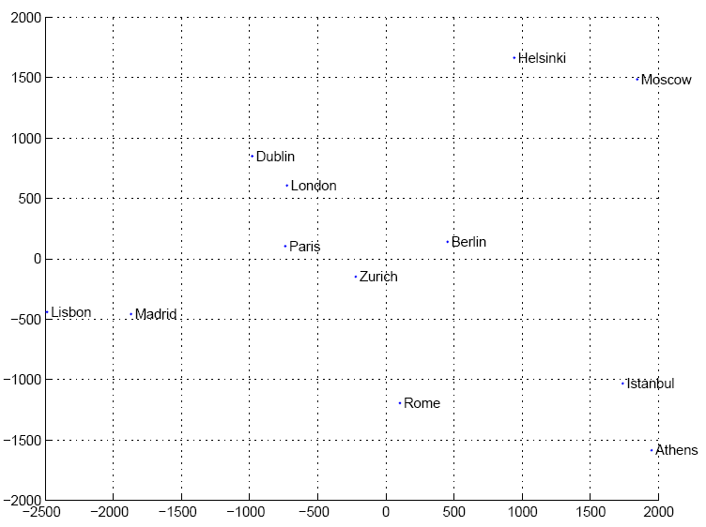
Map of Europe by MDS
Map from CIA – The World Factbook: http://www.cia.gov/
Lecture Notes for E Alpaydın 2010 Introduction to Machine Learning 2e © The MIT Press (V1.0)

Slide 27
Global or Topology preserving
Mostly used for visualization and classification
  PCA or KL decomposition
  MDS
  SVD
  ICA

Slide 28
Local embeddings (LE)
Overlapping local neighborhoods, collectively analyzed, can provide information on global geometry
LE preserves the local neighborhood of each object
preserving the global distances through the non-neighboring objects
Isomap and LLE

Slide 29
Isomap – general idea
Only geodesic distances reflect the true low dimensional geometry of the manifold
MDS and PCA see only Euclidian distances and there for fail to detect intrinsic low-dimensional structure
Geodesic distances are hard to compute even if you know the manifold
In a small neighborhood Euclidian distance is a good approximation of the geodesic distance
For faraway points, geodesic distance is approximated by adding up a sequence of “short hops” between neighboring points

Slide 30
Isomap algorithm
Find neighborhood of each object by computing distances between all pairs of points and selecting closest
Build a graph with a node for each object and an edge between neighboring points. Euclidian distance between two objects is used as edge weight
Use a shortest path graph algorithm to fill in distance between all non-neighboring points
Apply classical MDS on this distance matrix
Notes:
Dist matrix is double centered

Slide 31
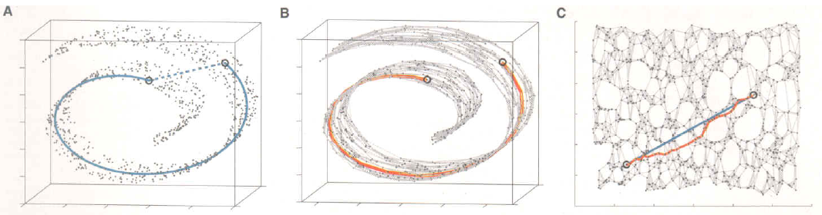
Isomap

Slide 32
Isomap on face images

Slide 33
Isomap on hand images

Slide 34
Isomap on written two-s

Slide 35
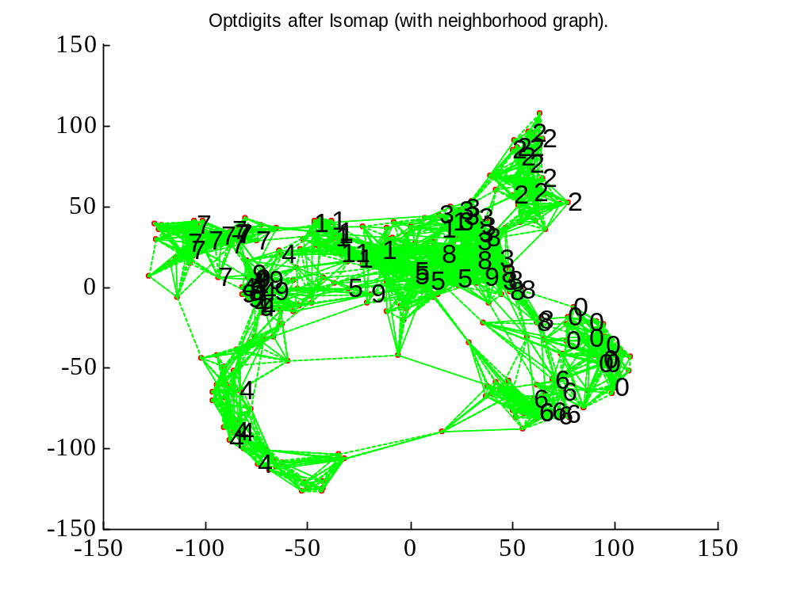
Matlab source from http://web.mit.edu/cocosci/isomap/isomap.html
Lecture Notes for E Alpaydın 2010 Introduction to Machine Learning 2e © The MIT Press (V1.0)

Slide 36
Isomap - summary
Inherits features of MDS and PCA:
  guaranteed asymptotic convergence to true structure
  Polynomial runtime
  Non-iterative
  Ability to discover manifolds of arbitrary dimensionality
Perform well when data is from a single well sampled cluster
Few free parameters
Good theoretical base for its metrics preserving properties

Slide 37
SVD
Singular Value Decomposition

Slide 38
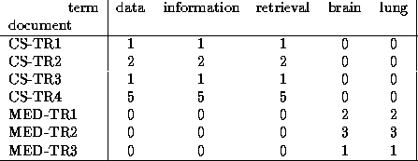
Singular Value Decomposition
Problem:
  #1: Find concepts in text
  #2: Reduce dimensionality

Slide 39
SVD - Definition
A_{[n x m]} = U_{[n x r]} Λ _{[ r x r]} (V_{[m x r]})^{T}
A: n x m matrix (e.g., n documents, m terms)
U: n x r matrix (n documents, r concepts)
Λ: r x r diagonal matrix (strength of each ‘concept’) (r: rank of the matrix)
V: m x r matrix (m terms, r concepts)

Slide 40
SVD - Properties
THEOREM [Press+92]: always possible to decompose matrix A into A = U Λ V^{T} , where
U, Λ, V: unique (*)
U, V: column orthonormal (ie., columns are unit vectors, orthogonal to each other)
  U^{T}U = I; V^{T}V = I (I: identity matrix)
Λ: singular value are positive, and sorted in decreasing order

Slide 41
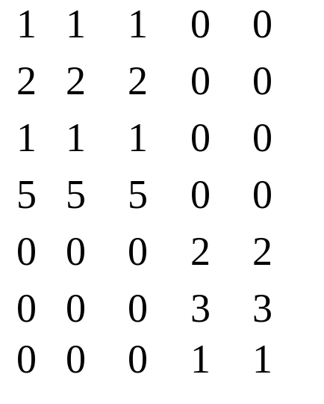
SVD - Properties
‘spectral decomposition’ of the matrix:
λ₁
=
u₁
u₂
x
x
λ₂
v₁
v₂

Slide 42
SVD - Interpretation
‘documents’, ‘terms’ and ‘concepts’:
U: document-to-concept similarity matrix
V: term-to-concept similarity matrix
Λ: its diagonal elements: ‘strength’ of each concept
Projection:
best axis to project on: (‘best’ = min sum of squares of projection errors)

Slide 43
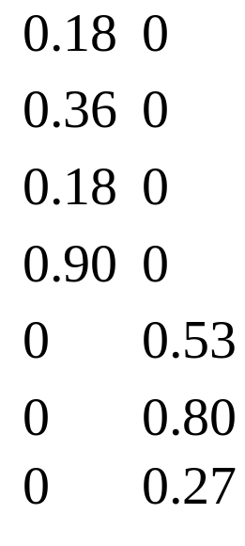
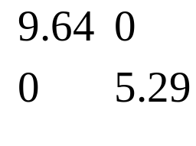
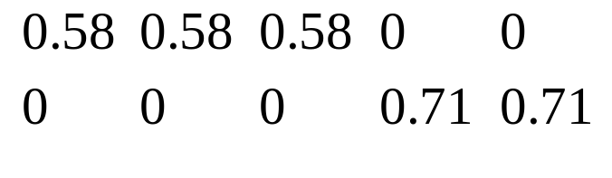
SVD - Example
A = U Λ V^{T} - example:
retrieval
inf.
lung
data
brain
CS
=
x
x
MD

Slide 44
SVD - Example
doc-to-concept
similarity matrix
A = U Λ V^{T} - example:
retrieval
CS-concept
inf.
lung
MD-concept
data
brain
CS
=
x
x
MD

Slide 45
SVD - Example
A = U Λ V^{T} - example:
retrieval
inf.
‘strength’ of CS-concept
lung
data
brain
CS
=
x
x
MD

Slide 46
SVD - Example
A = U Λ V^{T} - example:
term-to-concept
similarity matrix
retrieval
inf.
lung
data
brain
CS-concept
CS
=
x
x
MD

Slide 47
SVD – Dimensionality reduction
Q: how exactly is dim. reduction done?
A: set the smallest singular values to zero:
=
x
x

Slide 48
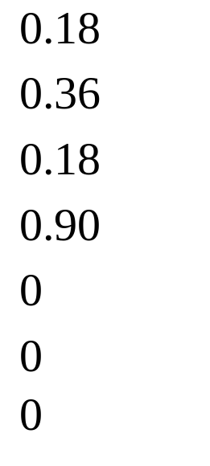
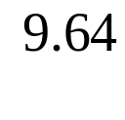
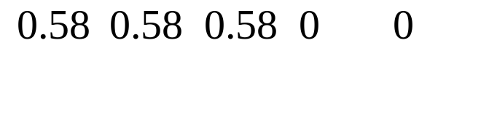
SVD - Dimensionality reduction
~
x
x

Slide 49
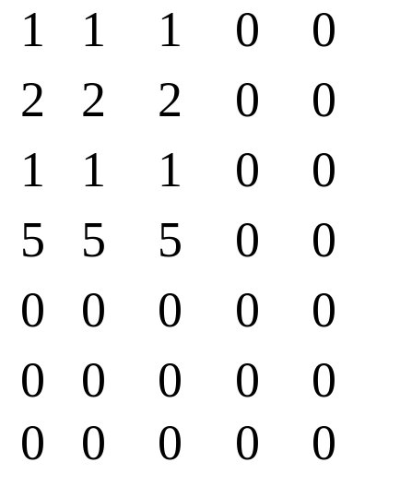
SVD - Dimensionality reduction
~

Slide 50
Matlab source from http://web.mit.edu/cocosci/isomap/isomap.html
Lecture Notes for E Alpaydın 2010 Introduction to Machine Learning 2e © The MIT Press (V1.0)

