Slide 1
Hidden Markov Model
CS570 Lecture Note
KAIST
This lecture note was made based on the notes of
Prof. B.K.Shin(Pukyung Nat’l Univ) and Prof. Wilensky (UCB)

Slide 2
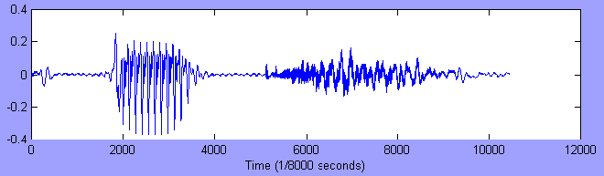


Sequential Data
Often highly variable, but has an embedded structure
Information is contained in the structure

Slide 3
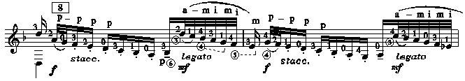
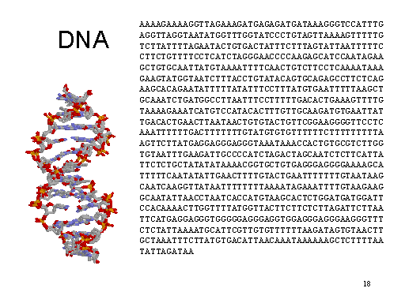
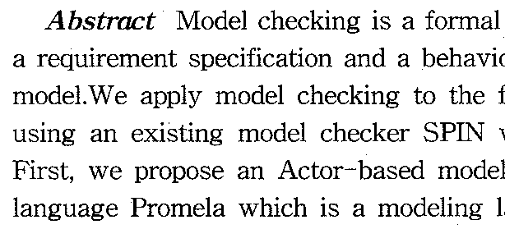
More examples
Text, on-line handwiritng, music notes, DNA sequence, program codes
main() { char q=34, n=10, *a=“main() {
char q=34, n=10, *a=%c%s%c; printf(
a,q,a,q,n);}%c”; printf(a,q,a,n); }

Slide 4
Example: Speech Recognition
Given a sequence of inputs-features of some kind extracted by some hardware, guess the words to which the features correspond.
Hard because features dependent on
  Speaker, speed, noise, nearby features(“co-articulation” constraints), word boundaries
“How to wreak a nice beach.”
“How to recognize speech.”

Slide 5
Defining the problem
Find argmax _{w∈L} P(w|y)
  y, a string of acoustic features of some form,
  w, a string of words, from some fixed vocabulary
  L, a language (defined as all possible strings in that language),
Given some features, what is the most probable string the speaker uttered?

Slide 6
Analysis
By Bayes’ rule:
P(w|y)= P(w)P(y|w)/P(y)
Since y is the same for different w’s we might choose, the
problem reduces to
argmax_{w∈L} P(w)P(y|w)
we need to be able to predict
  each possible string in our language
  pronunciation, given an utterance.

Slide 7
P(w) where w is an utterance
Problem: There are a very large number of possible utterances!
Indeed, we create new utterances all the time, so we cannot hope to have there probabilities.
So, we will need to make some independence assumptions.
First attempt: Assume that words are uttered independently of one another.
  Then P(w) becomes P(w₁)… P(w_{n}) , where w_{i} are the individual words in the string.
  Easy to estimate these numbers-count the relative frequency words in the language.

Slide 8
Assumptions
However, assumption of independence is pretty bad.
  Words don’t just follow each other randomly
Second attempt: Assume each word depends only on the previous word.
  E.g., “the” is more likely to be followed by “ball” than by “a”,
  despite the fact that “a” would otherwise be a very common, and hence, highly probably word.
Of course, this is still not a great assumption, but it may be a decent approximation

Slide 9
In General
This is typical of lots of problems, in which
  we view the probability of some event as dependent on potentially many past events,
  of which there too many actual dependencies to deal with.
So we simplify by making assumption that
  Each event depends only on previous event, and
  it doesn’t make any difference when these events happen
  in the sequence.

Slide 10
Speech Example
Representation
  X = x₁ x₂ x₃ x₄ x₅ … x_{T-1} x_{T}
  = s φ p iy iy iy φ φ ch ch ch ch

Slide 11
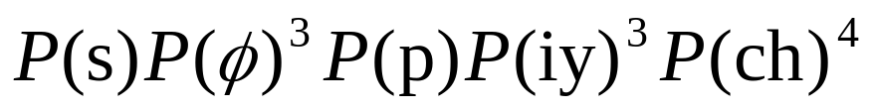
Analysis Methods
Probability-based analysis?
Method I
  Observations are independent; no time/order
  A poor model for temporal structure
    Model size = |V| = N

Slide 12
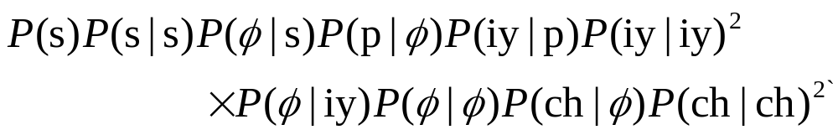
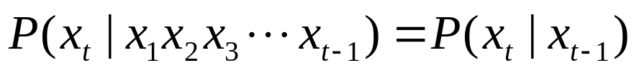
Analysis methods
Method II
  A simple model of ordered sequence
    A symbol is dependent only on the immediately preceding:
  |V|×|V| matrix model
    50×50 – not very bad …
    10⁵×10⁵ – doubly outrageous!!

Slide 13
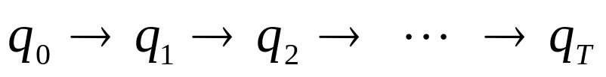
Another analysis method
Method III
  What you see is a clue to what lies behind and is not known a priori
    The source that generated the observation
    The source evolves and generates characteristic observation sequences

Slide 14
More Formally
We want to know P(w₁,….w_{n-1}, w_{n}).
To clarify, let’s write the sequence this way:
P(q₁=S_{i}, q₂=S_{j},…, q_{n-1}=S_{k}, q_{n}=S_{i})
Here the indicate the I-th position of the sequence,
and the S_{i} the possible different words from our
vocabulary.
E.g., if the string were “The girl saw the boy”, we might have
S₁= the q₁= S₁
S₂= girl q₂= S₂
S₃= saw q₃= S₃
S₄= boy q₄= S₁
S₁= the q₅= S₄

Slide 15
Formalization (continue)
We want P(q1=Si, q2=Sj,…, qn-1=Sk, qn=Si)
Let’s break this down as we usually break down a joint :
= P(qn=Si | q1=Sj,…,qn-1=Sk)ⅹP(q1=Sj,…,qn-1=Sk)
…
= P(qn=Si | q1=Sj,…,qn-1=Sk)ⅹP(qn-1=Sk|q1=Sj,…,
qn-1=Sm)ⅹP(q2=Sj|q1=Sj)ⅹP(q1=Si)
Our simplifying assumption is that each event is only
dependent on the previous event, and that we don’t care when
the events happen, I.e.,
P(qi=Si | q1=Sj,…,qi-1=Sk)ⅹP(qi=Si | qi-1=Sk)and
P(qi=Si | qi-1=Sk)=P(qj=Si | qj-1=Sk)
This is called the Markov assumption.

Slide 16
Markov Assumption
“The future does not depend on the past, given the present.”
Sometimes this if called the first-order Markov assumption.
second-order assumption would mean that each event depends on the previous two events.
  This isn’t really a crucial distinction.
  What’s crucial is that there is some limit on how far we are willing to look back.

Slide 17
Morkov Models
The Markov assumption means that there is only one probability to remember for each event type (e.g., word) to another event type.
Plus the probabilities of starting with a particular event.
This lets us define a Markov model as:
  finite state automaton in which
    the states represent possible event types(e.g., the different words in our example)
    the transitions represent the probability of one event type following another.
It is easy to depict a Markov model as a graph.

Slide 18
Example: A Markov Model for a Tiny Fragment
of English
.8
the
girl
.7
.2
.9
.78
.3
a
little
.22
.1
Numbers on arrows between nodes are “transition” probabilities,
e.g., P(q_{i}=girl|q_{i-1} =the)=.8
The numbers on the initial arrows show the probability of
starting in the given state.
Missing probabilities are assumed to be O.

Slide 19
Example: A Markov Model for a Tiny Fragment
of English
.8
the
girl
.7
.2
.9
.78
.3
a
little
.22
.1
Generates/recognizes a tiny(but infinite!) language, along
with probabilities :
P(“The little girl”)=.7ⅹ.2ⅹ.9= .126
P(“A little little girl”)=.3ⅹ.22ⅹ.1ⅹ.9= .00594

Slide 20
Example(con’t)
P(“The little girl”) is really shorthand for
P(q₁=the, q₂=little, q₃=girl)
where , and are states.
We can easily amswer other questions, e.g.:
“Given that sentence begins with “a”, what is the probability
that the next words were “little girl”?”
P(q₃=the, q₂=little, q₁=a)
= P(q₃=girl | q₂=little, q₁=a)P(q₂=little q₁=a)
= P(q₃=girl | q₂=little)P(q₂=little q₁=a)
= .9ⅹ.22=.198

Slide 21
Markov Models and Graphical Models
Markov models and Belief Networks can both be represented by nice graphs.
Do the graphs mean the same thing?
  No! In the graphs for Markov models; nodes do not represent random variables, CPTs.
Suppose we wanted to encode the same information via a belief network.
  We would have to “unroll” it into a sequence of nodes-as many as there are elements in the sequence-each dependent on the previous, each with the same CPT.
  This redrawing is valid, and sometimes useful, but doesn’t explicitly represent useful facts, such as that the CPTs are the same everywhere.

Slide 22
Back to the Speech Recognition Problem
A Markov model for all of English would have one node for each word, which would be connected to the node for each word that can follow it.
Without Loss Of Generality, we could have connections from every node to every node, some of which have transition probability 0.
Such a model is sometimes called a bigram model.
  This is equivalent to knowing the probability distribution of pair of words in sequences (and the probability distribution for individual words).
  A bigram model is an example of a language model, i.e., some (in this case, extremely simply) view of what sentences or sequences are likely to be seen.

Slide 23
Bigram Model
Bigram models are rather inaccurate language models.
  E.g., the word after “a” is much more likely to be “missile” if the word preceding “a” is “launch”.
the Markov assumption is pretty bad.
If we could condition on a few previous words, life gets a bit better:
  E.g., we could predict “missile” is more likely to follow “launch a” than “saw a”.
This would require a “second order” Markov model.

Slide 24
Higher-Order Models
In the case of words, this is equivalent to going to trigrams.
Fundamentally, this isn’t a big difference:
  We can convert a second order model into a first order model, but with a lot more states.
  And we would need much more data!
Note, though, that a second-order model still couldn’t accurately predict what follows “launch a large”
  i.e., we are predicting the next work based on only the two previous words, so the useful information before “a large” is lost.
Nevertheless, such language models are very useful approximations.

Slide 25
Back to Our Spoken Sentence recognition Problem
We are trying to find
argmax_{w∈L} P(w)P(y|w)
We just discussed estimating P(w).
Now let’s look at P(y|w).
- That is, how do we pronounce a sequence of words?
- Can make the simplification that how we pronounce words
is independent of one another.
P(y|w)=ΣP(o₁=v_{i},o₂=v_{j},…,o_{k}=v_{l}|w₁)×
… × P(o_{x-m}=v_{p},o_{x-m+1}=v_{q},…,o_{x}=v_{r} |w_{n})
i.e., each word produces some of the sounds with some
probability; we have to sum over possible different word
boundaries.
So, what we need is model of how we pronounce individual words.

Slide 26
A Model
Assume there are some underlying states, called “phones”,
say, that get pronounced in slightly different ways.
We can represent this idea by complicating the Markov model:
- Let’s add probabilistic emissions of outputs from each state.

Slide 27
Example: A (Simplistic) Model for Pronouncing “of”
“o”
“a”
“v”
.7
.3
1
Phone1
Phone2
End
.9
.1
Each state can emit a different sound, with some probability.
Variant: Have the emissions on the transitions, rather than
the states.

Slide 28
How the Model Works
We see outputs, e.g., “o v”.
We can’t “see” the actual state transitions.
But we can infer possible underlying transitions from the
observations, and then assign a probability to them
E.g., from “o v”, we infer the transition “phone1 phone2”
- with probability .7 x .9 = .63.
I.e., the probability that the word “of” would be pronounced
as “o v” is 63%.

Slide 29
Hidden Markov Models
This is a “hidden Markov model”, or HMM.
Like (fully observable) Markov models, transitions from one
state to another are independent of everything else.
Also, the emission of an output from a state depends only on
that state, i.e.:
P(O|Q)=P(o₁,o₂,…,o_{n}|q₁,…q_{n})
=P(o₁|q₁)×P(o₂|q₂)×…×P(o_{n}|q₁)

Slide 30
HMMs Assign Probabilities
to Sequences
We want to know how probable a sequence of observations
is given an HMM.
This is slightly complicated because there might be multiple
ways to produce the observed output.
So, we have to consider all possible ways an output might be
produced, i.e., for a given HMM:
P(O) = ∑_{Q} P(O|Q)P(Q)
where O is a given output sequence, and Q ranges over all
possible sequence of states in the model.
P(Q) is computed as for (visible) Markov models.
P(O|Q) = P(o₁,o₂,…,o_{n}|q₁,…q_{n})
= P(o₁|q₁)×P(o₂|q₂)×…×P(o_{n}|q₁)
We’ll look at computing this efficiently in a while…

Slide 31
Finishing Solving the Speech Problem
To find argmax_{w∈L} P(w)P(y|w), just consider these
probabilities over all possible strings of words.
Could “splice in” each word in language model with its HMM
pronunciation model to get one big HMM.
- Lets us incorporate more dependencies.
- E.g., could have two models of “of”, one of which has a
much higher probability of transitioning to words beginning
with consonants.
Real speech systems have another level in which phonemes
are broken up into acoustic vectors.
- but these are also HMMs.
- So we can make one gigantic HMM out of the whole thing.
So, given y, all we need is to find most probable path through
the model that generates it.

Slide 32
Example: Our Word Markov Model
.8
the
girl
.7
.2
.9
.78
.3
a
little
.22
.1

Slide 33
Example: Splicing in Pronunciation HMMs
the
girl
V₁
V₂
V₃
V₄
V₅
V₆
V₇
V₈
V₉
V₁₀
.8
1
2
3
4
5
6
.7
.2
.9
a
little
.78
V₁₁
V₁₂
V₉
V₁₀
V₈
V₁₁
V₁₂
.3
8
7
9
10
.22
.1

Slide 34
Example: Best Sequence
the
girl
V₁
V₂
V₃
V₄
V₅
V₆
V₇
V₈
V₉
V₁₀
.8
1
2
3
4
5
6
.7
.2
.9
a
little
V₁₂
.78
V₁₀
V₈
V₁₂
V₁₁
V₉
V₁₁
.3
7
8
9
10
.22
.1
Suppose observation is “v₁ v₃ v₄ v₉ v₈ v₁₁ v₇ v₈ v₁₀”
Suppose most probable sequence is determined to be
“1,2,3,8,9,10,4,5,6” (happens to be only way in example)
Then interpretation is “the little girl”.

Slide 35
Hidden Markov Models
Modeling sequences of events
Might want to
  Determine the probability of a give sequence
  Determine the probability of a model producing a sequence in a particular way
    equivalent to recognizing or interpreting that sequence
  Learning a model form some observations.

Slide 36
Why HMM?
Because the HMM is a very good model for such patterns!
  highly variable spatiotemporal data sequence
  often unclear, uncertain, and incomplete
Because it is very successful in many applications!
Because it is quite easy to use!
  Tools already exist…

Slide 37
The problem
“What you see is the truth”
  Not quite a valid assumption
  There are often errors or noise
    Noisy sound, sloppy handwriting, ungrammatical or Kornglish sentence
  There may be some truth process
    Underlying hidden sequence
    Obscured by the incomplete observation

Slide 38
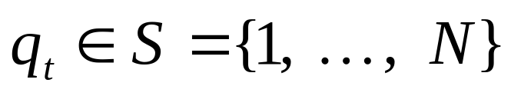
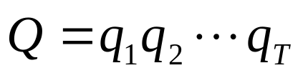
The Auxiliary Variable
N is also conjectured
{q_{t}:t≥0} is conjectured, not visible
  nor is
  is Markovian
  “Markov chain”

Slide 39
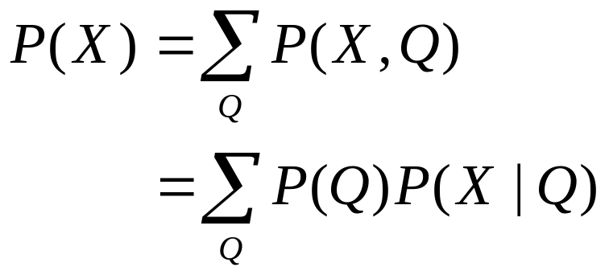
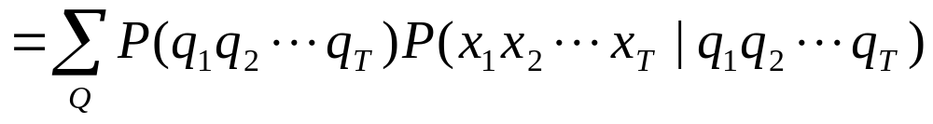
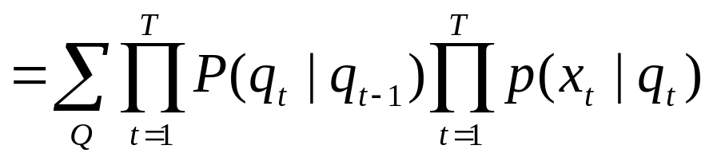
Summary of the Concept
Markov chain process
Output process

Slide 40
Hidden Markov Model
is a doubly stochastic process
  stochastic chain process : { q(t) }
  output process : { f(x|q) }
is also called as
  Hidden Markov chain
  Probabilistic function of Markov chain

Slide 41
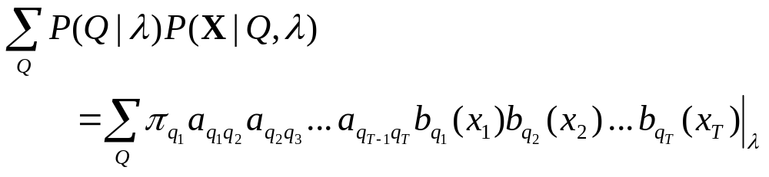
HMM Characterization
λ = (A, B, π)
  A : state transition probability
    { a_{ij} | a_{ij} = p(q_{t+1}=j|q_{t}=i) }
  B : symbol output/observation probability
    { b_{j}(v) | b_{j}(v) = p(x=v|q_{t}=j) }
  π : initial state distribution probability
    { π_{i} | π_{i} = p(q₁=i) }

Slide 42
HMM, Formally
A set of states {S₁,…,S_{N}}
  q_{t} denotes the state at time t.
A transition probability matrix A, such that
A[i,j]=a_{ij}=P(q_{t+1}=S_{j}|q_{t}=S_{i})
  This is an N x N matrix.
A set of symbols, {v₁,…,v_{M}}
  For all purposes, these might as well just be {1,…,M}
  o_{t} denotes the observation at time t.
A observation symbol probability distribution matrix B, such that
B[i,j]=b_{i,j}=P(o_{t}=v_{j}|q_{t}=S_{i})
  This is a N x M matrix.
An initial state distribution, π, such that π_{i}=P(q₁=S_{i})
For convenience, call the entire model λ = (A,B,π)
  Note that N and M are important implicit parameters.

Slide 43
Graphical Example
π = [ 1.0 0 0 0 ]
0.6
0.5
0.7
1 2 3 4
1
2
3
4
0.6 0.4 0.0 0.0
0.0 0.5 0.5 0.0
0.0 0.0 0.7 0.3
0.0 0.0 0.0 1.0
0.4
1
2
3
4
A =
iy
s
p
iy
ch
p
ch
ch iy p s
1
2
3
4
0.2 0.2 0.0 0.6 …
0.0 0.2 0.5 0.3 …
0.0 0.8 0.1 0.1 …
0.6 0.0 0.2 0.2 …
B =

Slide 44
Data interpretation
0.6 0.4 0.0 0.0
0.0 0.5 0.5 0.0
0.0 0.0 0.7 0.3
0.0 0.0 0.0 1.0
P(s s p p iy iy iy ch ch ch|λ)
= ∑_{Q} P(ssppiyiyiychchch,Q|λ)
= ∑_{Q} P(Q|λ) p(ssppiyiyiychchch|Q,λ)
0.2 0.2 0.0 0.6 …
0.0 0.2 0.5 0.3 …
0.0 0.8 0.1 0.1 …
0.6 0.0 0.2 0.2 …
Let Q = 1 1 2 2 3 3 3 4 4 4
P(Q|λ) p(ssppiyiyiychchch|Q, λ)
= P(1122333444|λ) p(ssppiyiyiychchch|1122333444, λ)
= P(1| λ)P(s|1,λ) P(1|1, λ)P(s|1,λ) P(2|1, λ)P(p|2,λ)
P(2|2, λ)P(p|2,λ) …..
= (1×.6)×(.6×.6)×(.4×.5)×(.5×.5)×(.5×.8)×(.7×.8)²
×(.3×.6)×(1.×.6)²
≅ 0.0000878
#multiplications ~ 2TN^{T}

Slide 45
Issues in HMM
Intuitive decisions
  number of states (N)
  topology (state inter-connection)
  number of observation symbols (V)
Difficult problems
  efficient computation methods
  probability parameters (λ)

Slide 46
The Number of States
How many states?
  Model size
  Model topology/structure
Factors
  Pattern complexity/length and variability
  The number of samples
Ex:
r r g b b g b b b r

Slide 47
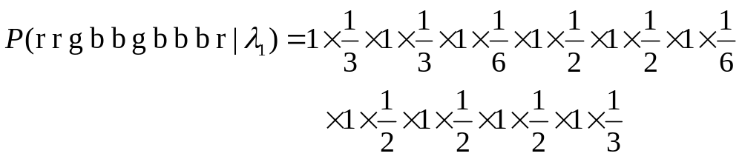
(1) The simplest model
Model I
  N = 1
  a₁₁=1.0
  B ≅ [1/3, 1/6, 1/2]
1.0

Slide 48
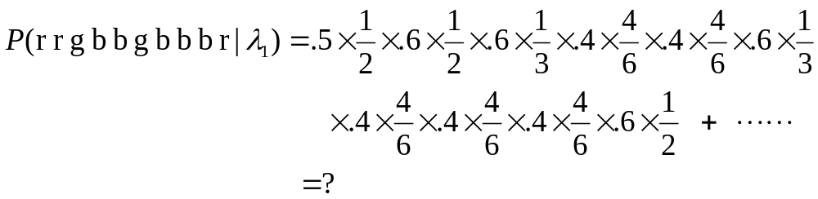
(2) Two state model
Model II:
  N = 2
0.6 0.4
0.6 0.4
0.6
1
0.4
2
0.4
A =
1/2 1/3 1/6
1/6 1/6 2/3
0.6
B =

Slide 49
(3) Three state models
0.3
N=3:
2
0.2
0.7
0.6
1
3
0.7
0.2
0.3
2
0.6
0.2
0.2
0.2
0.6
0.5
1
3
0.3
0.3
0.1

Slide 50
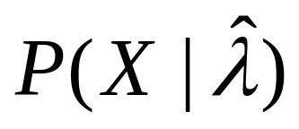
The Criterion is
Obtaining the best model(λ) that maximizes
The best topology comes from insight and experience
  ← the # classes/symbols/samples

Slide 51
A trained HMM
.5
.6
.2
.2
π =
1. 0. 0.
R
G
B
1
1 2 3
.4
1
2
3
.5 .4 .1
.0 .6 .4
.0 .0 .0
.6
.1
.2
.5
.3
A =
2
.4
R G B
.0
.3
.7
1
2
3
.6 .2 .2
.2 .5 .3
.0 .3 .7
3
B =

Slide 52
Three Problems
Model evaluation problem
  What is the probability of the observation?
  Given an observed sequence and an HMM, how probable is that sequence?
  Forward algorithm
Path decoding problem
  What is the best state sequence for the observation?
  Given an observed sequence and an HMM, what is the most likely state sequence that generated it?
  Viterbi algorithm
Model training problem
  How to estimate the model parameters?
  Given an observation, can we learn an HMM for it?
  Baum-Welch reestimation algorithm

Slide 53
Problem: How to Compute P(O|λ)
P(O|λ)=∑_{all Q} P(O|Q,λ)P(Q|λ)
where O is an observation sequence and Q is a sequence of
states.
= ∑q₁,q₂,…,q_{T}^{b}q₁,o₁^{b}q₂,o₂…^{b}q_{T},o_{T}^{π}q₁ªq₁,q₂…ªq_{T-1},q_{T}
So, we could just enumerate all possible sequences through
the model, and sum up their probabilities.
Naively, this would involve O(TN^{T}) operations:
- At every step, there are N possible transitions, and there are
T steps.
However, we can take advantage of the fact that, at any given
time, we can only be in one of N states, so we only have to
keep track of paths to each state.

Slide 54
Basic Idea for P(O|λ) Algorithm
α_{t}(i)
α_{t+1}(j) ← (∑_{i}^{N} α_{t}(i)a_{ij}) b_{j,ot+1}
1
1
If we know the probability
of being in each state at
time t, and producing the
observation so far (α_{t}(i)),
then the probability of
being in a given state at the
next clock tick, and then
emitting the next output, is
easy to compute.
2
a_{1,4}
2
3
a_{2,4}
4
…
…
a_{N-1,4}
N-1
N-1
a_{N,4}
N
N
time t
time t+1

Slide 55
A Better Algorithm For Computing P(O|λ)
Let α_{t}(i) be defined as P(o₁o₂…o_{t},q_{t}=S_{i}|λ).
- I.e., the probability of seeing a prefix of the observation, and
ending in a particular state.
Algorithm:
- Initialization: α₁(i) ← π_{i}b_{i,o}1,1 ≤ i ≤ N
- Induction: α_{t+1}(j) ← (∑_{1≤i≤N} α_{t}(i)a_{ij})b_{j,ot+1}
1 ≤ t ≤ T-1, 1 ≤ j ≤ N
- Finish: Return ∑_{1≤i≤N} α_{T}(i)
This is called the forward procedure.
How efficient is it?
- At each time step, do O(N) multiplications and additions for
each of N nodes, or O(N²T).

Slide 56
Can We Do it Backwards?
β_{t}(i)=∑_{1≤j≤N} a_{ij}b_{j},o_{t+1}β_{t+1}(j)
β_{t+1}(i)
β_{t}(i) is probability that,
given we are in state i at
time t we produce o_{t+1}…o_{T}.
If we know probability of
outputting the tail of the
observation, given that we
are in some state, we can
compute probability that,
given we are in some state
at the previous clock tick,
we emit the (one symbol
bigger) tail.
1
1
2
2
a_{4,1}
3
3
a_{4,2}
4
…
a_{4,N-1}
…
…
N-1
a_{4,N}
N-1
N
N
time t
time t+1

Slide 57
Going Backwards Instead
Define β_{t}(i) as P(o_{t+1}o_{t+2}…o_{T}|q_{t}=S_{i},λ).
- I.e., the probability of seeing a tail of the observation, given
that we were in a particular state.
Algorithm:
- Initialization: β_{T}(i) ← 1,1 ≤ i ≤ N
- Induction: β_{t}(i) ← ∑_{1≤j≤N} a_{ij}b_{j},o_{t+1}β_{t+1}(j)
T-1 ≥ t ≥ 1, 1 ≤ i ≤ N
This is called the backward procedure.
We could use this to compute P(O|λ) too (β₁(i) is
P(o₂o₃…o_{T}|q₁=S_{i},λ), so P(O|λ)= ∑_{1≤j≤N}^{π}_{i}b_{i,o1}β₁(i)).
- But nobody does this.
- Instead, we will have another use for it soon.
How efficient is it?
- Same as forward procedure.

Slide 58


1. Model Evaluation
Solution: forward/backward procedure
  Define: forward probability -> FW procedure
  Define: backward probability -> BW procedure
These are probabilities of the partial events leading to/from a point in space-time

Slide 59


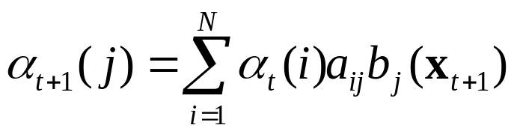

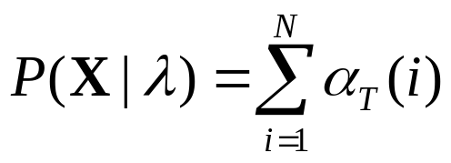
Forward procedure
Initialization:
Recursion:
Termination:
1
1
1
1
1
2
2
2
2
2
HMM states
i
i
i
i
j
N
N
N
N
N
1 - - -
t
t+1

Slide 60
Numerical example: P(RRGB|λ)
π =[1 0 0]^{T}
R
R
G
B
.5
R
G
B
.6
.2
.2
1×.6
.5×.6
.5×.2
.5×.2
.6
.18
.018
.0018
.4
.4×.2
.4×.5
.4×.3
.6
.1
.2
.5
.3
0×.2
.6×.2
.6×.5
.6×.3
.0
.048
.0504
.01123
.4
.1×.0
.1×.3
.1×.7
.4×.0
.4×.3
.4×.7
.0
.3
.7
0×.0
.0
.0
.01116
.01537

Slide 61

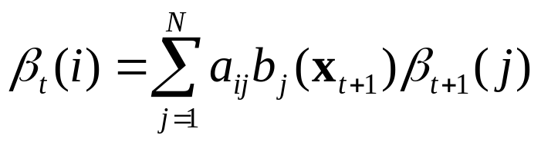

Backward procedure
Initialization:
Recursion:
1
1
1
2
2
2
HMM states
i
j
j
N
N
N
t
t+1 - - - T

Slide 62
2nd Problem: What’s the Most Likely State Sequence?
Actually, there is more than one possible interpretation of
“most likely state sequence”.
One is, which states are individually most likely.
- i.e., what is the most likely first state? The most likely second?
And so on.
- Note, though, that we can end up with a “sequence” that isn’t
even a possible sequence through the HMM, much less a
likely one.
Another criteria is the single best state sequence.
- i.e., find argmax_{Q} P(Q|O,λ)

Slide 63
Algorithm Idea
Suppose we knew the highest probability path ending in each
state at time step t.
We can compute the highest probability path ending in a state
at t+1 by considering each transition from each state at time t,
and remembering only the best one.
This is another application of the dynamic programming
principle.

Slide 64
Basic Idea for argmax_{Q}P(Q|O,λ) Algorithm
δ_{t}(i)
δ_{t+1}(j) ← (max_{i} δ_{t}(i)a_{ij})b_{j},o_{t+1}
1
1
If we know the probability
of the best path to each
state at time t producing
the observation so far
(δ_{t}(i)), then the probability
of the best path to a given
state producing the next
observation at the next
clock tick is the max of this
probability times the
transition probability, times
the probability of the right
emission.
2
a_{1,4}
2
3
a_{2,4}
4
…
…
…
a_{N-1,4}
N-1
N-1
a_{N,4}
N
N
time t
time t+1

Slide 65
Definitions for Computing argmax_{Q} P(Q|O,λ)
Note that P(Q|O,λ)=P(Q,O|λ)/P(O|λ), so maximizing
P(Q|O,λ) is equivalent to maximizing P(Q,O|λ).
- Turns out latter is a bit easier to work with.
Define δ_{t}(i) as
max_{q1,q2},…,_{qt-1}P(q₁,q₂,…,q_{t}=i,o₁,o₂,…,o_{t}|λ).
We’ll use these to inductively find P(Q,O|λ). But how do we
find the actual path?
We’ll maintain another array, ψ_{t}(i), which keeps track of the
argument that maximizes δ_{t}(i).

Slide 66
Algorithm for Computing argmax_{Q} P(Q|O,λ)
Algorithm:
- Initialization: δ₁(i) ← π_{i}b_{i,o1,}1 ≤ i ≤ N
ψ₁(i) ← 0
- Induction: δ_{t}(j) ← max_{i} (δ_{t-1}(i)a_{ij})b_{j,ot}
ψ_{t}(i) ← argmax_{i}(δ_{t-1}(i)a_{ij})
2 ≤ t ≤ T, 1 ≤ j ≤ N
- Finish: P* = max_{i} (δ_{T}(i)) is probability of best path
q_{T}* = argmax_{i} (δ_{T}(i)) is best final state
- Extract path by backtracking:
q_{t}* = ψ_{t+1}(q_{t+1}*), t=T-1, T-2, …,1
This is called the Viterbi algorithm.
Note that it is very similar to the forward procedure (and hence
as efficient).

Slide 67
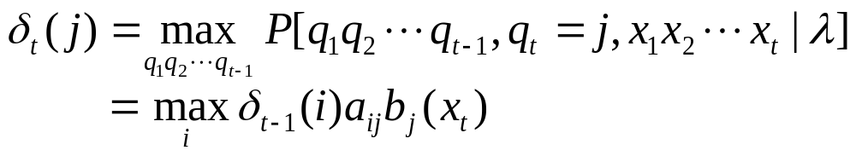
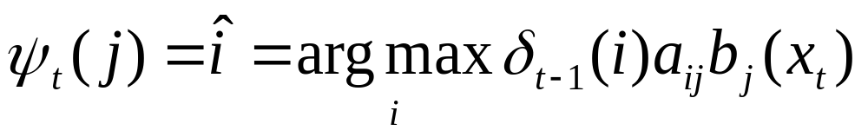
2. Decoding Problem
The best path Q* given an input X ?
  It can be obtained by maximizing the joint probability over state sequences
  Path likelihood score:
  Viterbi algorithm
Q_{1,t} = q₁q₂ ··· q_{t} : a partial (best) state sequence

Slide 68


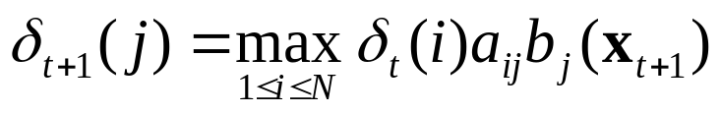
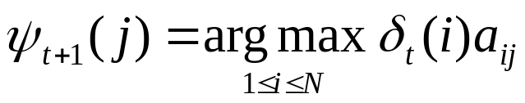
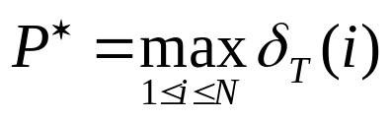
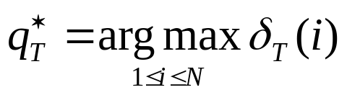
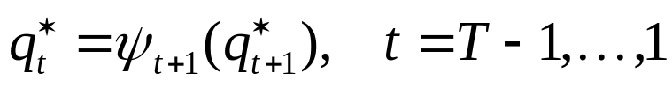
Viterbi algorithm
Introduction:
Recursion:
Termination:
Path backtracking:
1
states
2
3

Slide 69
Numerical Example: P(RRGB,Q*|λ)
π =[1 0 0]^{T}
R
R
G
B
.5
R
G
B
.6
.2
.2
1×.6
.5×.6
.5×.2
.5×.2
.6
.18
.018
.0018
.4
.4×.2
.4×.5
.4×.3
.6
.1
.2
.5
.3
0×.2
.6×.2
.6×.5
.6×.3
.0
.048
.036
.00648
.4
.1×.0
.1×.3
.1×.7
.4×.0
.4×.3
.4×.7
.0
.3
.7
0×.0
.0
.0
.00576
.01008

Slide 70
3. Model Training Problem
Estimate λ=(A,B,π) that maximizes P(X|λ)
No analytical solution exists
MLE + EM algorithm developed
  Baum-Welch reestimation [Baum+68,70]
  a local maximization using iterative procedure
  maximizes the probability estimate of observed events
  guarantees finite improvement
  is based on forward-backward procedure

Slide 71
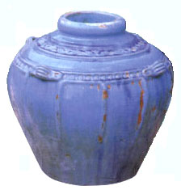
MLE Example
Experiment
  Known: 3 balls inside (some white, some red; exact numbers unknown)
  Unknown: R = # red balls
  Observation: one random samples :  (two reds)
three balls are inside,
some white, some red
Two models
  p (|R=2) = ₂C₂ × ₁C₀ / ₃C₂ = 1/3
  p (|R=3) = ₃C₂ / ₃C₂ = 1
Which model?

Slide 72
Learning an HMM
We will assume we have an observation O, and want to know
the “best” HMM for it.
I.e., we would want to find argmax_{λ} P(λ|O), where
λ= (A,B,π) is some HMM.
- I.e., what model is most likely, given the observation?
When we have a fixed observation that we use to pick a model,
we call the observation training data.
Functions/values like P(λ|O) are called likelihoods.
What we want is the maximum likelihood estimate(MLE) of the
parameters of our model, given some training data.
This is an estimate of the parameters, because it depends for
its accuracy on how representative the observation is.

Slide 73
Maximizing Likelihoods
We want to know argmax_{λ} P(λ|O).
By Bayes’ rule, P(λ|O)= P(λ)P(O|λ)/P(O).
- The observation is constant, so it is enough to maximize
P(λ)P(O|λ).
P(λ) is the prior probability of a model; P(O|λ) is the
probability of the observation, given a model.
Typically, we don’t know much about P(λ).
- E.g., we might assume all models are equally likely.
- Or, we might stipulate that some subclass are equally likely,
and the rest not worth considering.
We will ignore P(λ), and simply optimize P(O|λ).
I.e., we can find the most probable model by asking which
model makes the data most probable.

Slide 74
Maximum Likelihood Example
Simple example: We have a coin that may be biased. We
would like to know the probability that it will come up heads.
Let’s flip it a number of times; use percentage of times it comes
up heads to estimate the desired probability.
Given m out of n trials come up heads, what probability should
be assigned?
In terms of likelihoods, we want to know P(λ|O), where our
model is just the simple parameter, the probability of a coin
coming up heads.
As per our previous discussion, can maximize this by
maximizing P(λ)P(O|λ).

Slide 75
Maximizing P(λ)P(O|λ) For Coin Flips
Note that knowing something about P(λ) is knowing whether
coins tended to be biased.
If we don’t, we just optimize P(O|λ).
I.e., let’s pick the model that makes the observation most likely.
We can solve this analytically:
- P(m heads over n coin tosses|P(Heads)=p) = _{n}C_{m}p^{m}(1-p)^{n-m}
- Take derivative, set equal to 0, solve for p.
Turns out p is m/n.
- This is probably what you guessed.
So we have made a simple maximum likelihood estimate.

Slide 76
Comments
Making a MLE seems sensible, but has its problems.
Clearly, our result will just be an estimate.
- but one we hope will become increasingly accurate with
more data.
Note, though, via MLE, the probability of everything we haven’t
seen so far is 0.
For modeling rare events, there will never be enough data for
this problem to go away.
There are ways to smooth over this problem (in fact, one way
is called “smoothing”!), but we won’t worry about this now.

Slide 77
Back to HMMs
MLE tells us to optimize P(O|λ).
We know how to compute P(O|λ) for a given model.
- E.g., use the “forward” procedure.
How do we find the best one?
Unfortunately, we don’t know how to solve this problem
analytically.
However, there is a procedure to find a better model, given an
existing one.
- So, if we have a good guess, we can make it better.
- Or, start out with fully connected HMM (of given N, M) in
which each state can emit every possible value; set all
probabilities to random non-zero values.
Will this guarantee us a best solution?
No! So this is a form of …
- Hillclimbing!

Slide 78
Maximizing the Probability of the Observation
Basic idea is:
1. Start with an initial model, λ_{old}.
2. Compute new λ_{new} based on λ_{old} and observation O.
3. If P(O|λ_{new})-P(O| λ_{old}) < threshold
(or we’ve iterated enough), stop.
4. Otherwise, λ_{old} ← λ_{new} and go to step 2.

Slide 79
Increasing the Probability of the Observation
Let’s “count” the number of times, from each state, we
- start in a given state
- make a transition to each other state
- emit each different symbol.
given the model and the observation.
If we knew these numbers, we can compute new probability
estimates.
We can’t really “count” these.
- We don’t know for sure which path through the model was
taken.
- But we know the probability of each path, given the model.
So we can compute the expected value of each figure.

Slide 80
Set Up
Define ξ_{t}(i,j) = P(q_{t}=S_{i},q_{t+1}=S_{j}|O,λ)
- i.e., the probability that, given observation and model, we
are in state S_{i} at time t and state S_{j} at time t+1.
Here is how such a transition can happen:
a_{ij}b_{j},o_{t+1}
S_{i}
S_{j}
…
…
α_{t}(i)
β_{t+1}(j)
t-1
t
t+1
t+2
P(o₁o₂…o_{t},q_{t}=S_{i}|λ).
P(o_{t+2…}o_{T}|q_{t+1}=S_{i},λ)

Slide 81
Computing ξ_{t}(i,j)
α_{t}(i)a_{ij}b_{j},o_{t+1}β_{t+1}(j) = P(q_{t}=S_{i},q_{t+1}=S_{j},O|λ)
But we want ξ_{t}(i,j) = P(q_{t}=S_{i},q_{t+1}=S_{j}|O,λ)
By definition of conditional probability,
ξ_{t}(i,j) = α_{t}(i)a_{ij}b_{j},o_{t+1}β_{t+1}(j)/P(O|λ)
i.e., given
- α, which we can compute by forward procedure,
- β, which we can compute by backward procedure,
- P(O), which we can compute by forward, but also, by
∑_{i} ∑_{j} α_{t}(i)a_{ij}b_{j},o_{t+1}β_{t+1}(j)
- and A,B, which are given in model, – we can compute ξ.

Slide 82
One more preliminary…
Define γ_{t}(i) as probability of being in state S_{i} at time t, given
the observation and the model.
Given our definition of ξ:
γ_{t}(i)=∑_{1≤j≤N} ξ_{t}(i,j)
So:
- ∑_{1≤t≤T-1} γ_{t}(i) = expected number of transitions from S_{i}
- ∑_{1≤t≤T-1} ξ_{t}(i,j) = expected number of transitions from
S_{i} to S_{j}

Slide 83
Now We Can Reestimate Parameters
a_{ij}’ = expected no. of transitions from S_{i} to S_{j}/expected no. of
transitions from S_{i}
= ∑_{1≤t≤T-1} ξ_{t}(i,j)/∑_{1≤t≤T-1} γ_{t}(i)
π_{i}’ = probability of being in S1 = γ₁(i)
b_{jk}’ = expected no. of times in S_{j}, observing v_{k}/expected no.
of times in S_{j}
= ∑_{1≤t≤T}, s.t. O_{t}=v_{k}γ_{t}(i)/∑_{1≤t≤T} γ_{t}(i)

Slide 84
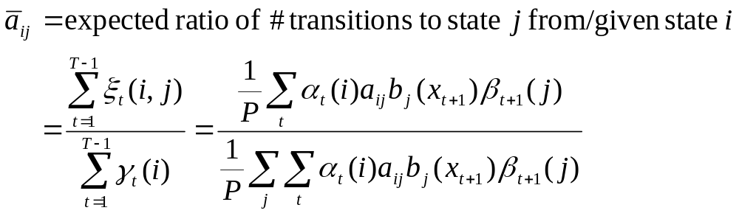
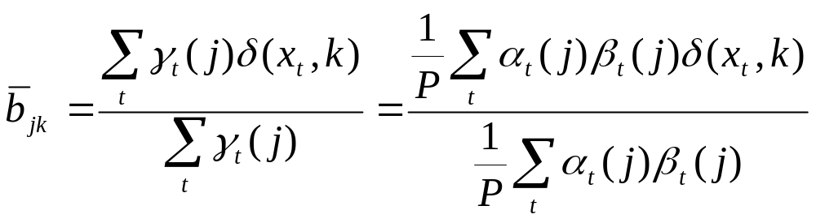
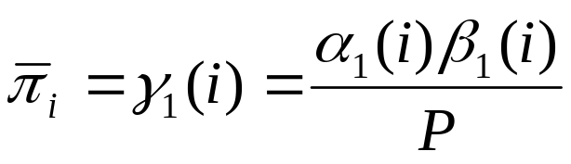
Iterative Reestimation Formulae
repeat

Slide 85
Baum-Welch Algorithm
This Algorithm is Known As Baum-Welch Algorithm
or Forward-backward algorithm
It was proven (by Baum et al.) that this reestimation procedure
leads to increased likelihood.
But remember, it only guarantees climbing to a local maximum!
It is a special case of a very general algorithm for incremental
improvement by iteratively
- computing expected values some unobservables (e.g.,
transitions and state emissions),
- using these to compute new MLEs of parameters (A,B,π)
- The general procedure is called Expectation-Maximization,
or the EM algorithm.

Slide 86
Implementation Considerations
This doesn’t quite work as advertised in practice.
One problem: α_{t}(i), β_{t}(j) get smaller with length of
observation, and eventually underflow.
This is readily fixed by “normalizing” these values.
- I.e., instead of computing α_{t}(i), at each time step, compute
α_{t}(i)/∑_{i}α_{t}(i).
- Turns out that if you also used the ∑_{i}α_{t}(i)s to scale the
β_{t}(j)s, you get a numerically nice value, although it doesn’t
has a nice probabilities interpretation;
- Yet, when you use both scaled values, the rest of the ξ_{t}(i,j)
computation is exactly the same.
Another: Sometimes estimated probabilities will still get very
small, and it seems better to not let these fall all the way to 0.

Slide 87
Other issues
Other method of training
  MAP estimation – for adaptation
  MMI estimation
  MDI estimation
  Viterbi training
  Discriminant/reinforcement training

Slide 88
Other types of parametric structure
  Continuous density HMM (CHMM)
    More accurate, but much more parameters to train
  Semi-continuous HMM
    Mix of CHMM and DHMM, using parameter sharing
  State-duration HMM
    More accurate temporal behavior
Other extensions
  HMM+NN, Autoregressive HMM
  2D models: MRF, Hidden Mesh model, pseudo-2D HMM

Slide 89
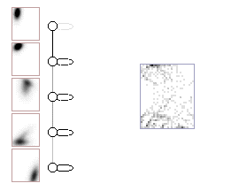

Graphical DHMM and CHMM
Models for ‘5’ and ‘2’

Slide 90
Statistical Decision Making System
Statistical K-class pattern recognition
  Prepare K HMMs trained with samples
    λ₁, …, λ_{K}
  Integrate measurement and a priori knowledge
    P(X|λ_{k})
    P(λ_{k})
  Decision

Slide 91
An Application of HMMs:“Part of Speech” Tagging
A problem: Word sense disambiguation.
- I.e., words typically have multiple senses; need to determine
which one a given word is being used as.
For now, we just want to guess the “part of speech” of each
word in a sentence.
- Linguists propose that words have properties that are a
function of their “grammatical class”.
- Grammatical classes are things like verb, noun, preposition,
determiner, etc.
- Words often have multiple grammatical classes.
» For example, the word “rock” can be a noun or a verb.
» Each of which can have a number of different meanings.
We want an algorithm that will “tag” each word with its most
likely part of speech.
- Why? Helping with parsing, pronunciation.

Slide 92
Parsing, Briefly
Consider a simple sentence:
“I saw a bird.”
Let’s “diagram” this sentences, making a parse tree:
S
NP
VP
PRO
V
NP
D
N
I
saw
a
bird

Slide 93
However
Each of these words is listed in the dictionary as having
multiple POS entries:
- “saw”: noun, verb
- “bird”: noun, intransitive verb (“to catch or hunt birds,
birdwatch”)
- “I”: pronoun, noun (the letter “I”, the square root of –1,
something shaped like an I (I-beam), symbol (I-80, Roman
numeral, iodine)
- “a”: article, noun (the letter “a”, something shaped like an “a”,
the grade “A”), preposition (“three times a day”), French
pronoun.

Slide 94
Moreover, there is a parse!
S
NP
VP
N
N
N
V
bird
I
saw
a

Slide 95
What’s It Mean?
It’s nonsense, of course.
The question is, can we avoid such nonsense cheaply.
Note that this parse corresponds to a very unlikely set of POS
tags.
So, just restricting our tags to reasonably probably ones might
eliminate such silly options.

Slide 96
Solving the Problem
A “baseline” solution: Just count the frequencies in which
each word occurs as a particular part of speech.
- Using “tagged corpora”.
Pick most frequent POS for each word.
How well does it work?
Turns out it will be correct about 91% of the time.
Good?
Humans will agree with each other about 97-98% of the time.
So, room for improvement.

Slide 97
A Better Algorithm
Make POS guess depend on context.
For example, if the previous word were “the”, then the word
“rock” is much more likely to be occurring as a noun than as
a verb.
We can incorporate context by setting up an HMM in which the
hidden states are POSs, and the words the emissions in those
states.

Slide 98
HMM For POS Tagging:Example
.1
time
files
a
.54
.36
.025
…
.05
.0001
start
D
N
.3
.1
.25
.85
in
N
N
.15
N
.076
…
.05
.15
…
.01
files
little
smiling
time

Slide 99
HMM For POS Tagging
First-order HMM equivalent to POS bigrams
Second-order equivalent to POS trigrams.
Generally works well if there is a hand-tagged corpus from
which to read off the probabilities.
- Lots of detailed issues: smoothing, etc.
If none available, train using Baum-Welch.
Usually start with some constraints:
- E.g., start with 0 emissions for words not listed in dictionary
as having a given POS; estimate transitions.
Best variations get about 96-97% accuracy, which is
approaching human performance.

