Slide 1
CSCE833 Machine Learning
Ensemble Algorithms
Dr. Jianjun Hu
http://mleg.cse.sc.edu/edu/csce833
University of South Carolina
Department of Computer Science and Engineering

Slide 2
Roadmap
Ensemble Learning: General Ideas
Bootstrap Sampling
Bagging
Boosting
Ensemble classifiers/clustering
Success Story of Ensemble method
General Idea of Ensemble methods

Slide 3
Ensemble Learning
Employ multiple learners and combine their predictions.
Methods of combination:
  Bagging, boosting, voting
  Error-correcting output codes
  Mixtures of experts
  Stacked generalization
  Cascading
  …
Advantage: improvement in predictive accuracy.
Disadvantage: it is difficult to understand an ensemble of classifiers

Slide 4
Why Do Ensembles Work?
Dietterich(2002) showed that ensembles overcome three problems:
The Statistical Problem arises when the hypothesis space is too large for the amount of available data. Hence, there are many hypotheses with the same accuracy on the data and the learning algorithm chooses only one of them! There is a risk that the accuracy of the chosen hypothesis is low on unseen data!
The Computational Problem arises when the learning algorithm cannot guarantee finding the best hypothesis.
The Representational Problem arises when the hypothesis space does not contain any good approximation of the target class(es).
T.G. Dietterich, Ensemble Learning, 2002.

Slide 5
Categories of Ensemble Learning
Methods for Independently Constructing Ensembles
  Bagging
  Randomness Injection
  Feature-Selection Ensembles
  Error-Correcting Output Coding
Methods for Coordinated Construction of Ensembles
  Boosting
  Stacking
  Co-training

Slide 6
Methods for Independently Constructing Ensembles
One way to force a learning algorithm to construct multiple hypotheses is to run the algorithm several times and provide it with somewhat different data in each run. This idea is used in the following methods:
Bagging
Randomness Injection
Feature-Selection Ensembles
Error-Correcting Output Coding.

Slide 7
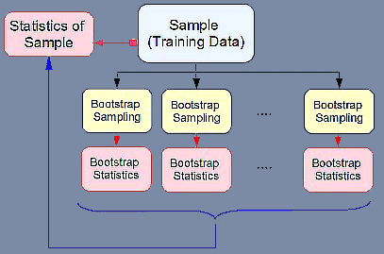
What is Bootstrap (sampling)?
Bootstrap is sampling with replacement from a sample.
The name may come from phrase “pull up by your own bootstraps” which mean ‘rely on your own resources

Slide 8
Bagging (Bootstrap Aggregration)
ML
Random sample
with replacement
f₁
Voting (for classification)
ML
f₂
f
Averaging (for regression)
ML
Random sample
with replacement
f_{T}
Bagging is only effective when using unstable (i.e. a small change in the training set can cause a significant change in the model) nonlinear models

Slide 9
Bias-variance Decomposition
Theoretical tool for analyzing how much specific training set affects performance of a classifier
  Total expected error: bias + variance
  The bias of a classifier is the expected error of the classifier due to the fact that the classifier is not perfect
  The variance of a classifier is the expected error due to the particular training set used

Slide 10
Why does bagging work?
Bagging reduces variance by voting/ averaging, thus reducing the overall expected error
  In the case of classification there are pathological situations where the overall error might increase
  Usually, the more classifiers the better

Slide 11
Randomization Injection
Inject some randomization into a standard learning algorithm (usually easy):
  Neural network: random initial weights
  Decision tree: when splitting, choose one of the top N attributes at random (uniformly)
Dietterich (2000) showed that 200 randomized trees are statistically significantly better than C4.5 for over 33 datasets!

Slide 12
Random Forest algorithm
If the number of cases in the training set is N, sample N cases at random - but with replacement, from the original data. This sample will be the training set for growing the tree.
If there are M input variables, a number m<<M is specified such that at each node, m variables are selected at random out of the M and the best split on these m is used to split the node. The value of m is held constant during the forest growing.
Each tree is grown to the largest extent possible. There is no pruning.

Slide 13
Features of Random Forests
It is unexcelled in accuracy among current algorithms.
It runs efficiently on large data bases.
It can handle thousands of input variables without variable deletion.
It gives estimates of what variables are important in the classification.
It generates an internal unbiased estimate of the generalization error as the forest building progresses.
It has an effective method for estimating missing data and maintains accuracy when a large proportion of the data are missing.
It has methods for balancing error in class population unbalanced data sets.
Generated forests can be saved for future use on other data.
Prototypes are computed that give information about the relation between the variables and the classification.
It computes proximities between pairs of cases that can be used in clustering, locating outliers, or (by scaling) give interesting views of the data.
The capabilities of the above can be extended to unlabeled data, leading to unsupervised clustering, data views and outlier detection.
It offers an experimental method for detecting variable interactions.

Slide 14
Feature-Selection Ensembles
(Random Subspace Method)
Key idea: Provide a different subset of the input features in each call of the learning algorithm.
Example: Venus&Cherkauer (1996) trained an ensemble with 32 neural networks. The 32 networks were based on 8 different subsets of 119 available features and 4 different algorithms. The ensemble was significantly better than any of the neural networks!

Slide 15
Error-correcting output codes
Very elegant method of transforming multi-class problem into two-class problem
  Simple scheme: as many binary class attributes as original classes using one-per-class coding
Train f(ci) for each bit
Idea: use error-correcting codes instead
class | class vector
a | 1000
b | 0100
c | 0010
d | 0001

Slide 16
Error-correcting output codes
Example:
  What’s the true class if base classifiers predict 1011111?
class | class vector
a | 1111111
b | 0000111
c | 0011001
d | 0101010
Thomas G. Dietterich, Ghulum Bakiri. Journal of Articial IntelligenceResearch 2 1995. Solving Multiclass Learning Problems via. Error-Correcting Output Codes.

Slide 17
Hamming Distance as Quality measurement
class | class vector
a | 1000
b | 0100
c | 0010
d | 0001
Simple code
Dh=1
class | class vector
a | 1111111
b | 0000111
c | 0011001
d | 0101010
Error correction code
Dh=4
We use nearest code as the output code. So simple code no robustness.

Slide 18
Methods for Coordinated Construction of Ensembles
The key idea is to learn complementary classifiers so that instance classification is realized by taking a weighted sum of the classifiers. This idea is used in following methods:
  Boosting
  Stacking.

Slide 19

Inefficiency with Bagging
Bagging
Inefficiency with bootstrap sampling:
  Every example has equal chance to be sampled
  No distinction between “easy” examples and “difficult” examples
D
Bootstrap Sampling
D¹
D²
D^{k}
…
h₁
h₂
h_{k}
Inefficiency with model combination
  A constant weight for each classifier
  No distinction between accurate classifiers and inaccurate classifiers

Slide 20
Improve the Efficiency of Bagging
Better sampling strategy
  Focus on the examples that are difficult to classify correctly
Better combination strategy
  Accurate model should be assigned with more weights

Slide 21
Overview of Boosting
Introduced by Schapire and Freund in 1990s.
“Boosting”: convert a weak learning algorithm into a strong one.
Main idea: Combine many weak classifiers to produce a powerful committee.
Algorithms:
  AdaBoost: adaptive boosting
  Gentle AdaBoost
  BrownBoost
  …

Slide 22
Boosting
Also uses voting/averaging but models are weighted according to their performance
Iterative procedure: new models are influenced by performance of previously built ones
  New model is encouraged to become expert for instances classified incorrectly by earlier models
  Intuitive justification: models should be experts that complement each other
There are several variants of this algorithm

Slide 23
Boosting
ML
Training Sample
f₁
ML
Weighted Sample
f₂
f
…
ML
Weighted Sample
f_{T}
Boosting: Use the same sample with different weights to generate classifiers
Bagging: Use different samples with identical weights to generate classifiers

Slide 24

Intuition of Boosting
Train a set of weak hypotheses: h₁, …., h_{T}.
The combined hypothesis H is a weighted majority vote of the T weak hypotheses.
  Each hypothesis h_{t} has a weight α_{t}.
During the training, focus on the examples that are misclassified.
  ➔ At round t, example x_{i} has the weight D_{t}(i).

Slide 25

Basic Setting
Binary classification problem
Training data:
D_{t}(i): the weight of x_{i} at round t. D₁(i)=1/m.
A learner L that finds a weak hypothesis h_{t}: X ➔ Y given the training set and D_{t}
The error of a weak hypothesis h_{t}:

Slide 26
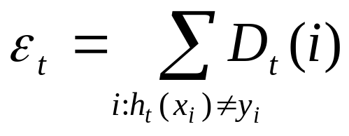
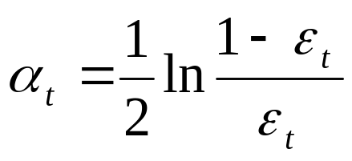
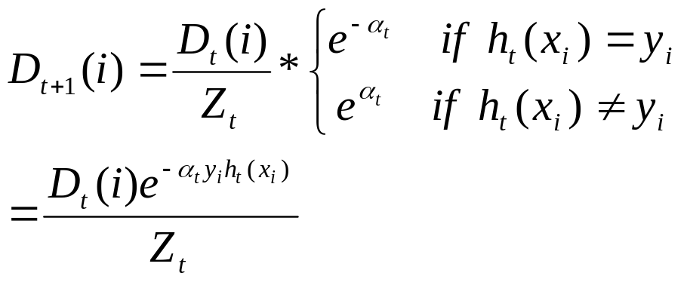
The Basic AdaBoost Algorithm
For t=1, …, T
Train weak learner using training data and D_{t}
Get ht: X ➔ {-1,1} with error
Choose
Update

Slide 27
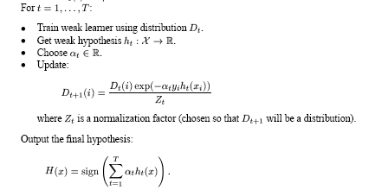
The general AdaBoost algorithm

Slide 28
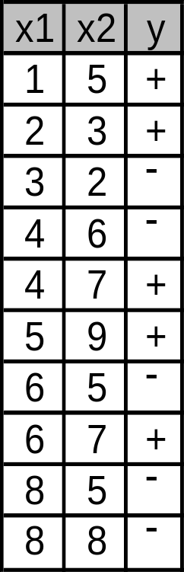
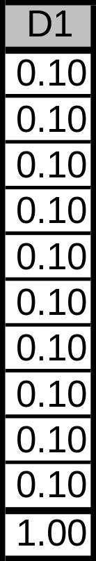
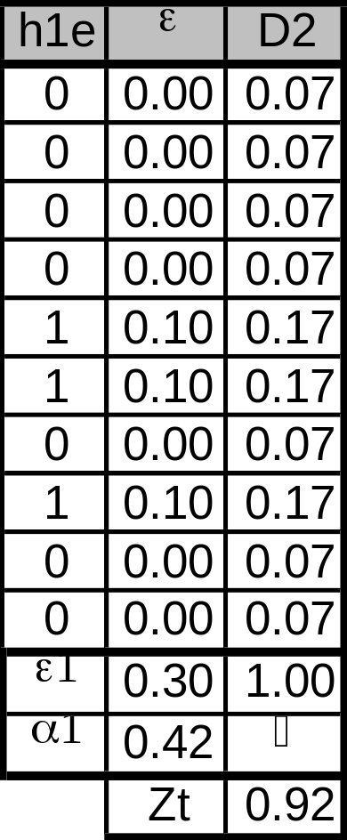
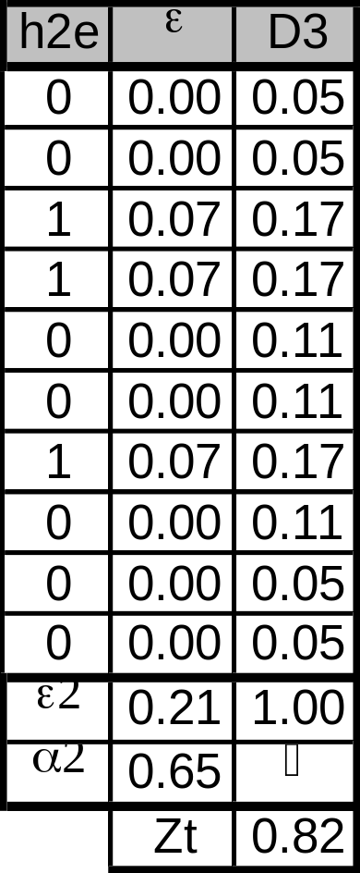
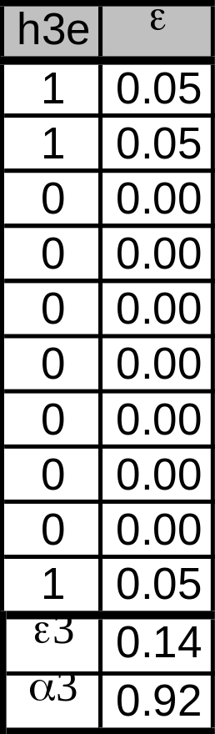
AdaBoost Example
Train data
Round 1
Round 2
Round 3
Initialization

Slide 29
Multiclass problems
There are k possible classes.
Approaches:
  AdaBoost.MH
  AdaBoost.MI

Slide 30
AdaBoost.MH
Training time: (K class)
  Train one classifier: f(x’), where x’=(x,c)
  Replace (x,y) with k derived examples
    ((x,1), 0)
    …
    ((x, y), 1)
    …
    ((x, k), 0)
Decoding time: given a new example x
  Run the classifier f(x, c) on k derived examples:
  (x, 1), (x, 2), …, (x, k)
  Choose the class c with the highest confidence score f(x, c).

Slide 31
AdaBoost.MI
Training time:
  Train k independent classifiers: f₁(x), f₂(x), …, f_{k}(x)
  When training the classifier f_{c} for class c, replace (x,y) with
    (x, 1) if y = c
    (x, 0) if y != c
Decoding time: given a new example x
  Run each of the k classifiers on x
  Choose the class with the highest confidence score f_{c}(x).

Slide 32
Remarks on Boosting
Boosting can be applied without weights using re-sampling with probability determined by weights;
Boosting decreases exponentially the training error in the number of iterations;
Boosting works well if base classifiers are not too complex and their error doesn’t become too large too quickly!

Slide 33
Strengths of AdaBoost
It has no parameters to tune (except for the number of rounds)
It is fast, simple and easy to program (??)
It comes with a set of theoretical guarantee (e.g., training error, test error)
Instead of trying to design a learning algorithm that is accurate over the entire space, we can focus on finding base learning algorithms that only need to be better than random.
It can identify outliners: i.e. examples that are either mislabeled or that are inherently ambiguous and hard to categorize.

Slide 34
Weakness of AdaBoost
The actual performance of boosting depends on the data and the base learner.
Boosting seems to be especially susceptible to noise.
When the number of outliners is very large, the emphasis placed on the hard examples can hurt the performance.
➔ “Gentle AdaBoost”, “BrownBoost”

Slide 35
Comparison of Bagging and Boosting
Bagging always uses resampling rather than reweighting.
Bagging does not modify the distribution over examples or mislabels, but instead always uses the uniform distribution
In forming the final hypothesis, bagging gives equal weight to each of the weak hypotheses

Slide 36
Sources of Errors:
Bias and Variance
  Bias arises when the classifier cannot represent the true function – that is, the classifier underfits the data
  Variance arises when the classifier overfits the data
  There is often a tradeoff between bias and variance

Slide 37
Effect of Bagging
If the bootstrap replicate approximation were correct, then bagging would reduce variance without changing bias.
In practice, bagging can reduce both bias and variance
  For high-bias classifiers, it can reduce bias
  For high-variance classifiers, it can reduce variance

Slide 38
Effect of Boosting
In the early iterations, boosting is primary a bias-reducing method
In later iterations, it appears to be primarily a variance-reducing method

Slide 39
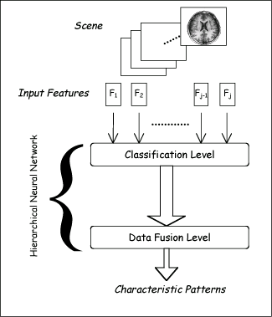
Stacking
Uses meta learner instead of voting to combine predictions of base learners
  Predictions of base learners (level-0 models) are used as input for meta learner (level-1 model)
Base learners usually different learning schemes
Hard to analyze theoretically: “black magic”
Hierarchical Neural Networks

Slide 40
Stacking
BC₁
0
BC₂
1
instance₁
BC_{n}
1
BC₁
BC₂
…
BC_{n}
Class
meta instances
instance₁
0
1
1
1

Slide 41
Stacking
BC₁
1
BC₂
0
instance₂
BC_{n}
0
BC₁
BC₂
…
BC_{n}
Class
meta instances
instance₁
0
1
1
1
instance₂
1
0
0
0

Slide 42
Stacking
Meta Classifier
BC₁
BC₂
…
BC_{n}
Class
meta instances
instance₁
0
1
1
1
instance₂
1
0
0
0

Slide 43
Stacking
BC₁
0
1
BC₂
1
instance
Meta Classifier
BC_{n}
1
BC₁
BC₂
…
BC_{n}
meta instance
instance
0
1
1

Slide 44
More on stacking
Predictions on training data can’t be used to generate data for level-1 model! The reason is that the level-0 classifier that better fit training data will be chosen by the level-1 model! Thus,
k-fold cross-validation-like scheme is employed! An example for k = 3!
train
train
test
train
test
train
test
train
train
Meta Data
test
test
test

Slide 45
More on stacking
If base learners can output probabilities it’s better to use those as input to meta learner
Which algorithm to use to generate meta learner?
  In principle, any learning scheme can be applied
  David Wolpert: “relatively global, smooth” model
    Base learners do most of the work
    Reduces risk of overfitting

Slide 46
Some Practical Advices
If the classifier is unstable (i.e, decision trees) then apply bagging!
If the classifier is stable and simple (e.g. Naïve Bayes) then apply boosting!
If the classifier is stable and complex (e.g. Neural Network) then apply randomization injection!
If you have many classes and a binary classifier then try error-correcting codes! If it does not work then use a complex binary classifier!

Slide 47
Summary
Boosting combines many weak classifiers to produce a powerful committee.
It comes with a set of theoretical guarantee (e.g., training error, test error)
It performs well on many tasks.
It is related to many topics (TBL, MaxEnt, linear programming, etc)

Slide 48
Slides Credits
Slides in this presentation is partially based on the work of
  Rong Jin (Michigan State University)
  Yaochu Jin (Future Technology Research
  Honda R&D Europe (Germany)
  Evgueni Smirnov (www.cs.unimaas.nl/smirnov)

