Slide 1
CSCE833 Machine Learning
Lecture 11
Evolutionary Algorithms
Dr. Jianjun Hu
mleg.cse.sc.edu/edu/csce833
University of South Carolina
Department of Computer Science and Engineering

Slide 2
Objectives
Understand ideas and components of Genetic Algorithms (GA)
Able to formulate and solve problems using GA (global optimization problem)
Understand basic ideas of Genetic Programming
Able to do symbolic regression using GP using GP software package

Slide 3
Easy-to-use GA/GP packages
Matlab GA package
Open Beagle (C++): GA, GP, ES
http://gaul.sourceforge.net/
ECJ: Java EA package: GA, GP, ES, etc
Python, Perl, etc

Slide 4
Genetic Algorithms:
A Tutorial
“Genetic Algorithms are good at taking large, potentially huge search spaces and navigating them, looking for optimal combinations of things, solutions you might not otherwise find in a lifetime.”
- Salvatore Mangano
Computer Design, May 1995

Slide 5
The Genetic Algorithm
Directed search algorithms based on the mechanics of biological evolution
Developed by John Holland, University of Michigan (1970’s)
  To understand the adaptive processes of natural systems
  To design artificial systems software that retains the robustness of natural systems

Slide 6
The Genetic Algorithm (cont.)
Provide efficient, effective techniques for optimization and machine learning applications
Widely-used today in business, scientific and engineering circles

Slide 7
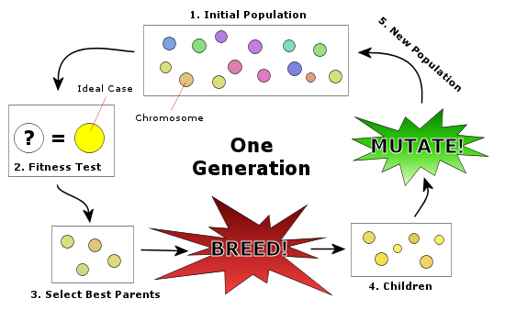
How GA Works

Slide 8
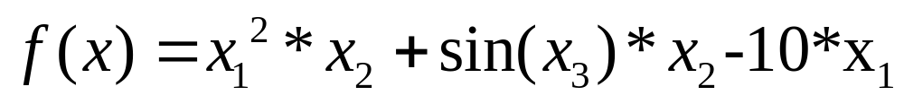
Components of a GA
A problem to solve, and ...
Encoding technique (gene, chromosome)
Initialization procedure (creation)
Evaluation function (environment)
Selection of parents (reproduction)
Genetic operators (mutation, recombination)
Parameter settings (practice and art)
x=(0.1,0.21, 0.32)

Slide 9
Simple Genetic Algorithm
{
  initialize population;
  evaluate population;
  while TerminationCriteriaNotSatisfied
  {
    select parents for reproduction;
    perform recombination and mutation;
    evaluate population;
  }
}

Slide 10
Population
population
Chromosomes could be:
  Bit strings (0101 ... 1100)
  Real numbers (43.2 -33.1 ... 0.0 89.2)
  Permutations of element (E11 E3 E7 ... E1 E15)
  Lists of rules (R1 R2 R3 ... R22 R23)
  Program elements (genetic programming)
  ... any data structure ...

Slide 11
Reproduction
children
reproduction
parents
Tournament Selection
population
Parents are selected at random with selection chances biased in relation to chromosome evaluations.

Slide 12
PROBABILISTIC SELECTION BASED ON FITNESS
Better individuals are preferred
Best is not always picked
Worst is not necessarily excluded
Nothing is guaranteed
Mixture of greedy exploitation and adventurous exploration
Similarities to simulated annealing (SA)

Slide 13
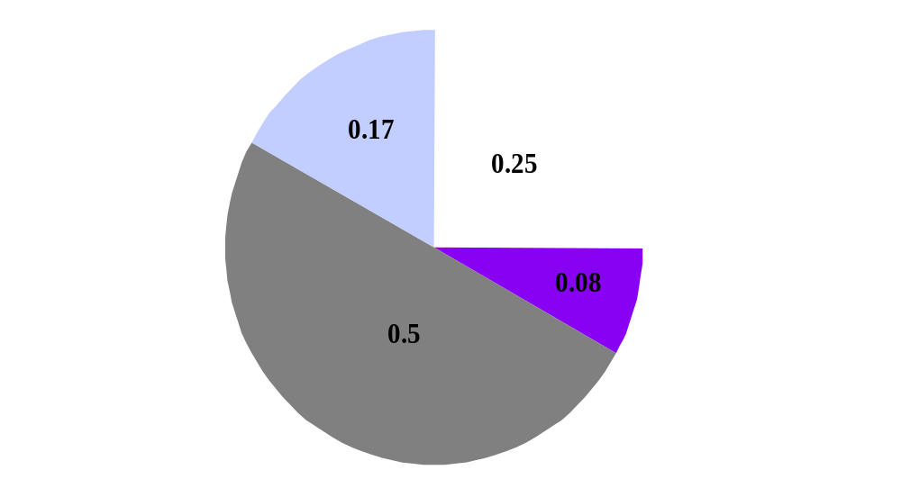
PROBABILISTIC SELECTION BASED ON FITNESS

Slide 14
Chromosome Modification
Modifications are stochastically triggered
Operator types are:
  Mutation
  Crossover (recombination)
children
modification
modified children

Slide 15
Mutation: Local Modification
Before: (1 0 1 1 0 1 1 0)
After: (0 1 1 0 0 1 1 0)
Before: (1.38 -69.4 326.44 0.1)
After: (1.38 -67.5 326.44 0.1)
Causes movement in the search space
(local or global)
Restores lost information to the population

Slide 16
Crossover: Recombination
*
P1 (0 1 1 0 1 0 0 0) (0 1 0 0 1 0 0 0) C1
P2 (1 1 0 1 1 0 1 0) (1 1 1 1 1 0 1 0) C2
Crossover is a critical feature of genetic
algorithms:
  It greatly accelerates search early in evolution of a population
  It leads to effective combination of schemata (subsolutions on different chromosomes)

Slide 17
Evaluation
The evaluator decodes a chromosome and assigns it a fitness measure
The evaluator is the only link between a classical GA and the problem it is solving
modified
children
evaluated
children
evaluation

Slide 18
Deletion
population
Generational GA:
entire populations replaced with each iteration
Steady-state GA:
a few members replaced each generation
discarded members
discard

Slide 19
An Abstract Example
Distribution of Individuals in Generation 0
Distribution of Individuals in Generation N

Slide 20
A Simple Example
The Traveling Salesman Problem:
Find a tour of a given set of cities so that
  each city is visited only once
  the total distance traveled is minimized

Slide 21
Representation
Representation is an ordered list of city
numbers known as an order-based GA.
1) London 3) Dunedin 5) Beijing 7) Tokyo
2) Venice 4) Singapore 6) Phoenix 8) Victoria
CityList1 (3 5 7 2 1 6 4 8)
CityList2 (2 5 7 6 8 1 3 4)

Slide 22
Crossover
Crossover combines inversion and
recombination:
* *
Parent1 (3 5 7 2 1 6 4 8)
Parent2 (2 5 7 6 8 1 3 4)
Child (5 8 7 2 1 6 3 4)
This operator is called the Order1 crossover.

Slide 23
Mutation
Mutation involves reordering of the list:
* *
Before: (5 8 7 2 1 6 3 4)
After: (5 8 6 2 1 7 3 4)

Slide 24
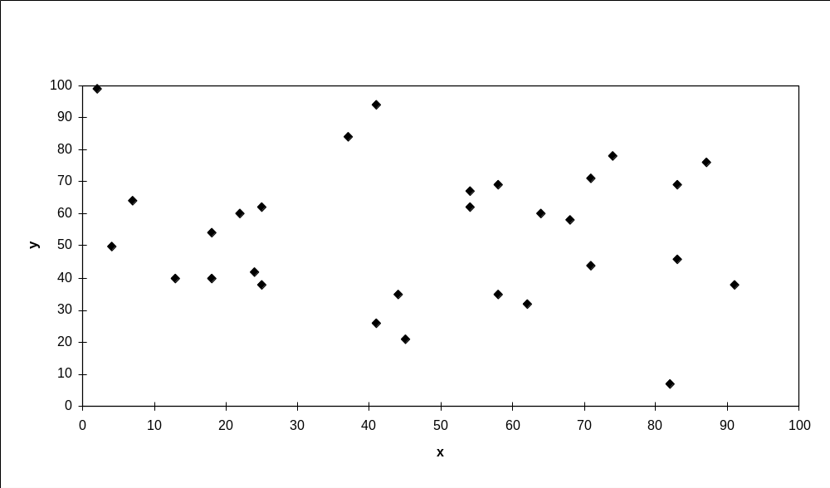
TSP Example: 30 Cities

Slide 25
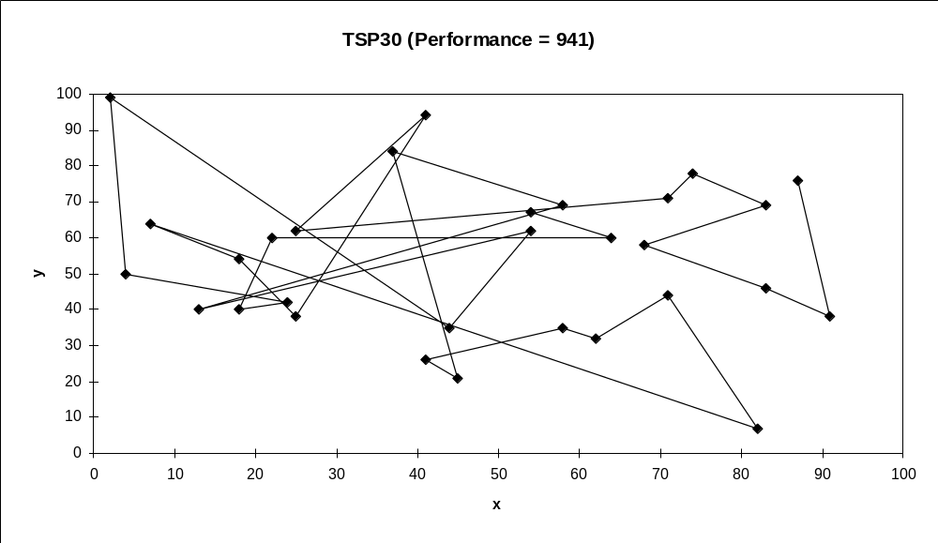
Solution _{i} (Distance = 941)

Slide 26
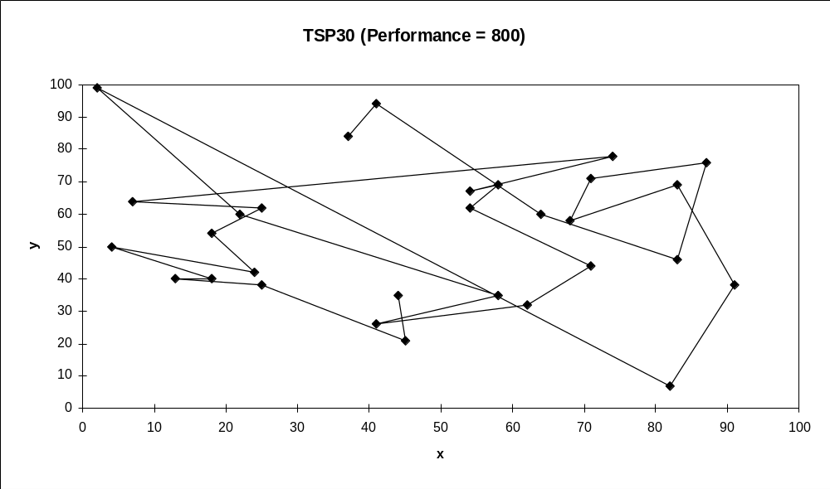
Solution _{j}(Distance = 800)

Slide 27
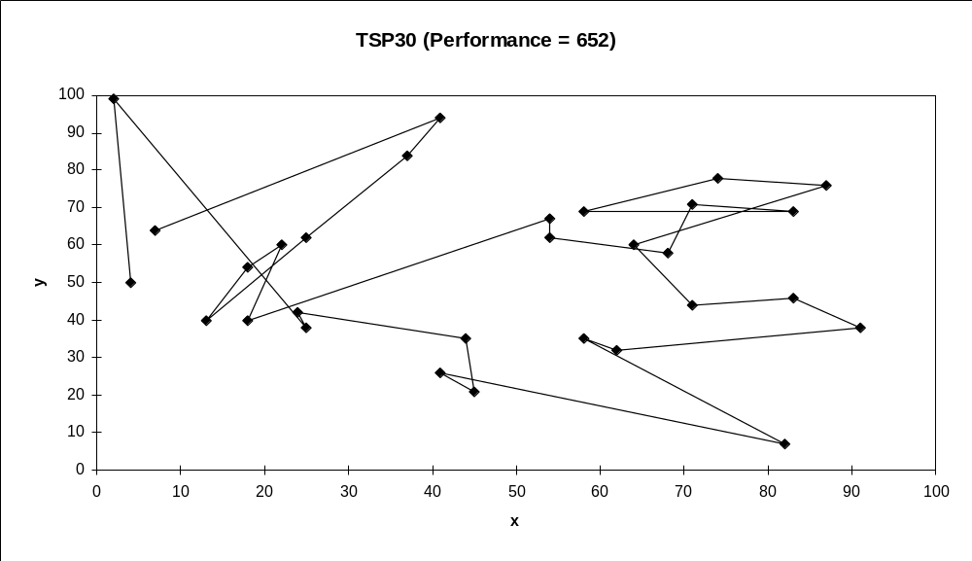
Solution _{k}(Distance = 652)

Slide 28
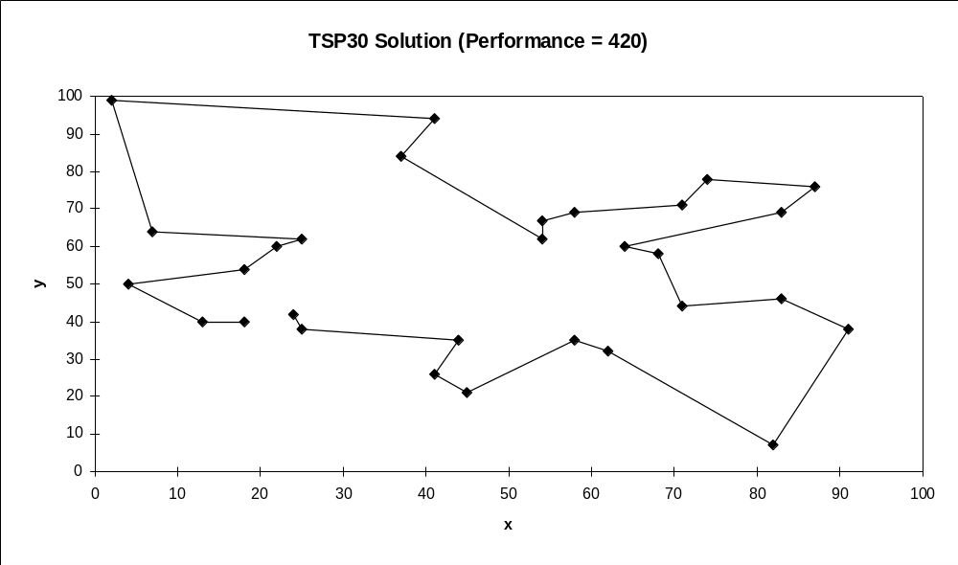
Best Solution (Distance = 420)

Slide 29
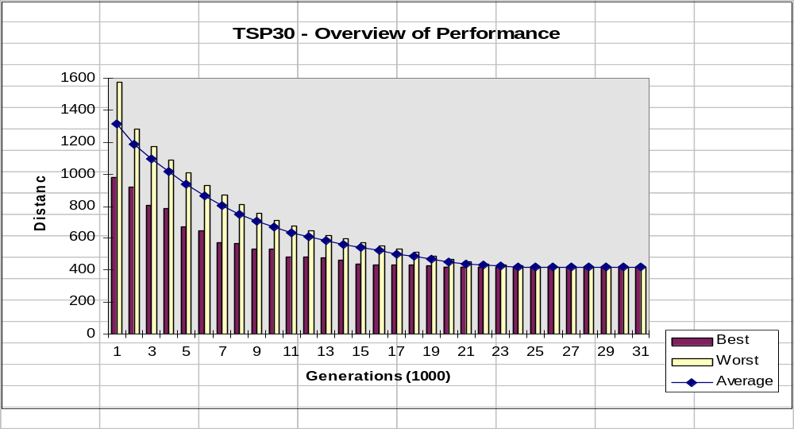
Overview of Performance

Slide 30
Issues for GA Practitioners
Choosing basic implementation issues:
  representation
  population size, mutation rate, ...
  selection, deletion policies
  crossover, mutation operators
Termination Criteria
Performance, scalability
Solution is only as good as the evaluation function (often hardest part)

Slide 31
Benefits of Genetic Algorithms
Concept is easy to understand
Modular, separate from application
Supports multi-objective optimization
Good for “noisy” environments
Always an answer; answer gets better with time
Inherently parallel; easily distributed

Slide 32
Benefits of Genetic Algorithms (cont.)
Many ways to speed up and improve a GA-based application as knowledge about problem domain is gained
Easy to exploit previous or alternate solutions
Flexible building blocks for hybrid applications
Substantial history and range of use

Slide 33
When to Use a GA
Alternate solutions are too slow or overly complicated
Need an exploratory tool to examine new approaches
Problem is similar to one that has already been successfully solved by using a GA
Want to hybridize with an existing solution
Benefits of the GA technology meet key problem requirements

Slide 34
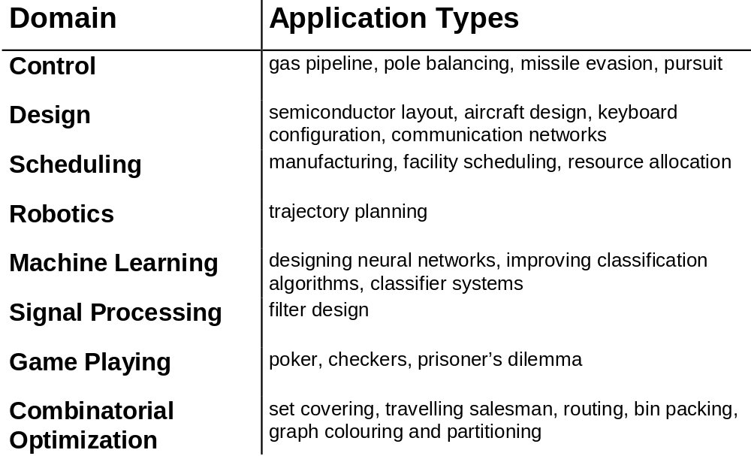
Some GA Application Types

Slide 35

GENETIC PROGRAMMING
Notes:
BBB4003

Slide 36
THE CHALLENGE
"How can computers learn to solve problems without being explicitly programmed? In other words, how can computers be made to do what is needed to be done, without being told exactly how to do it?"
⎯ Attributed to Arthur Samuel (1959)

Slide 37
CRITERION FOR SUCCESS
"The aim [is] ... to get machines to exhibit behavior, which if done by humans, would be assumed to involve the use of intelligence.“
⎯ Arthur Samuel (1983)

Slide 38
REPRESENTATIONS
Decision trees
If-then production rules
Horn clauses
Neural nets
Bayesian networks
Frames
Propositional logic
Binary decision diagrams
Formal grammars
Coefficients for polynomials
Reinforcement learning tables
Conceptual clusters
Classifier systems

Slide 39
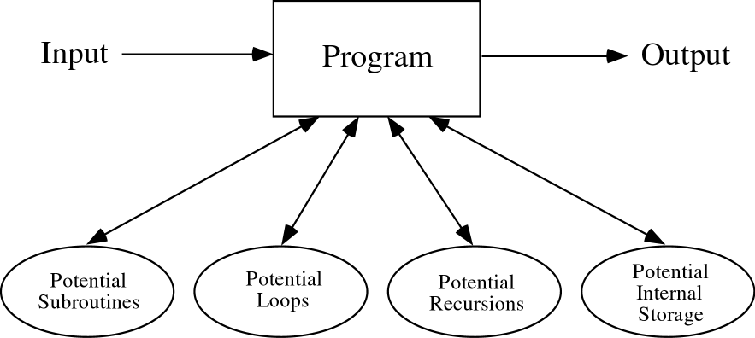
A COMPUTER PROGRAM
Notes:
BBB121

Slide 40
GENETIC PROGRAMMING (GP)
GP applies the approach of the genetic algorithm to the space of possible computer programs
Computer programs are the lingua franca for expressing the solutions to a wide variety of problems
A wide variety of seemingly different problems from many different fields can be reformulated as a search for a computer program to solve the problem.

Slide 41
GP ⎯ MAIN POINTS
Genetic programming now routinely delivers high-return human-competitive machine intelligence.
Genetic programming is an automated invention machine.
Genetic programming has delivered a progression of qualitatively more substantial results in synchrony with five approximately order-of-magnitude increases in the expenditure of computer time.

Slide 42
PROGRESSION OF QUALITATIVELY MORE SUBSTANTIAL RESULTS PRODUCED BY GP
Toy problems
Human-competitive non-patent results
20th-century patented inventions
21st-century patented inventions
Patentable new inventions

Slide 43
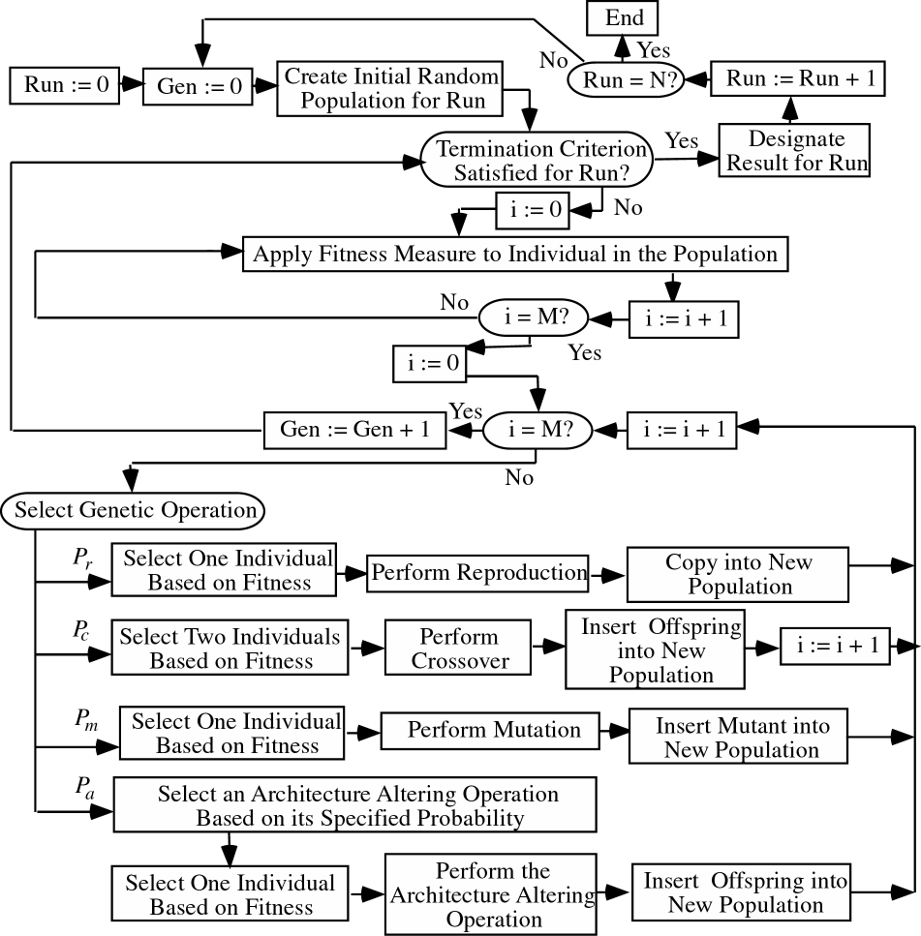
GP FLOWCHART
Notes:
BBB2028 (converted to BMP)

Slide 44
A COMPUTER PROGRAM IN C
int foo (int time)
{
int temp1, temp2;
if (time > 10)
temp1 = 3;
else
temp1 = 4;
temp2 = temp1 + 1 + 2;
return (temp2);
}

Slide 45
OUTPUT OF C PROGRAM
Time | Output
0 | 6
1 | 6
2 | 6
3 | 6
4 | 6
5 | 6
6 | 6
7 | 6
8 | 6
9 | 6
10 | 6
11 | 7
12 | 7

Slide 46
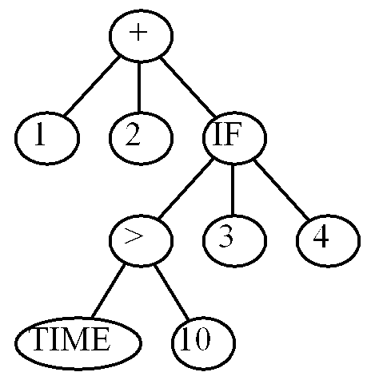
PROGRAM TREE
(+ 1 2 (IF (> TIME 10) 3 4))

Slide 47
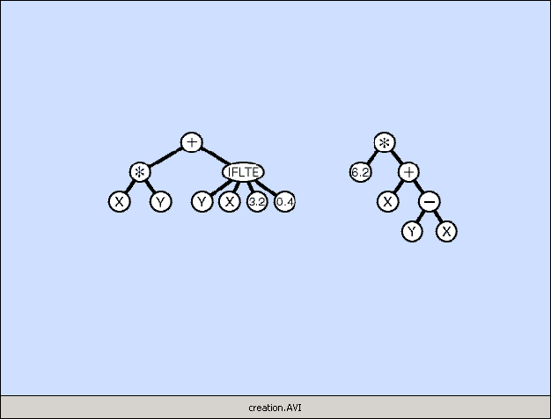
CREATING RANDOM PROGRAMS
Notes:
Creation.avi (creation.gif converted to AVI movie file)

Slide 48
CREATING RANDOM PROGRAMS
Available functions F = {+, -, *, %, IFLTE}
Available terminals T = {X, Y, Random-Constants}
The random programs are:
  Of different sizes and shapes
  Syntactically valid
  Executable

Slide 49
GP GENETIC OPERATIONS
Reproduction
Mutation
Crossover (sexual recombination)
Architecture-altering operations

Slide 50

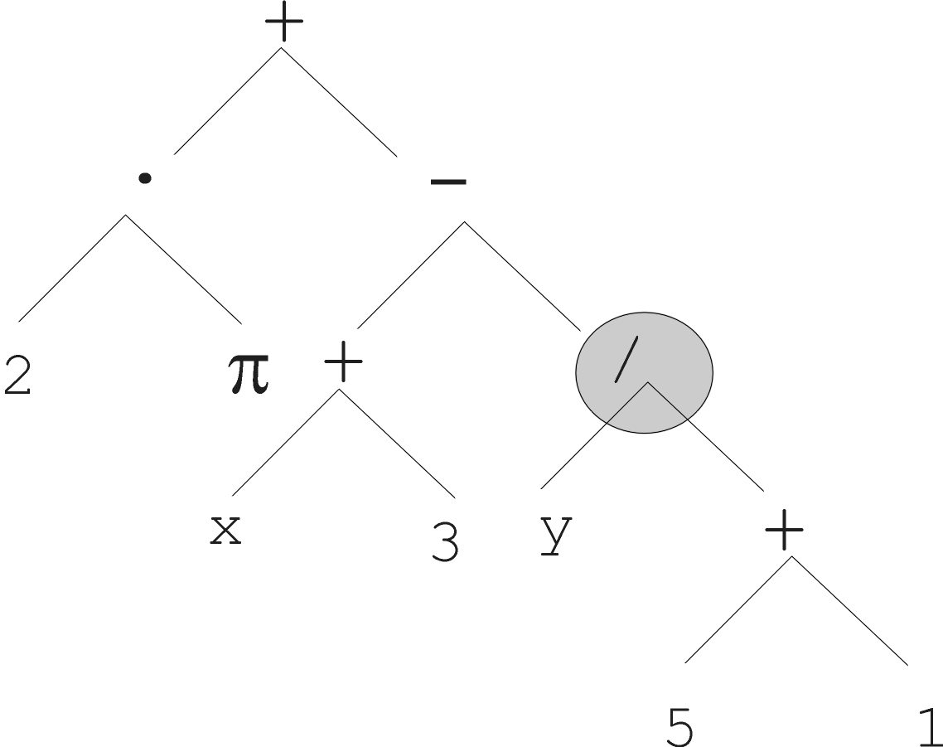
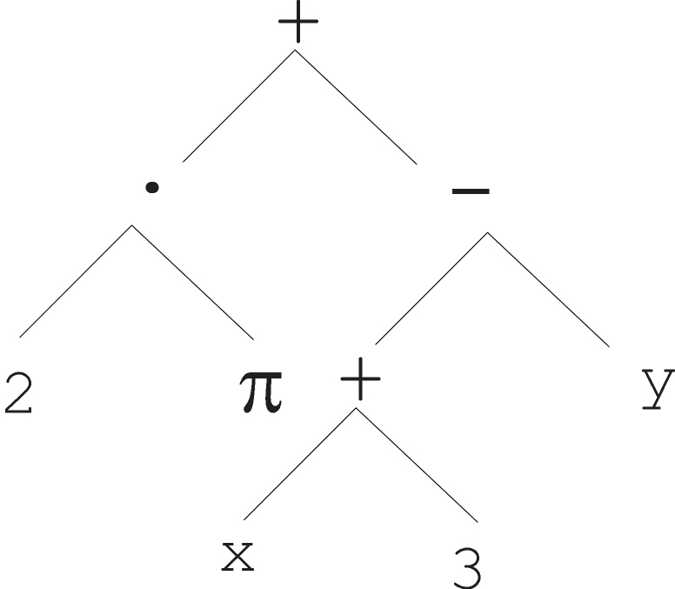
MUTATION OPERATION
Notes:
Mutation.avi

Slide 51
MUTATION OPERATION
Select 1 parent probabilistically based on fitness
Pick point from 1 to NUMBER-OF-POINTS
Delete subtree at the picked point
Grow new subtree at the mutation point in same way as generated trees for initial random population (generation 0)
The result is a syntactically valid executable program
Put the offspring into the next generation of the population

Slide 52
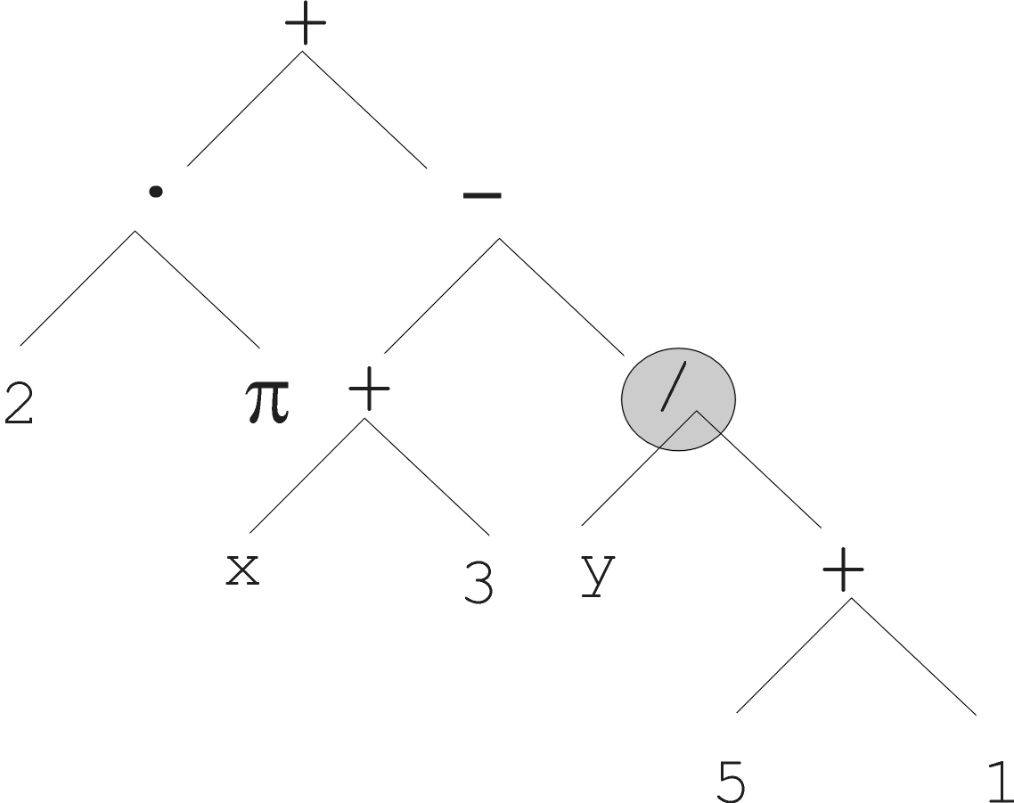
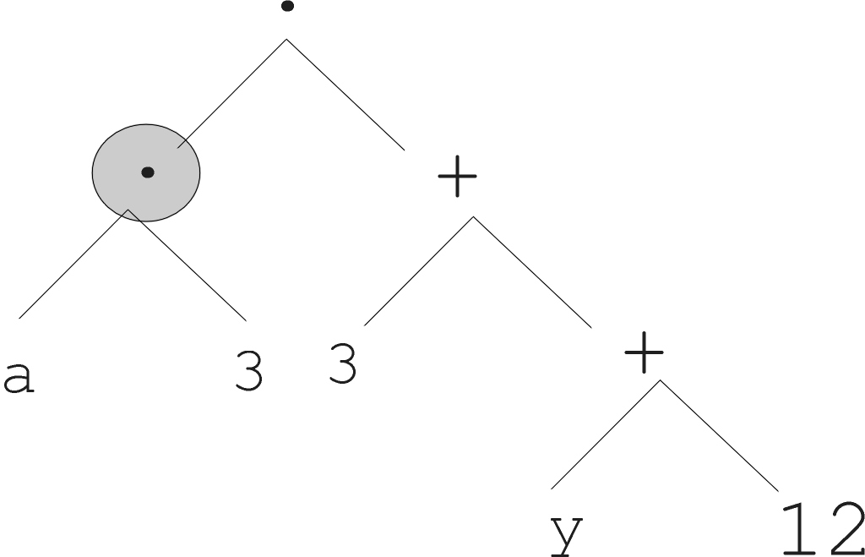
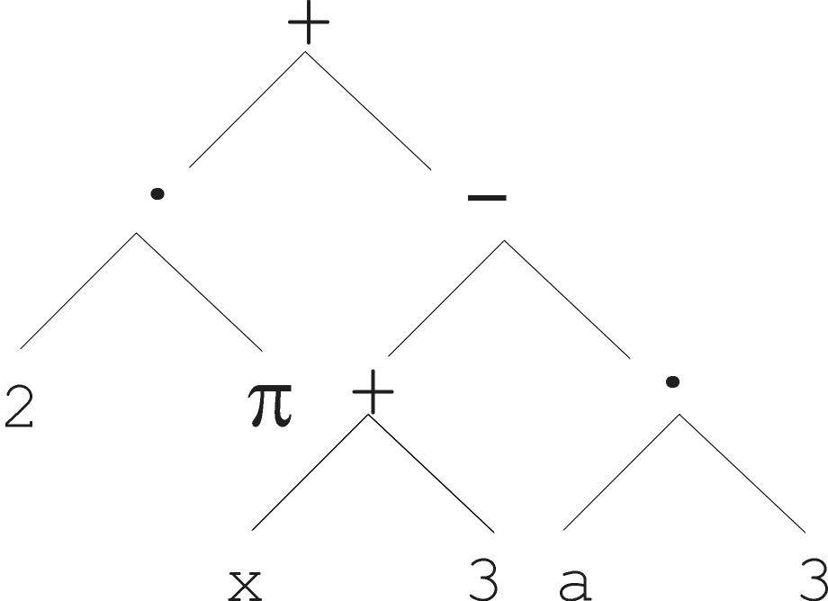
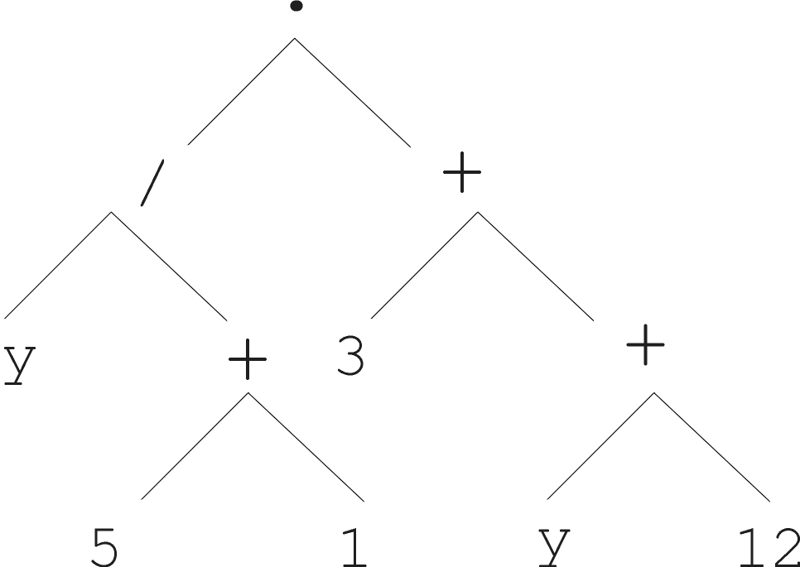
CROSSOVER OPERATION
Parent 1
Parent 2
Child 1
Child 2

Slide 53
CROSSOVER OPERATION
Select 2 parents probabilistically based on fitness
Randomly pick a number from 1 to NUMBER-OF-POINTS for 1st parent
Independently randomly pick a number for 2nd parent
The result is a syntactically valid executable program
Put the offspring into the next generation of the population
Identify the subtrees rooted at the two picked points

Slide 54
REPRODUCTION OPERATION
Select parent probabilistically based on fitness
Copy it (unchanged) into the next generation of the population

Slide 55
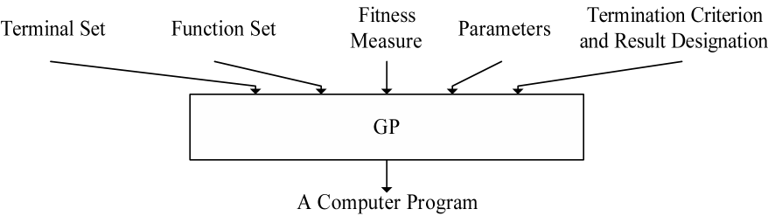
FIVE MAJOR PREPARATORY STEPS FOR GP
Determining the set of terminals
Determining the set of functions
Determining the fitness measure
Determining the parameters for the run
Determining the method for designating a result and the criterion for terminating a run
Notes:
BBB3666 (converted to BMP from eps)
The following were cut as parameter subpoints so that the text fit on a slide
population size
number of generations
minor parameters

Slide 56
ILLUSTRATIVE GP RUN

Slide 57
SYMBOLIC REGRESSION
Independent variable X | Dependent variable Y
-1.00 | 1.00
-0.80 | 0.84
-0.60 | 0.76
-0.40 | 0.76
-0.20 | 0.84
0.00 | 1.00
0.20 | 1.24
0.40 | 1.56
0.60 | 1.96
0.80 | 2.44
1.00 | 3.00

Slide 58
PREPARATORY STEPS
 | Objective: | Find a computer program with one input (independent variable X) whose output equals the given data
1 | Terminal set: | T = {X, Random-Constants}
2 | Function set: | F = {+, -, *, %}
3 | Fitness: | The sum of the absolute value of the differences between the candidate program’s output and the given data (computed over numerous values of the independent variable x from –1.0 to +1.0)
4 | Parameters: | Population size M = 4
5 | Termination: | An individual emerges whose sum of absolute errors is less than 0.1

Slide 59
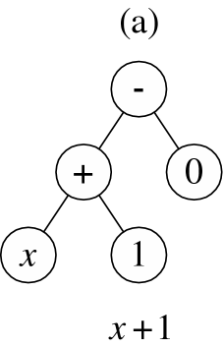
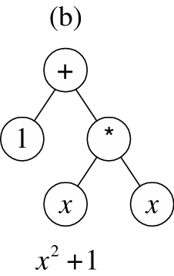
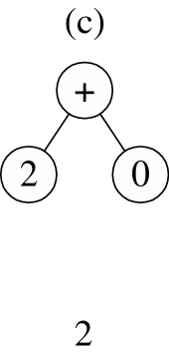
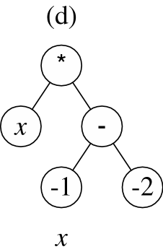
SYMBOLIC REGRESSION
POPULATION OF 4 RANDOMLY CREATED INDIVIDUALS FOR GENERATION 0
Notes:
BBB3663 was broken into 4 components and converted to BMP files for the incremental unveiling

Slide 60
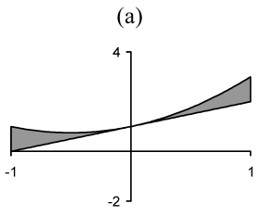
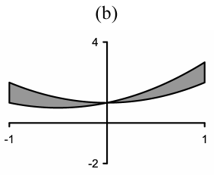
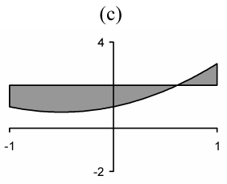
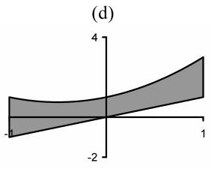
SYMBOLIC REGRESSION x² + x + 1
FITNESS OF THE 4 INDIVIDUALS IN GEN 0
x + 1
x² + 1
2
x
0.67
1.00
1.70
2.67
Notes:
BBB3662 was broken up into 4 indidual BMP files from the original eps file to satisfy display constraings

Slide 61
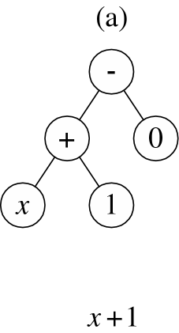
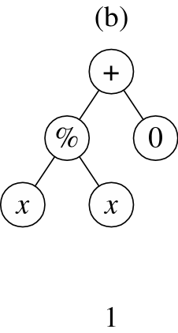
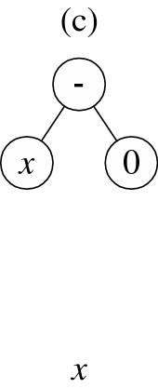
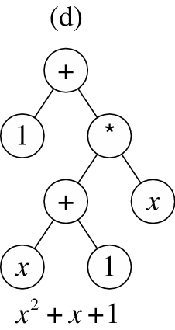
SYMBOLIC REGRESSION x² + x + 1
GENERATION 1
Second offspring of crossover of (a) and (b)
picking “+” of parent (a) and left-most “x” of parent (b) as crossover points
First offspring of crossover of (a) and (b)
picking “+” of parent (a) and left-most “x” of parent (b) as crossover points
Mutant of (c)
picking “2” as mutation point
Copy of (a)
Notes:
BBB3664 was broken up into 4 indidual BMP files from the original eps file to satisfy display constraings

Slide 62

GENETIC PROGRAMMING: ON THE PROGRAMMING OF COMPUTERS BY MEANS OF NATURAL SELECTION
(Koza 1992)
Notes:
BBB4031 (converted to BMP)

Slide 63
2 MAIN POINTS FROM 1992 BOOK
Virtually all problems in artificial intelligence, machine learning, adaptive systems, and automated learning can be recast as a search for a computer program.
Genetic programming provides a way to successfully conduct the search for a computer program in the space of computer programs.

Slide 64
SOME RESULTS FROM 1992 BOOK
Intertwined Spirals
Truck Backer Upper
Broom Balancer
Wall Follower
Box Mover
Artificial Ant
Differential Games
Inverse Kinematics
Central Place Foraging
Block Stacking
Randomizer
Cellular Automata
Task Prioritization
Image Compression
Econometric Equation
Optimization
Boolean Function Learning
Co-Evolution of Game-Playing Strategies

Slide 65
PROGRESSION OF QUALITATIVELY MORE SUBSTANTIAL RESULTS PRODUCED BY GP
Toy problems
Human-competitive non-patent results
20th-century patented inventions
21st-century patented inventions
Patentable new inventions

Slide 66
SYMBOLIC REGRESSION
Fitness case | L₀ | W₀ | H₀ | L₁ | W₁ | H₁ | Dependent variable D
1 | 3 | 4 | 7 | 2 | 5 | 3 | 54
2 | 7 | 10 | 9 | 10 | 3 | 1 | 600
3 | 10 | 9 | 4 | 8 | 1 | 6 | 312
4 | 3 | 9 | 5 | 1 | 6 | 4 | 111
5 | 4 | 3 | 2 | 7 | 6 | 1 | -18
6 | 3 | 3 | 1 | 9 | 5 | 4 | -171
7 | 5 | 9 | 9 | 1 | 7 | 6 | 363
8 | 1 | 2 | 9 | 3 | 9 | 2 | -36
9 | 2 | 6 | 8 | 2 | 6 | 10 | -24
10 | 8 | 1 | 10 | 7 | 5 | 1 | 45

Slide 67
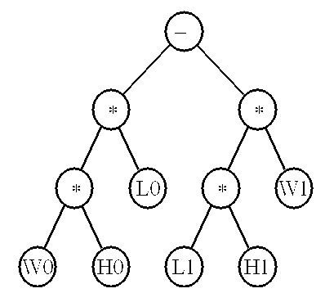
EVOLVED SOLUTION
(- (* (* W0 L0) H0)
(* (* W1 L1) H1))
Notes:
BBB??? No number, only existed as embedded word file

