Slide 1
CSCE883 Support Vector Machines
Lecture 13
Support Vector Machines
MWF 11:15aM-12:05PM
Dr. Jianjun Hu
http://mleg.cse.sc.edu/edu/csce883
University of South Carolina
Department of Computer Science and Engineering

Slide 2
Roadmap
A brief history of SVM
Large-margin linear classifier
  Linear separable
  Nonlinear separable
Creating nonlinear classifiers: kernel trick
A simple example
Discussion on SVM
Conclusion

Slide 3
History of SVM (Support Vector Machines)
SVM is related to statistical learning theory [3]
SVM was first introduced in 1992 [1]
SVM becomes popular because of its success in handwritten digit recognition
  1.1% test error rate for SVM. This is the same as the error rates of a carefully constructed neural network, LeNet 4.
    See Section 5.11 in [2] or the discussion in [3] for details
SVM is now regarded as an important example of “kernel methods”, one of the key area in machine learning
  Note: the meaning of “kernel” is different from the “kernel” function for Parzen windows
[1] B.E. Boser et al. A Training Algorithm for Optimal Margin Classifiers. Proceedings of the Fifth Annual Workshop on Computational Learning Theory 5 144-152, Pittsburgh, 1992.
[2] L. Bottou et al. Comparison of classifier methods: a case study in handwritten digit recognition. Proceedings of the 12th IAPR International Conference on Pattern Recognition, vol. 2, pp. 77-82.
[3] V. Vapnik. The Nature of Statistical Learning Theory. 2nd edition, Springer, 1999.
Notes:
First introduced in COLT-92 by Boser, Guyon and Vapnik
COLT = computational learning theory
B. Scholkopf et al. ICANN 96. 47-52.

Slide 4
What is a good Decision Boundary?
Consider a two-class, linearly separable classification problem
Many decision boundaries!
  The Perceptron algorithm can be used to find such a boundary
  Different algorithms have been proposed (DHS ch. 5)
Are all decision boundaries equally good?
x2
Class 2
Class 1
x1
Notes:
Perceptron learning rule can be used to find any decision boundary between class 1 and class 2

Slide 5
Examples of Bad Decision Boundaries
Class 2
Class 2
Class 1
Class 1

Slide 6

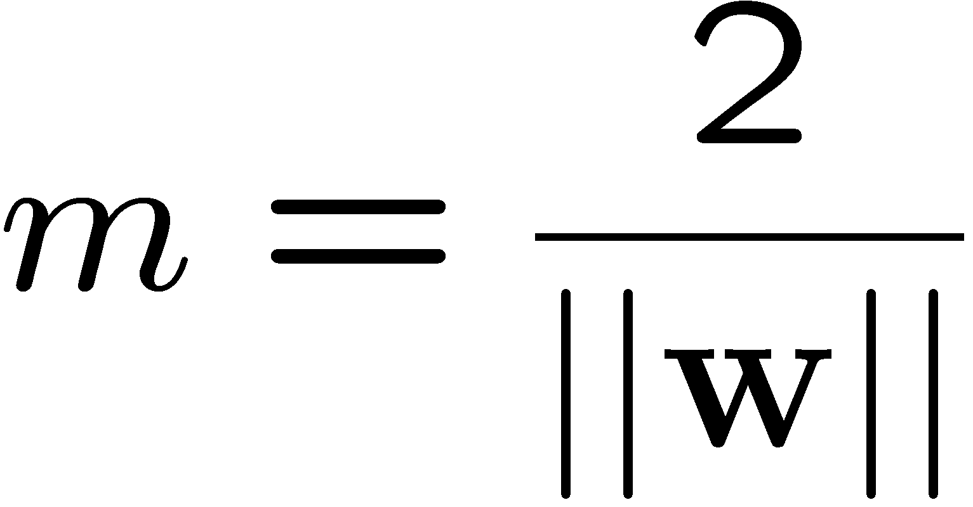
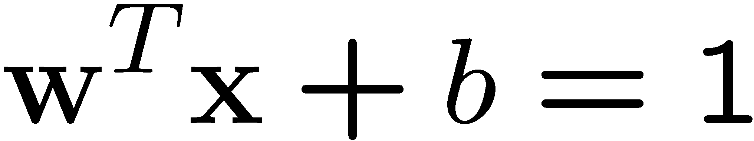
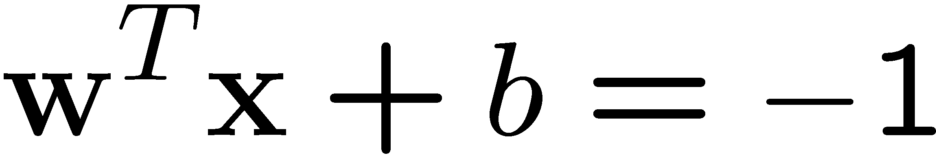
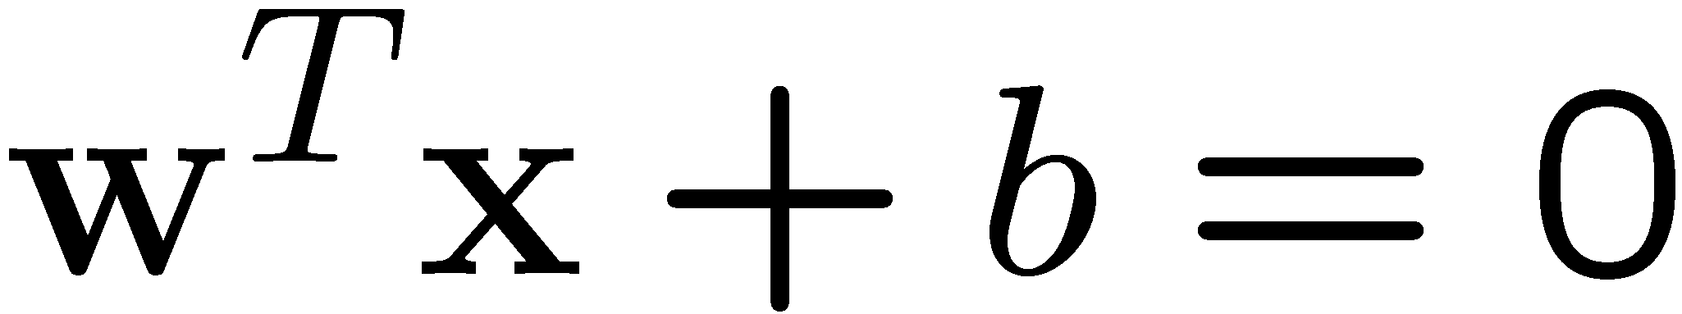
Large-margin Decision Boundary
The decision boundary should be as far away from the data of both classes as possible
  We should maximize the margin, m
  Distance between the origin and the line w^{t}x=k is k/||w||
Class 2
m
Class 1

Slide 7
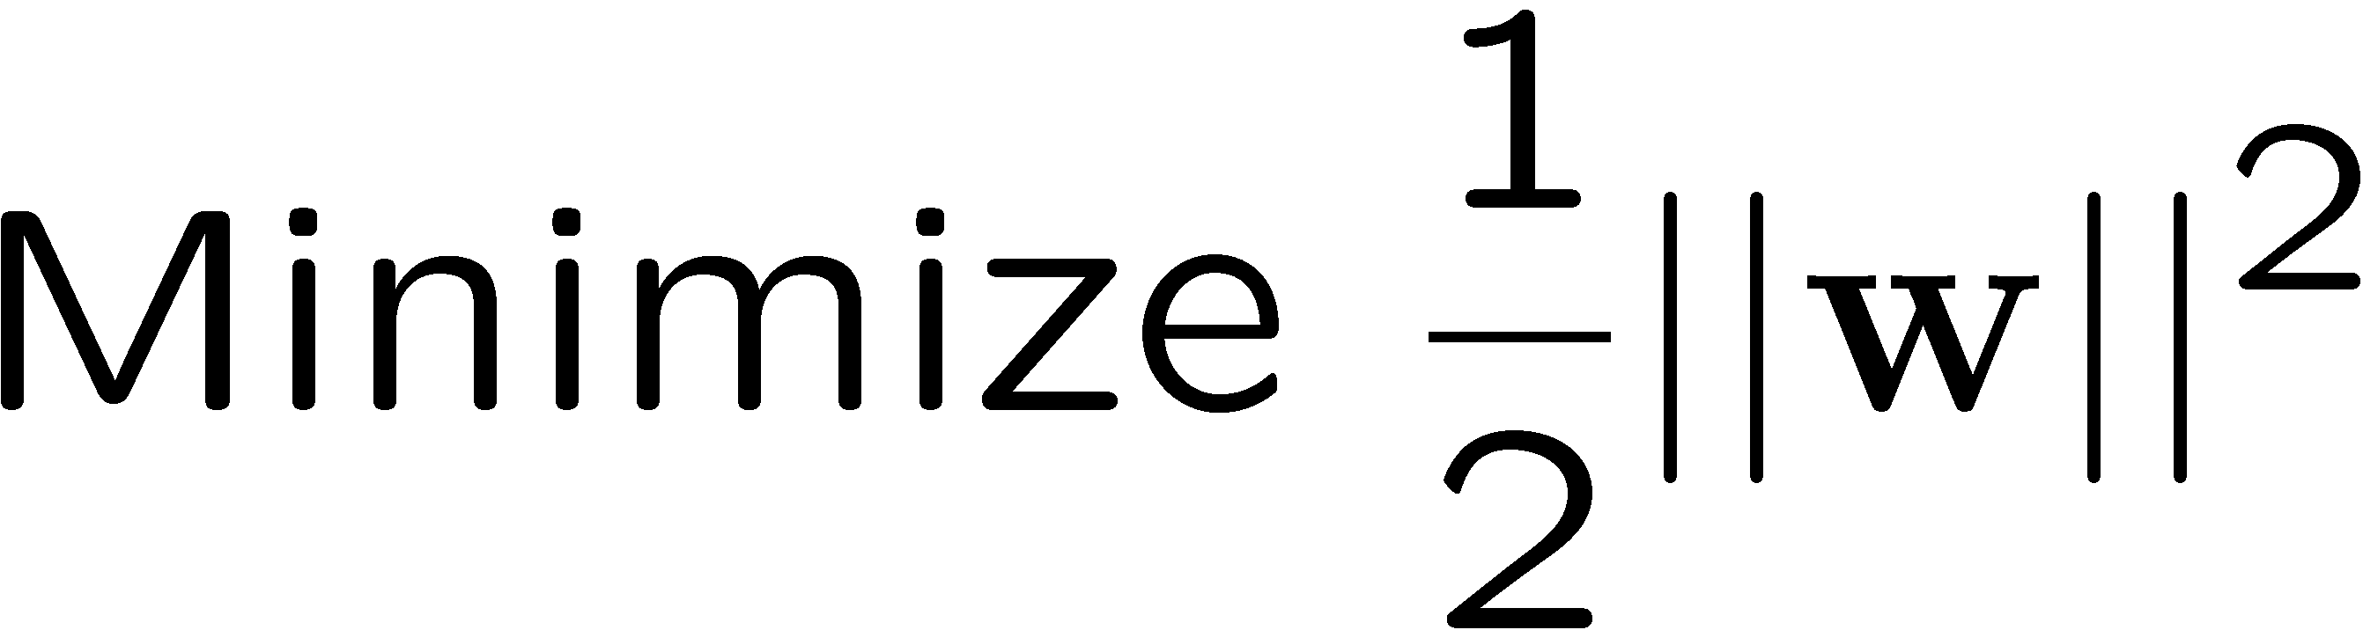
Finding the Decision Boundary
Let {x₁, ..., x_{n}} be our data set and let y_{i} ∈ {1,-1} be the class label of x_{i}
The decision boundary should classify all points correctly ⇒
The decision boundary can be found by solving the following constrained optimization problem
This is a constrained optimization problem. Solving it requires some new tools
  Feel free to ignore the following several slides; what is important is the constrained optimization problem above

Slide 8
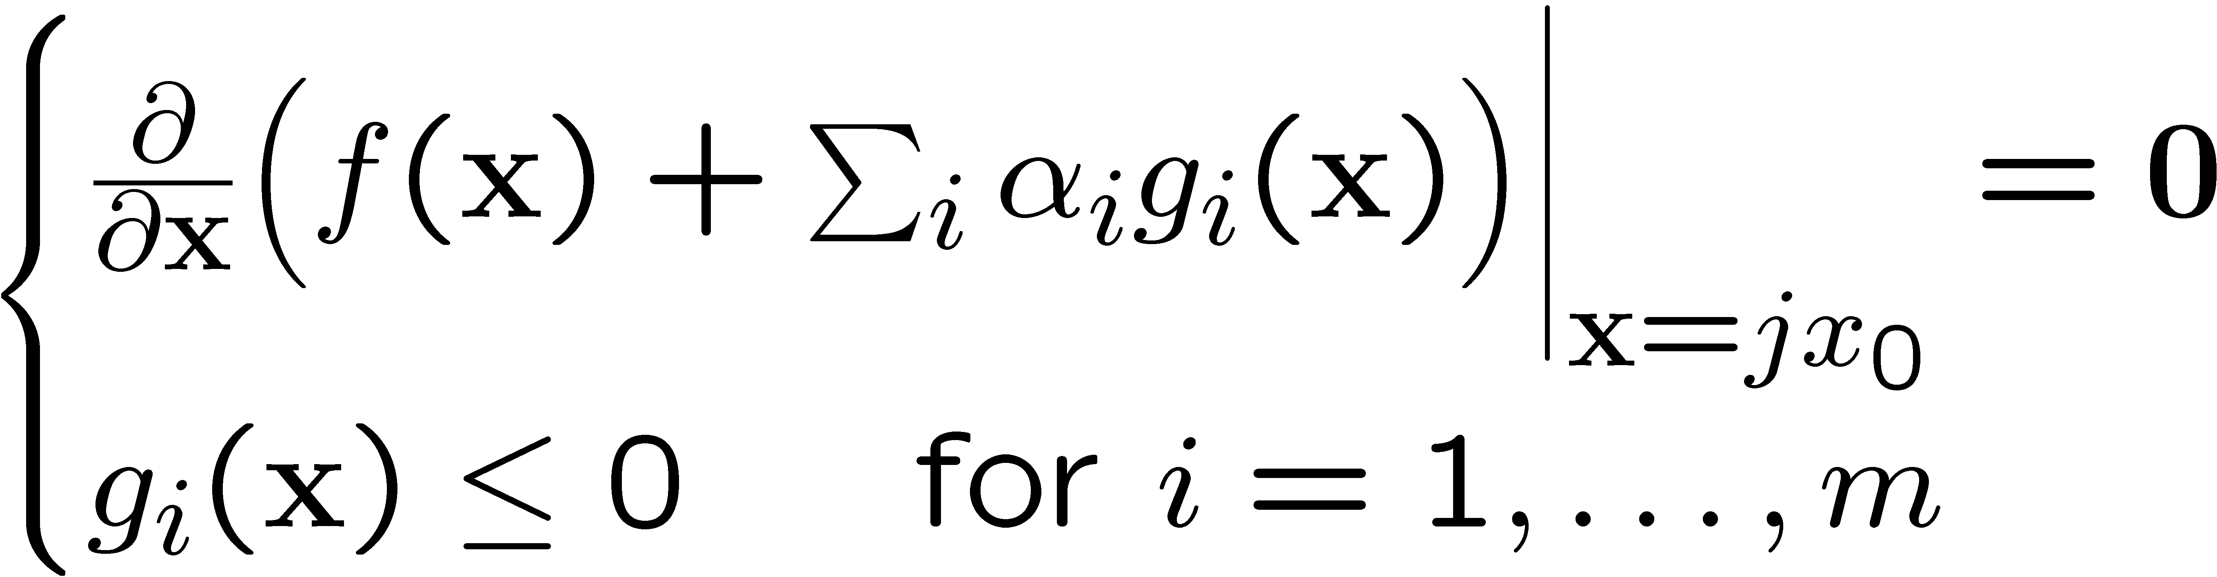
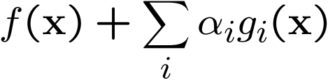
Recap of Constrained Optimization
The case for inequality constraint g_{i}(x)≤0 is similar, except that the Lagrange multiplier α_{i} should be positive
If x₀ is a solution to the constrained optimization problem
There must exist α_{i}≥0 for i=1, …, m such that x₀ satisfy
The function is also known as the Lagrangrian; we want to set its gradient to 0

Slide 9
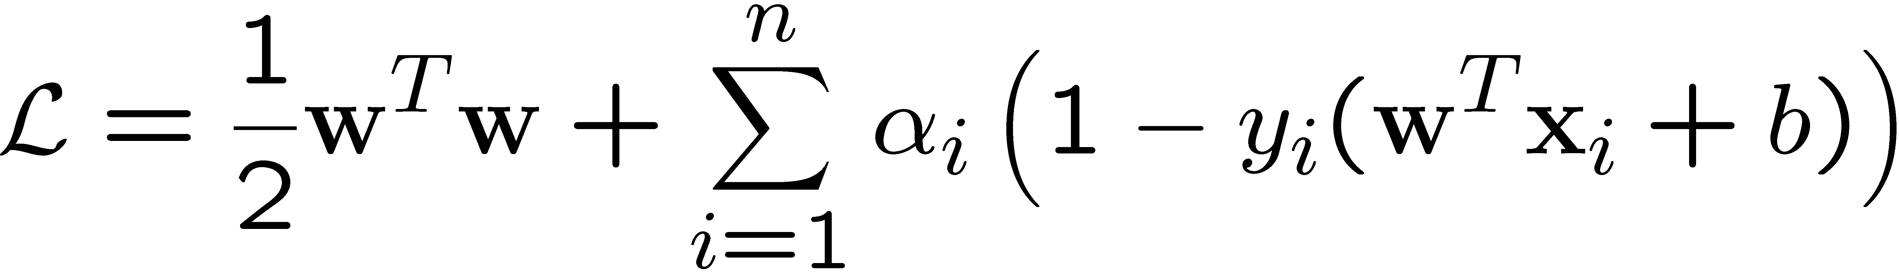

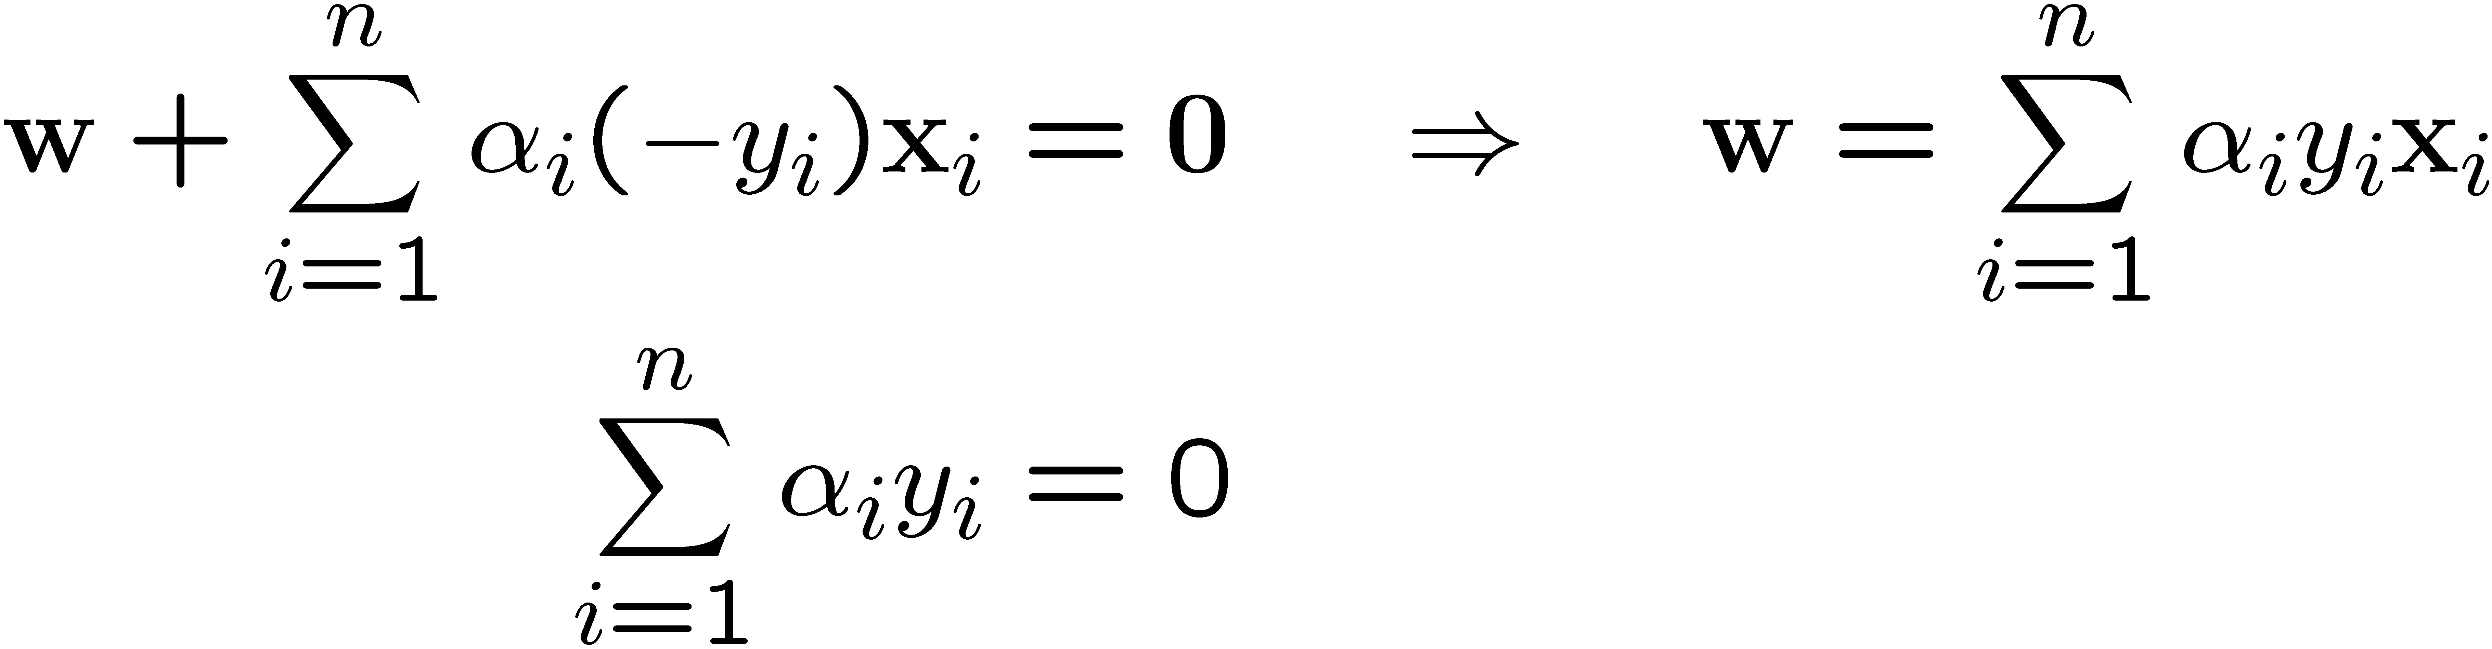
Back to the Original Problem
The Lagrangian is
  Note that ||w||² = w^{T}w
Setting the gradient of w.r.t. w and b to zero, we have

Slide 10
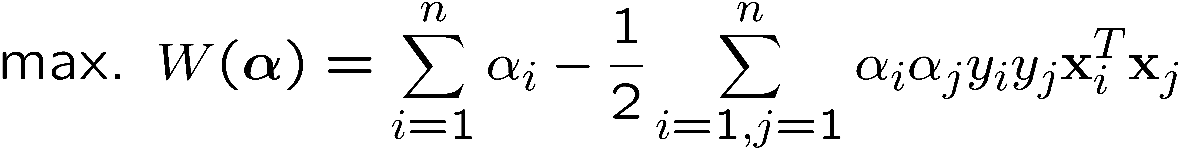
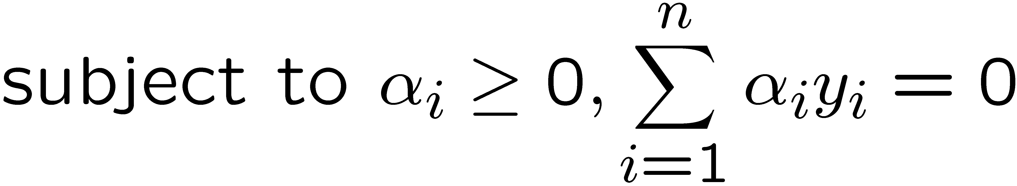
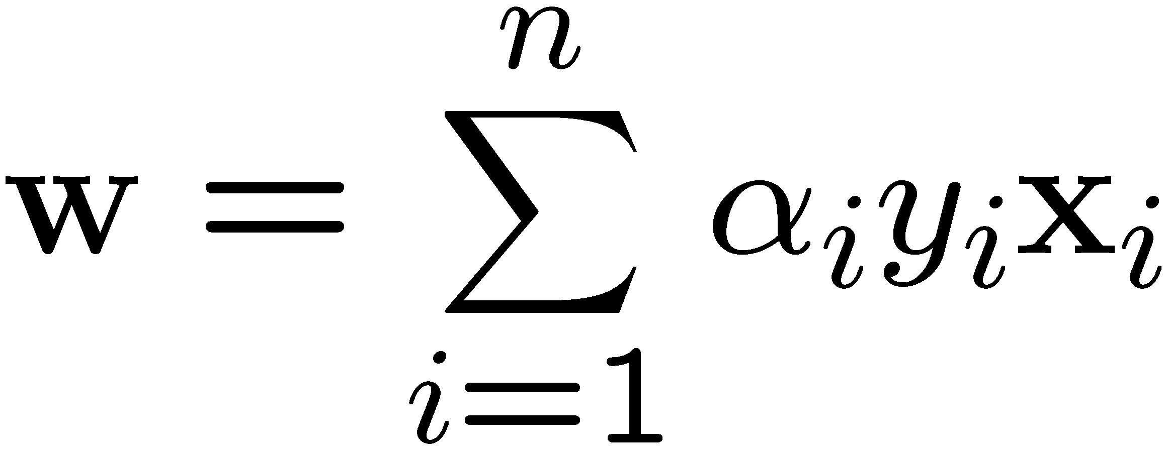
The Dual Problem
This is a quadratic programming (QP) problem
  A global maximum of α_{i} can always be found
w can be recovered by
Notes:
Let x(1) and x(-1) be two S.V.
Then b = -1/2( w^T x(1) + w^T x(-1) )

Slide 11
The Quadratic Programming Problem
Many approaches have been proposed
  Loqo, cplex, etc. (see http://www.numerical.rl.ac.uk/qp/qp.html)
Most are “interior-point” methods
  Start with an initial solution that can violate the constraints
  Improve this solution by optimizing the objective function and/or reducing the amount of constraint violation
For SVM, sequential minimal optimization (SMO) seems to be the most popular
  A QP with two variables is trivial to solve
  Each iteration of SMO picks a pair of (α_{i},α_{j}) and solve the QP with these two variables; repeat until convergence
In practice, we can just regard the QP solver as a “black-box” without bothering how it works

Slide 12
A Geometrical Interpretation
Class 2
α₁₀=0
α₈=0.6
α₇=0
α₂=0
α₅=0
α₁=0.8
α₄=0
α₆=1.4
α₉=0
α₃=0
Class 1
Notes:
So, if change internal points, no effect on the decision boundary

Slide 13

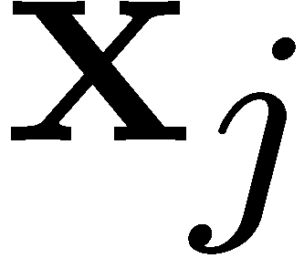
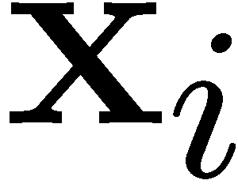

Non-linearly Separable Problems
We allow “error” ξ_{i} in classification; it is based on the output of the discriminant function w^{T}x+b
ξ_{i} approximates the number of misclassified samples
Class 2
Class 1

Slide 14
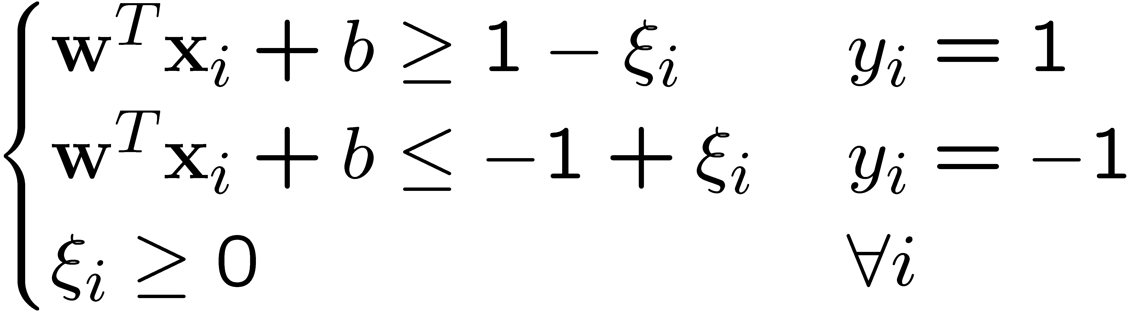
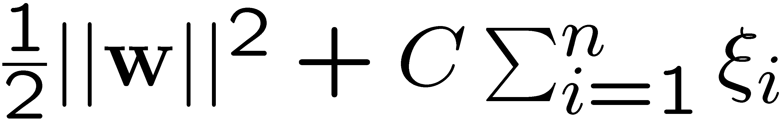
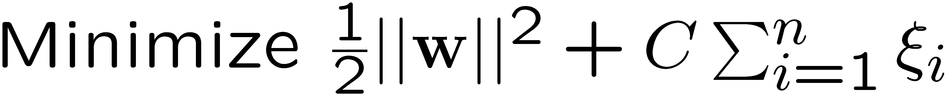
Soft Margin Hyperplane
If we minimize ∑_{i}ξ_{i}, ξ_{i} can be computed by
  ξ_{i} are “slack variables” in optimization
  Note that ξ_{i}=0 if there is no error for x_{i}
  ξ_{i} is an upper bound of the number of errors
We want to minimize
  C : tradeoff parameter between error and margin
The optimization problem becomes

Slide 15
Feature Mapping and Kernel Trick
Non-linear separable problem can be mapped to linearly mapped high-dimension space
Feature mapping can be done implicitly by Kernel Trick

Slide 16
Extension to Non-linear Decision Boundary
So far, we have only considered large-margin classifier with a linear decision boundary
How to generalize it to become nonlinear?
Key idea: transform x_{i} to a higher dimensional space to “make life easier”
  Input space: the space the point x_{i} are located
  Feature space: the space of φ(x_{i}) after transformation
Why transform?
  Linear operation in the feature space is equivalent to non-linear operation in input space
  Classification can become easier with a proper transformation. In the XOR problem, for example, adding a new feature of x₁x₂ make the problem linearly separable
Notes:
XOR: x_1, x_2, and we want to transform to x_1^2, x_2^2, x_1 x_2
It can also be viewed as feature extraction from the feature vector x, but now we extract more feature than the number of features in x.

Slide 17
Suppose we’re in 1-dimension
What would SVMs do with this data?
x=0
Copyright © 2001, 2003, Andrew W. Moore

Slide 18
Suppose we’re in 1-dimension
Not a big surprise
x=0
Positive “plane”
Negative “plane”

Slide 19
Harder 1-dimensional dataset
That’s wiped the smirk off SVM’s face.
What can be done about this?
x=0

Slide 20
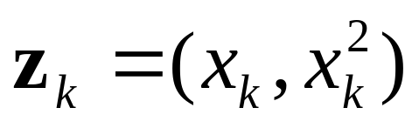
Harder 1-dimensional dataset
Remember how permitting non-linear basis functions made linear regression so much nicer?
Let’s permit them here too
x=0

Slide 21
Harder 1-dimensional dataset
Remember how permitting non-linear basis functions made linear regression so much nicer?
Let’s permit them here too
x=0

Slide 22
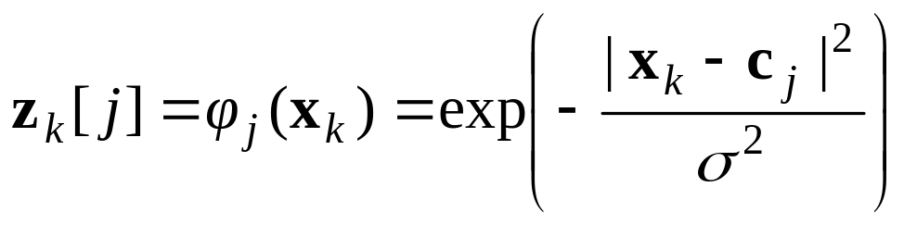
Common SVM basis functions
z_{k} = ( polynomial terms of x_{k} of degree 1 to q )
z_{k} = ( radial basis functions of x_{k} )
z_{k} = ( sigmoid functions of x_{k} )
This is sensible.
Is that the end of the story?
No…there’s one more trick!

Slide 23
Transforming the Data (c.f. DHS Ch. 5)
φ( )
φ( )
φ( )
φ( )
φ( )
φ(.)
φ( )
φ( )
φ( )
φ( )
φ( )
φ( )
φ( )
φ( )
φ( )
φ( )
φ( )
φ( )
φ( )
Input space
Feature space
Note: feature space is of higher dimension than the input space in practice
Computation in the feature space can be costly because it is high dimensional
  The feature space is typically infinite-dimensional!
The kernel trick comes to rescue

Slide 24
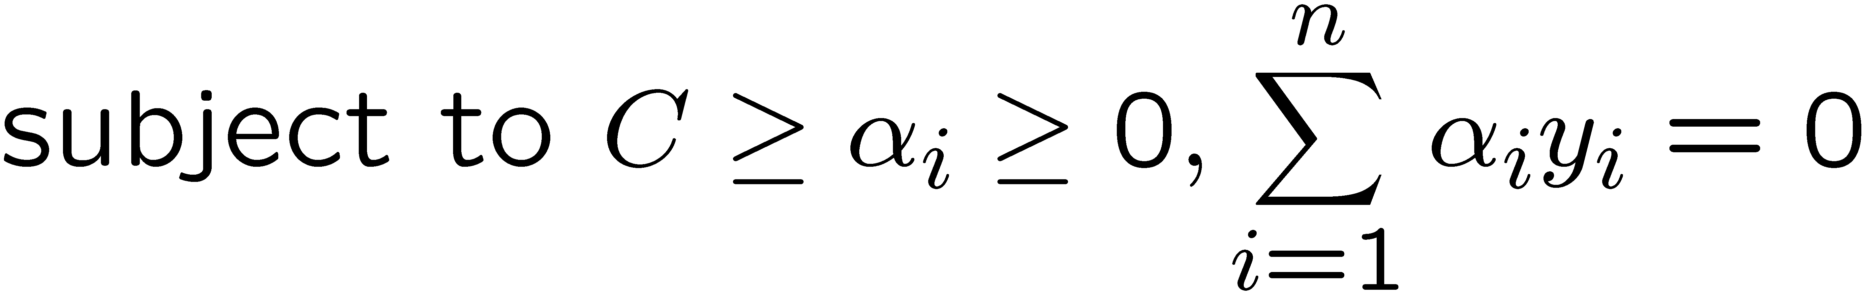
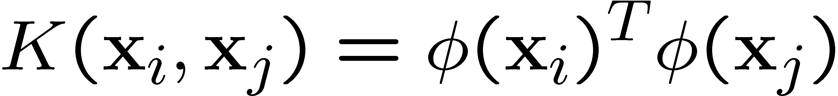
The Kernel Trick
Recall the SVM optimization problem
The data points only appear as inner product
As long as we can calculate the inner product in the feature space, we do not need the mapping explicitly
Many common geometric operations (angles, distances) can be expressed by inner products
Define the kernel function K by

Slide 25
An Example for φ(.) and K(.,.)
Suppose φ(.) is given as follows
An inner product in the feature space is
So, if we define the kernel function as follows, there is no need to carry out φ(.) explicitly
This use of kernel function to avoid carrying out φ(.) explicitly is known as the kernel trick

Slide 26
Kernel Functions
In practical use of SVM, the user specifies the kernel function; the transformation φ(.) is not explicitly stated
Given a kernel function K(x_{i}, x_{j}), the transformation φ(.) is given by its eigenfunctions (a concept in functional analysis)
  Eigenfunctions can be difficult to construct explicitly
  This is why people only specify the kernel function without worrying about the exact transformation
Another view: kernel function, being an inner product, is really a similarity measure between the objects

Slide 27
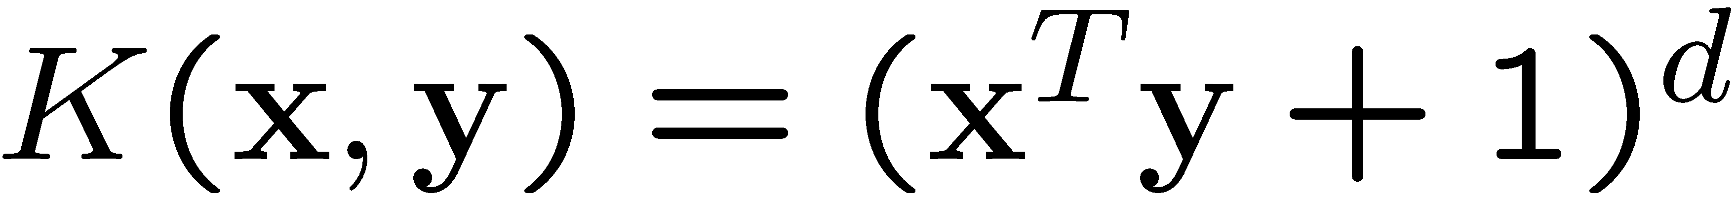
Examples of Kernel Functions
Polynomial kernel with degree d
Radial basis function kernel with width σ
  Closely related to radial basis function neural networks
  The feature space is infinite-dimensional
Sigmoid with parameter κ and θ
  It does not satisfy the Mercer condition on all κ and θ
Notes:
Despite violating Mercer condition, the sigmoid kernel function can still work

Slide 28
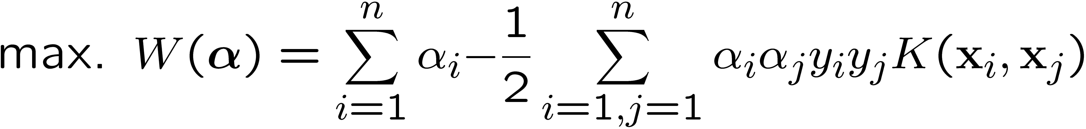
Modification Due to Kernel Function
Change all inner products to kernel functions
For training,
Original
With kernel function

Slide 29
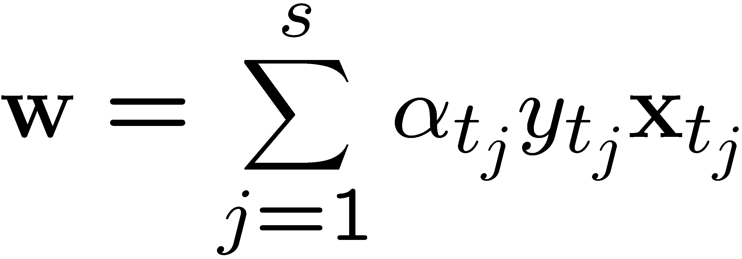
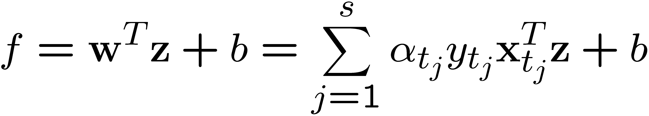
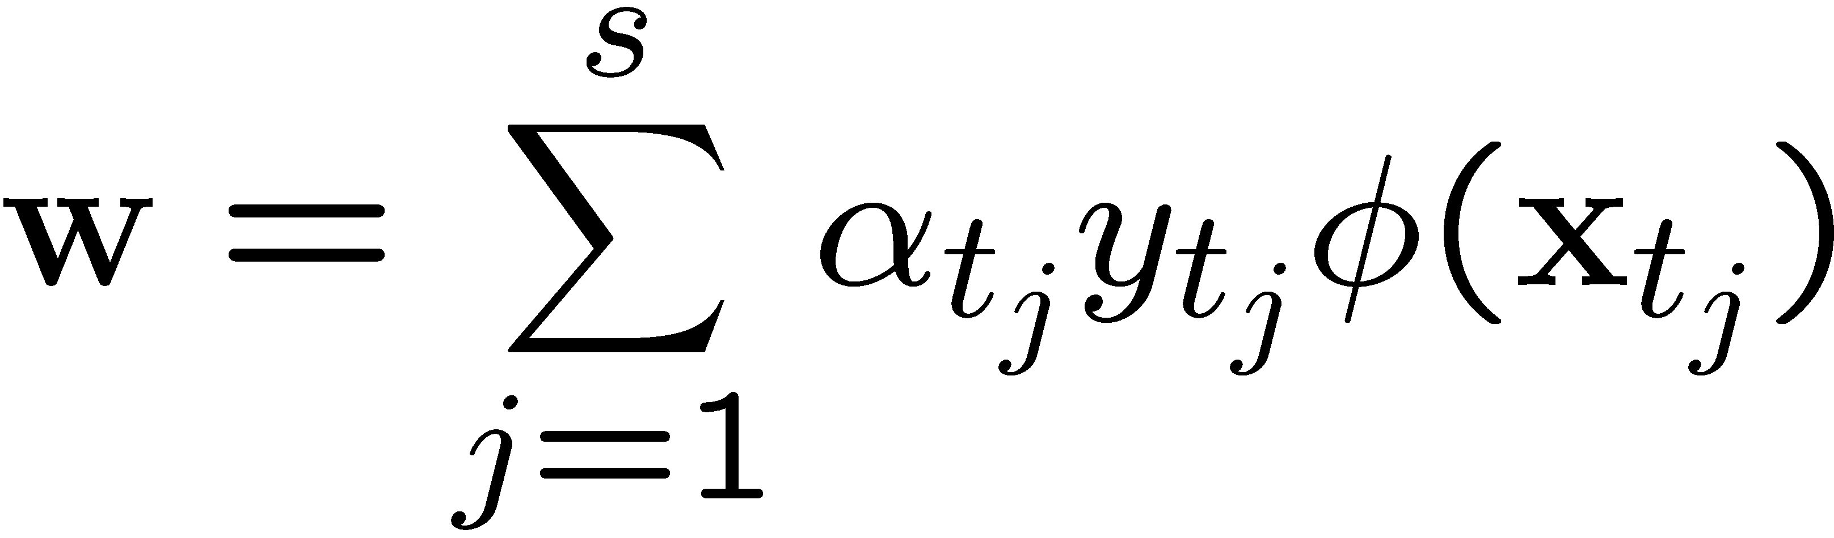
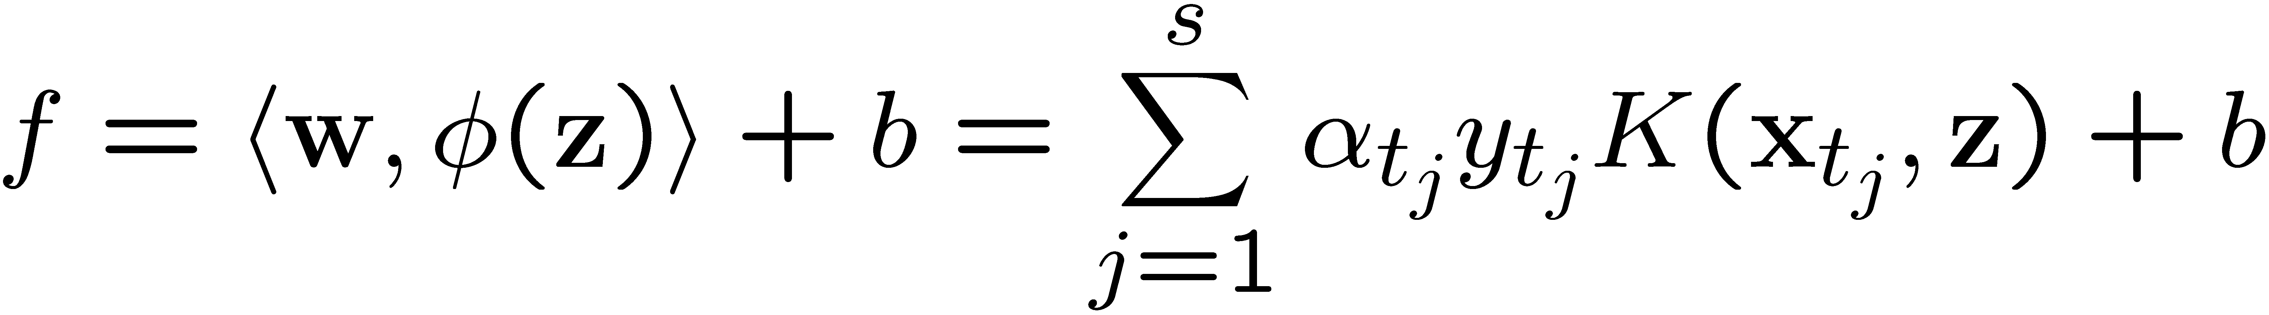
Modification Due to Kernel Function
For testing, the new data z is classified as class 1 if f ≥0, and as class 2 if f <0
Original
With kernel function

Slide 30
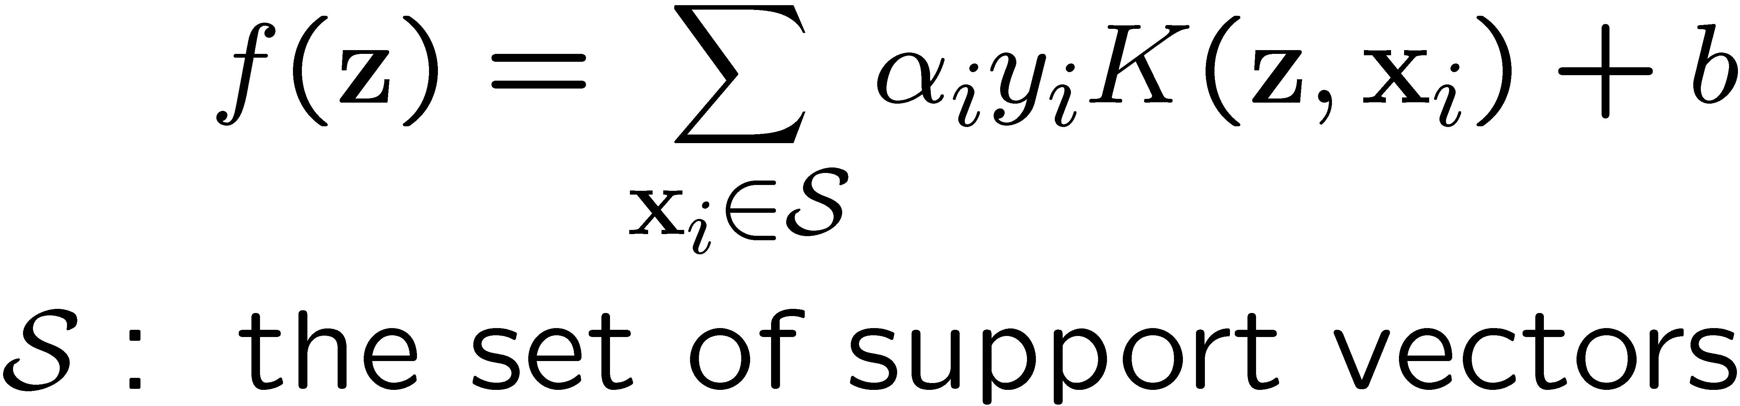
More on Kernel Functions
Since the training of SVM only requires the value of K(x_{i}, x_{j}), there is no restriction of the form of x_{i} and x_{j}
  x_{i} can be a sequence or a tree, instead of a feature vector
K(x_{i}, x_{j}) is just a similarity measure comparing x_{i} and x_{j}
For a test object z, the discriminat function essentially is a weighted sum of the similarity between z and a pre-selected set of objects (the support vectors)

Slide 31
Choosing the Kernel Function
Probably the most tricky part of using SVM.
The kernel function is important because it creates the kernel matrix, which summarizes all the data
Many principles have been proposed (diffusion kernel, Fisher kernel, string kernel, …)
There is even research to estimate the kernel matrix from available information
In practice, a low degree polynomial kernel or RBF kernel with a reasonable width is a good initial try
Note that SVM with RBF kernel is closely related to RBF neural networks, with the centers of the radial basis functions automatically chosen for SVM

Slide 32
Multi-class Classification
SVM is basically a two-class classifier
One can change the QP formulation to allow multi-class classification
More commonly, the data set is divided into two parts “intelligently” in different ways and a separate SVM is trained for each way of division
Multi-class classification is done by combining the output of all the SVM classifiers
  Majority rule
  Error correcting code
  Directed acyclic graph
Notes:
Multi-class classification is done by combining the output of all the SVM classifiers
Majority rule
Error correcting code
Directed acyclic graph

Slide 33
Software
A list of SVM implementation can be found at http://www.kernel-machines.org/software.html
Some implementations (such as LIBSVM) can handle multi-class classification
SVMLight is among one of the earliest implementation of SVM
Several Matlab toolboxes for SVM are also available

Slide 34
Summary: Steps for SVM Classification
Prepare the pattern matrix
Select the kernel function to use
Select the parameter of the kernel function and the value of C
  You can use the values suggested by the SVM software, or you can set apart a validation set to determine the values of the parameter
Execute the training algorithm and obtain the α_{i}
Unseen data can be classified using the α_{i} and the support vectors

Slide 35
Strengths and Weaknesses of SVM
Strengths
  Training is relatively easy
    No local optimal, unlike in neural networks
  It scales relatively well to high dimensional data
  Tradeoff between classifier complexity and error can be controlled explicitly
  Non-traditional data like strings and trees can be used as input to SVM, instead of feature vectors
  Inherent feature selection capability
Weaknesses
  Need to choose a “good” kernel function.

Slide 36
Other Types of Kernel Methods
A lesson learnt in SVM: a linear algorithm in the feature space is equivalent to a non-linear algorithm in the input space
Standard linear algorithms can be generalized to its non-linear version by going to the feature space
  Kernel principal component analysis, kernel independent component analysis, kernel canonical correlation analysis, kernel k-means, 1-class SVM are some examples

Slide 37
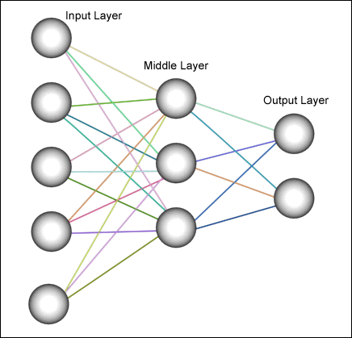
Comparing ANN and SVM
Learn a non-linear classifier with non-linear decision boundary: →very hard optimization problem
Map input to high-dimension space and train a simple linear classifier → no local optima issue.

Slide 38
Conclusion
SVM is a useful alternative to neural networks
Two key concepts of SVM: maximize the margin and the kernel trick
Many SVM implementations are available on the web for you to try on your data set!

Slide 39
Resources
http://www.kernel-machines.org/
http://www.support-vector.net/
http://www.support-vector.net/icml-tutorial.pdf
http://www.kernel-machines.org/papers/tutorial-nips.ps.gz
http://www.clopinet.com/isabelle/Projects/SVM/applist.html

Slide 40
Slides Credits
Han. Textbook slides
Tan Textbook slides
Martin Law SVM slides, MSU
Andrew W. Moore, CMU

