Slide 1
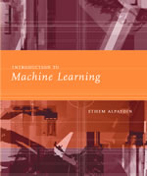
INTRODUCTION TO
Machine Learning
Lecture Slides for
ETHEM ALPAYDIN
© The MIT Press, 2004
alpaydin@boun.edu.tr
http://www.cmpe.boun.edu.tr/~ethem/i2ml

Slide 2
CHAPTER 14:
Assessing and Comparing Classification Algorithms

Slide 3
Introduction
Questions:
  Assessment of the expected error of a learning algorithm: Is the error rate of 1-NN less than 2%?
  Comparing the expected errors of two algorithms: Is k-NN more accurate than MLP ?
Training/validation/test sets
Resampling methods: K-fold cross-validation
Lecture Notes for E Alpaydın 2004 Introduction to Machine Learning © The MIT Press (V1.1)

Slide 4
Algorithm Preference
Criteria (Application-dependent):
  Misclassification error, or risk (loss functions)
  Training time/space complexity
  Testing time/space complexity
  Interpretability
  Easy programmability
Cost-sensitive learning
Lecture Notes for E Alpaydın 2004 Introduction to Machine Learning © The MIT Press (V1.1)

Slide 5
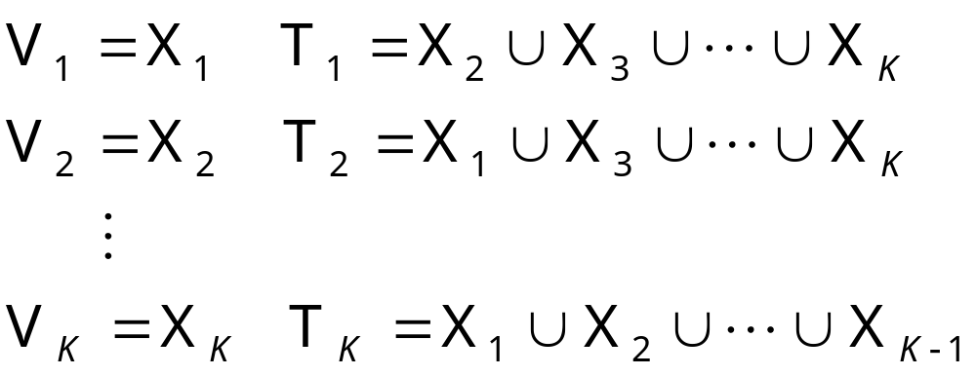
Resampling and
K-Fold Cross-Validation
The need for multiple training/validation sets
{X_{i},V_{i}}_{i}: Training/validation sets of fold i
K-fold cross-validation: Divide X into k, X_{i},i=1,...,K
T_{i} share K-2 parts
Lecture Notes for E Alpaydın 2004 Introduction to Machine Learning © The MIT Press (V1.1)

Slide 6
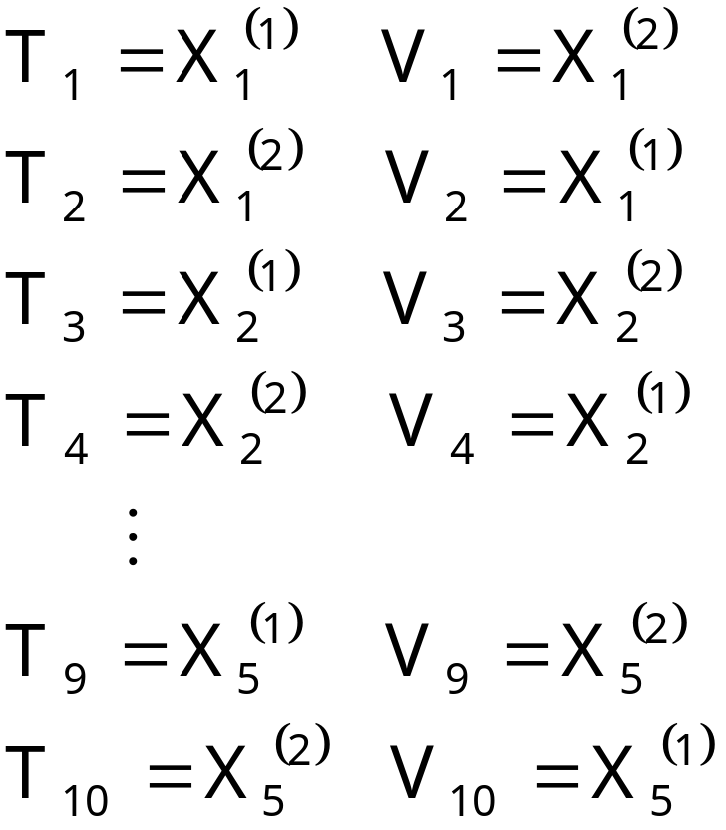
5×2 Cross-Validation
5 times 2 fold cross-validation (Dietterich, 1998)
Lecture Notes for E Alpaydın 2004 Introduction to Machine Learning © The MIT Press (V1.1)

Slide 7
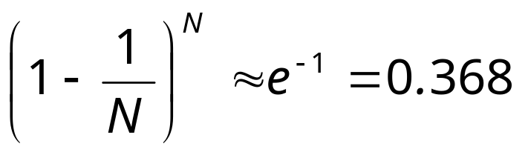
Bootstrapping
Draw instances from a dataset with replacement
Prob that we do not pick an instance after N draws
that is, only 36.8% is new!
Lecture Notes for E Alpaydın 2004 Introduction to Machine Learning © The MIT Press (V1.1)

Slide 8
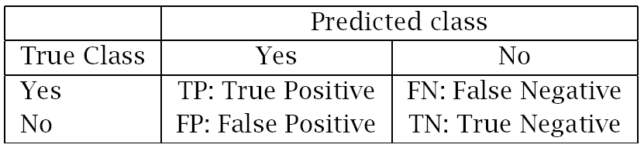
Measuring Error
Error rate = # of errors / # of instances = (FN+FP) / N
Recall = # of found positives / # of positives
= TP / (TP+FN) = sensitivity = hit rate
Precision = # of found positives / # of found
= TP / (TP+FP)
Specificity = TN / (TN+FP)
False alarm rate = FP / (FP+TN) = 1 - Specificity
Lecture Notes for E Alpaydın 2004 Introduction to Machine Learning © The MIT Press (V1.1)

Slide 9
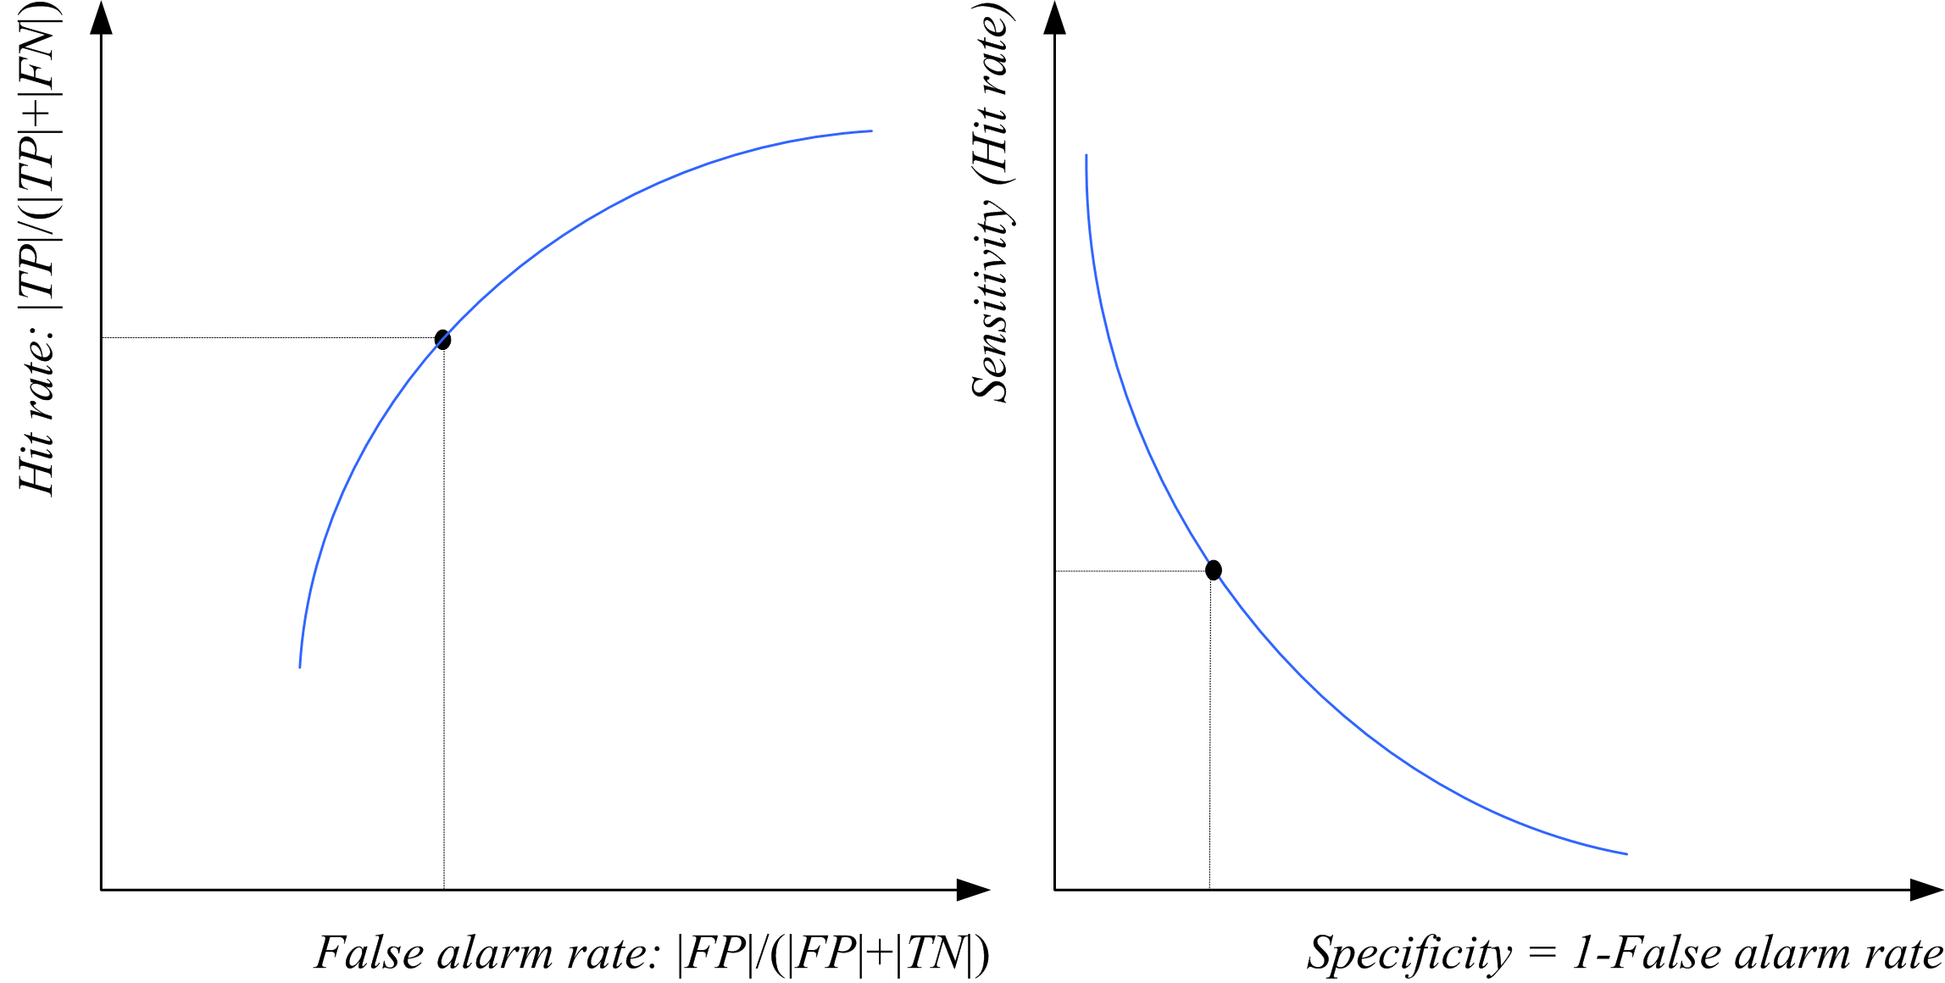
ROC Curve
Lecture Notes for E Alpaydın 2004 Introduction to Machine Learning © The MIT Press (V1.1)

Slide 10
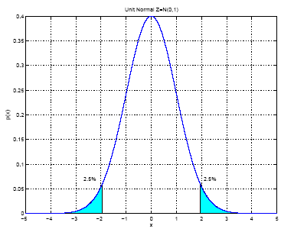
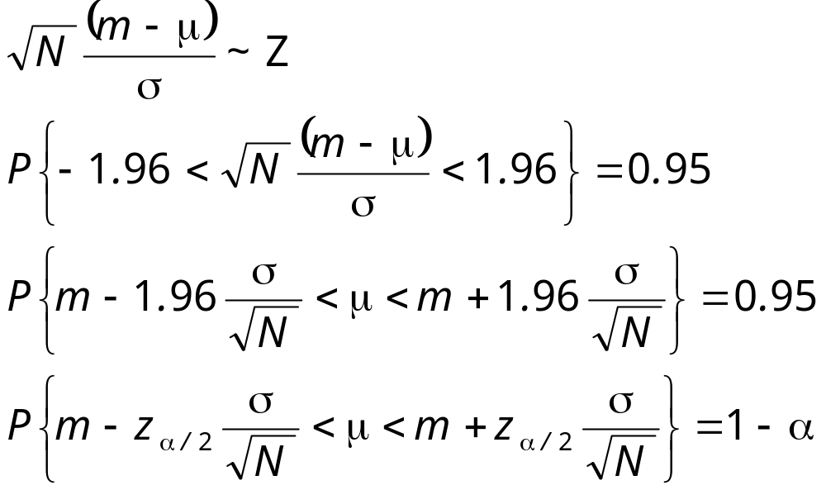
Interval Estimation
X = { x^{t} }_{t} where x^{t} ~ N ( μ, σ²)
m ~ N ( μ, σ²/N)
100(1- α) percent
confidence
interval
Lecture Notes for E Alpaydın 2004 Introduction to Machine Learning © The MIT Press (V1.1)

Slide 11
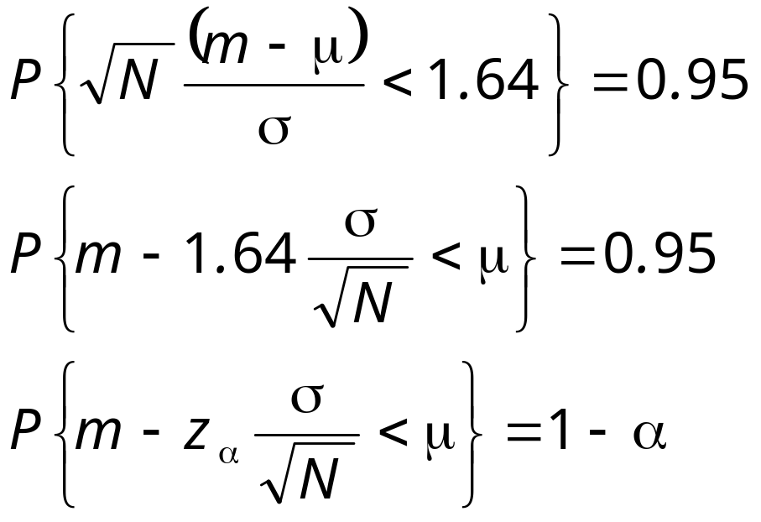
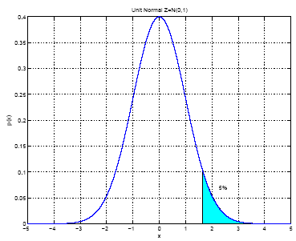
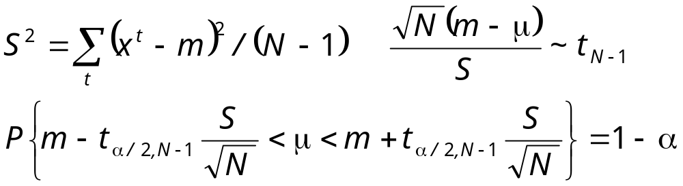
When σ² is not known:
Lecture Notes for E Alpaydın 2004 Introduction to Machine Learning © The MIT Press (V1.1)

Slide 12
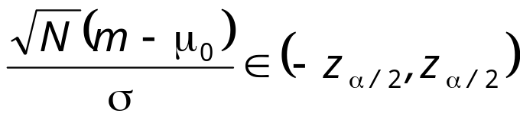
Hypothesis Testing
Reject a null hypothesis if not supported by the sample with enough confidence
X = { x^{t} }_{t} where x^{t} ~ N ( μ, σ²)
H₀: μ = μ₀ vs. H₁: μ ≠ μ₀
Accept H₀ with level of significance α if μ₀ is in the 100(1- α) confidence interval
Two-sided test
Lecture Notes for E Alpaydın 2004 Introduction to Machine Learning © The MIT Press (V1.1)

Slide 13
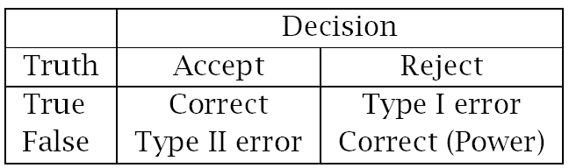
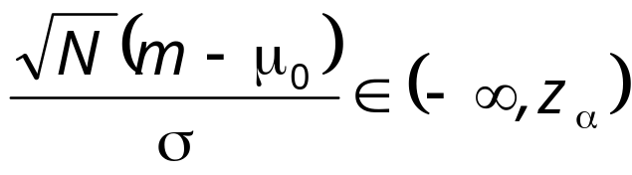
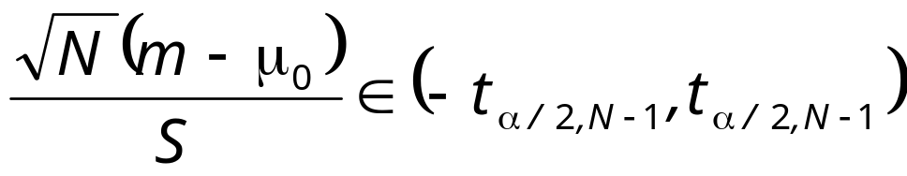
One-sided test: H₀: μ ≤ μ₀ vs. H₁: μ > μ₀
Accept if
Variance unknown: Use t, instead of z
Accept H₀: μ = μ₀ if
Lecture Notes for E Alpaydın 2004 Introduction to Machine Learning © The MIT Press (V1.1)

Slide 14
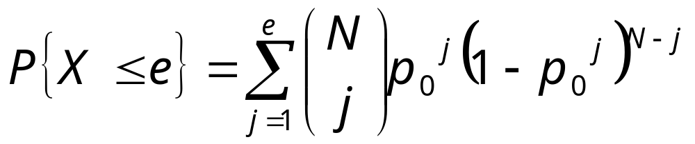
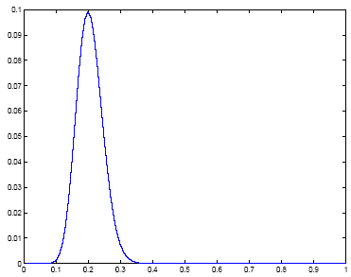
Assessing Error:
H₀: p ≤ p₀ vs. H₁: p > p₀
Single training/validation set: Binomial Test
If error prob is p₀, prob that there are e errors or less in N validation trials is
Accept if this prob is less than 1- α
1- α
N=100, e=20
Lecture Notes for E Alpaydın 2004 Introduction to Machine Learning © The MIT Press (V1.1)

Slide 15
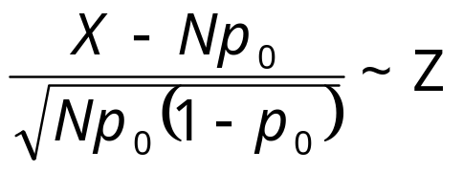
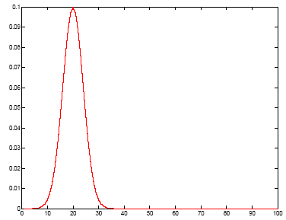
Normal Approximation to the Binomial
Number of errors X is approx N with mean Np₀ and var Np₀(1-p₀)
Accept if this prob for X = e is
less than z_{1-α}
1- α
Lecture Notes for E Alpaydın 2004 Introduction to Machine Learning © The MIT Press (V1.1)

Slide 16
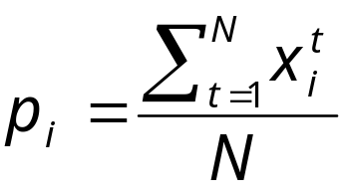
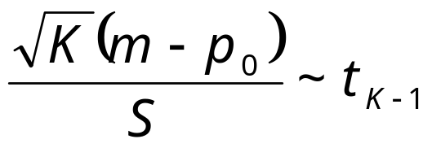
Paired t Test
Multiple training/validation sets
x^{t}_{i} = 1 if instance t misclassified on fold i
Error rate of fold i:
With m and s² average and var of p_{i}
we accept p₀ or less error if
is less than t_{α,K-1}
Lecture Notes for E Alpaydın 2004 Introduction to Machine Learning © The MIT Press (V1.1)

Slide 17
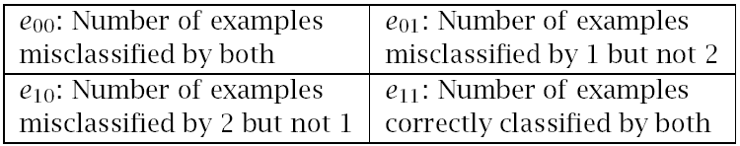
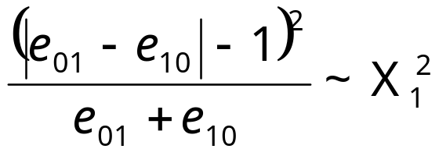
Comparing Classifiers:
H₀: μ₀ = μ₁ vs. H₁: μ₀ ≠ μ₁
Single training/validation set: McNemar’s Test
Under H₀, we expect e₀₁= e₁₀=(e₀₁+ e₁₀)/2
Accept if < X²_{α,1}
Lecture Notes for E Alpaydın 2004 Introduction to Machine Learning © The MIT Press (V1.1)

Slide 18
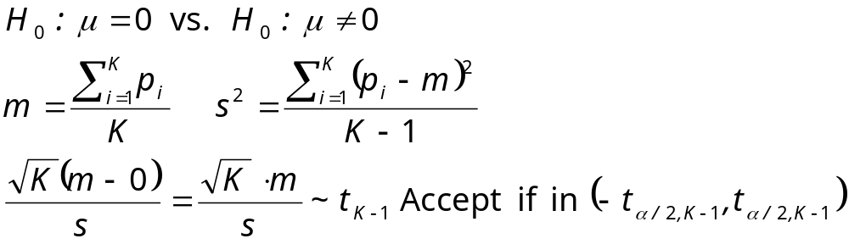
K-Fold CV Paired t Test
Use K-fold cv to get K training/validation folds
p_{i}¹, p_{i}²: Errors of classifiers 1 and 2 on fold i
p_{i} = p_{i}¹ – p_{i}² : Paired difference on fold i
The null hypothesis is whether p_{i} has mean 0
Lecture Notes for E Alpaydın 2004 Introduction to Machine Learning © The MIT Press (V1.1)

Slide 19
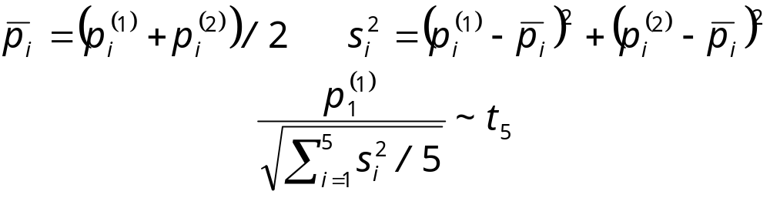
5×2 cv Paired t Test
Use 5×2 cv to get 2 folds of 5 tra/val replications (Dietterich, 1998)
p_{i}^{(j)} : difference btw errors of 1 and 2 on fold j=1, 2 of replication i=1,...,5
Two-sided test: Accept H₀: μ₀ = μ₁ if in (-t_{α/2,5},t_{α/2,5})
One-sided test: Accept H₀: μ₀ ≤ μ₁ if < t_{α,5}
Lecture Notes for E Alpaydın 2004 Introduction to Machine Learning © The MIT Press (V1.1)

Slide 20
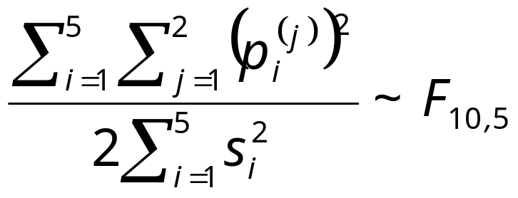
5×2 cv Paired F Test
Two-sided test: Accept H₀: μ₀ = μ₁ if < F_{α,10,5}
Lecture Notes for E Alpaydın 2004 Introduction to Machine Learning © The MIT Press (V1.1)

Slide 21
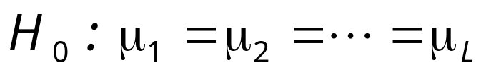

Comparing L>2 Algorithms: Analysis of Variance (Anova)
Errors of L algorithms on K folds
We construct two estimators to σ² .
One is valid if H₀ is true, the other is always valid.
We reject H₀ if the two estimators disagree.
Lecture Notes for E Alpaydın 2004 Introduction to Machine Learning © The MIT Press (V1.1)

Slide 22
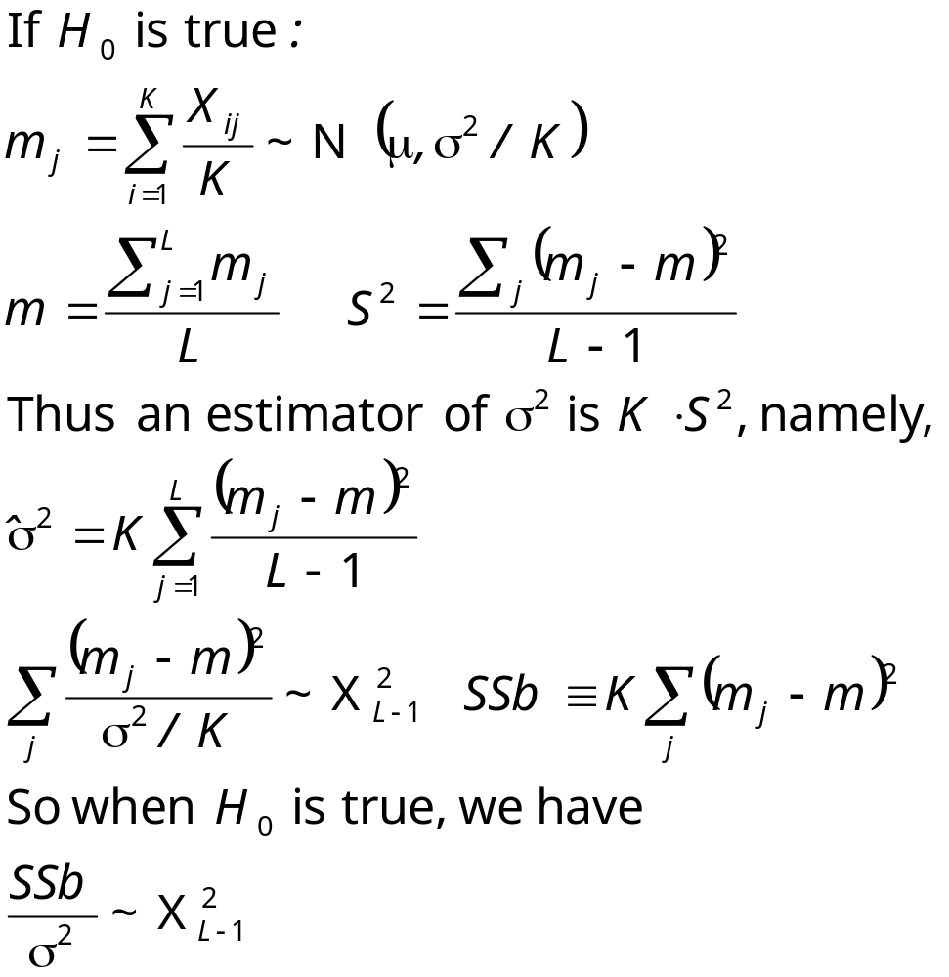
Lecture Notes for E Alpaydın 2004 Introduction to Machine Learning © The MIT Press (V1.1)

Slide 23
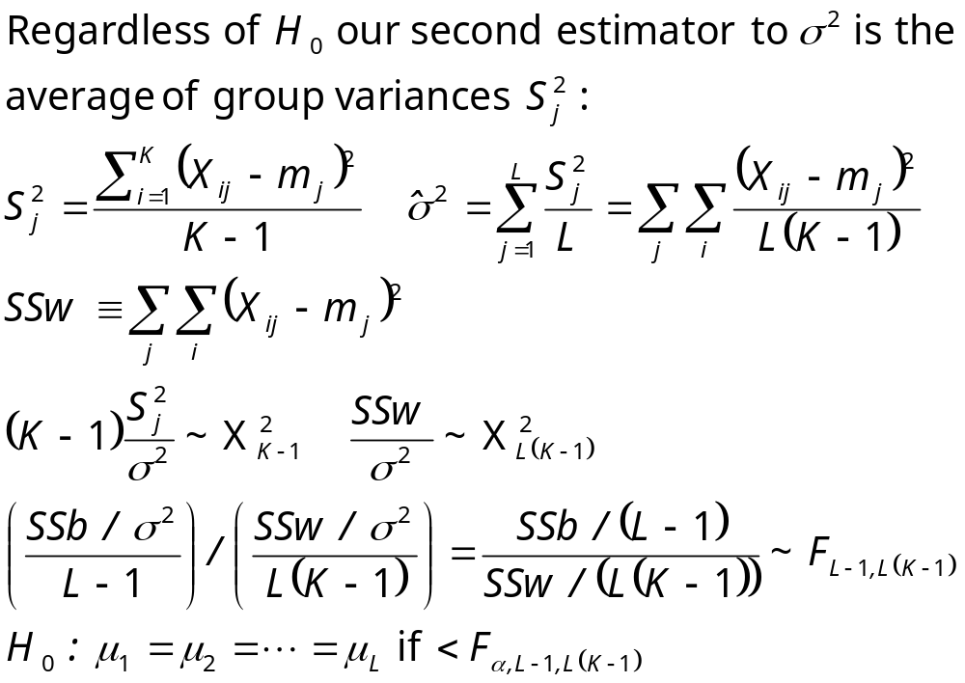
Lecture Notes for E Alpaydın 2004 Introduction to Machine Learning © The MIT Press (V1.1)

Slide 24

Other Tests
Range test (Newman-Keuls):
Nonparametric tests (Sign test, Kruskal-Wallis)
Contrasts: Check if 1 and 2 differ from 3,4, and 5
Multiple comparisons require Bonferroni correction If there are m tests, to have an overall significance of α, each test should have a significance of α/m.
Regression: CLT states that the sum of iid variables from any distribution is approximately normal and the preceding methods can be used.
Other loss functions ?
Lecture Notes for E Alpaydın 2004 Introduction to Machine Learning © The MIT Press (V1.1)

