Slide 1
CSCE833 Machine Learning
Lecture 15
Hidden Markov Models
Dr. Jianjun Hu
mleg.cse.sc.edu/edu/csce833
University of South Carolina
Department of Computer Science and Engineering

Slide 2
Outline
Evaluation problem of HMM
Decoding problem of HMM
Learning problem of HMM
  A multi-million dollar algorithm—viterbi algorithm

Slide 3
Main issues using HMMs :
Evaluation problem. Given the HMM M=(A, B, π) and the observation sequence O=o₁ o₂ ... o_{K} , calculate the probability that model M has generated sequence O .
Decoding problem. Given the HMM M=(A, B, π) and the observation sequence O=o₁ o₂ ... o_{K} , calculate the most likely sequence of hidden states s_{i} that produced this observation sequence O.
Learning problem. Given some training observation sequences O=o₁ o₂ ... o_{K} and general structure of HMM (numbers of hidden and visible states), determine HMM parameters M=(A, B, π) that best fit training data.
O=o₁...o_{K} denotes a sequence of observations o_{k}∈{v₁,…,v_{M}}.

Slide 4
Word recognition example(1).
Typed word recognition, assume all characters are separated.
Amherst
Character recognizer outputs probability of the image being particular character, P(image|character).
a
0.5
b
0.03
c
A
0.005
z
0.31
Hidden state Observation

Slide 5
Word recognition example(2).
If lexicon is given, we can construct separate HMM models for each lexicon word.
Amherst
a
m
h
e
r
s
t
Buffalo
b
u
f
f
a
l
o
0.5
0.03
0.4
0.6
A
m
Here recognition of word image is equivalent to the problem of evaluating few HMM models.
This is an application of Evaluation problem.

Slide 6
Word recognition example(3).
We can construct a single HMM for all words.
Hidden states = all characters in the alphabet.
Transition probabilities and initial probabilities are calculated from language model.
Observations and observation probabilities are as before.
a
m
r
f
t
o
b
h
v
e
s
Here we have to determine the best sequence of hidden states, the one that most likely produced word image.
This is an application of Decoding problem.

Slide 7
Evaluation Problem.
Evaluation problem. Given the HMM M=(A, B, π) and the observation sequence O=o₁ o₂ ... o_{K} , calculate the probability that model M has generated sequence O .
Trying to find probability of observations O=o₁ o₂ ... o_{K} by means of considering all hidden state sequences (as was done in example) is impractical:
N^{K} hidden state sequences - exponential complexity.
Use Forward-Backward HMM algorithms for efficient calculations. (Dynamic programming!)
Define the forward variable α_{k}(i) as the joint probability of the partial observation sequence o₁ o₂ ... o_{k} and that the hidden state at time k is s_{i} : α_{k}(i)= P(o₁ o₂ ... o_{k ,} q_{k}= s_{i} )

Slide 8
Trellis representation of an HMM
o₁ o_{k} o_{k+1} o_{K} = Observations
s₁
s₁
s₁
s₁
s₂
s₂
a_{1j}
s₂
s₂
a_{2j}
s_{i}
s_{i}
s_{j}
s_{i}
a_{ij}
a_{Nj}
s_{N}
s_{N}
s_{N}
s_{N}
Time= 1 k k+1 K

Slide 9
Forward recursion for HMM
Initialization:
α₁(i)= P(o_{1 ,} q₁= s_{i} ) = π_{i} b_{i} (o₁) , 1<=i<=N.
Forward recursion:
α_{k+1}(i)= P(o₁ o₂ ... o_{k+1 ,} q_{k+1}= s_{j} ) =
Σ_{i} P(o₁ o₂ ... o_{k+1 ,} q_{k}= s_{i ,} q_{k+1}= s_{j} ) =
Σ_{i} P(o₁ o₂ ... o_{k ,} q_{k}= s_{i}) a_{ij} b_{j} (o_{k+1} ) =
[Σ_{i} α_{k}(i) a_{ij} ] b_{j} (o_{k+1} ) , 1<=j<=N, 1<=k<=K-1.
Termination:
P(o₁ o₂ ... o_{K}) = Σ_{i} P(o₁ o₂ ... o_{K ,} q_{K}= s_{i}) = Σ_{i} α_{K}(i)
Complexity :
N²K operations.

Slide 10
Trellis representation of an HMM
o₁ o_{k} o_{k+1} o_{K} = Observations
s₁
s₁
s₁
s₁
s₂
s₂
a_{j1}
s₂
s₂
a_{j2}
s_{i}
s_{j}
s_{i}
s_{i}
a_{ji}
a_{jN}
s_{N}
s_{N}
s_{N}
s_{N}
Time= 1 k k+1 K

Slide 11
Backward recursion for HMM
Define the forward variable β_{k}(i) as the joint probability of the partial observation sequence o_{k+1} o_{k+2} ... o_{K} given that the hidden state at time k is s_{i} : β_{k}(i)= P(o_{k+1} o_{k+2} ... o_{K} |q_{k}= s_{i} )
Initialization:
β_{K}(i)= 1 , 1<=i<=N.
Backward recursion:
β_{k}(j)= P(o_{k+1} o_{k+2} ... o_{K} | q_{k}= s_{j} ) =
Σ_{i} P(o_{k+1} o_{k+2} ... o_{K ,} q_{k+1}= s_{i} | q_{k}= s_{j} ) =
Σ_{i} P(o_{k+2} o_{k+3} ... o_{K} | q_{k+1}= s_{i}) a_{ji} b_{i} (o_{k+1} ) =
Σ_{i} β_{k+1}(i) a_{ji} b_{i} (o_{k+1} ) , 1<=j<=N, 1<=k<=K-1.
Termination:
P(o₁ o₂ ... o_{K}) = Σ_{i} P(o₁ o₂ ... o_{K ,} q₁= s_{i}) =
Σ_{i} P(o₁ o₂ ... o_{K} |q₁= s_{i}) P(q₁= s_{i}) = Σ_{i} β₁(i) b_{i} (o₁) π_{i}

Slide 12
Decoding problem
Decoding problem. Given the HMM M=(A, B, π) and the observation sequence O=o₁ o₂ ... o_{K} , calculate the most likely sequence of hidden states s_{i} that produced this observation sequence.
We want to find the state sequence Q= q₁…q_{K} which maximizes P(Q | o₁ o₂ ... o_{K} ) , or equivalently P(Q , o₁ o₂ ... o_{K} ) .
Brute force consideration of all paths takes exponential time. Use efficient Viterbi algorithm instead.
Define variable δ_{k}(i) as the maximum probability of producing observation sequence o₁ o₂ ... o_{k} when moving along any hidden state sequence q₁… q_{k-1} and getting into q_{k}= s_{i} .
δ_{k}(i) = max P(q₁… q_{k-1} , q_{k}= s_{i} , o₁ o₂ ... o_{k})
where max is taken over all possible paths q₁… q_{k-1} .

Slide 13

Andrew Viterbi
In 1967 he invented the Viterbi algorithm, which he used for decoding convolutionally encoded data. It is still used widely in cellular phones for error correcting codes, as well as for speech recognition, DNA analysis, and many other applications of Hidden Markov models
In September 2008, he was awarded the National Medal of Science for developing "the 'Viterbi algorithm,' and for his contributions to Code Division Multiple Access (CDMA) wireless technology that transformed the theory and practice of digital communications."

Slide 14
Viterbi algorithm (1)
General idea:
if best path ending in q_{k}= s_{j} goes through q_{k-1}= s_{i} then it should coincide with best path ending in q_{k-1}= s_{i} .
q_{k-1} q_{k}
s₁
a_{1j}
s_{i}
s_{j}
a_{ij}
s_{N}
a_{Nj}
δ_{k}(i) = max P(q₁… q_{k-1} , q_{k}= s_{j} , o₁ o₂ ... o_{k}) =
max_{i} [ a_{ij} b_{j} (o_{k} ) max P(q₁… q_{k-1}= s_{i} , o₁ o₂ ... o_{k-1}) ]
To backtrack best path keep info that predecessor of s_{j} was s_{i}.

Slide 15
Viterbi algorithm (2)
Initialization:
δ₁(i) = max P(q₁= s_{i} , o₁) = π_{i} b_{i} (o₁) , 1<=i<=N.
Forward recursion:
δ_{k}(j) = max P(q₁… q_{k-1} , q_{k}= s_{j} , o₁ o₂ ... o_{k}) =
max_{i} [ a_{ij} b_{j} (o_{k} ) max P(q₁… q_{k-1}= s_{i} , o₁ o₂ ... o_{k-1}) ] =
max_{i} [ a_{ij} b_{j} (o_{k} ) δ_{k-1}(i) ] , 1<=j<=N, 2<=k<=K.
Termination: choose best path ending at time K
max_{i} [ δ_{K}(i) ]
Backtrack best path.
This algorithm is similar to the forward recursion of evaluation problem, with Σ replaced by max and additional backtracking.

Slide 16
Learning problem (1)
Learning problem. Given some training observation sequences O=o₁ o₂ ... o_{K} and general structure of HMM (numbers of hidden and visible states), determine HMM parameters M=(A, B, π) that best fit training data, that is maximizes P(O | M) .
There is no algorithm producing optimal parameter values.

Slide 17
Learning problem (2)
If training data has information about sequence of hidden states (as in word recognition example), then use maximum likelihood estimation of parameters:
a_{ij}= P(s_{i} | s_{j}) =
Number of transitions from state s_{j} to state s_{i}
Number of transitions out of state s_{j}
Number of times observation v_{m} occurs in state s_{i}
Number of times in state s_{i}
b_{i}(v_{m} ) = P(v_{m} | s_{i})=
The state sequence is generated by Viterbi algoritm

Slide 18
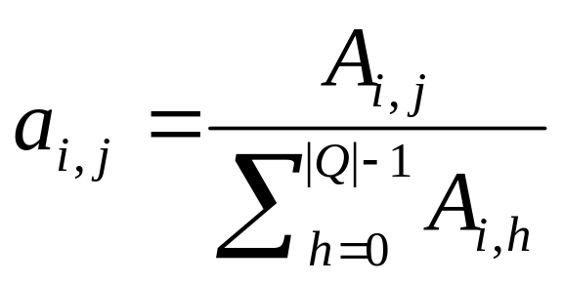
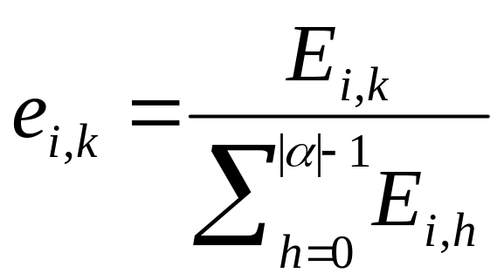

Example: Training Unambiguous Models
CGATATTCGATTCTACGCGCGTATACTAGCTTATCTGATC 011111112222222111111222211111112222111110
 |  | to state
 |  | 0 | 1 | 2
from state | 0 | 0 (0%) | 1 (100%) | 0 (0%)
 | 1 | 1 (4%) | 21 (84%) | 3 (12%)
 | 2 | 0 (0%) | 3 (20%) | 12 (80%)
transitions
 |  | symbol
 |  | A | C | G | T
in state | 1 | 6 (24%) | 7 (28%) | 5 (20%) | 7 (28%)
 | 2 | 3 (20%) | 3 (20%) | 2 (13%) | 7 (47%)
emissions

Slide 19
HMM Training Ambiguous Models
The Problem:
We have training sequences, but not the associated paths (state labels)
Two Solutions:
  1. Viterbi Training: Start with random HMM parameters. Use Viterbi to find the most probable path for each training sequence, and then label the sequence with that path. Use labeled sequence training on the resulting set of sequences and paths.
  2. Baum-Welch Training: sum over all possible paths (rather than the single most probable one) to estimate expected counts A_{i, j} and E_{i,k}; then use the same formulas as for labeled sequence training on these expected counts:

Slide 20
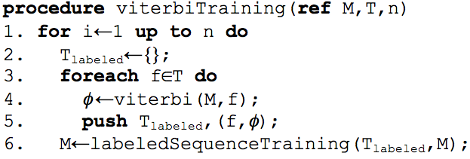
Viterbi Training
training
features
initial submodel M
Labeled
Sequence
Trainer
final submodel M *
Viterbi
Decoder
Sequence
Labeler
paths {φ_{i}}
labeled features
new submodel M ′
repeat n times
(iterate over the training sequences)
(find most probable path for this sequence)
(label the sequence with that path)

Slide 21
Baum-Welch algorithm
General idea:
Expected number of transitions from state s_{j} to state s_{i}
Expected number of transitions out of state s_{j}
a_{ij}= P(s_{i} | s_{j}) =
Expected number of times observation v_{m} occurs in state s_{i}
Expected number of times in state s_{i}
b_{i}(v_{m} ) = P(v_{m} | s_{i})=
π_{i} = P(s_{i}) = Expected frequency in state s_{i} at time k=1.

Slide 22
Trellis representation of an HMM
o₁ o_{k} o_{k+1} o_{K} = Observations
s₁
s₁
s₁
s₁
s₂
s₂
s₂
s₂
β_{k+1}(j)
α_{k}(i)
s_{i}
s_{i}
s_{j}
s_{i}
a_{ij}
s_{N}
s_{N}
s_{N}
s_{N}
Time= 1 k k+1 K

Slide 23
Baum-Welch algorithm: expectation step(1)
Define variable ξ_{k}(i,j) as the probability of being in state s_{i} at time k and in state s_{j} at time k+1, given the observation sequence o₁ o₂ ... o_{K} .
ξ_{k}(i,j)= P(q_{k}= s_{i} , q_{k+1}= s_{j} | o₁ o₂ ... o_{K})
P(q_{k}= s_{i} , q_{k+1}= s_{j} , o₁ o₂ ... o_{k})
P(o₁ o₂ ... o_{k})
ξ_{k}(i,j)=
=
P(q_{k}= s_{i} , o₁ o₂ ... o_{k}) a_{ij} b_{j} (o_{k+1} ) P(o_{k+2} ... o_{K} | q_{k+1}= s_{j} )
P(o₁ o₂ ... o_{k})
=
α_{k}(i) a_{ij} b_{j} (o_{k+1} ) β_{k+1}(j)
Σ_{i} Σ_{j} α_{k}(i) a_{ij} b_{j} (o_{k+1} ) β_{k+1}(j)

Slide 24
Baum-Welch algorithm: expectation step(2)
Define variable γ_{k}(i) as the probability of being in state s_{i} at time k, given the observation sequence o₁ o₂ ... o_{K} .
γ_{k}(i)= P(q_{k}= s_{i} | o₁ o₂ ... o_{K})
P(q_{k}= s_{i} , o₁ o₂ ... o_{k})
P(o₁ o₂ ... o_{k})
α_{k}(i) β_{k}(i)
Σ_{i} α_{k}(i) β_{k}(i)
γ_{k}(i)=
=

Slide 25
Baum-Welch algorithm: expectation step(3)
We calculated ξ_{k}(i,j) = P(q_{k}= s_{i} , q_{k+1}= s_{j} | o₁ o₂ ... o_{K})
and γ_{k}(i)= P(q_{k}= s_{i} | o₁ o₂ ... o_{K})
Expected number of transitions from state s_{i} to state s_{j} =
= Σ_{k} ξ_{k}(i,j)
Expected number of transitions out of state s_{i} = Σ_{k} γ_{k}(i)
Expected number of times observation v_{m} occurs in state s_{i} =
= Σ_{k} γ_{k}(i) , k is such that o_{k}= v_{m}
Expected frequency in state s_{i} at time k=1 : γ₁(i) .

Slide 26
Baum-Welch algorithm: maximization step
Σ_{k} ξ_{k}(i,j)
Σ_{k} γ_{k}(i)
a_{ij} =
Expected number of transitions from state s_{j} to state s_{i}
Expected number of transitions out of state s_{j}
=
Σ_{k} ξ_{k}(i,j)
Σk,o_{k}= v_{m} γ_{k}(i)
b_{i}(v_{m} ) =
Expected number of times observation v_{m} occurs in state s_{i}
Expected number of times in state s_{i}
=
π_{i} = (Expected frequency in state s_{i} at time k=1) = γ₁(i).

Slide 27
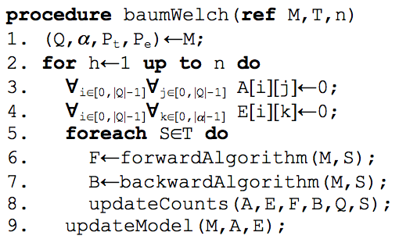
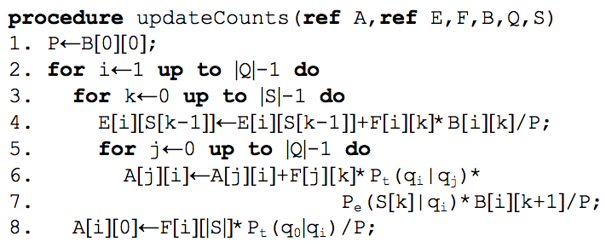


Baum-Welch Training
compute Fwd & Bkwd DP matrices
accumulate expected counts for E & A

