Slide 1
A Brief Introduction to Graphical Models
CSCE883 Machine Learning
University of South Carolina

Slide 2
Outline
Application
Definition
Representation
Inference and Learning
Conclusion

Slide 3
Application
Probabilistic expert system for medical diagnosis
Widely adopted by Microsoft
  e.g. the Answer Wizard of Office 95
  the Office Assistant of Office 97
  over 30 technical support troubleshooters

Slide 4
Application
Machine Learning
Statistics
Patten Recognition
Natural Language Processing
Computer Vision
Image Processing
Bio-informatics
…….

Slide 5
What causes grass wet?
Mr. Holmes leaves his house:
  the grass is wet in front of his house.
  two reasons are possible: either it rained or the sprinkler of Holmes has been on during the night.
Then, Mr. Holmes looks at the sky and finds it is cloudy:
  Since when it is cloudy, usually the sprinkler is off
  and it is more possible it rained.
  He concludes it is more likely that rain causes
  grass wet.

Slide 6
What causes grass wet?
Cloudy
P(S=T|C=T) P(R=T|C=T)
Sprinkler
Rain
WetGrass

Slide 7
Earthquake or burglary?
Mr. Holmes is in his office
  He receives a call from his neighbor that the alarm of his house went off.
  He thinks that somebody broke into his house.
Afterwards he hears an announcement from radio that a small earthquake just happened
  Since the alarm has been going off during an earthquake.
  He concludes it is more likely that earthquake causes the alarm.

Slide 8
Earthquake or burglary?
Burglary
Earthquake
Alarm
Newscast
Call

Slide 9
Graphical Model
Graphical Model:
+
Provides a natural tool for two problems:
Uncertainty and Complexity
Plays an important role in the design and analysis of machine learning algorithms
Probability Theory
Graph Theory

Slide 10
Graphical Model
Modularity: a complex system is built by combining simpler parts.
Probability theory: ensures consistency, provides interface models to data.
Graph theory: intuitively appealing interface for humans, efficient general purpose algorithms.

Slide 11
Graphical Model
Many of the classical multivariate probabilistic systems are special cases of the general graphical model formalism:
-Mixture models
-Factor analysis
-Hidden Markov Models
-Kalman filters
The graphical model framework provides a way to view all of these systems as instances of common underlying formalism.

Slide 12
Representation
Graphical representation of probabilistic relationship between a set of random variables.
Variables are represented by nodes.
  Binary events
  Discrete variables
  Continuous variables
x
Conditional (in)dependency is represented by (missing) edges.
y
Directed Graphical Model: (Bayesian network)
Undirected Graphical Model: (Markov Random Field)
Combined: chain graph
v
u

Slide 13
Bayesian Network
y₂
Y₃
Directed acyclic graphs (DAG).
Directed edge means causal dependencies.
For each variable X and parents pa(X) exists a conditional probability
  --P(X|pa(X))
Joint distribution
Parent
Y₁
X

Slide 14
Simple Case
  That means: the value of B depends on A
  Dependency is described by the conditional probability P(B|A)
  Knowledge about A: prior probability P(A)
  Thus computation of joint probability of A and B : P(A,B)=P(B|A)P(A)
A
B

Slide 15
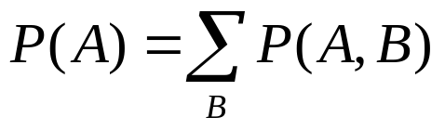
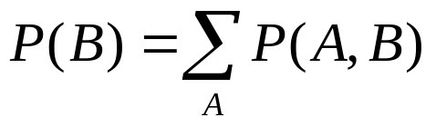
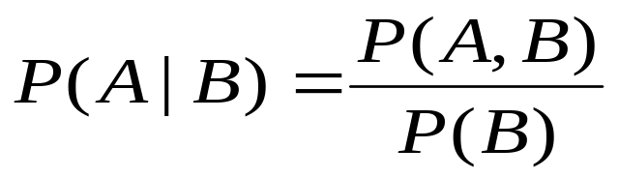
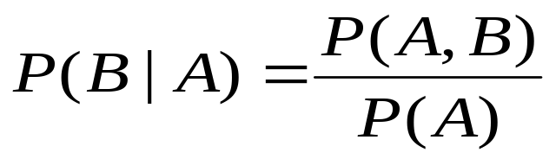
Simple Case
From the joint probability, we can derive all other probabilities:
  Marginalization: (sum rule)
  Conditional probabilities: (Bayesian Rule)

Slide 16
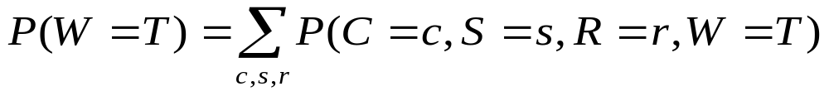
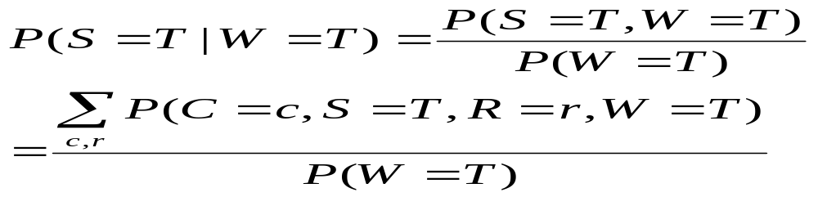
Simple Example
Cloudy
Sprinkler
Rain
WetGrass

Slide 17
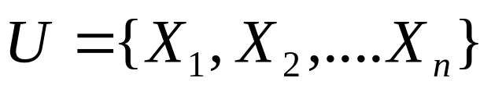
Bayesian Network
Variables:
The joint probability of P(U) is given by
If the variables are binary,
we need O(2^{n}) parameters to describe P
Can we do better?
Key idea: use properties of independence.

Slide 18

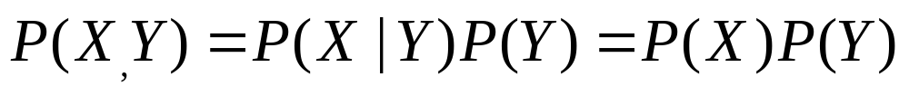
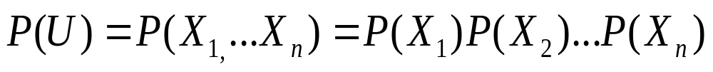
Independent Random Variables
X is independent of Y iif
for all values x,y
If X and Y are independent then
Unfortunately, most of random variables of interest are not independent of each other

Slide 19
Conditional Independence
A more suitable notion is that of conditional independence.
X and Y are conditional independent given Z iff
P(X=x|Y=y,Z=z)=P(X=x|Z=z) for all values x,y,z
notion: I(X,Y|Z)
P(X,Y,Z)=P(X|Y,Z)P(Y|Z)P(Z)=P(X|Z)P(Y|Z)P(Z)

Slide 20
Bayesian Network
Directed Markov Property:
Each random variable X, is
conditional independent of
its non-descendents,
given its parents Pa(X)
Formally,
P(X|NonDesc(X), Pa(X))=P(X|Pa(X))
Notation: I (X, NonDesc(X) | Pa(X))
Parent
Y₁
X
Y₂
Descendent
Y₃
Y₄
Non-descendent

Slide 21
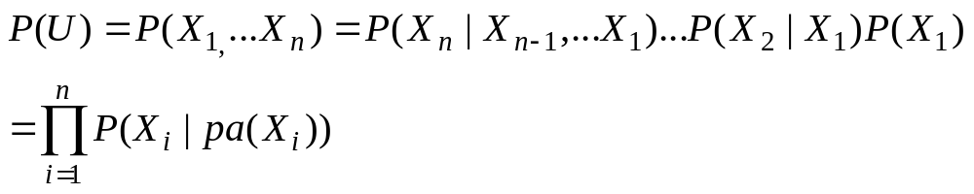
Bayesian Network
Factored representation of joint probability
  Variables:
  The joint probability of P(U) is given by
  the joint probability is product of all conditional probabilities

Slide 22
Bayesian Network
Complexity reduction
  Joint probability of n binary variables
  O(2^{n})
  Factorized form
  O(n*2^{k})
  K: maximal number of parents of a node

Slide 23
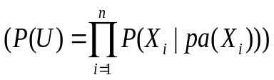
Simple Case
  Dependency is described by the conditional probability P(B|A)
  Knowledge about A: priori probability P(A)
  Calculate the joint probability of the A and B
  P(A,B)=P(B|A)P(A)
A
B

Slide 24
Serial Connection
  Calculate as before:
  --P(A,B)=P(B|A)P(A)
  --P(A,B,C)=P(C|A,B)P(A,B)
  =P(C|B)P(B|A)P(A)
  I(C,A|B).
A
B
C

Slide 25
Converging Connection
  Value of A depends on B and C:
  P(A|B,C)
  P(A,B,C)=P(A|B,C)P(B)P(C)
B
c
A

Slide 26
Diverging Connection
  B and C depend on A: P(B|A) and P(C|A)
  P(A,B,C)=P(B|A)P(C|A)P(A)
  I(B,C|A)
A
B
C

Slide 27
Wetgrass
Cloudy
P(C)
P(S|C) P(R|C)
P(W|S,R)
P(C,S,R,W)=P(W|S,R)P(R|C)P(S|C)P(C)
versus
P(C,S,R,W)=P(W|C,S,R)P(R|C,S)P(S|C)P(C)
Sprinkler
Rain
WetGrass

Slide 28
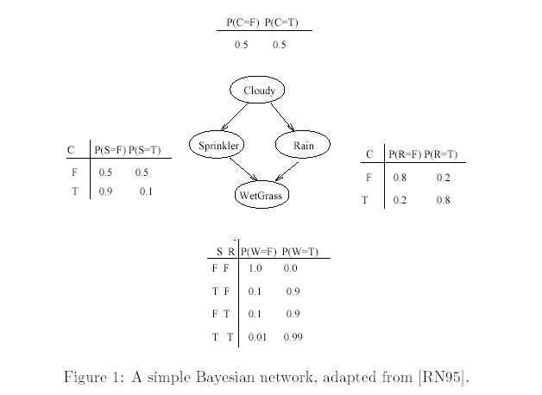

Slide 29
Markov Random Fields
Links represent symmetrical probabilistic dependencies
Direct link between A and B: conditional dependency.
Weakness of MRF: inability to represent induced dependencies.

Slide 30
Markov Random Fields
A
B
Global Markov property: x is independent of Y given Z iff all paths between X and Y are blocked by Z.
(here: A is independent of E, given C)
Local Markov property: X is independent of all other nodes given its neighbors.
(here: A is independent of D and E, given C and B
C
D
E

Slide 31
Inference
Computation of the conditional probability distribution of one set of nodes, given a model and another set of nodes.
Bottom-up
  Observation (leaves): e.g. wet grass
  The probabilities of the reasons (rain, sprinkler) can be calculated accordingly
  “diagnosis” from effects to reasons
Top-down
  Knowledge (e.g. “it is cloudy”) influences the probability
  for “wet grass”
  Predict the effects

Slide 32


Inference
Observe: wet grass (denoted by W=1)
  Two possible causes: rain or sprinkler
  Which is more likely?
  Using Bayes’ rule to compute the posterior probabilities of the reasons (rain, sprinkler)

Slide 33
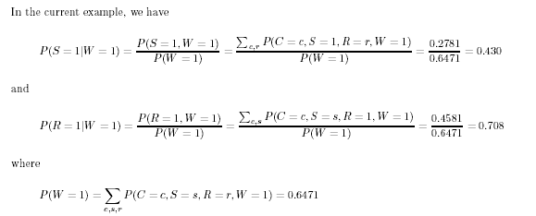
Inference

Slide 34
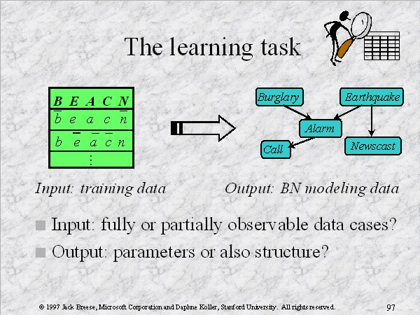
Learning

Slide 35
Learning
Learn parameters or structure from data
Parameter learning: find maximum likelihood estimates of parameters of each conditional probability distribution
Structure learning: find correct connectivity between existing nodes

Slide 36
Learning
Structure | Observation | Method
Known | Full | Maximum Likelihood (ML) estimation
Known | Partial | Expectation Maximization algorithm (EM)
Unknown | Full | Model selection
Unknown | Partial | EM + model selection

Slide 37
Model Selection Method
- Select a ‘good’ model from all possible models and use it as if it were the correct model
- Having defined a scoring function, a search algorithm is then used to find a network structure that receives the highest score fitting the prior knowledge and data
- Unfortunately, the number of DAG’s on n variables is super-exponential in n. The usual approach is therefore to use local search algorithms (e.g., greedy hill climbing) to search through the space of graphs.

Slide 38
The Bayes Net Toolbox for Matlab
What is BNT?
Why yet another BN toolbox?
Why Matlab?
An overview of BNT’s design
How to use BNT
Other GM projects

Slide 39
What is BNT?
BNT is an open-source collection of matlab functions for inference and learning of (directed) graphical models
Started in Summer 1997 (DEC CRL), development continued while at UCB
Over 100,000 hits and about 30,000 downloads since May 2000
About 43,000 lines of code (of which 8,000 are comments)

Slide 40
Why yet another BN toolbox?
In 1997, there were very few BN programs, and all failed to satisfy the following desiderata:
  Must support real-valued (vector) data
  Must support learning (params and struct)
  Must support time series
  Must support exact and approximate inference
  Must separate API from UI
  Must support MRFs as well as BNs
  Must be possible to add new models and algorithms
  Preferably free
  Preferably open-source
  Preferably easy to read/ modify
  Preferably fast
BNT meets all these criteria except for the last

Slide 41
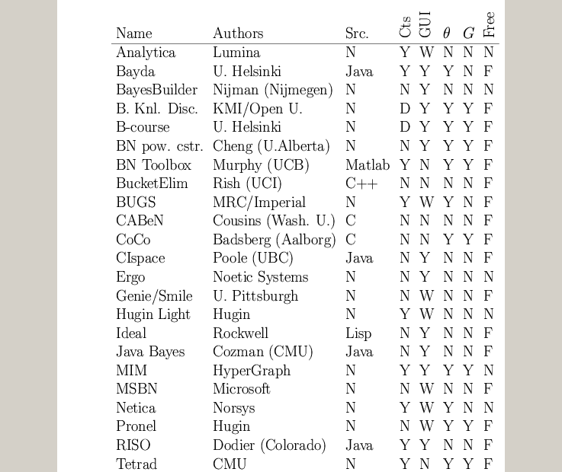
A comparison of GM software
www.ai.mit.edu/~murphyk/Software/Bayes/bnsoft.html

Slide 42
Summary of existing GM software
~8 commercial products (Analytica, BayesiaLab, Bayesware, Business Navigator, Ergo, Hugin, MIM, Netica), focused on data mining and decision support; most have free “student” versions
~30 academic programs, of which ~20 have source code (mostly Java, some C++/ Lisp)
Most focus on exact inference in discrete, static, directed graphs (notable exceptions: BUGS and VIBES)
Many have nice GUIs and database support
BNT contains more features than most of these packages combined!

Slide 43
Why Matlab?
Pros
  Excellent interactive development environment
  Excellent numerical algorithms (e.g., SVD)
  Excellent data visualization
  Many other toolboxes, e.g., netlab
  Code is high-level and easy to read (e.g., Kalman filter in 5 lines of code)
  Matlab is the lingua franca of engineers and NIPS
Cons:
  Slow
  Commercial license is expensive
  Poor support for complex data structures
Other languages I would consider in hindsight:
  Lush, R, Ocaml, Numpy, Lisp, Java

Slide 44
BNT’s class structure
Models – bnet, mnet, DBN, factor graph, influence (decision) diagram
CPDs – Gaussian, tabular, softmax, etc
Potentials – discrete, Gaussian, mixed
Inference engines
  Exact - junction tree, variable elimination
  Approximate - (loopy) belief propagation, sampling
Learning engines
  Parameters – EM, (conjugate gradient)
  Structure - MCMC over graphs, K2

Slide 45
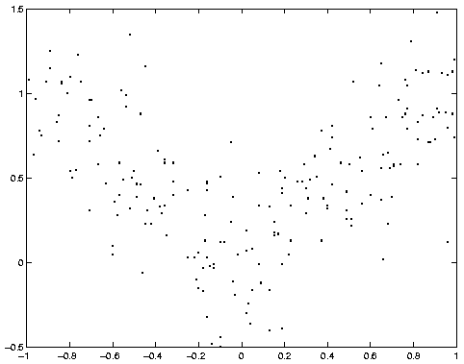
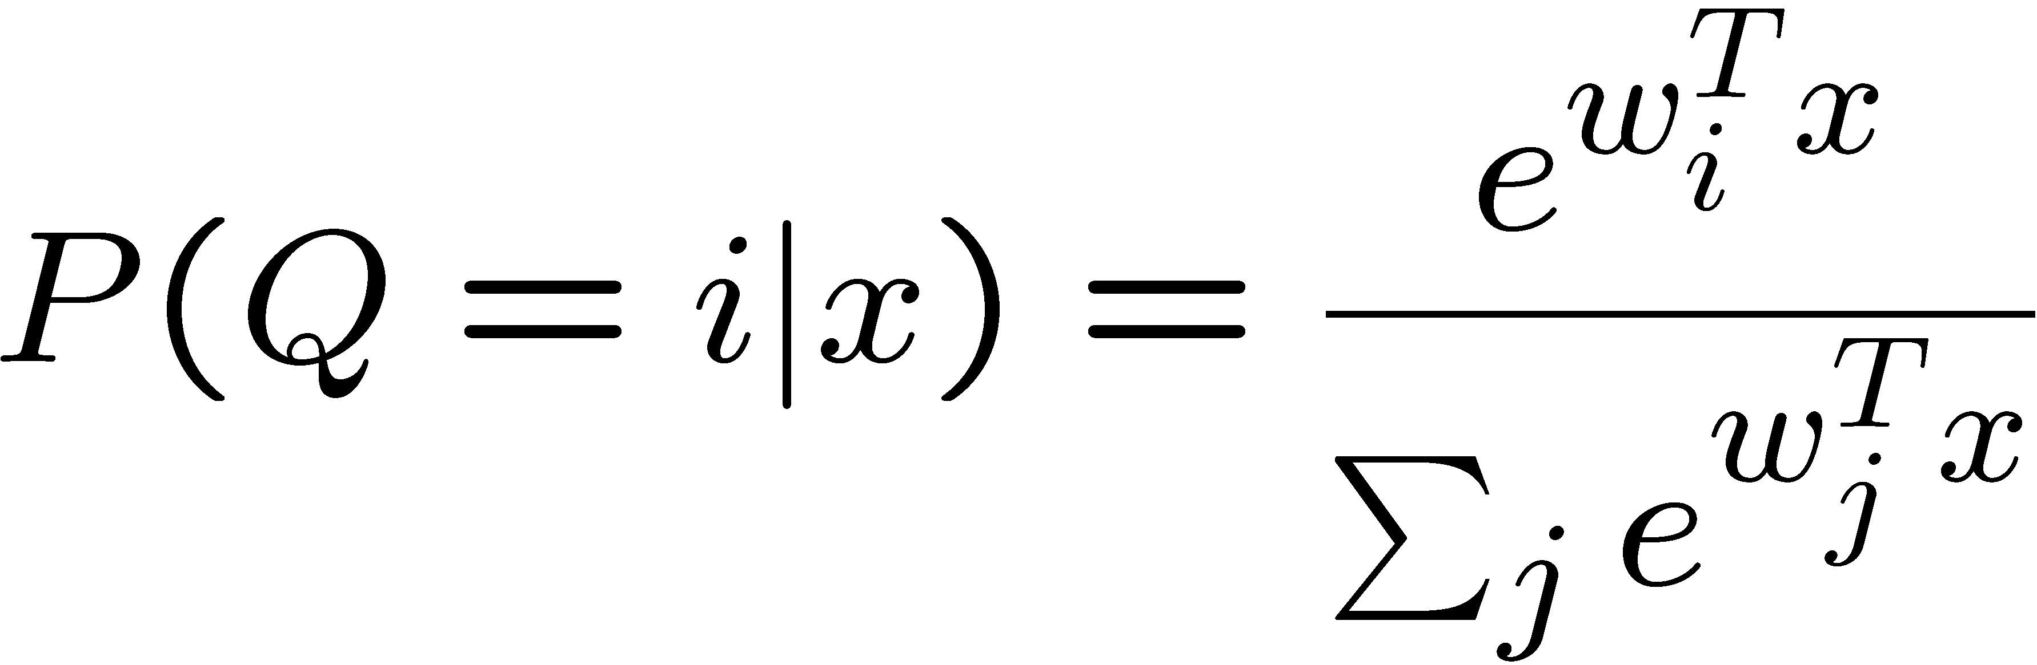
Example: mixture of experts
X
Q
Y
softmax/logistic function

Slide 46
1. Making the graph
X = 1; Q = 2; Y = 3;
dag = zeros(3,3);
dag(X, [Q Y]) = 1;
dag(Q, Y) = 1;
X
Q
Graphs are (sparse) adjacency matrices
GUI would be useful for creating complex graphs
Repetitive graph structure (e.g., chains, grids) is best
created using a script (as above)
Y

Slide 47
2. Making the model
X
node_sizes = [1 2 1];
dnodes = [2];
bnet = mk_bnet(dag, node_sizes, …
‘discrete’, dnodes);
Q
X is always observed input, hence only one effective value
Q is a hidden binary node
Y is a hidden scalar node
bnet is a struct, but should be an object
mk_bnet has many optional arguments, passed as string/value pairs
Y

Slide 48
3. Specifying the parameters
X
bnet.CPD{X} = root_CPD(bnet, X);
bnet.CPD{Q} = softmax_CPD(bnet, Q);
bnet.CPD{Y} = gaussian_CPD(bnet, Y);
Q
CPDs are objects which support various methods such as
  Convert_from_CPD_to_potential
  Maximize_params_given_expected_suff_stats
Each CPD is created with random parameters
Each CPD constructor has many optional arguments
Y

Slide 49
4. Training the model
X
load data –ascii;
ncases = size(data, 1);
cases = cell(3, ncases);
observed = [X Y];
cases(observed, :) = num2cell(data’);
Q
Y
Training data is stored in cell arrays (slow!), to allow for
variable-sized nodes and missing values
cases{i,t} = value of node i in case t
engine = jtree_inf_engine(bnet, observed);
Any inference engine could be used for this trivial model
bnet2 = learn_params_em(engine, cases);
We use EM since the Q nodes are hidden during training
learn_params_em is a function, but should be an object

Slide 50
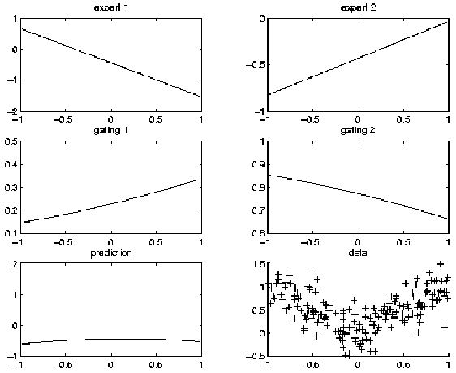
Before training

Slide 51
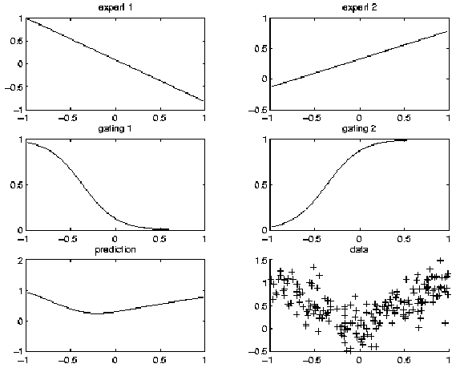
After training

Slide 52
5. Inference/ prediction
engine = jtree_inf_engine(bnet2);
evidence = cell(1,3);
evidence{X} = 0.68; % Q and Y are hidden
engine = enter_evidence(engine, evidence);
m = marginal_nodes(engine, Y);
m.mu % E[Y|X]
m.Sigma % Cov[Y|X]
X
Q
Y

Slide 53
Other kinds of models that BNT supports
Classification/ regression: linear regression, logistic regression, cluster weighted regression, hierarchical mixtures of experts, naïve Bayes
Dimensionality reduction: probabilistic PCA, factor analysis, probabilistic ICA
Density estimation: mixtures of Gaussians
State-space models: LDS, switching LDS, tree-structured AR models
HMM variants: input-output HMM, factorial HMM, coupled HMM, DBNs
Probabilistic expert systems: QMR, Alarm, etc.
Limited-memory influence diagrams (LIMID)
Undirected graphical models (MRFs)

Slide 54
Summary of BNT
Provides many different kinds of models/ CPDs – lego brick philosophy
Provides many inference algorithms, with different speed/ accuracy/ generality tradeoffs (to be chosen by user)
Provides several learning algorithms (parameters and structure)
Source code is easy to read and extend

Slide 55
What is wrong with BNT?
It is slow
It has little support for undirected models
Models are not bona fide objects
Learning engines are not objects
It does not support online inference/learning
It does not support Bayesian estimation
It has no GUI
It has no file parser
It is more complex than necessary

Slide 56
Some alternatives to BNT?
HUGIN: commercial
  Junction tree inference only, no support for DBNs
PNL: Probabilistic Networks Library (Intel)
  Open-source C++, based on BNT, work in progress (due 12/03)
GMTk: Graphical Models toolkit (Bilmes, Zweig/ UW)
  Open source C++, designed for ASR (HTK), binary avail now
AutoBayes: code generator (Fischer, Buntine/NASA Ames)
  Prolog generates matlab/C, not avail. to public
VIBES: variational inference (Winn / Bishop, U. Cambridge)
  conjugate exponential models, work in progress
BUGS: (Spiegelhalter et al., MRC UK)
  Gibbs sampling for Bayesian DAGs, binary avail. since ’96

Slide 57
Conclusion
A graphical representation of the probabilistic structure of a set of random variables, along with functions that can be used to derive the joint probability distribution.
Intuitive interface for modeling.
Modular: Useful tool for managing complexity.
Common formalism for many models.

