Slide 1
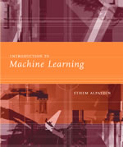
INTRODUCTION TO
Machine Learning
Lecture Slides for
ETHEM ALPAYDIN
© The MIT Press, 2004
alpaydin@boun.edu.tr
http://www.cmpe.boun.edu.tr/~ethem/i2ml

Slide 2
CHAPTER 4:
Parametric Methods

Slide 3
Parametric Estimation
X = { x^{t} }_{t} where x^{t} ~ p (x)
Parametric estimation:
  Assume a form for p (x | θ) and estimate θ, its sufficient statistics, using X
  e.g., N ( μ, σ²) where θ = { μ, σ²}
Lecture Notes for E Alpaydın 2004 Introduction to Machine Learning © The MIT Press (V1.1)

Slide 4
Maximum Likelihood Estimation
Likelihood of θ given the sample X
l (θ|X) = p (X |θ) = ∏_{t} p (x^{t}|θ)
Log likelihood
L(θ|X) = log l (θ|X) = ∑_{t} log p (x^{t}|θ)
Maximum likelihood estimator (MLE)
θ* = argmax_{θ} L(θ|X)
Lecture Notes for E Alpaydın 2004 Introduction to Machine Learning © The MIT Press (V1.1)

Slide 5
Examples: Bernoulli/Multinomial
Bernoulli: Two states, failure/success, x in {0,1}
  P (x) = p_{o}^{x} (1 – p_{o} ) ^{(1 – x)}
  L (p_{o}|X) = log ∏_{t} p_{o}^{xt} (1 – p_{o} ) ^{(1 – xt)}
  MLE: p_{o} = ∑_{t} x^{t} / N
Multinomial: K>2 states, x_{i} in {0,1}
  P (x₁,x₂,...,x_{K}) = ∏_{i} p_{i}^{xi}
  L(p₁,p₂,...,p_{K}|X) = log ∏_{t} ∏_{i} p_{i}^{xit}
  MLE: p_{i} = ∑_{t} x_{i}^{t} / N
Lecture Notes for E Alpaydın 2004 Introduction to Machine Learning © The MIT Press (V1.1)

Slide 6
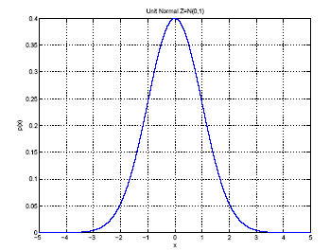
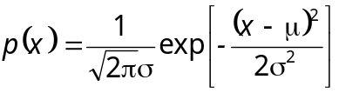
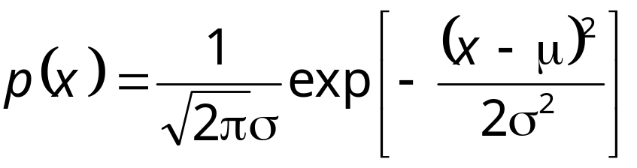
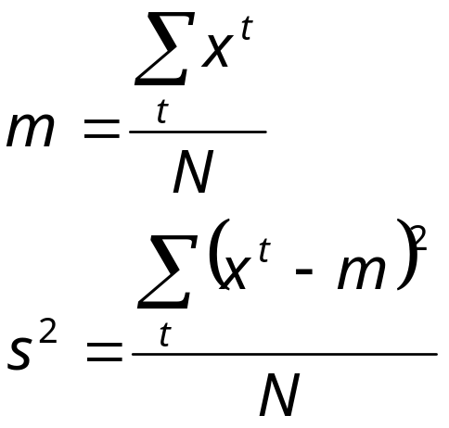
Gaussian (Normal) Distribution
p(x) = N ( μ, σ²)
MLE for μ and σ²:
μ
σ
Lecture Notes for E Alpaydın 2004 Introduction to Machine Learning © The MIT Press (V1.1)

Slide 7
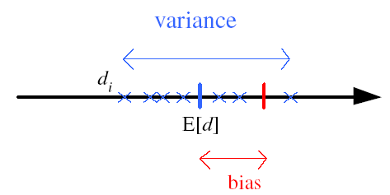
Bias and Variance
Unknown parameter θ
Estimator d_{i} = d (X_{i}) on sample X_{i}
Bias: b_{θ}(d) = E [d] – θ
Variance: E [(d–E [d])²]
Mean square error:
r (d,θ) = E [(d–θ)²]
= (E [d] – θ)² + E [(d–E [d])²]
= Bias² + Variance
Lecture Notes for E Alpaydın 2004 Introduction to Machine Learning © The MIT Press (V1.1)

Slide 8
Bayes’ Estimator
Treat θ as a random var with prior p (θ)
Bayes’ rule: p (θ|X) = p(X|θ) p(θ) / p(X)
Full: p(x|X) = ∫ p(x|θ) p(θ|X) dθ
Maximum a Posteriori (MAP): θ_{MAP} = argmax_{θ} p(θ|X)
Maximum Likelihood (ML): θ_{ML} = argmax_{θ} p(X|θ)
Bayes’: θ_{Bayes’} = E[θ|X] = ∫ θ p(θ|X) dθ
Lecture Notes for E Alpaydın 2004 Introduction to Machine Learning © The MIT Press (V1.1)

Slide 9
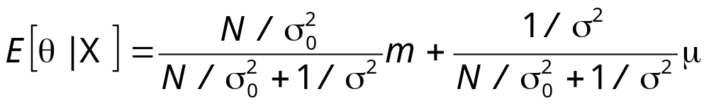
Bayes’ Estimator: Example
x^{t} ~ N (θ, σ_{o}²) and θ ~ N ( μ, σ²)
θ_{ML} = m
θ_{MAP} = θ_{Bayes’} =
Lecture Notes for E Alpaydın 2004 Introduction to Machine Learning © The MIT Press (V1.1)

Slide 10
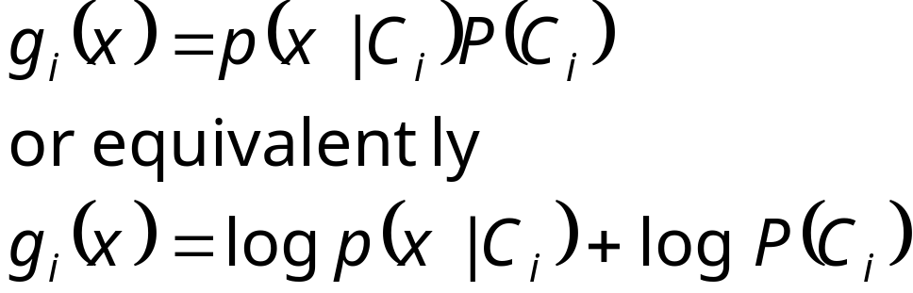
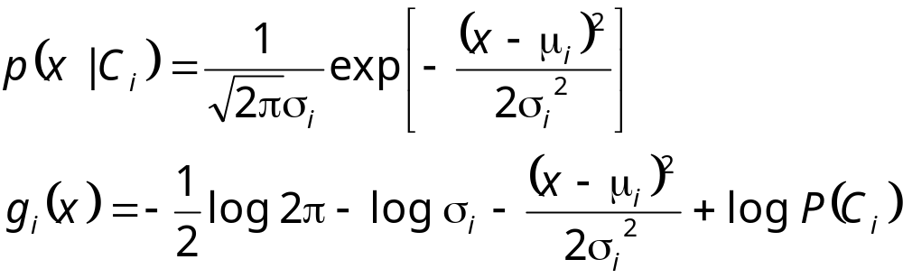
Parametric Classification
Lecture Notes for E Alpaydın 2004 Introduction to Machine Learning © The MIT Press (V1.1)

Slide 11
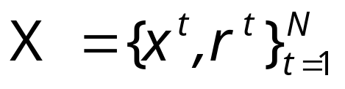
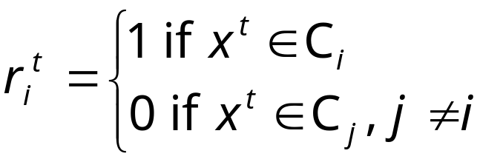

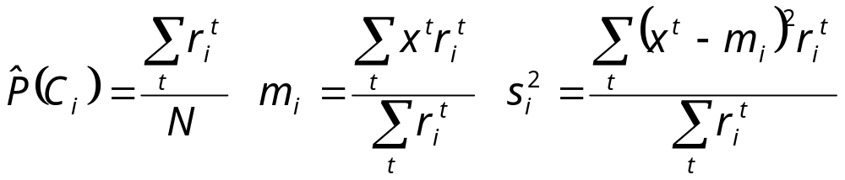
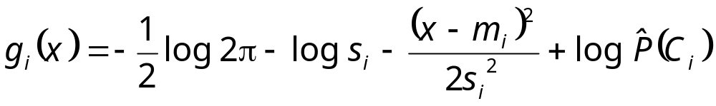
Given the sample
ML estimates are
Discriminant becomes
Lecture Notes for E Alpaydın 2004 Introduction to Machine Learning © The MIT Press (V1.1)

Slide 12
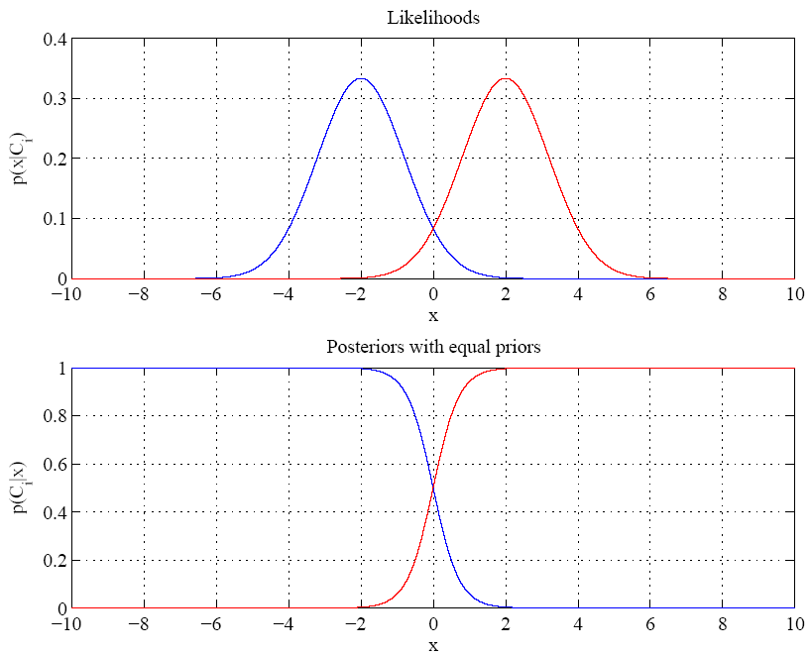
Equal variances
Single boundary at
halfway between means
Lecture Notes for E Alpaydın 2004 Introduction to Machine Learning © The MIT Press (V1.1)

Slide 13
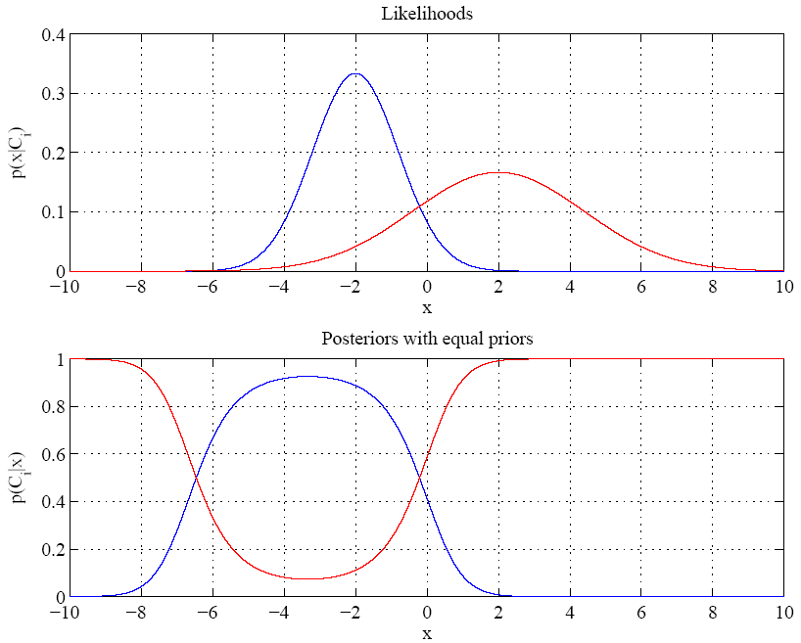
Variances are different
Two boundaries
Lecture Notes for E Alpaydın 2004 Introduction to Machine Learning © The MIT Press (V1.1)

Slide 14
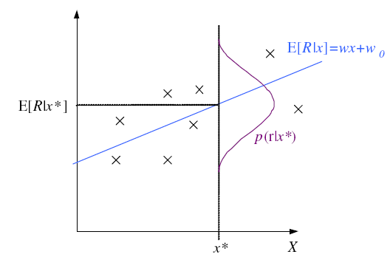
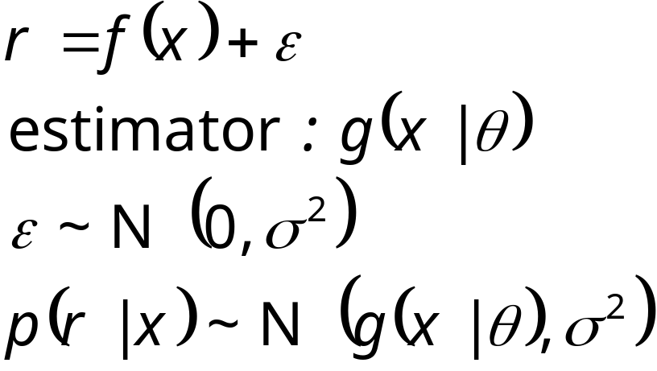
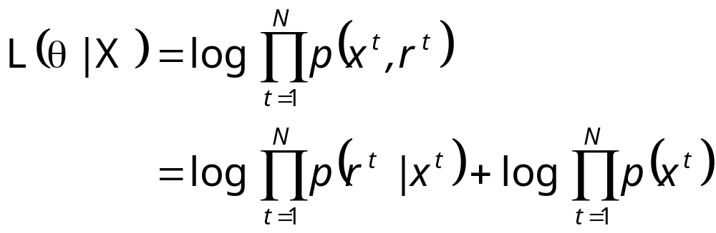
Regression
Lecture Notes for E Alpaydın 2004 Introduction to Machine Learning © The MIT Press (V1.1)

Slide 15
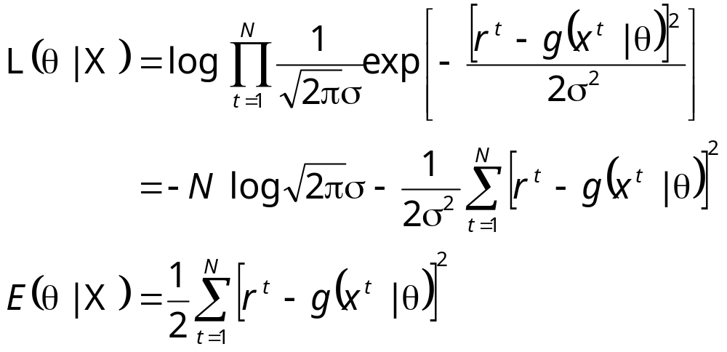
Regression: From LogL to Error
Lecture Notes for E Alpaydın 2004 Introduction to Machine Learning © The MIT Press (V1.1)

Slide 16
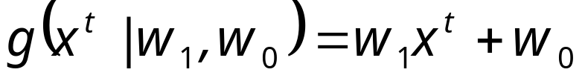
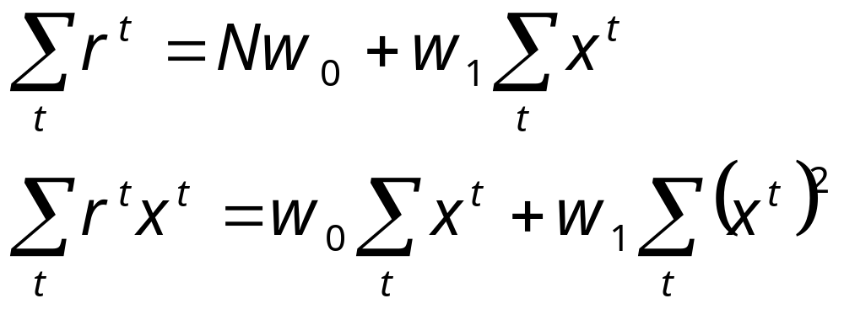
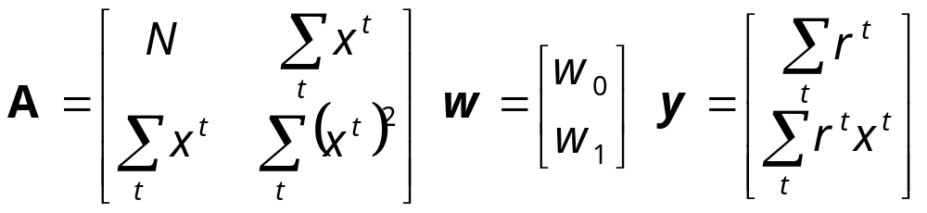
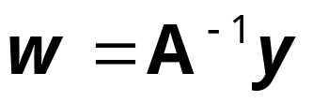
Linear Regression
Lecture Notes for E Alpaydın 2004 Introduction to Machine Learning © The MIT Press (V1.1)

Slide 17
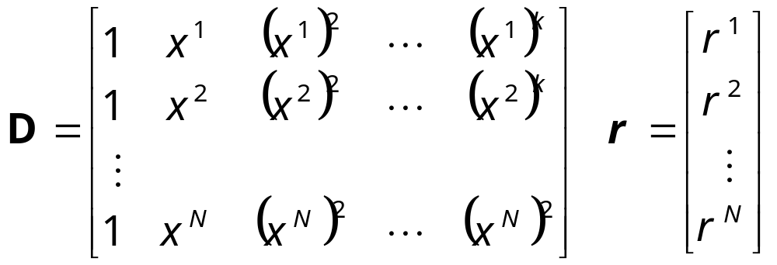
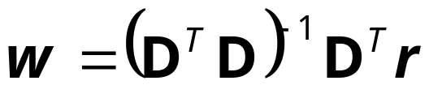
Polynomial Regression
Lecture Notes for E Alpaydın 2004 Introduction to Machine Learning © The MIT Press (V1.1)

Slide 18
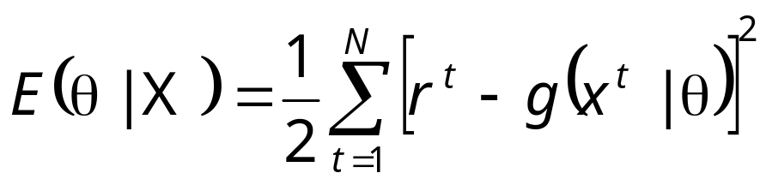
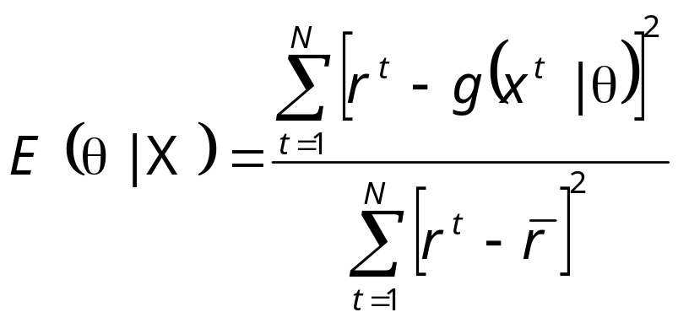
Other Error Measures
Square Error:
Relative Square Error:
Absolute Error: E (θ|X) = _{∑t} |r^{t} – g(x^{t}|θ)|
ε-sensitive Error:
  E (θ|X) = _{∑ t} 1(|r^{t} – g(x^{t}|θ)|>ε) (|r^{t} – g(x^{t}|θ)| – ε)
Lecture Notes for E Alpaydın 2004 Introduction to Machine Learning © The MIT Press (V1.1)

Slide 19
Bias and Variance
noise
squared error
bias
variance
Lecture Notes for E Alpaydın 2004 Introduction to Machine Learning © The MIT Press (V1.1)

Slide 20
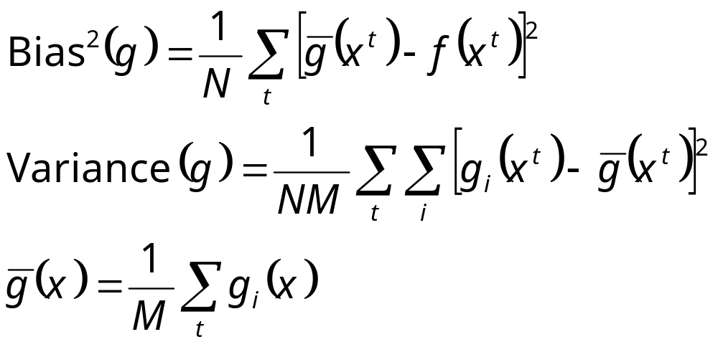
Estimating Bias and Variance
M samples X_{i}={x^{t}_{i} , r^{t}_{i}}, i=1,...,M
are used to fit g_{i} (x), i =1,...,M
Lecture Notes for E Alpaydın 2004 Introduction to Machine Learning © The MIT Press (V1.1)

Slide 21
Bias/Variance Dilemma
Example: g_{i}(x)=2 has no variance and high bias
g_{i}(x)= _{∑t} r^{t}_{i}/N has lower bias with variance
As we increase complexity,
bias decreases (a better fit to data) and
variance increases (fit varies more with data)
Bias/Variance dilemma: (Geman et al., 1992)
Lecture Notes for E Alpaydın 2004 Introduction to Machine Learning © The MIT Press (V1.1)

Slide 22
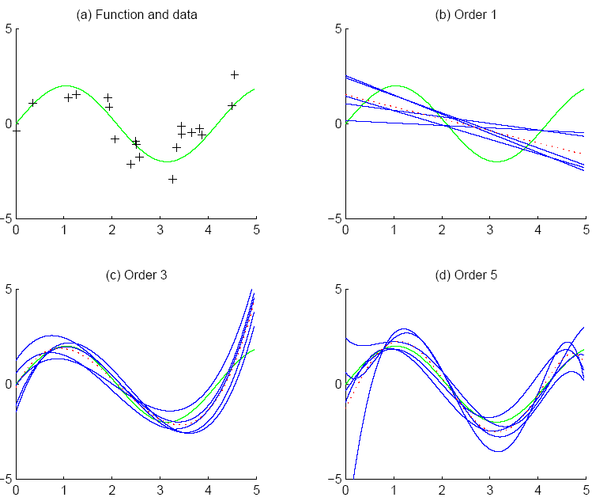
f
f
bias
g_{i}
g
variance
Lecture Notes for E Alpaydın 2004 Introduction to Machine Learning © The MIT Press (V1.1)

Slide 23
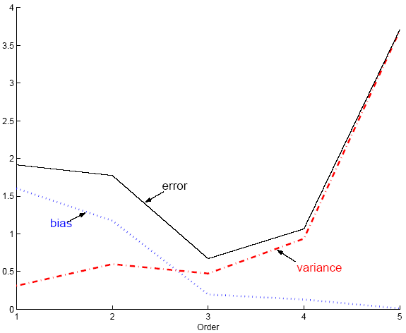
Polynomial Regression
Best fit “min error”
Lecture Notes for E Alpaydın 2004 Introduction to Machine Learning © The MIT Press (V1.1)

Slide 24
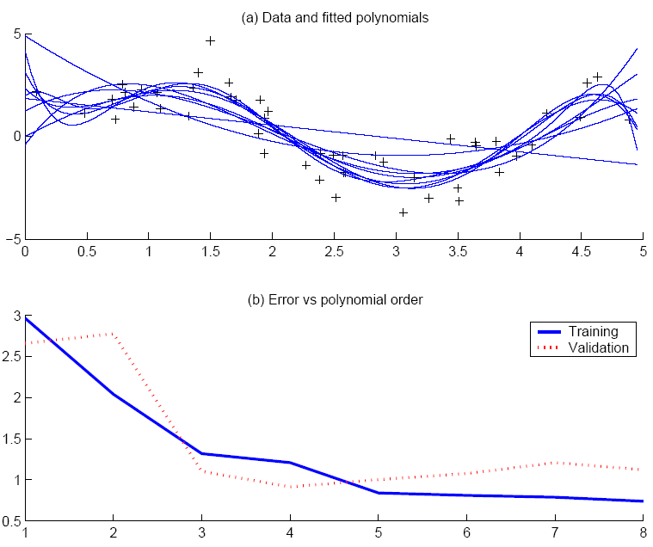
Best fit, “elbow”
Lecture Notes for E Alpaydın 2004 Introduction to Machine Learning © The MIT Press (V1.1)

Slide 25
Model Selection
Cross-validation: Measure generalization accuracy by testing on data unused during training
Regularization: Penalize complex models
E’=error on data + λ model complexity
Akaike’s information criterion (AIC), Bayesian information criterion (BIC)
Minimum description length (MDL): Kolmogorov complexity, shortest description of data
Structural risk minimization (SRM)
Lecture Notes for E Alpaydın 2004 Introduction to Machine Learning © The MIT Press (V1.1)

Slide 26
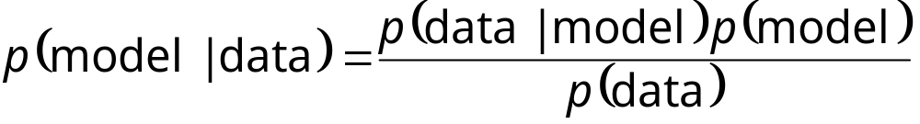
Bayesian Model Selection
Prior on models, p(model)
Regularization, when prior favors simpler models
Bayes, MAP of the posterior, p(model|data)
Average over a number of models with high posterior (voting, ensembles: Chapter 15)
Lecture Notes for E Alpaydın 2004 Introduction to Machine Learning © The MIT Press (V1.1)

