Slide 1
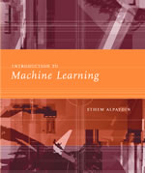
INTRODUCTION TO
Machine Learning
Lecture Slides for
ETHEM ALPAYDIN
© The MIT Press, 2004
alpaydin@boun.edu.tr
http://www.cmpe.boun.edu.tr/~ethem/i2ml

Slide 2
Topics
Bayes Estimation of parametric models
Regression using Maximum Likelihood
Semi-parametric modeling
Lecture Notes for E ALPAYDIN 2004 Introduction to Machine Learning © The MIT Press (V1.1)

Slide 3
Parametric Estimation
X = { x^{t} }_{t} where x^{t} ~ p (x)
Parametric estimation:
  Assume a form for p (x | θ) and estimate θ, its sufficient statistics, using X
  e.g., N ( μ, σ²) where θ = { μ, σ²}
Lecture Notes for E Alpaydın 2004 Introduction to Machine Learning © The MIT Press (V1.1)

Slide 4
Bayes’ Estimator
Treat θ as a random var with prior p (θ)
Bayes’ rule: p (θ|X) = p(X|θ) p(θ) / p(X)
Full: p(x|X) = ∫ p(x|θ) p(θ|X) dθ
Maximum a Posteriori (MAP): θ_{MAP} = argmax_{θ} p(θ|X)
Maximum Likelihood (ML): θ_{ML} = argmax_{θ} p(X|θ)
Bayes’: θ_{Bayes’} = E[θ|X] = ∫ θ p(θ|X) dθ
Lecture Notes for E Alpaydın 2004 Introduction to Machine Learning © The MIT Press (V1.1)

Slide 5
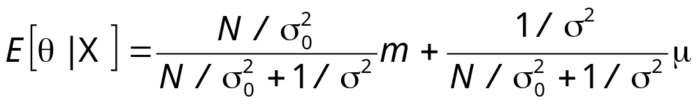
Bayes’ Estimator: Example
x^{t} ~ N (θ, σ_{o}²) and θ ~ N ( μ, σ²)
θ_{ML} = m
θ_{MAP} = θ_{Bayes’} =
Lecture Notes for E Alpaydın 2004 Introduction to Machine Learning © The MIT Press (V1.1)

Slide 6
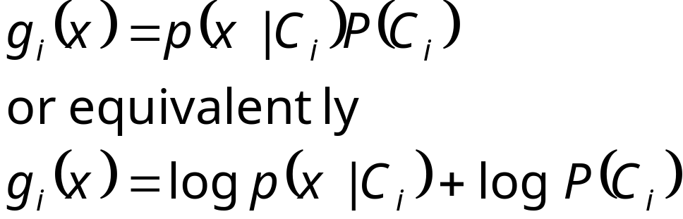
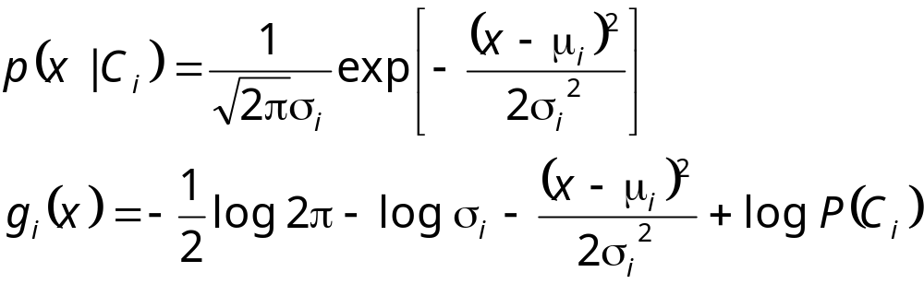
Parametric Classification
Lecture Notes for E Alpaydın 2004 Introduction to Machine Learning © The MIT Press (V1.1)

Slide 7
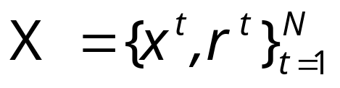
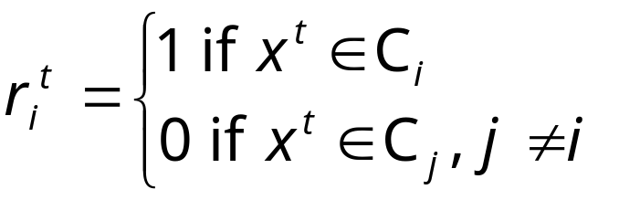

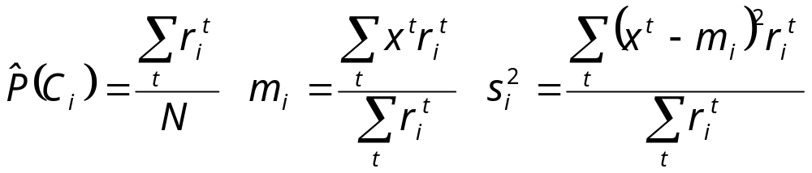
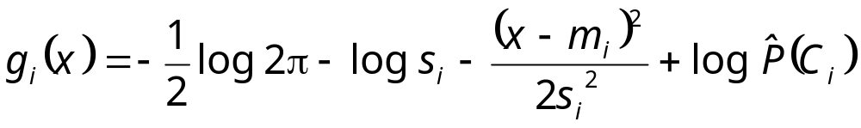
Given the sample
ML estimates are
Discriminant becomes
Lecture Notes for E Alpaydın 2004 Introduction to Machine Learning © The MIT Press (V1.1)

Slide 8
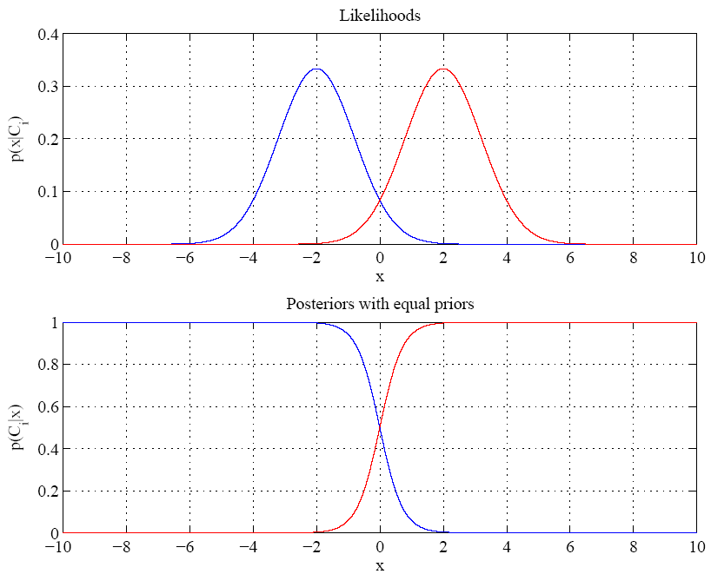
Equal variances
Single boundary at
halfway between means
Lecture Notes for E Alpaydın 2004 Introduction to Machine Learning © The MIT Press (V1.1)

Slide 9
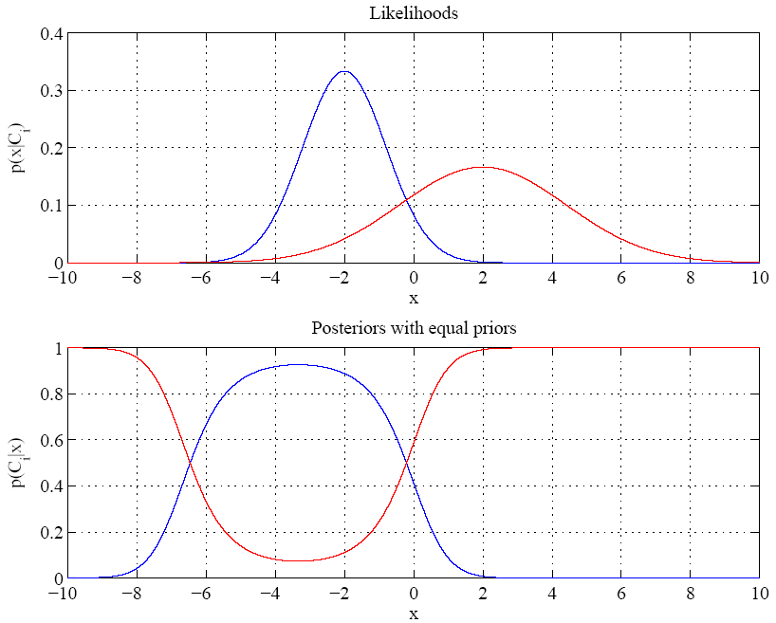
Variances are different
Two boundaries
Lecture Notes for E Alpaydın 2004 Introduction to Machine Learning © The MIT Press (V1.1)

Slide 10
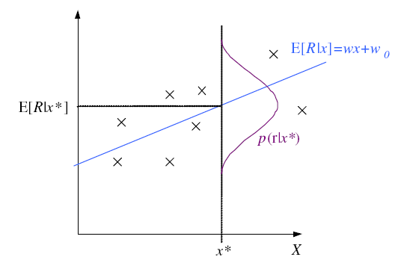
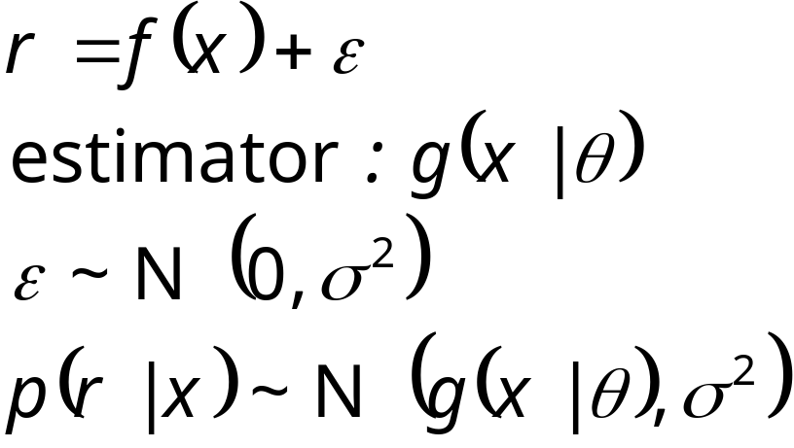
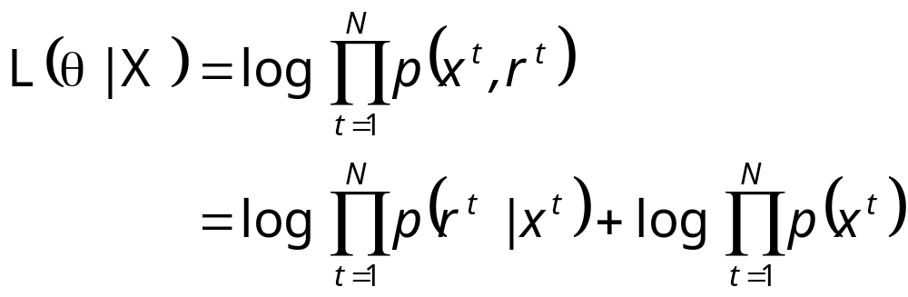
Regression
Lecture Notes for E Alpaydın 2004 Introduction to Machine Learning © The MIT Press (V1.1)

Slide 11
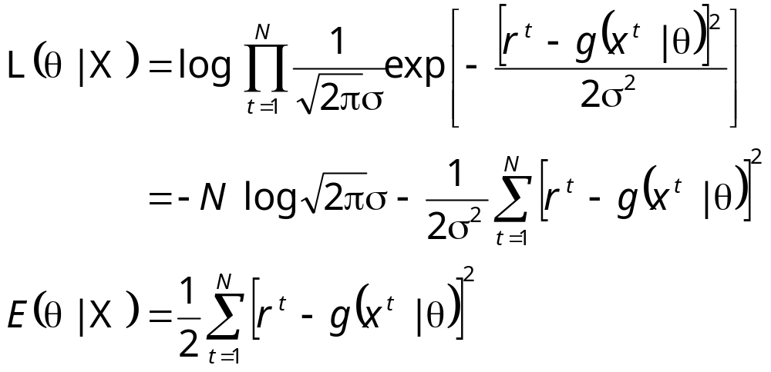
Regression: From LogL to Error
Lecture Notes for E Alpaydın 2004 Introduction to Machine Learning © The MIT Press (V1.1)

Slide 12
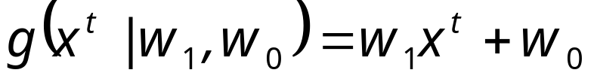
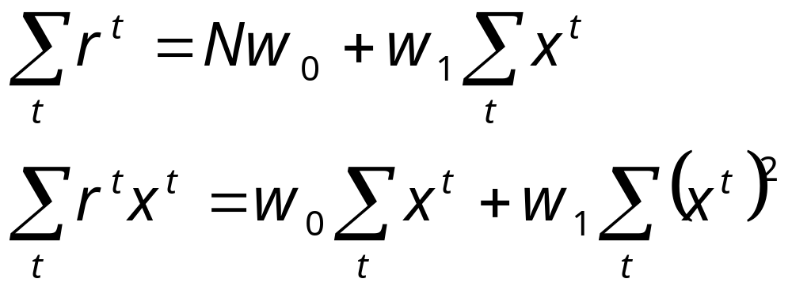
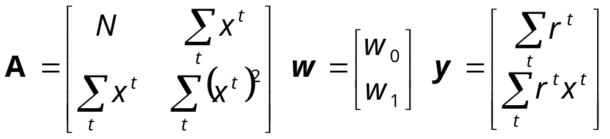
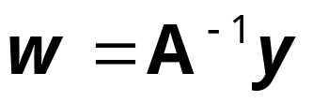
Linear Regression
Lecture Notes for E Alpaydın 2004 Introduction to Machine Learning © The MIT Press (V1.1)

Slide 13
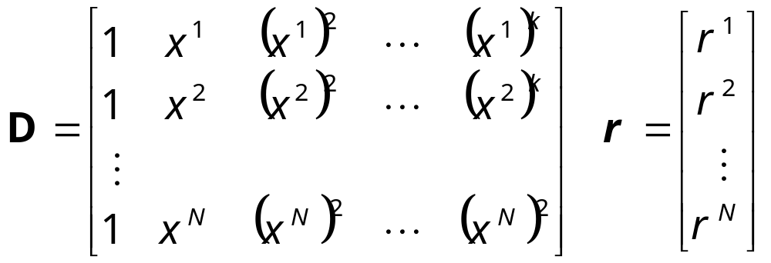
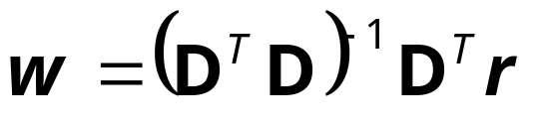
Polynomial Regression
Lecture Notes for E Alpaydın 2004 Introduction to Machine Learning © The MIT Press (V1.1)

Slide 14
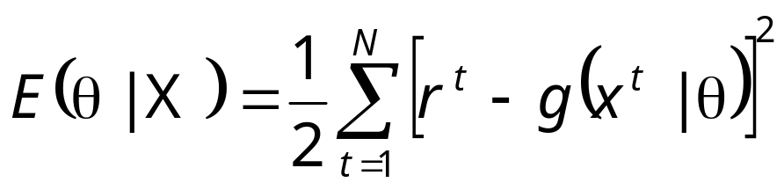
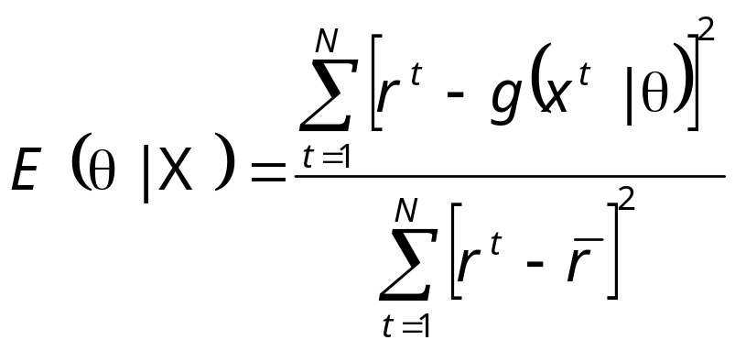
Other Error Measures
Square Error:
Relative Square Error:
Absolute Error: E (θ|X) = _{∑t} |r^{t} – g(x^{t}|θ)|
ε-sensitive Error:
  E (θ|X) = _{∑ t} 1(|r^{t} – g(x^{t}|θ)|>ε) (|r^{t} – g(x^{t}|θ)| – ε)
Lecture Notes for E Alpaydın 2004 Introduction to Machine Learning © The MIT Press (V1.1)

Slide 15
CHAPTER 7:
Clustering

Slide 16
Semiparametric Density Estimation
Parametric: Assume a single model for p (x | C_{i}) (Chapter 4 and 5)
Semiparametric: p (x | C_{i}) is a mixture of densities
Multiple possible explanations/prototypes:
Different handwriting styles, accents in speech
Nonparametric: No model; data speaks for itself (Chapter 8)
Lecture Notes for E ALPAYDIN 2004 Introduction to Machine Learning © The MIT Press (V1.1)

Slide 17
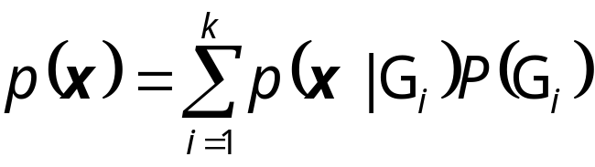
Mixture Densities
where G_{i} the components/groups/clusters,
P ( G_{i} ) mixture proportions (priors),
p ( x | G_{i}) component densities
Gaussian mixture where p(x|G_{i}) ~ N ( μ_{i} , ∑_{i} ) parameters Φ = {P ( G_{i} ), μ_{i} , ∑_{i} }^{k}_{i=1}
unlabeled sample X={x^{t}}_{t} (unsupervised learning)
Lecture Notes for E Alpaydın 2004 Introduction to Machine Learning © The MIT Press (V1.1)

Slide 18
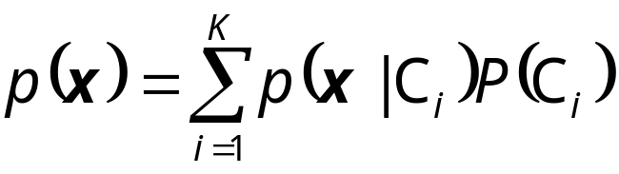
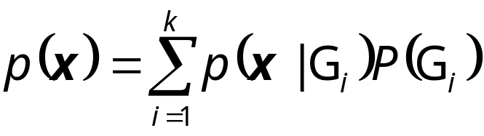
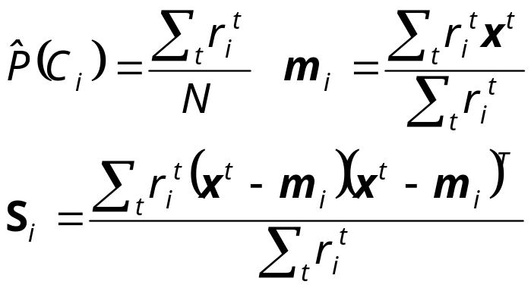
Classes vs. Clusters
Supervised: X = { x^{t} ,r^{t} }_{t}
Classes C_{i} i=1,...,K
where p ( x | C_{i}) ~ N ( μ_{i} , ∑_{i} )
Φ = {P (C_{i} ), μ_{i} , ∑_{i} }^{K}_{i=1}
Unsupervised : X = { x^{t} }_{t}
Clusters G_{i} i=1,...,k
where p ( x | G_{i}) ~ N ( μ_{i} , ∑_{i} )
Φ = {P ( G_{i} ), μ_{i} , ∑_{i} }^{k}_{i=1}
Labels, r ^{t}_{i} ?
Lecture Notes for E ALPAYDIN 2004 Introduction to Machine Learning © The MIT Press (V1.1)

Slide 19
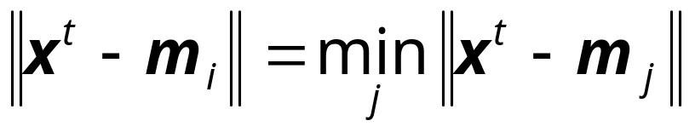
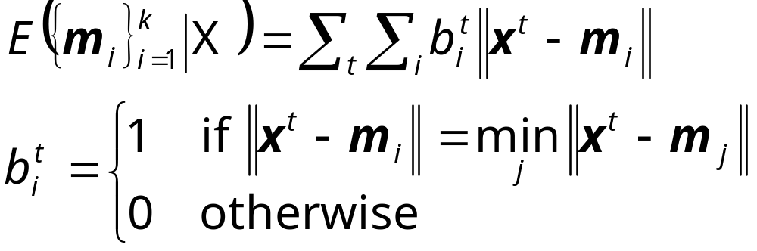
k-Means Clustering
Find k reference vectors (prototypes/codebook vectors/codewords) which best represent data
Reference vectors, m_{j}, j =1,...,k
Use nearest (most similar) reference:
Reconstruction error
Lecture Notes for E ALPAYDIN 2004 Introduction to Machine Learning © The MIT Press (V1.1)

Slide 20
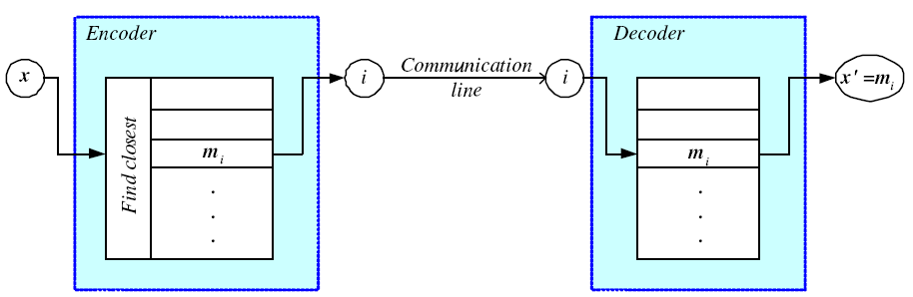
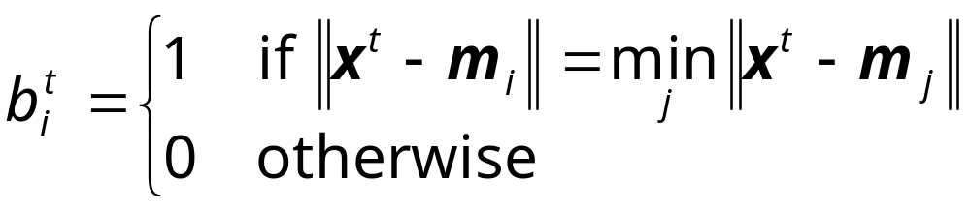
Encoding/Decoding
Lecture Notes for E ALPAYDIN 2004 Introduction to Machine Learning © The MIT Press (V1.1)

Slide 21
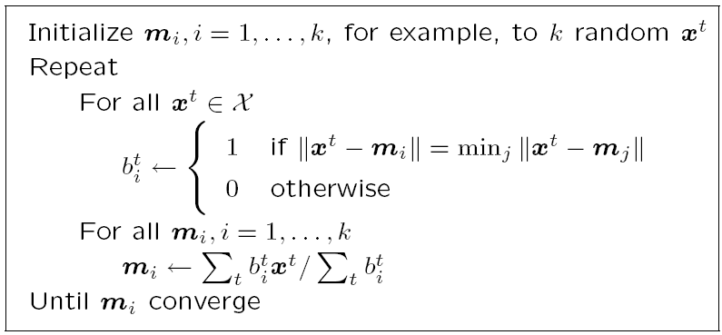
k-means Clustering
Lecture Notes for E ALPAYDIN 2004 Introduction to Machine Learning © The MIT Press (V1.1)

Slide 22
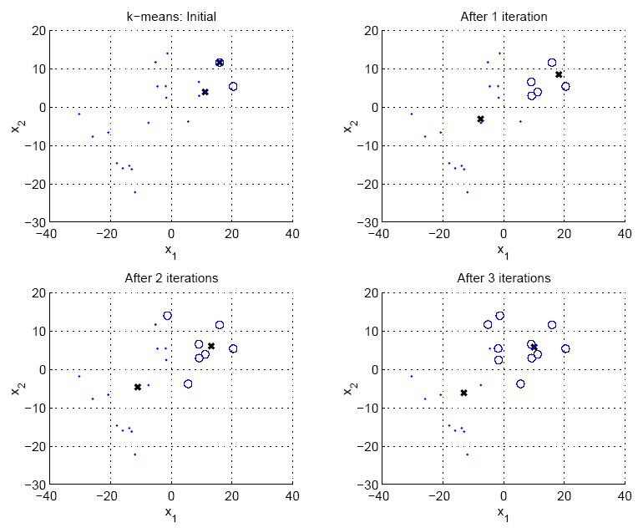
Lecture Notes for E ALPAYDIN 2004 Introduction to Machine Learning © The MIT Press (V1.1)

Slide 23
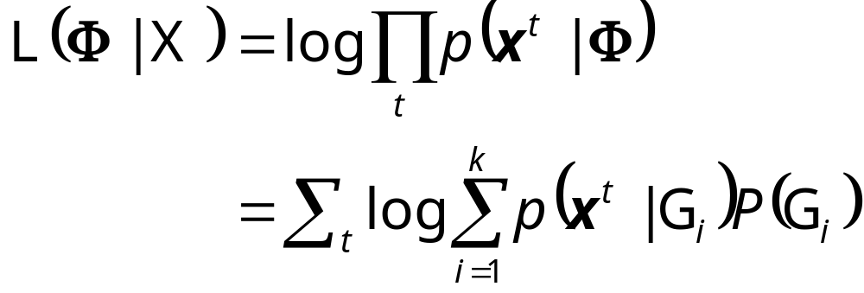
Expectation-Maximization (EM)
Log likelihood with a mixture model
Assume hidden variables z, which when known, make optimization much simpler
Complete likelihood, L_{c}(Φ |X,Z), in terms of x and z
Incomplete likelihood, L(Φ |X), in terms of x
Lecture Notes for E ALPAYDIN 2004 Introduction to Machine Learning © The MIT Press (V1.1)

Slide 24
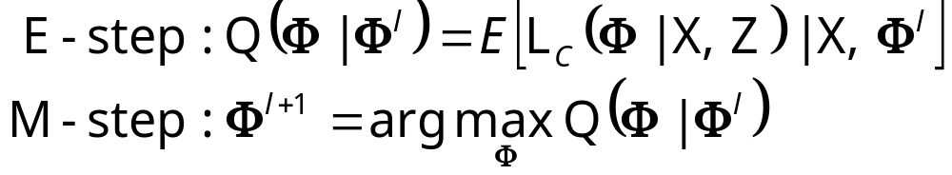
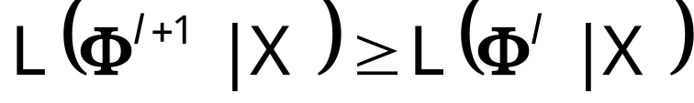
E- and M-steps
Iterate the two steps
E-step: Estimate z given X and current Φ
M-step: Find new Φ’ given z, X, and old Φ.
An increase in Q increases incomplete likelihood
Lecture Notes for E ALPAYDIN 2004 Introduction to Machine Learning © The MIT Press (V1.1)

Slide 25
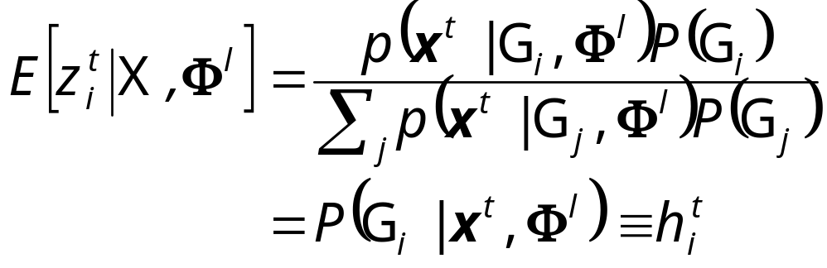
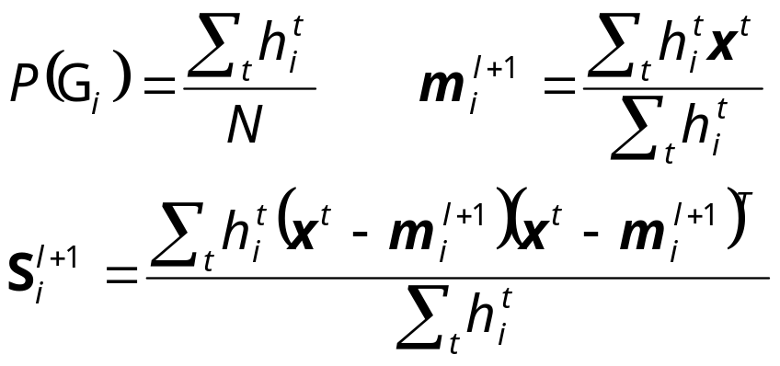
EM in Gaussian Mixtures
z^{t}_{i} = 1 if x^{t} belongs to G_{i}, 0 otherwise (labels r ^{t}_{i} of supervised learning); assume p(x|G_{i})~N(μ_{i},∑_{i})
E-step:
M-step:
Use estimated labels in place of unknown labels
Lecture Notes for E ALPAYDIN 2004 Introduction to Machine Learning © The MIT Press (V1.1)

Slide 26
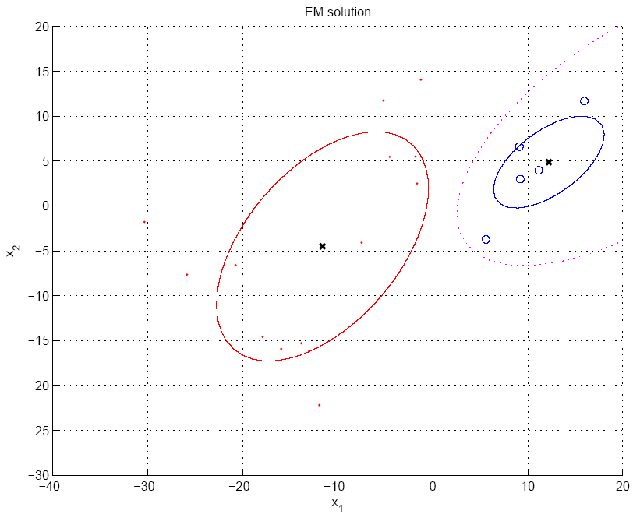
P(G₁|x)=h₁=0.5
Lecture Notes for E ALPAYDIN 2004 Introduction to Machine Learning © The MIT Press (V1.1)

Slide 27
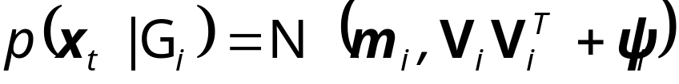
Mixtures of Latent Variable Models
Regularize clusters
Assume shared/diagonal covariance matrices
Use PCA/FA to decrease dimensionality: Mixtures of PCA/FA
Can use EM to learn V_{i} (Ghahramani and Hinton, 1997; Tipping and Bishop, 1999)
Lecture Notes for E ALPAYDIN 2004 Introduction to Machine Learning © The MIT Press (V1.1)

Slide 28
After Clustering
Dimensionality reduction methods find correlations between features and group features
Clustering methods find similarities between instances and group instances
Allows knowledge extraction through
  number of clusters,
  prior probabilities,
  cluster parameters, i.e., center, range of features.
Example: CRM, customer segmentation
Lecture Notes for E ALPAYDIN 2004 Introduction to Machine Learning © The MIT Press (V1.1)

Slide 29
Clustering as Preprocessing
Estimated group labels h_{j} (soft) or b_{j} (hard) may be seen as the dimensions of a new k dimensional space, where we can then learn our discriminant or regressor.
Local representation (only one b_{j} is 1, all others are 0; only few h_{j} are nonzero) vs
Distributed representation (After PCA; all z_{j} are nonzero)
Lecture Notes for E ALPAYDIN 2004 Introduction to Machine Learning © The MIT Press (V1.1)

Slide 30
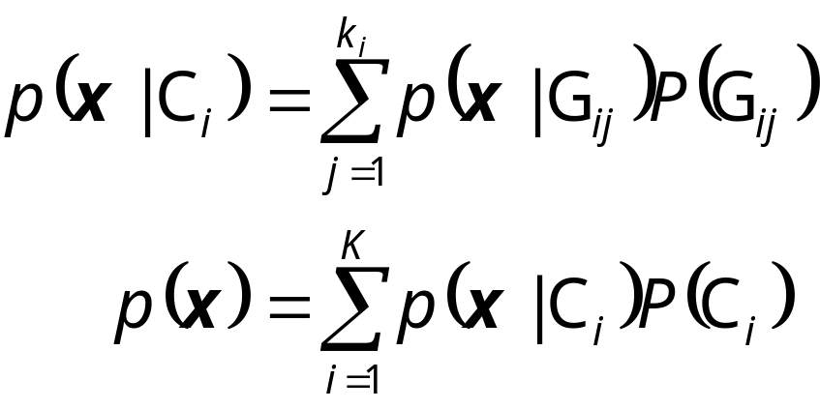
Mixture of Mixtures
In classification, the input comes from a mixture of classes (supervised).
If each class is also a mixture, e.g., of Gaussians, (unsupervised), we have a mixture of mixtures:
Lecture Notes for E ALPAYDIN 2004 Introduction to Machine Learning © The MIT Press (V1.1)

Slide 31
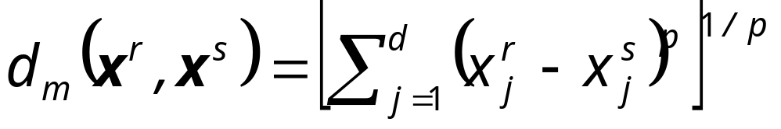
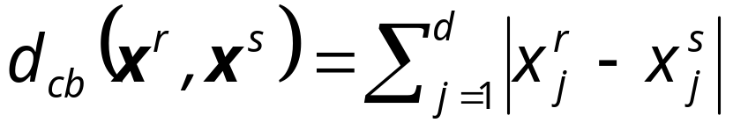
Hierarchical Clustering
Cluster based on similarities/distances
Distance measure between instances x^{r} and x^{s}
Minkowski (L_{p}) (Euclidean for p = 2)
City-block distance
Lecture Notes for E ALPAYDIN 2004 Introduction to Machine Learning © The MIT Press (V1.1)

Slide 32
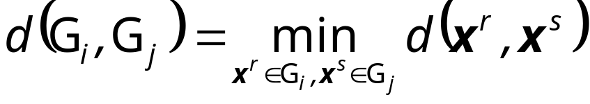
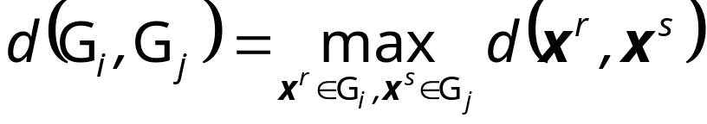
Agglomerative Clustering
Start with N groups each with one instance and merge two closest groups at each iteration
Distance between two groups G_{i} and G_{j}:
  Single-link:
  Complete-link:
  Average-link, centroid
Lecture Notes for E ALPAYDIN 2004 Introduction to Machine Learning © The MIT Press (V1.1)

Slide 33
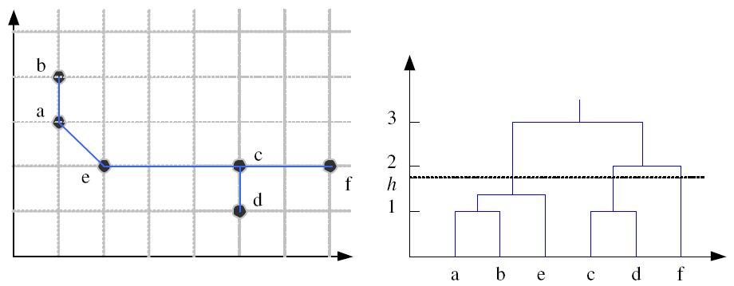
Example: Single-Link Clustering
Dendrogram
Lecture Notes for E ALPAYDIN 2004 Introduction to Machine Learning © The MIT Press (V1.1)

Slide 34
Choosing k
Defined by the application, e.g., image quantization
Plot data (after PCA) and check for clusters
Incremental (leader-cluster) algorithm: Add one at a time until “elbow” (reconstruction error/log likelihood/intergroup distances)
Manual check for meaning
Lecture Notes for E ALPAYDIN 2004 Introduction to Machine Learning © The MIT Press (V1.1)

