Slide 1
CSCE883
Machine Learning
Lecture 6
Spring 2010
Dr. Jianjun Hu

Slide 2
Outline
The EM Algorithm and Derivation
EM Clustering as a special case of Mixture Modeling
EM for Mixture Estimations
Hierarchical Clustering

Slide 3
Introduction
In the last class the K-means algorithm for clustering was introduced.
The two steps of K-means: assignment and update appear frequently in data mining tasks.
In fact a whole framework under the title “EM Algorithm” where EM stands for Expectation and Maximization is now a standard part of the data mining toolkit

Slide 4
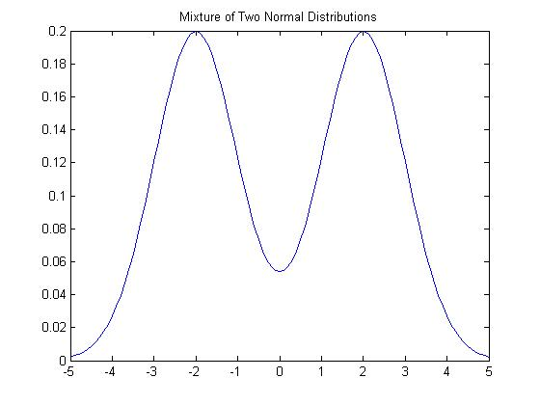
A Mixture Distribution

Slide 5
Missing Data
We think of clustering as a problem of estimating missing data.
The missing data are the cluster labels.
Clustering is only one example of a missing data problem. Several other problems can be formulated as missing data problems.

Slide 6
Missing Data Problem (in clustering)
Let D = {x(1),x(2),…x(n)} be a set of n observations.
Let H = {z(1),z(2),..z(n)} be a set of n values of a hidden variable Z.
  z(i) corresponds to x(i)
Assume Z is discrete.

Slide 7
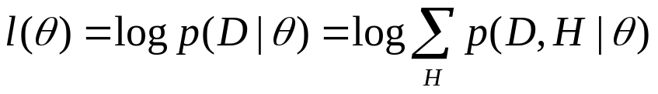
EM Algorithm
The log-likelihood of the observed data is
Not only do we have to estimate θ but also H
Let Q(H) be the probability distribution on the missing data.

Slide 8
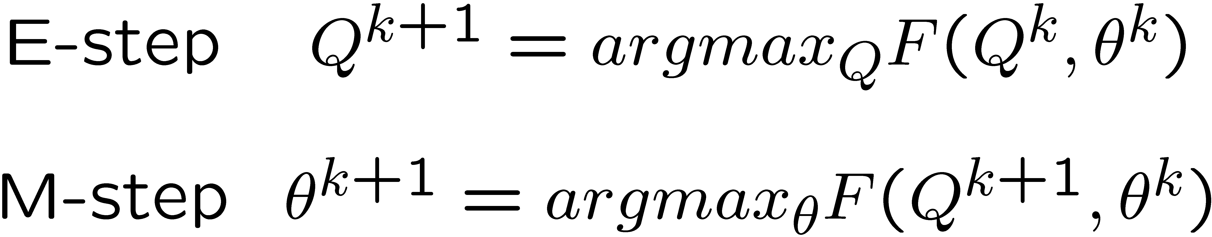
EM Algorithm
The EM Algorithm alternates between maximizing F with respect to Q (theta fixed) and then maximizing F with respect to theta (Q fixed).

Slide 9
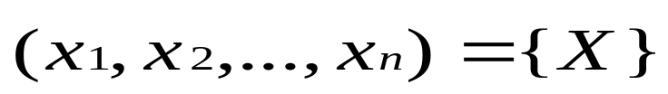
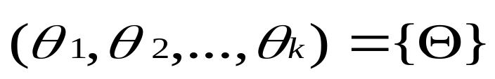
Example: EM-Clustering
Given a set of data points in R₂
Assume underlying distribution is mixture of Gaussians
Goal: estimate the parameters of each gaussian distribution
Ѳ is the parameter, we consider it consists of means and variances, k is the number of Gaussian model.
We use EM algorithm to solve this (clustering) problem
EM clustering usually applies K-means algorithm first to estimate initial parameters of

Slide 10
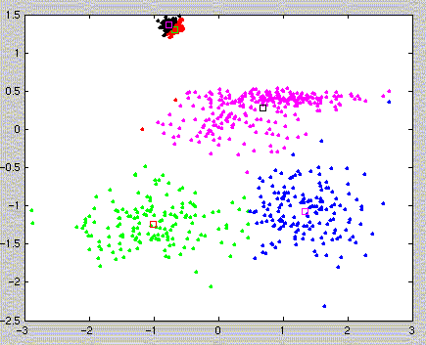
Steps of EM algorithm(1)
randomly pick values for Ѳ_{k} (mean and variance) ( or from K-means)
for each x_{n}, associate it with a responsibility value r
r_{n,k} - how likely the n^{th} point comes from/belongs to the k^{th} mixture
how to find r?
Assume data come from
these two distributions

Slide 11
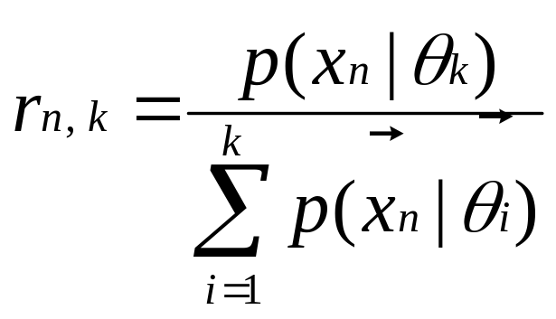
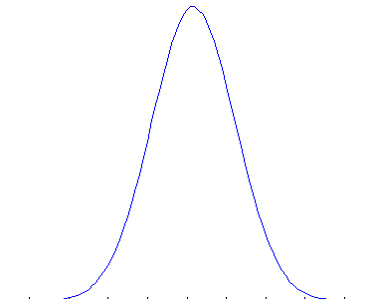
Steps of EM algorithm(2)
Probability that we observe x_{n} in the data set provided it comes from k^{th} mixture
Distribution by Ѳ_{k}
Distance between x_{n} and center of k^{th} mixture

Slide 12
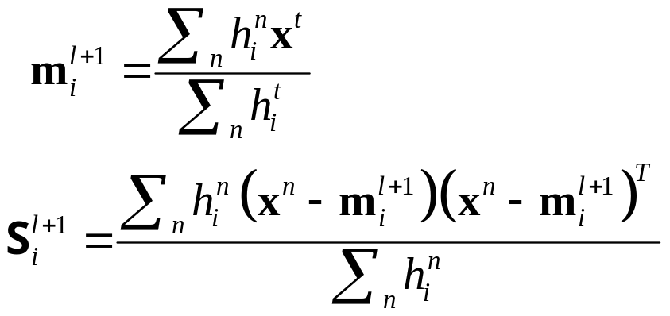
Steps of EM algorithm(3)
each data point now associate with (r_{n,1}, r_{n,2},…, r_{n,k})
r_{n,k} – how likely they belong to k^{th} mixture, 0<r<1
using r, compute weighted mean and variance for each gaussian model
We get new Ѳ, set it as the new parameter and iterate the process (find new r -> new Ѳ -> ……)
Consist of expectation step and maximization step

Slide 13
EM Ideas and Intuition
given a set of incomplete (observed) data
assume observed data come from a specific model
formulate some parameters for that model, use this to guess the missing value/data (expectation step)
from the missing data and observed data, find the most likely parameters (maximization step) MLE
iterate step 2,3 and converge

Slide 14
MLE for Mixture Distributions
When we proceed to calculate the MLE for a mixture, the presence of the sum of the distributions prevents a “neat” factorization using the log function.
A completely new rethink is required to estimate the parameter.
The new rethink also provides a solution to the clustering problem.

Slide 15
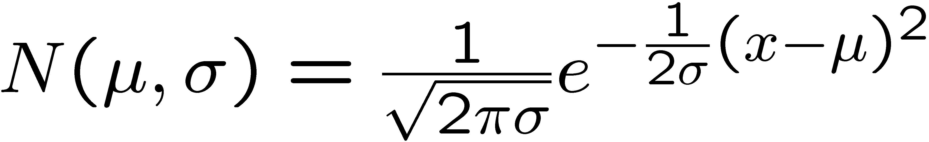
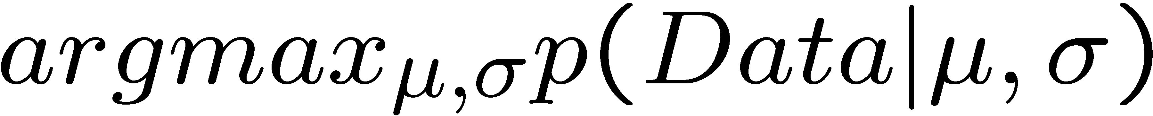
MLE Examples
Suppose the following are marks in a course
55.5, 67, 87, 48, 63
Marks typically follow a Normal distribution whose density function is
Now, we want to find the best μ,σ such that

Slide 16
EM in Gaussian Mixtures Estimation: Examples
Suppose we have data about heights of people (in cm)
  185,140,134,150,170
Heights follow a normal (log normal) distribution but men on average are taller than women. This suggests a mixture of two distributions

Slide 17
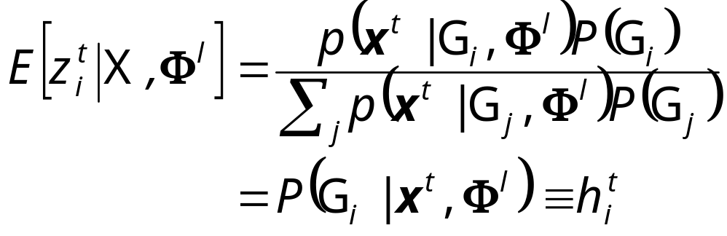
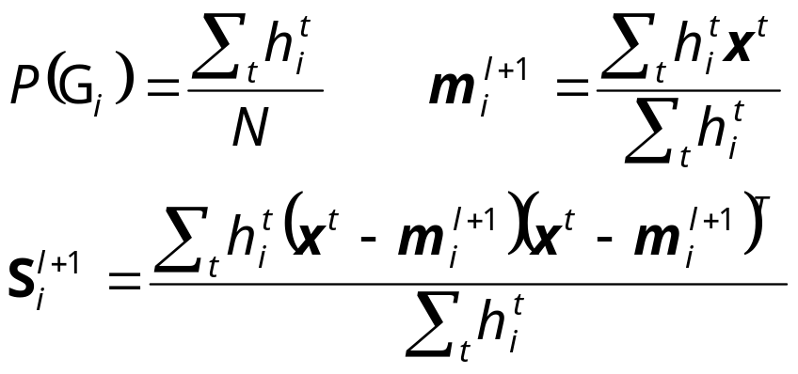
EM in Gaussian Mixtures Estimation
z^{t}_{i} = 1 if x^{t} belongs to G_{i}, 0 otherwise (labels r ^{t}_{i} of supervised learning); assume p(x|G_{i})~N(μ_{i},∑_{i})
E-step:
M-step:
Use estimated labels in place of unknown labels

Slide 18
EM and K-means
Notice the similarity between EM for Normal mixtures and K-means.
The expectation step is the assignment.
The maximization step is the update of centers.

Slide 19
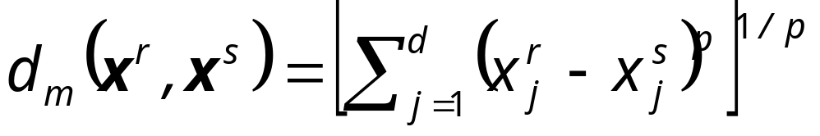
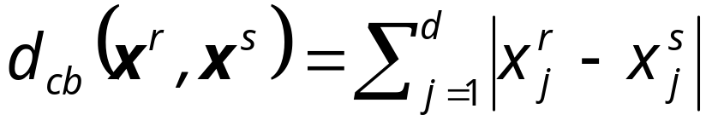
Hierarchical Clustering
Cluster based on similarities/distances
Distance measure between instances x^{r} and x^{s}
Minkowski (L_{p}) (Euclidean for p = 2)
City-block distance

Slide 20
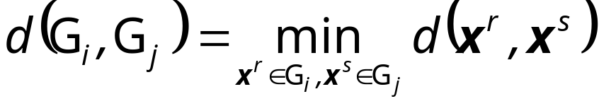
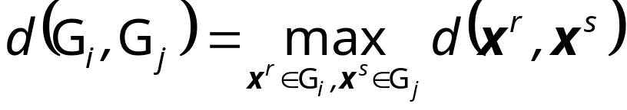
Agglomerative Clustering
Start with N groups each with one instance and merge two closest groups at each iteration
Distance between two groups G_{i} and G_{j}:
  Single-link:
  Complete-link:
  Average-link, centroid

Slide 21
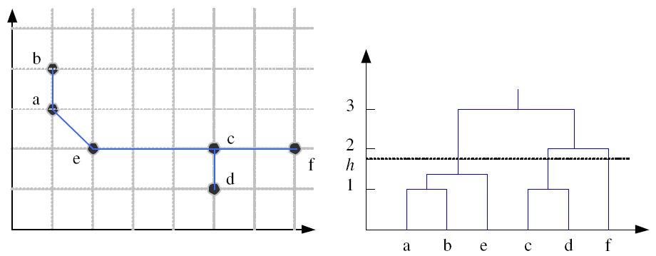
Example: Single-Link Clustering
Dendrogram

Slide 22
Choosing k
Defined by the application, e.g., image quantization
Plot data (after PCA) and check for clusters
Incremental (leader-cluster) algorithm: Add one at a time until “elbow” (reconstruction error/log likelihood/intergroup distances)
Manual check for meaning

