Slide 1
CSCE883
Machine Learning
Lecture 7
Spring 2010
Dr. Jianjun Hu

Slide 2
CHAPTER 8:
Nonparametric Methods

Slide 3
Nonparametric Estimation
Parametric (single global model), semiparametric (small number of local models)
Nonparametric ideas: Similar inputs have similar outputs
Functions (pdf, discriminant, regression) change smoothly
Keep the training data;“let the data speak for itself”
Given x, find a small number of closest training instances and interpolate from these
Aka lazy/memory-based/case-based/instance-based learning
Lecture Notes for E Alpaydın 2004 Introduction to Machine Learning © The MIT Press (V1.1)

Slide 4
Density Estimation (cdf)
Cumulative distribution function
  F(x)=#{xt<=x}/N
Cdf: p(x)=[#{xt<=x+h - #{xt<=x}]/(N.h)
Lecture Notes for E Alpaydın 2004 Introduction to Machine Learning © The MIT Press (V1.1)

Slide 5
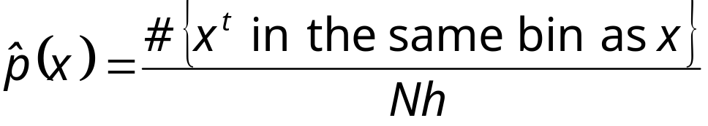
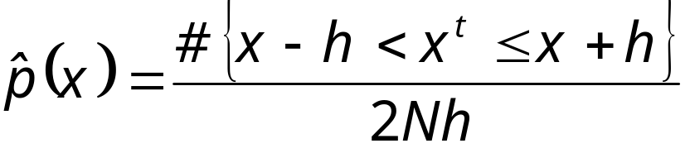
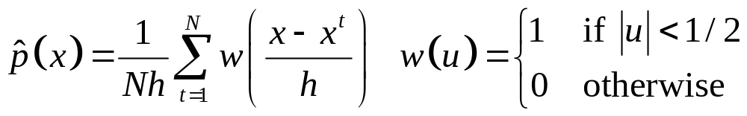
Density Estimation
Given the training set X={x^{t}}_{t} drawn iid from p(x)
Divide data into bins of size h
Histogram:
Naive estimator:
or
Lecture Notes for E Alpaydın 2004 Introduction to Machine Learning © The MIT Press (V1.1)

Slide 6
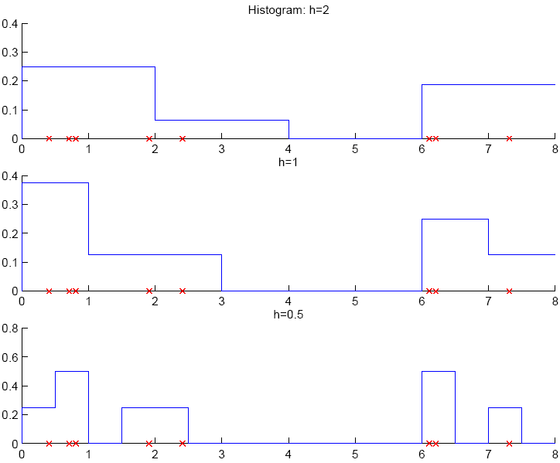
Lecture Notes for E Alpaydın 2004 Introduction to Machine Learning © The MIT Press (V1.1)

Slide 7
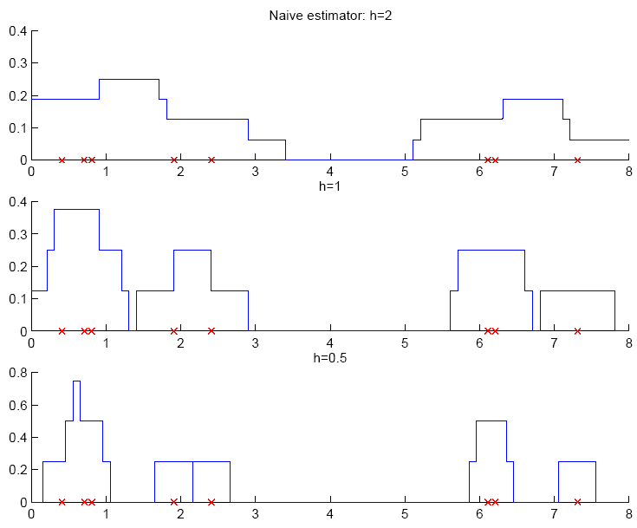
Lecture Notes for E Alpaydın 2004 Introduction to Machine Learning © The MIT Press (V1.1)

Slide 8
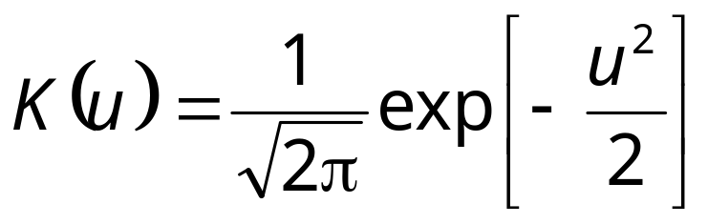
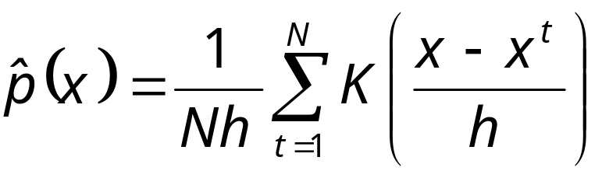
Kernel Estimator to get smooth estimation
Kernel function, e.g., Gaussian kernel:
Kernel estimator (Parzen windows)
Lecture Notes for E Alpaydın 2004 Introduction to Machine Learning © The MIT Press (V1.1)

Slide 9
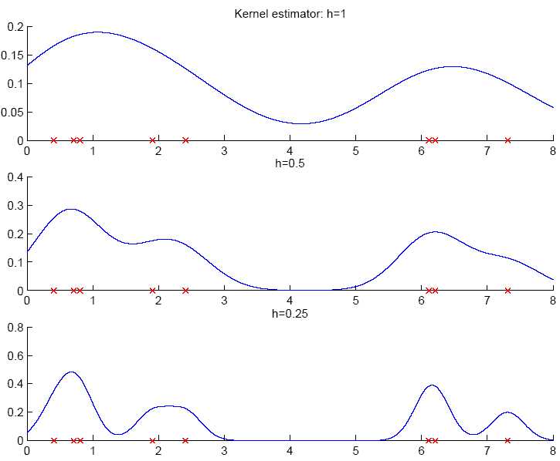
Lecture Notes for E Alpaydın 2004 Introduction to Machine Learning © The MIT Press (V1.1)

Slide 10
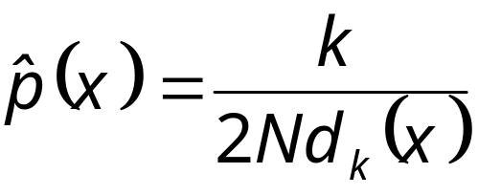
k-Nearest Neighbor Estimator
Instead of fixing bin width h and counting the number of instances, fix the instances (neighbors) k and check bin width
d_{k}(x), distance to kth closest instance to x
Lecture Notes for E Alpaydın 2004 Introduction to Machine Learning © The MIT Press (V1.1)

Slide 11
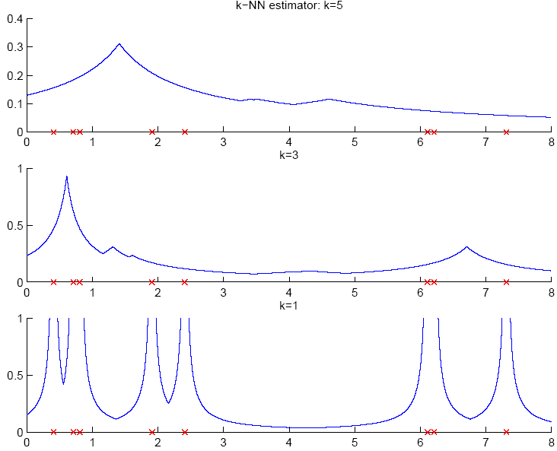
Lecture Notes for E Alpaydın 2004 Introduction to Machine Learning © The MIT Press (V1.1)

Slide 12
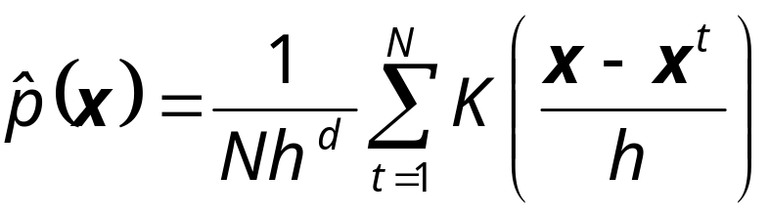
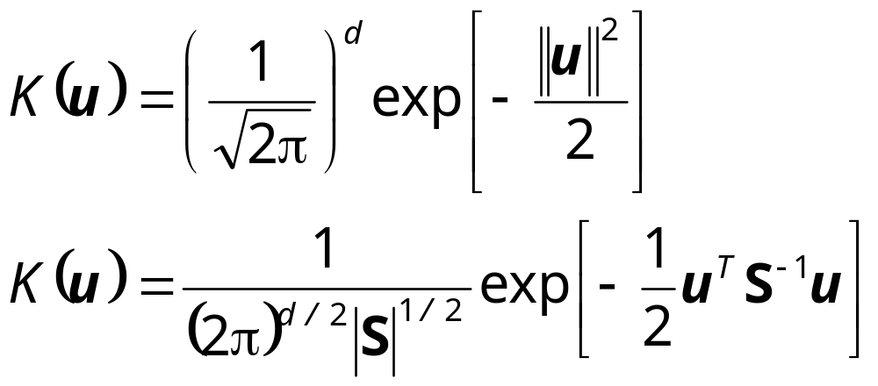
Multivariate Data
Kernel density estimator
Multivariate Gaussian kernel
spheric
ellipsoid
Lecture Notes for E Alpaydın 2004 Introduction to Machine Learning © The MIT Press (V1.1)

Slide 13
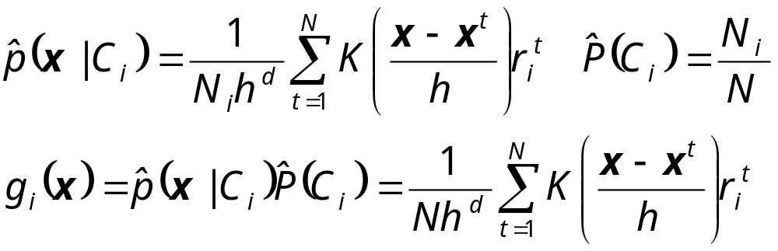
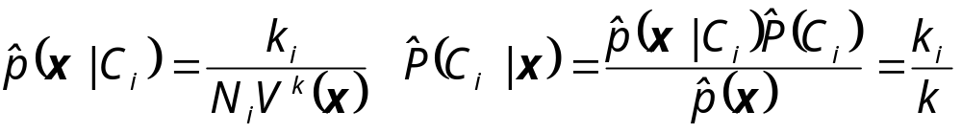
Nonparametric Classification
Estimate p(x|C_{i}) and use Bayes’ rule
Kernel estimator
k-NN estimator
Lecture Notes for E Alpaydın 2004 Introduction to Machine Learning © The MIT Press (V1.1)

Slide 14
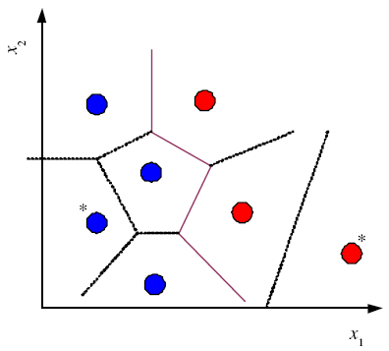
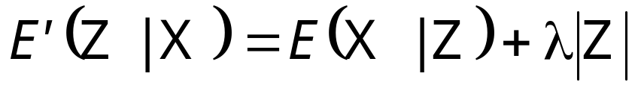
Condensed Nearest Neighbor
Time/space complexity of k-NN is O (N)
Find a subset Z of X that is small and is accurate in classifying X (Hart, 1968)
Lecture Notes for E Alpaydın 2004 Introduction to Machine Learning © The MIT Press (V1.1)

Slide 15
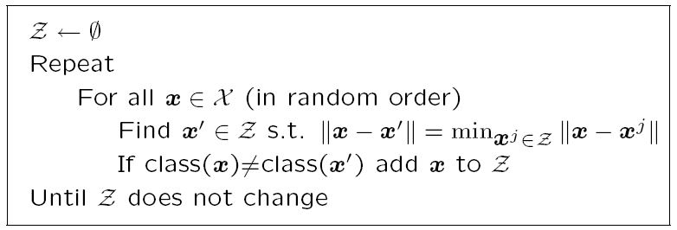
Condensed Nearest Neighbor
Incremental algorithm: Add instance if needed
Lecture Notes for E Alpaydın 2004 Introduction to Machine Learning © The MIT Press (V1.1)

Slide 16
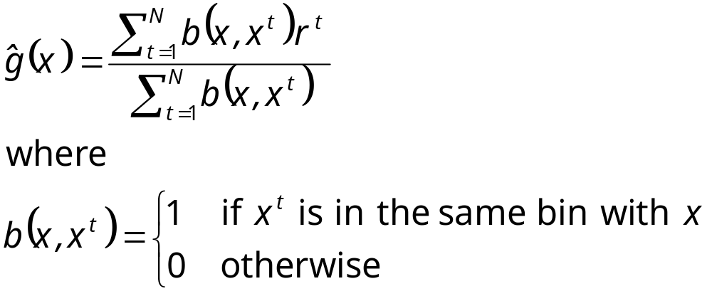
Nonparametric Regression
Aka smoothing models
Regressogram
Lecture Notes for E Alpaydın 2004 Introduction to Machine Learning © The MIT Press (V1.1)

Slide 17
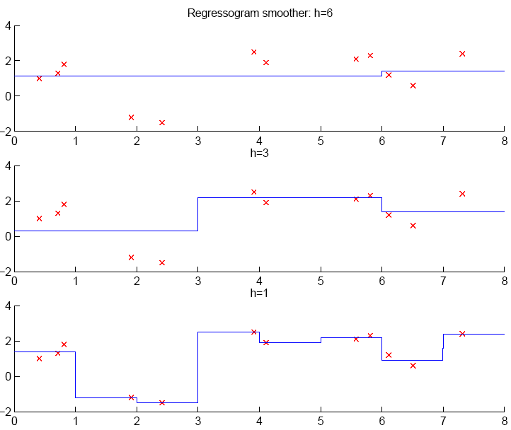
Lecture Notes for E Alpaydın 2004 Introduction to Machine Learning © The MIT Press (V1.1)

Slide 18
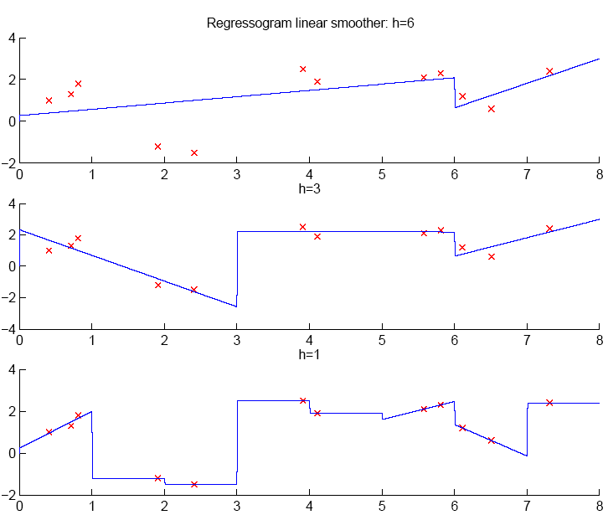
Lecture Notes for E Alpaydın 2004 Introduction to Machine Learning © The MIT Press (V1.1)

Slide 19
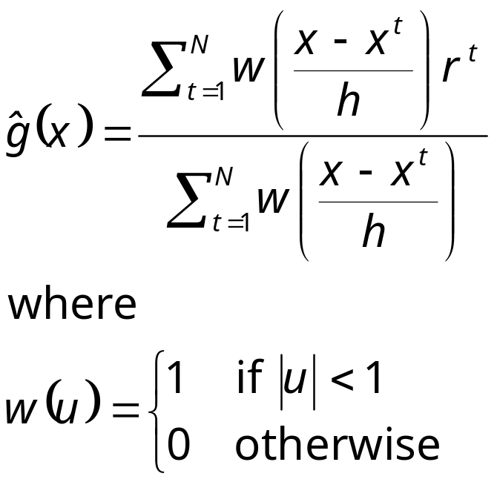
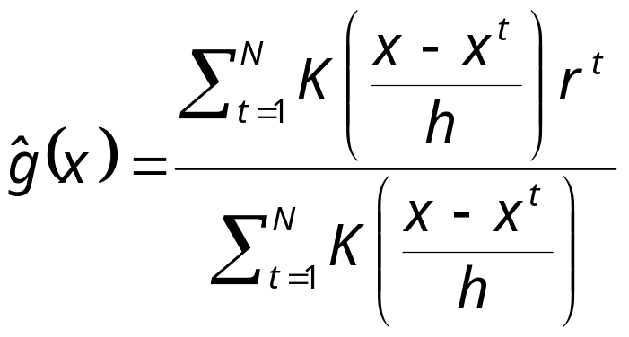
Running Mean/Kernel Smoother
Running mean smoother
Running line smoother
Kernel smoother
where K( ) is Gaussian
Additive models (Hastie and Tibshirani, 1990)
Lecture Notes for E Alpaydın 2004 Introduction to Machine Learning © The MIT Press (V1.1)

Slide 20
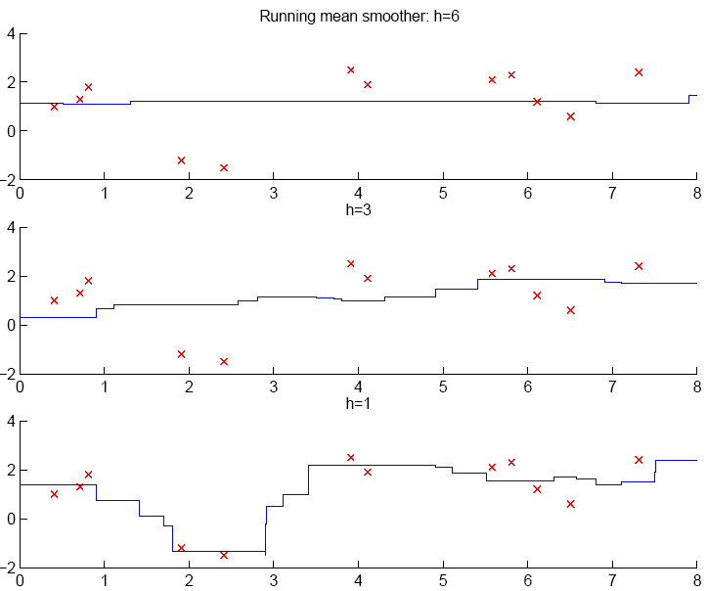
Lecture Notes for E Alpaydın 2004 Introduction to Machine Learning © The MIT Press (V1.1)

Slide 21
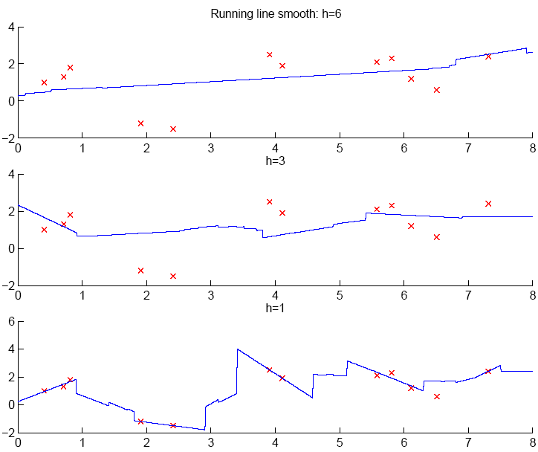
Lecture Notes for E Alpaydın 2004 Introduction to Machine Learning © The MIT Press (V1.1)

Slide 22
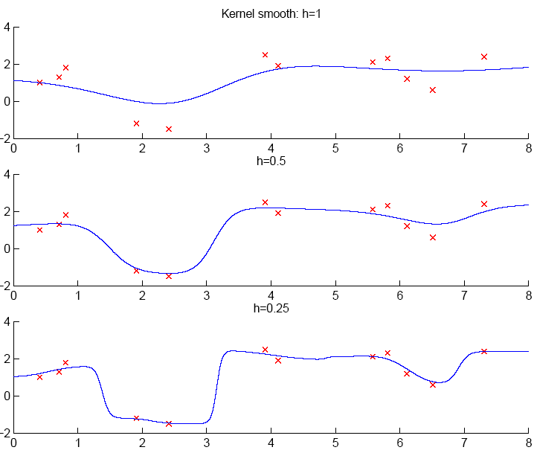
Lecture Notes for E Alpaydın 2004 Introduction to Machine Learning © The MIT Press (V1.1)

Slide 23
How to Choose k or h?
When k or h is small, single instances matter; bias is small, variance is large (undersmoothing): High complexity
As k or h increases, we average over more instances and variance decreases but bias increases (oversmoothing): Low complexity
Cross-validation is used to finetune k or h.
Lecture Notes for E Alpaydın 2004 Introduction to Machine Learning © The MIT Press (V1.1)

Slide 24
Using Weka ML system
Demo
Lecture Notes for E Alpaydın 2004 Introduction to Machine Learning © The MIT Press (V1.1)

