Slide 1
CSCE833 Machine Learning
Lecture 9
Linear Discriminant Analysis
Dr. Jianjun Hu
mleg.cse.sc.edu/edu/csce833
University of South Carolina
Department of Computer Science and Engineering

Slide 2
Likelihood- vs. Discriminant-based Classification
Likelihood-based: Assume a model for p(x|C_{i}), use Bayes’ rule to calculate P(C_{i}|x)
g_{i}(x) = log P(C_{i}|x)
Discriminant-based: Assume a model for g_{i}(x|Φ_{i}); no density estimation
Estimating the boundaries is enough; no need to accurately estimate the densities inside the boundaries
Lecture Notes for E Alpaydın 2004 Introduction to Machine Learning © The MIT Press (V1.1)

Slide 3
Example: Boundary or Class Model
Lecture Notes for E Alpaydın 2004 Introduction to Machine Learning © The MIT Press (V1.1)

Slide 4
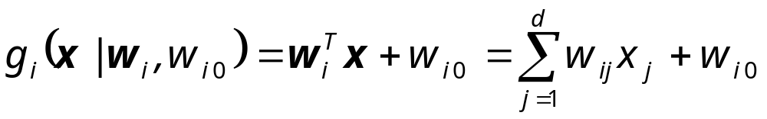
Linear Discriminant
Linear discriminant:
Advantages:
  Simple: O(d) space/computation
  Knowledge extraction: Weighted sum of attributes; positive/negative weights, magnitudes (credit scoring)
  Optimal when p(x|C_{i}) are Gaussian with shared cov matrix; useful when classes are (almost) linearly separable
Lecture Notes for E Alpaydın 2004 Introduction to Machine Learning © The MIT Press (V1.1)

Slide 5
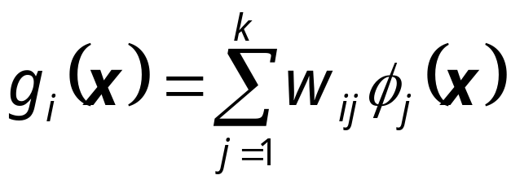
Generalized Linear Model
Quadratic discriminant:
Higher-order (product) terms:
Map from x to z using nonlinear basis functions and use a linear discriminant in z-space
Lecture Notes for E Alpaydın 2004 Introduction to Machine Learning © The MIT Press (V1.1)

Slide 6
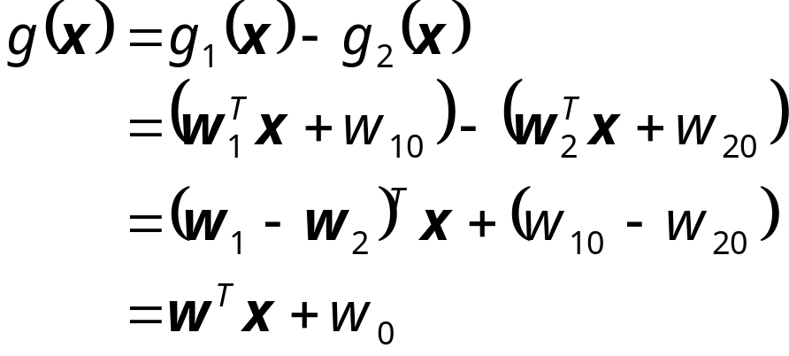
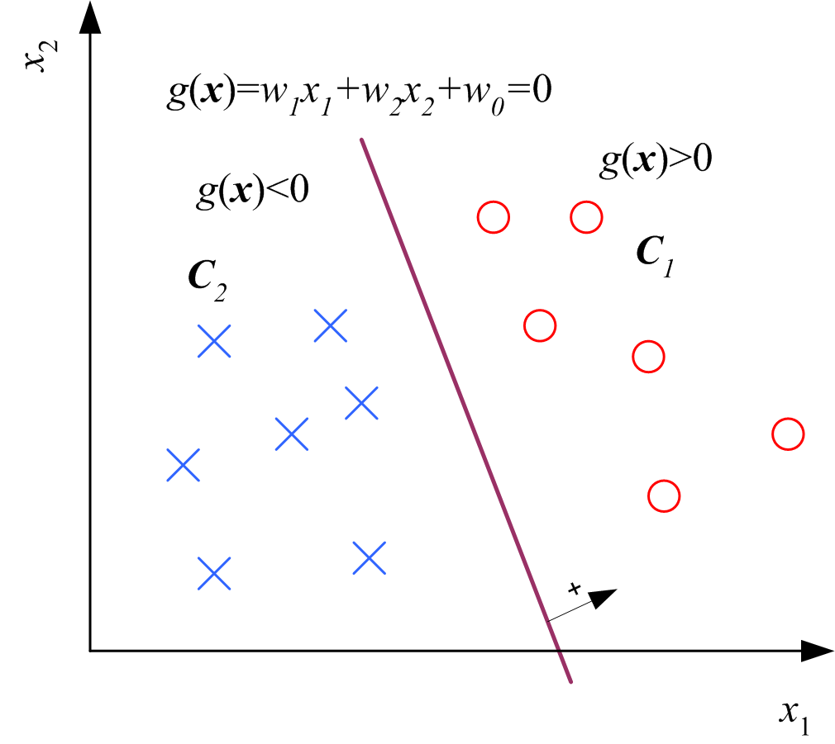
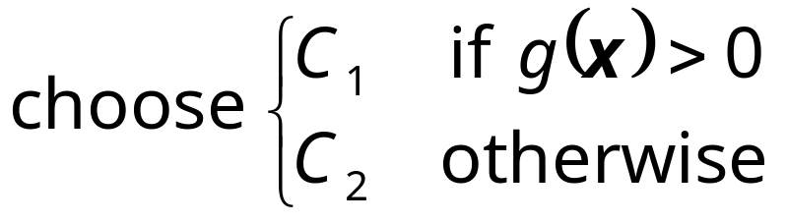
Two Classes
Lecture Notes for E Alpaydın 2004 Introduction to Machine Learning © The MIT Press (V1.1)

Slide 7
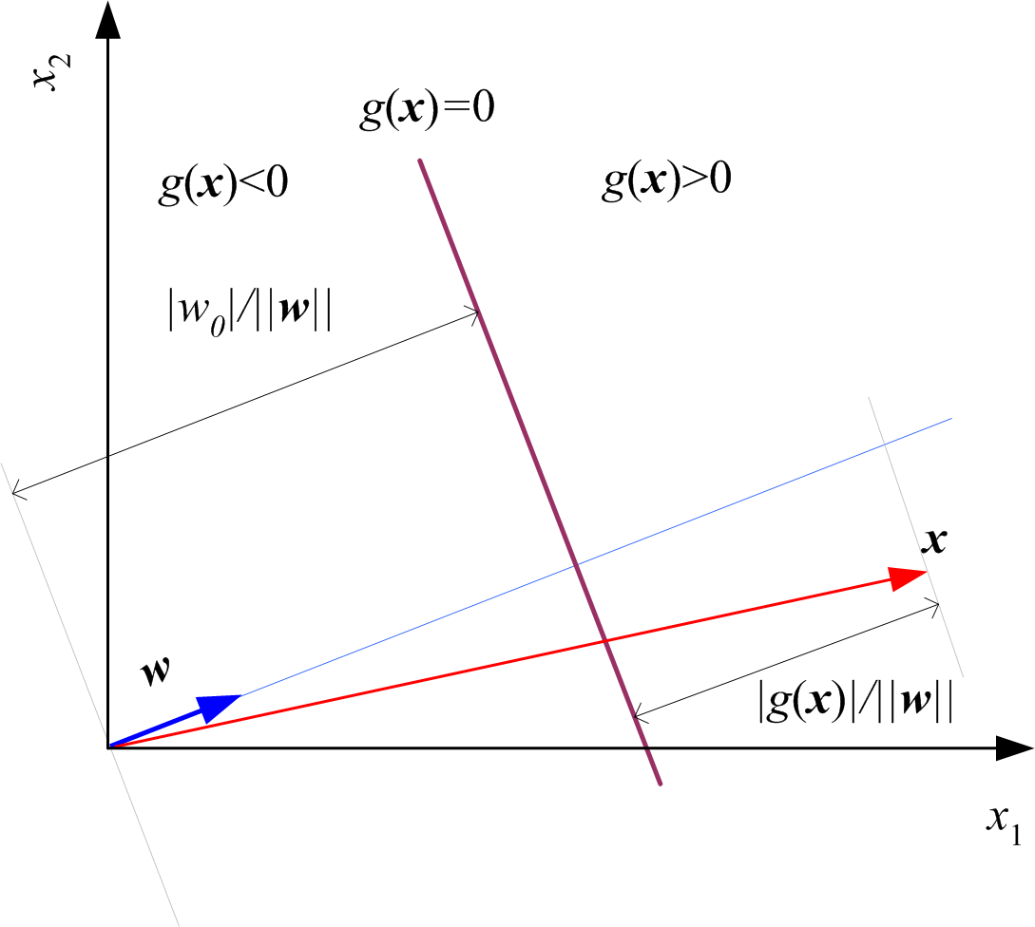
Geometry
Lecture Notes for E Alpaydın 2004 Introduction to Machine Learning © The MIT Press (V1.1)

Slide 8
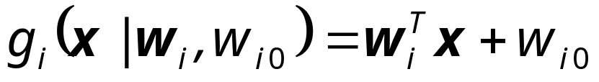
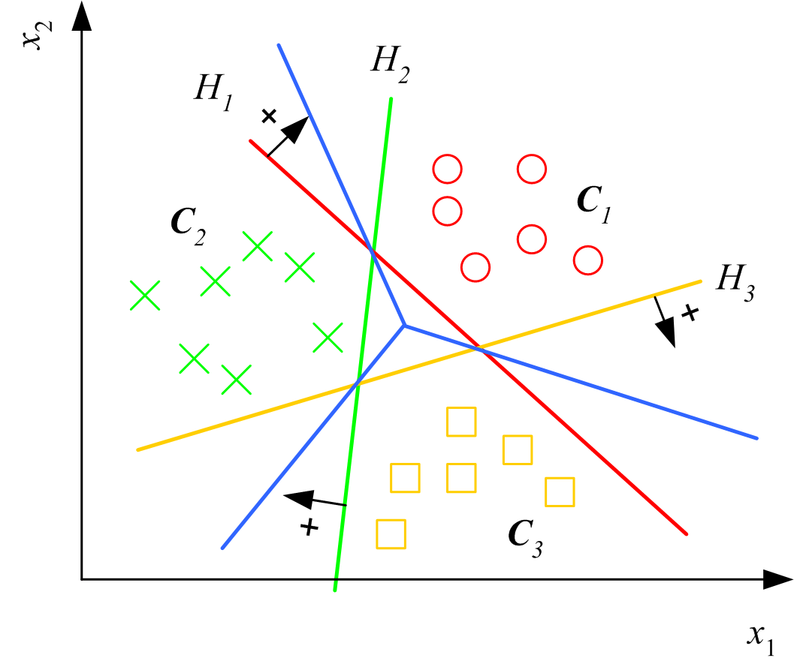
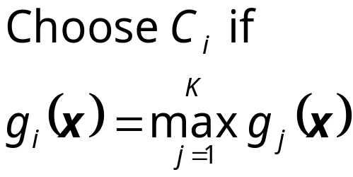
Multiple Classes
Classes are
linearly separable
Lecture Notes for E Alpaydın 2004 Introduction to Machine Learning © The MIT Press (V1.1)

Slide 9
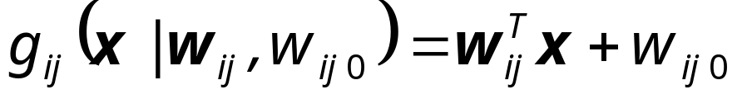
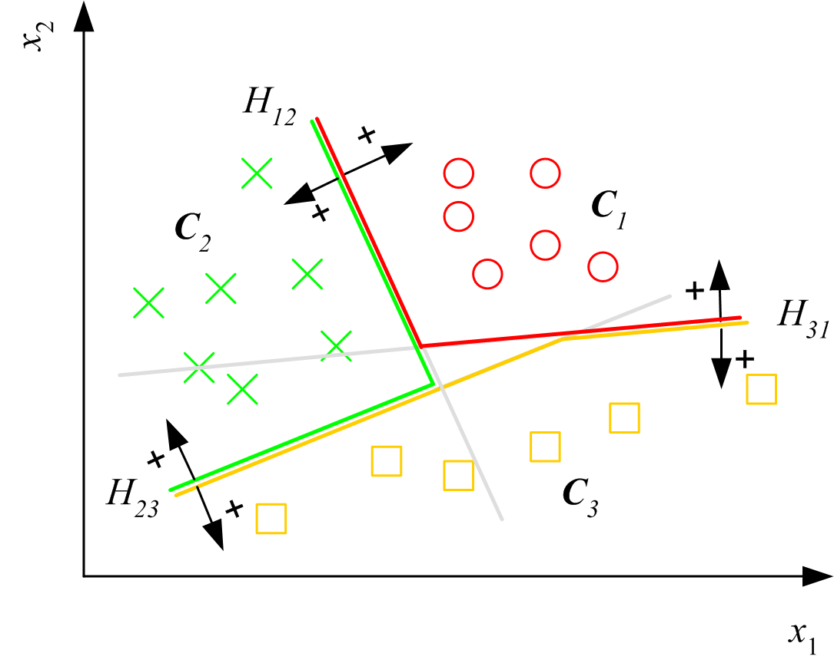
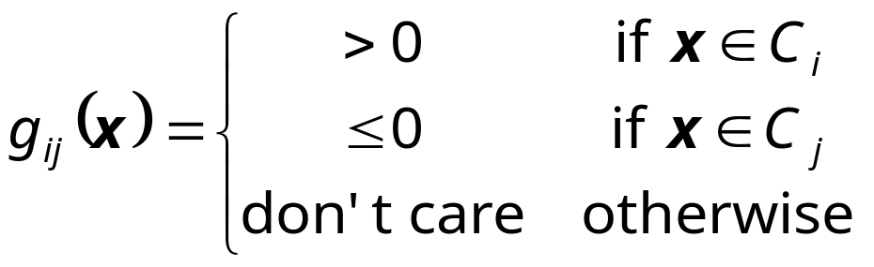
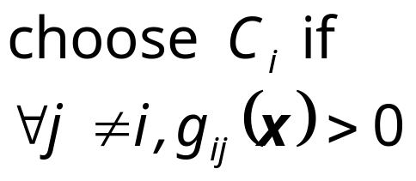
Pairwise Separation
Lecture Notes for E Alpaydın 2004 Introduction to Machine Learning © The MIT Press (V1.1)

Slide 10
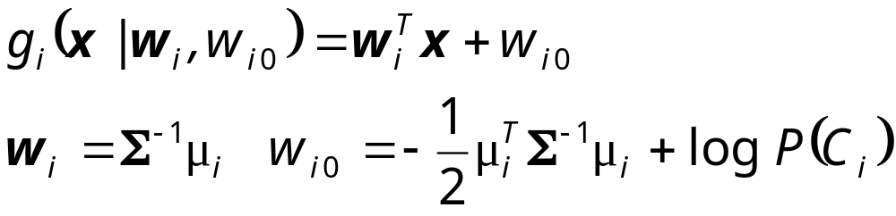
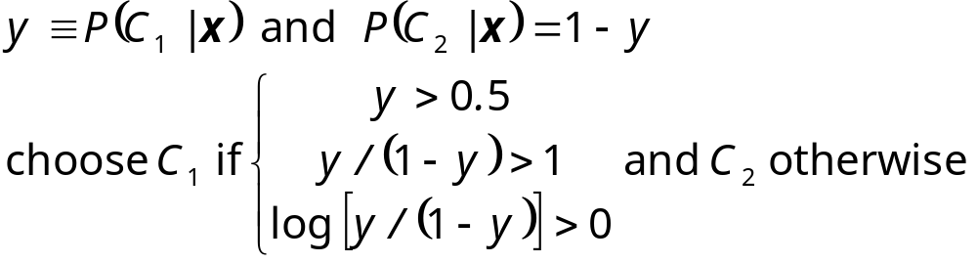
From Discriminants to Posteriors
When p (x | C_{i} ) ~ N ( μ_{i} , ∑)
Lecture Notes for E Alpaydın 2004 Introduction to Machine Learning © The MIT Press (V1.1)

Slide 11
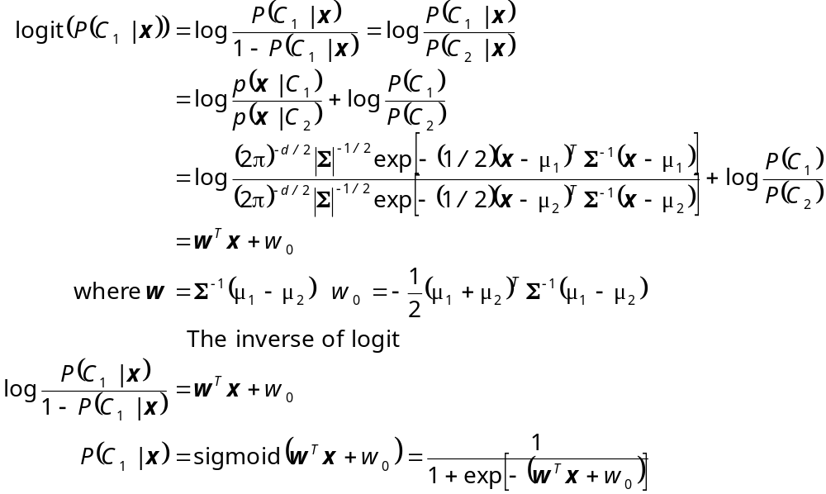
Lecture Notes for E Alpaydın 2004 Introduction to Machine Learning © The MIT Press (V1.1)

Slide 12
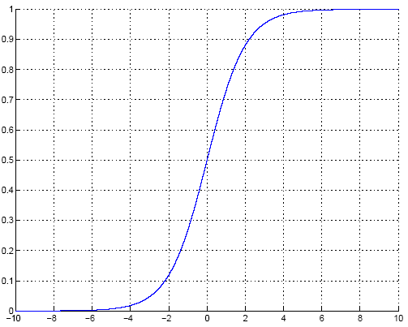
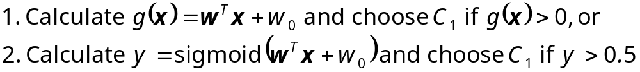
Sigmoid (Logistic) Function
Lecture Notes for E Alpaydın 2004 Introduction to Machine Learning © The MIT Press (V1.1)

Slide 13
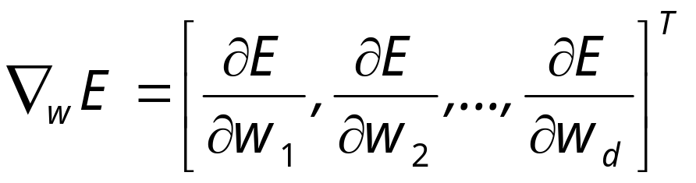
Gradient-Descent
E(w|X) is error with parameters w on sample X
w*=arg min_{w} E(w | X)
Gradient
Gradient-descent:
  Starts from random w and updates w iteratively in the negative direction of gradient
Lecture Notes for E Alpaydın 2004 Introduction to Machine Learning © The MIT Press (V1.1)

Slide 14
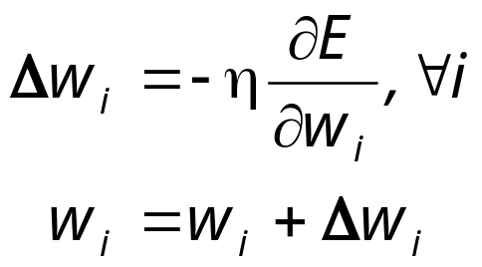
Gradient-Descent
E (w^{t})
E (w^{t+1})
w^{t}
w^{t+1}
η
Lecture Notes for E Alpaydın 2004 Introduction to Machine Learning © The MIT Press (V1.1)

Slide 15
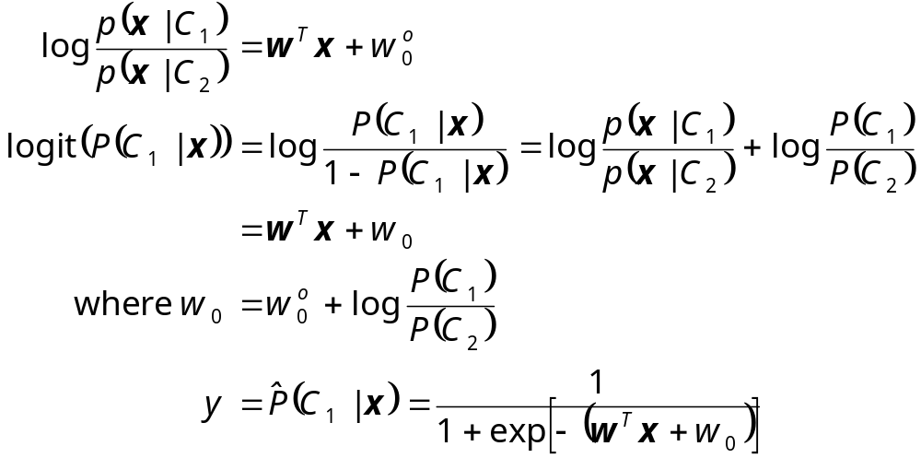
Logistic Discrimination
Two classes: Assume log likelihood ratio is linear
Lecture Notes for E Alpaydın 2004 Introduction to Machine Learning © The MIT Press (V1.1)

Slide 16
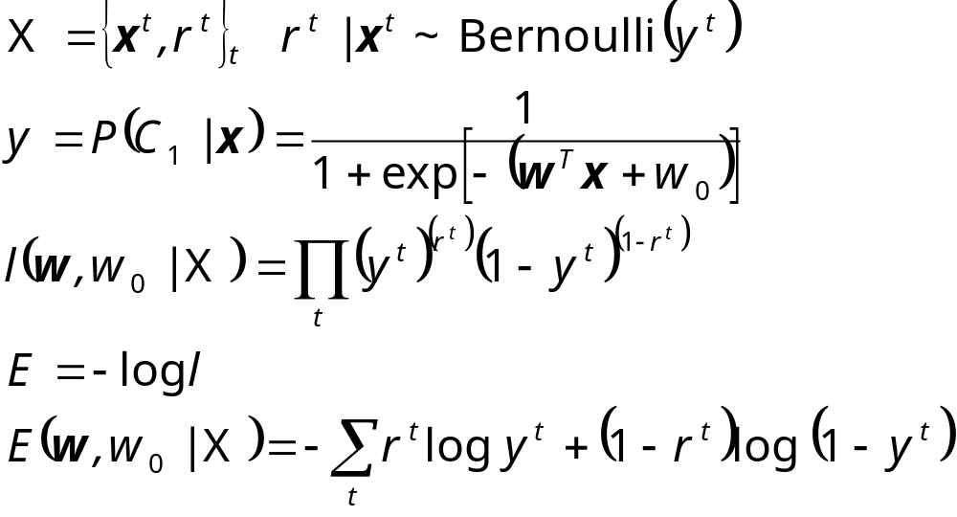
Training: Two Classes
Lecture Notes for E Alpaydın 2004 Introduction to Machine Learning © The MIT Press (V1.1)

Slide 17
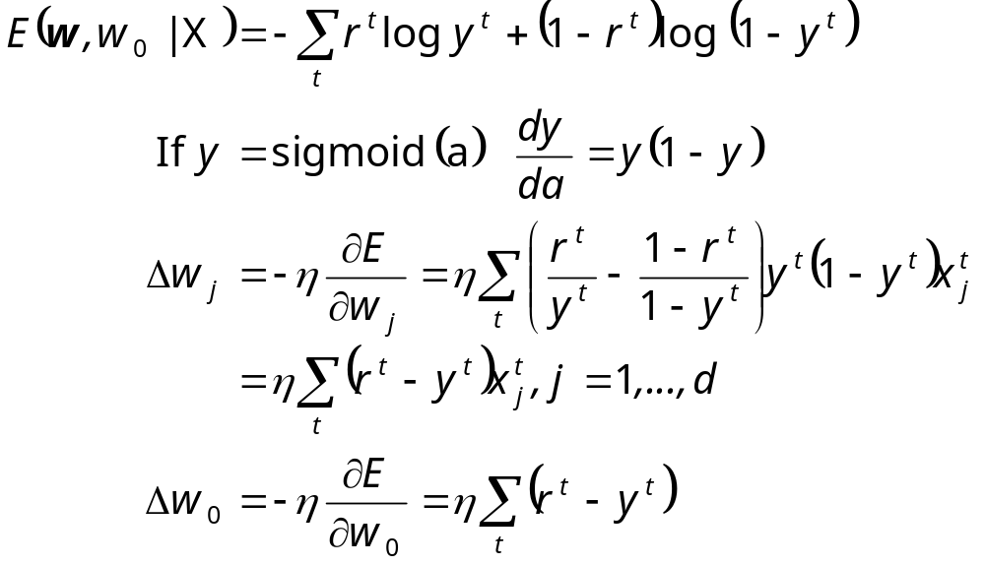
Training: Gradient-Descent
Lecture Notes for E Alpaydın 2004 Introduction to Machine Learning © The MIT Press (V1.1)

Slide 18
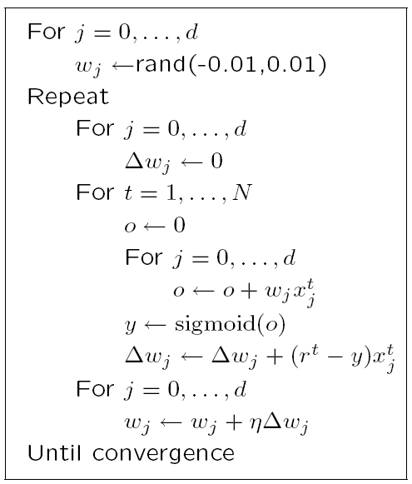
Lecture Notes for E Alpaydın 2004 Introduction to Machine Learning © The MIT Press (V1.1)

Slide 19
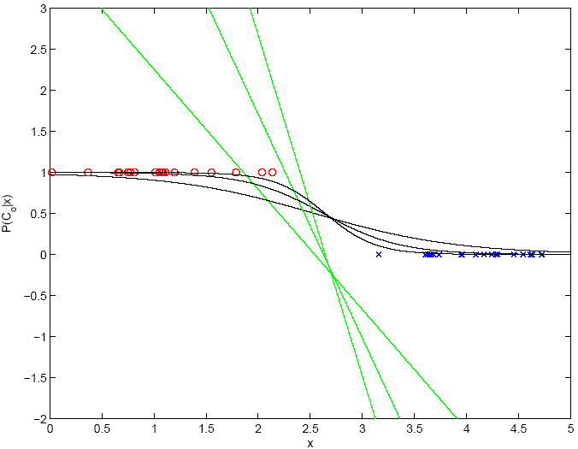
100
1000
10
Lecture Notes for E Alpaydın 2004 Introduction to Machine Learning © The MIT Press (V1.1)

Slide 20
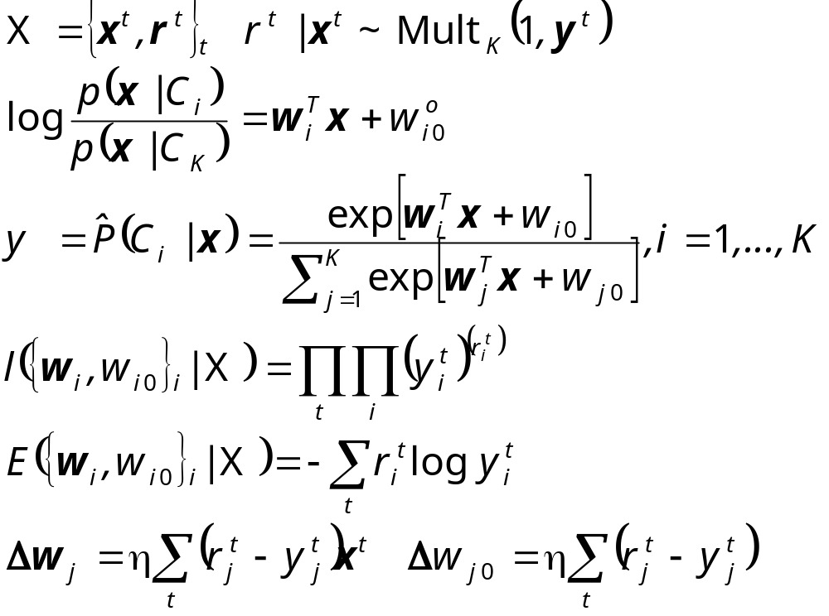
K>2 Classes
softmax
Lecture Notes for E Alpaydın 2004 Introduction to Machine Learning © The MIT Press (V1.1)

Slide 21
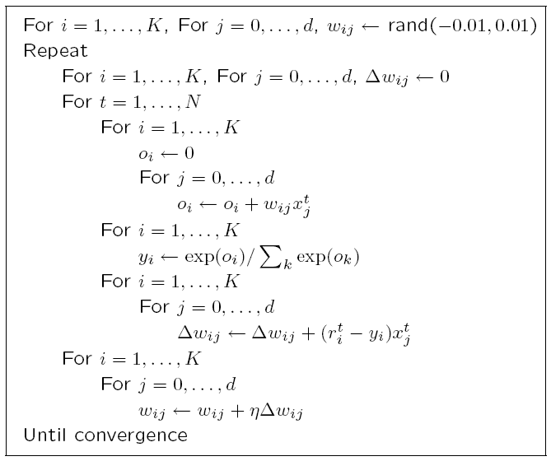
Lecture Notes for E Alpaydın 2004 Introduction to Machine Learning © The MIT Press (V1.1)

Slide 22
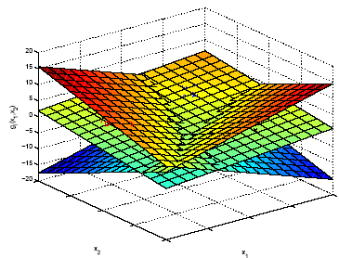
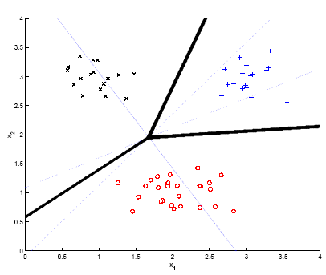
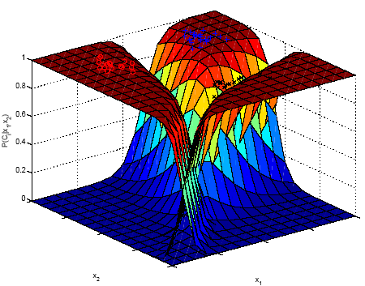
Example
Lecture Notes for E Alpaydın 2004 Introduction to Machine Learning © The MIT Press (V1.1)

Slide 23
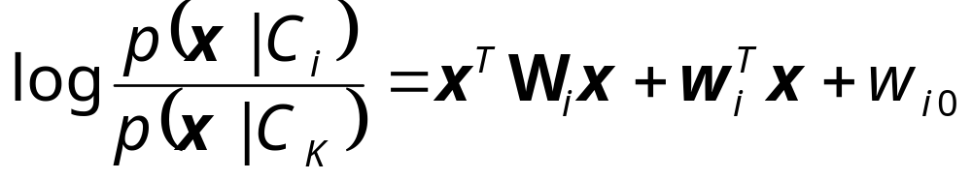
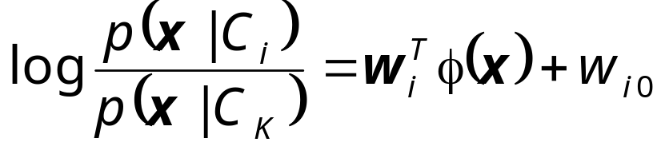
Generalizing the Linear Model
Quadratic:
Sum of basis functions:
where φ(x) are basis functions
  Kernels in SVM
  Hidden units in neural networks
Lecture Notes for E Alpaydın 2004 Introduction to Machine Learning © The MIT Press (V1.1)

Slide 24
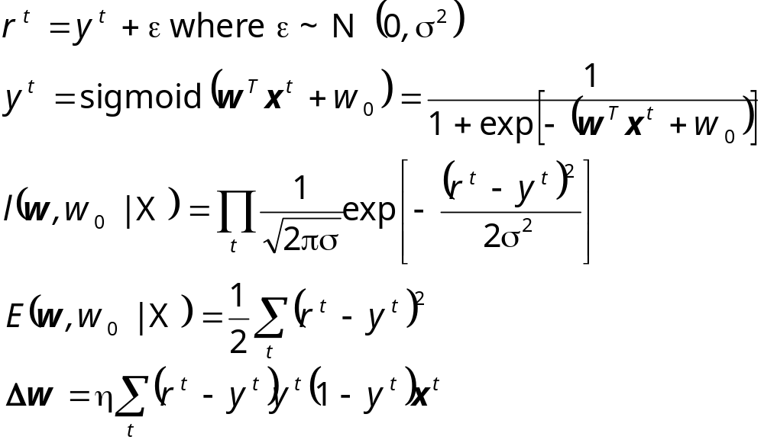
Discrimination by Regression
Classes are NOT mutually exclusive and exhaustive
Lecture Notes for E Alpaydın 2004 Introduction to Machine Learning © The MIT Press (V1.1)

Slide 25
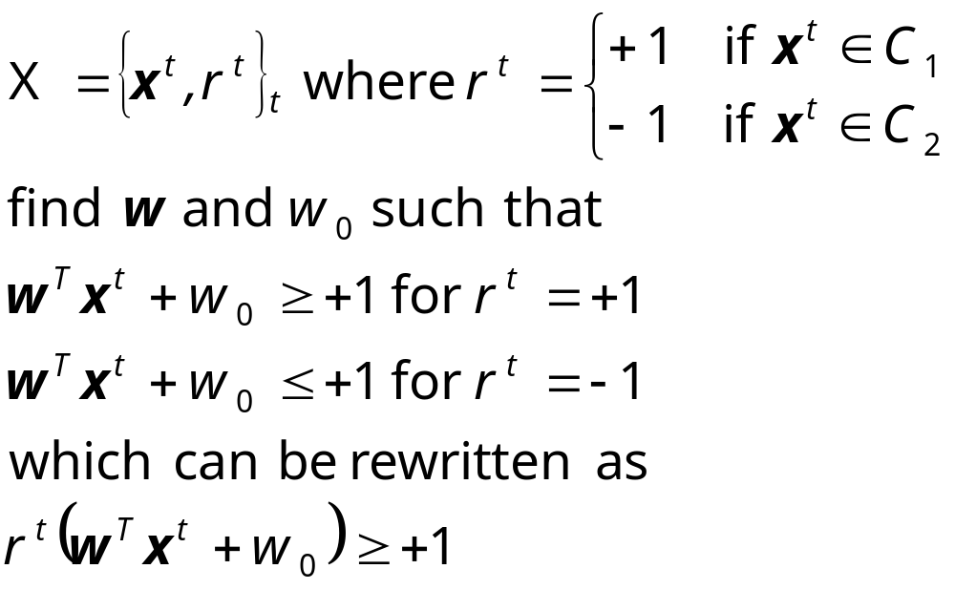
Optimal Separating Hyperplane
(Cortes and Vapnik, 1995; Vapnik, 1995)
Lecture Notes for E Alpaydın 2004 Introduction to Machine Learning © The MIT Press (V1.1)

Slide 26
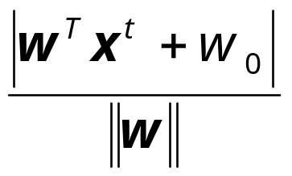
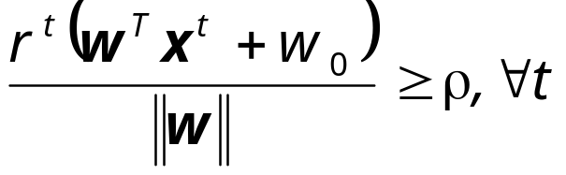
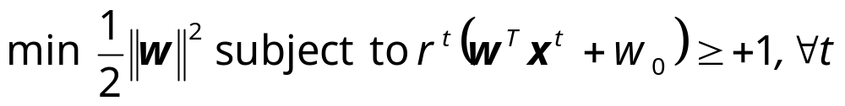
Margin
Distance from the discriminant to the closest instances on either side
Distance of x to the hyperplane is
We require
For a unique sol’n, fix ρ||w||=1and to max margin
Lecture Notes for E Alpaydın 2004 Introduction to Machine Learning © The MIT Press (V1.1)

Slide 27
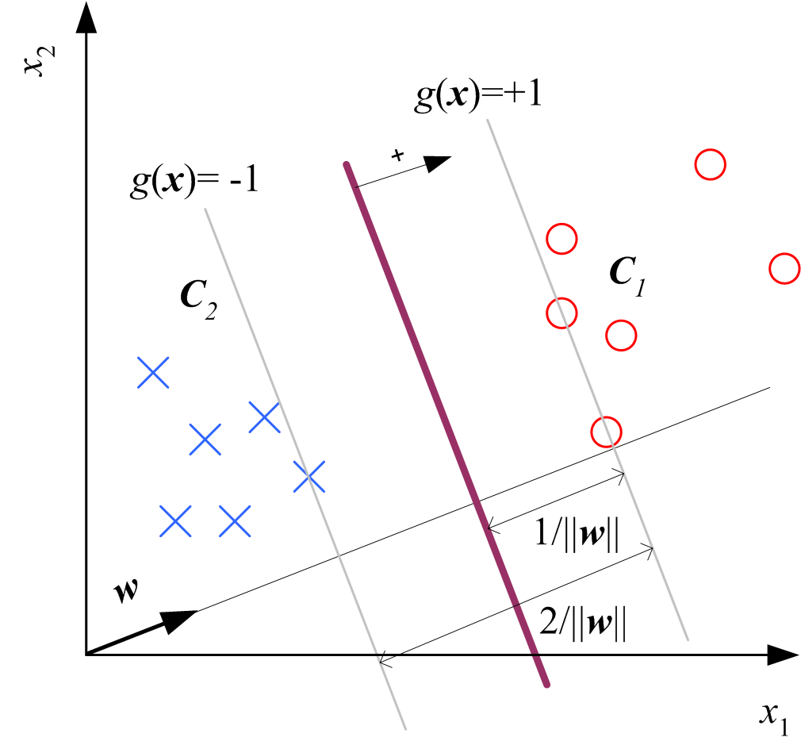
Lecture Notes for E Alpaydın 2004 Introduction to Machine Learning © The MIT Press (V1.1)

Slide 28
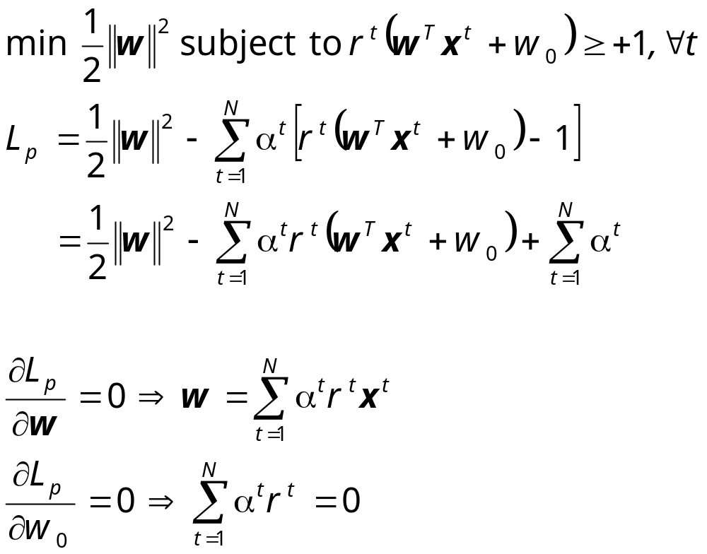
Lecture Notes for E Alpaydın 2004 Introduction to Machine Learning © The MIT Press (V1.1)

Slide 29
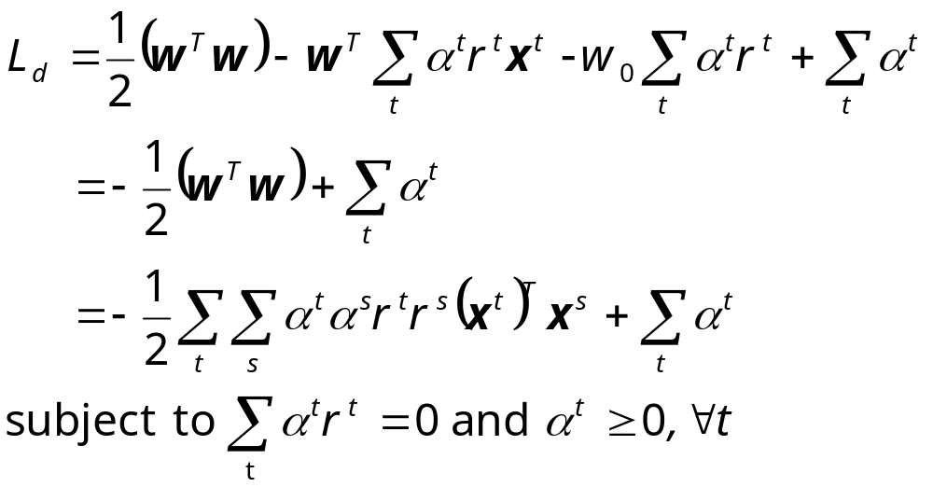
Most α^{t} are 0 and only a small number have α^{t} >0; they are the support vectors
Lecture Notes for E Alpaydın 2004 Introduction to Machine Learning © The MIT Press (V1.1)

Slide 30
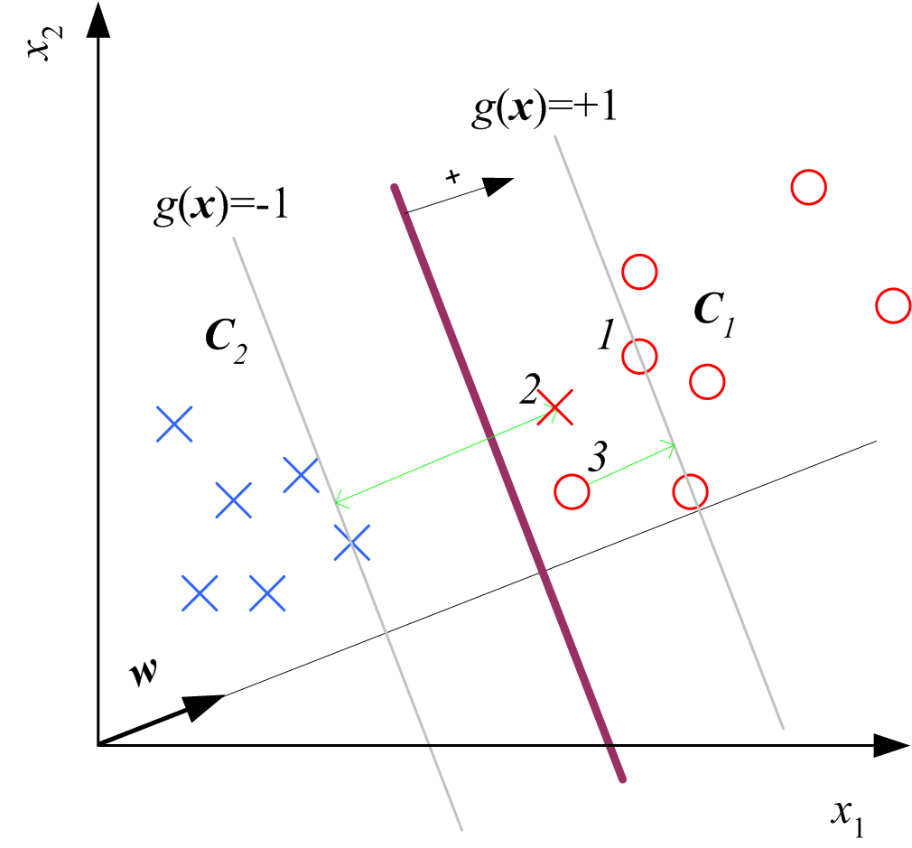
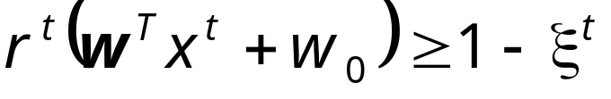
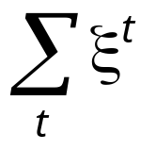
Soft Margin Hyperplane
Not linearly separable
Soft error
New primal is
Lecture Notes for E Alpaydın 2004 Introduction to Machine Learning © The MIT Press (V1.1)

Slide 31
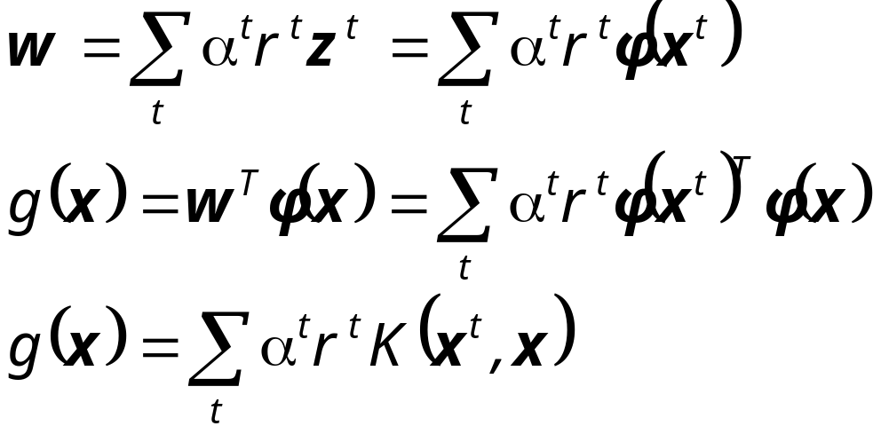
Kernel Machines
Preprocess input x by basis functions
z = φ(x) g(z)=w^{T}z
g(x)=w^{T} φ(x)
The SVM solution
Lecture Notes for E Alpaydın 2004 Introduction to Machine Learning © The MIT Press (V1.1)

Slide 32
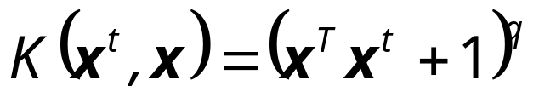
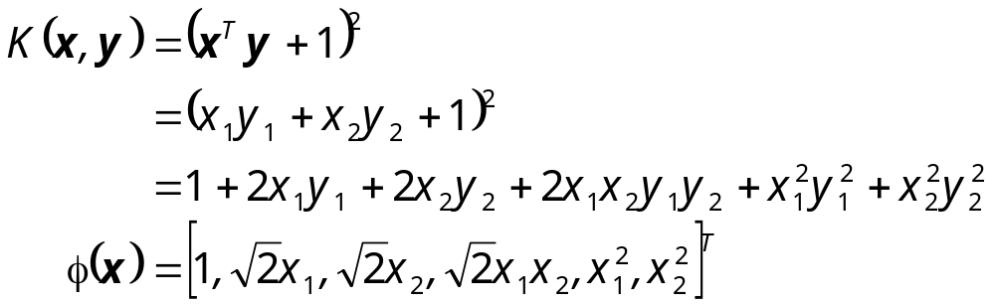
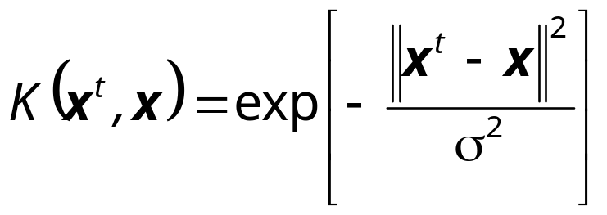

Kernel Functions
Polynomials of degree q:
Radial-basis functions:
Sigmoidal functions:
(Cherkassky and Mulier, 1998)
Lecture Notes for E Alpaydın 2004 Introduction to Machine Learning © The MIT Press (V1.1)

Slide 33
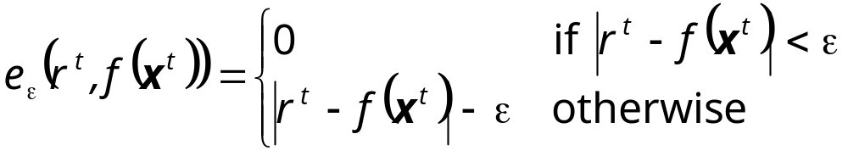
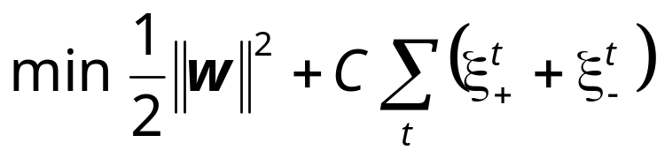
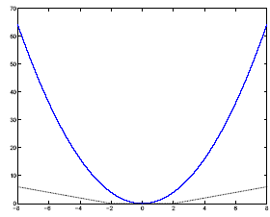

SVM for Regression
Use a linear model (possibly kernelized)
  f(x)=w^{T}x+w₀
Use the є-sensitive error function
Lecture Notes for E Alpaydın 2004 Introduction to Machine Learning © The MIT Press (V1.1)

