Slide 1
StackOverflow API Knowledge Base

Slide 2
Introduction
Problem Statement:
Design a data pipeline architecture to ingest data from StackOverflow API which can serve as a seamless knowledge source to answer business queries.
Proposed Solution Summary:
End-to-End data driven solution for StackOverflow data Analytics using GCP bigdata products.
The final data is collected as a Knowledge base to BigQuery which can be queried for any insight based on the business requirements by BI Tools.
Two main data sources: Questions and Answers endpoints.
Questions: Mostly contains questions posted by users for a particular date range.
Answers: Knowledge base for answers supplied by users to posted questions on the platform.
Few applications of knowledge base are User Analytics, Summary Dashboards and Forecasting for Audience Targeting Campaigns, Product/Post uplifting etc.

Slide 3
Data Source
Why StackAPI? Why not StackExchange API?
StackAPI is a better Python Wrapper around the existing StackExchange API to deal with technical nuances.
API serves seamlessly in few lines of code.
There are request quota limitations which can hinder the data ingestion process.
To avoid hitting request quota, it is suggested to query and store on incremental basis rather than full data crawling.
To maintain history of data load, Snapshot tables are maintained and used as final knowledge base.

Slide 4
Data Pipeline Architectural Design Choices
Main Components
Cloud Data Platform: BigQuery
Data Ingestion Application Platform: Apache Airflow(Cloud Composer for GCP)
Why BigQuery?
Petabyte-Scale Data warehouse without any maintenance of clusters to run the queries.
BigQuery can be integrated with several BI tools like ThoughtSpot, PowerBI, Looker, native Google Data Studio 360 etc.
Why Apache Airflow?
Better for scheduled data ingestion, analytics and orchestration. Apache Airflow leverages Celery as its main executor for better task queue handling and parallel processing.
No Docker management required.
Cloud Composer is a managed service provided for Apache Airflow which allows autoscaling.
It comes with better WebUI for tracking data lineage and data transformation stages.
Why not AppEngine, Cloud Functions, Cloud Run?
AppEngine: Requires setup of custom containerised application from scratch. Application needs to have attached persistent disk for storage and data base for data lineage tracking graph and finally custom CRON scheduler. Good for seamless multiprocessing.
Cloud Functions: Suffers from execution timeout of 9 minutes and multiprocessing logic can’t be achieved. Lacks scheduling capability.
Cloud Run: Application needs to be built on Flask in case of Python and exposed as endpoint service for trigger and it suffers from execution timeout of 60 minutes. Lacks scheduling capability.

Slide 5



Data Ingestion Pipeline Summary Architecture
StackAPI
(Source)
Cloud Composer for Apache Airflow
Staged BigQuery Tables
Fact BigQuery Tables
Questions Endpoint
Stage Questions
Fact Questions
DAG Application
Answers Endpoint
Stage Answers
Fact Answers

Slide 6
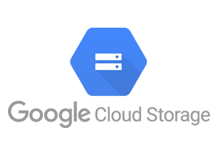




Data Pipeline Magnified Architecture
Data Ingestion and Data Lake formation
Data Staging and Transformations for Incremental Load
Snapshot Tables for BI
SITE = StackAPI('stackoverflow',max_pages=20,page_size=100)
STG_ANSWERS
STG_QUESTIONS
SNAP_FCT_ANSWERS
SNAP_FCT_QUESTIONS
SITE.fetch(‘questions’, fromdate=day-1, todate=day)
JSON Response
SITE.fetch(‘answers’, fromdate=day-1, todate=day)
JSON Response
Data Type Transformations
Knowledge Base
FCT_ANSWERS
FCT_QUESTIONS
GCS Bucket (gs://stackapi-data)
Format-CSV
QUESTIONS
ANSWERS
BI Tools

Slide 7
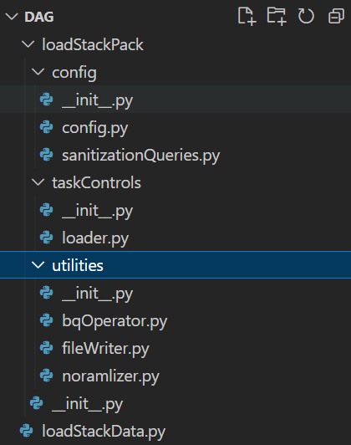
Project Structure
Project Modules:
loadStackData.py - Main DAG file which Apache Airflow looks out for to upload it to WebUI server. This file contains the modules loaded from loadStackPack package folder.
loadStackPack: Modularized Python Package to serve functional classes for DAG. This file has 3 main components.
config: Contains configuration class for project environment setup.
utilities: Contains helper functions for writing files, data cleansing and BigQuery connections.
taskControls: Main module which utilizes other configuration and utility modules for building task class. This is the main module to run data ingestion.
NOTE:
Apache Airflow has special process to handle with custom modules. It doesn’t support relative imports and requires a full path to the modules when importing them. This can be resolved by using sys.append(‘module path’).

Slide 8

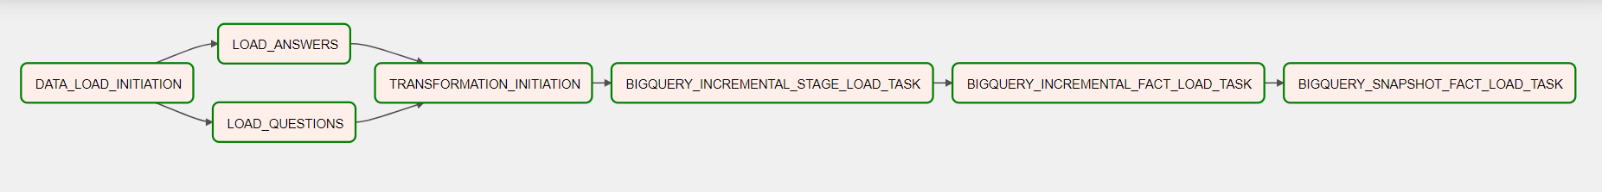
Data+Task Lineage Tractability
Data Pipeline Tractability can be done using either the main DAG file code or it can be visualized using Apache Airflow WebUI.
Tasks Lineage: At the end of the loadStackData.py, there is a special code flow as shown in the figure left.
This shows separate functions each executable by DAG with special kwarg named as **context which can be used to pass down contextual information from one task to another.
A detailed discussion is done in next slides to explain each tasks’ responsibility.
Task Lineage Visualisation: From the Apache Airflow WebUI, Graph visualisation can be retrieved to get an idea of how tasks will be upstreamed and downstreamed.
For Stack Overflow API data ingestion pipeline, Graph visualisation is provided below.

Slide 9
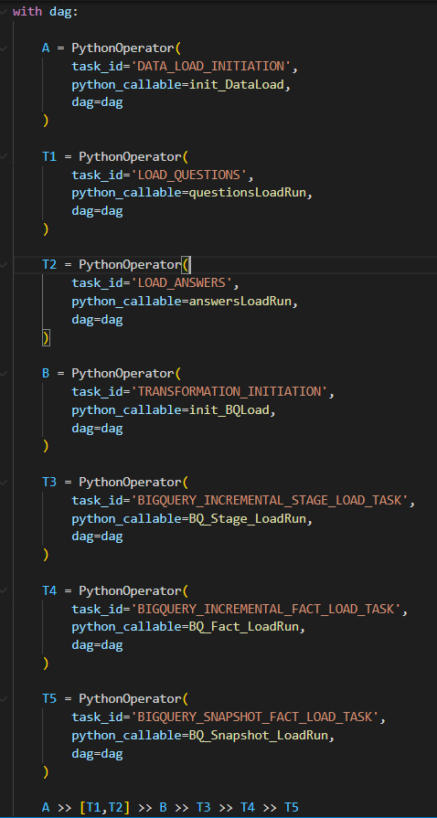
Tasks Lineage Brief
Task: A
* DATA_LOAD_INITIATION: Starting checkpoint to notify about loading commencement.
Task: T1
* LOAD_QUESTION: Python Operator responsible for loading and saving Questions data from Stack API as CSV in GCS bucket.
Task: T2
* LOAD_ANSWERS: Python Operator responsible for loading and saving Answers data from Stack API as CSV in GCS bucket.
Task: B
* TRANSFORMATION_INITIATION: Checkpoint for ending of Data Load and starting of transformation and loading to BigQuery
Task: T3
* BIGQUERY_INCREMENTAL_STAGE_LOAD_TASK: Incremental upload of pulled data from GCS to Staging table in Bigquery
Task: T4
* BIGQUERY_INCREMENTAL_FACT_LOAD_TASK: Incremental upload of pulled data from Staging to Fact table in Bigquery
Task: T5
* BIGQUERY_SNAPSHOT_FACT_LOAD_TASK: History upload of pulled data from Fact table to Snapshot table in Bigquery

Slide 10
DAG Run Test

Slide 11
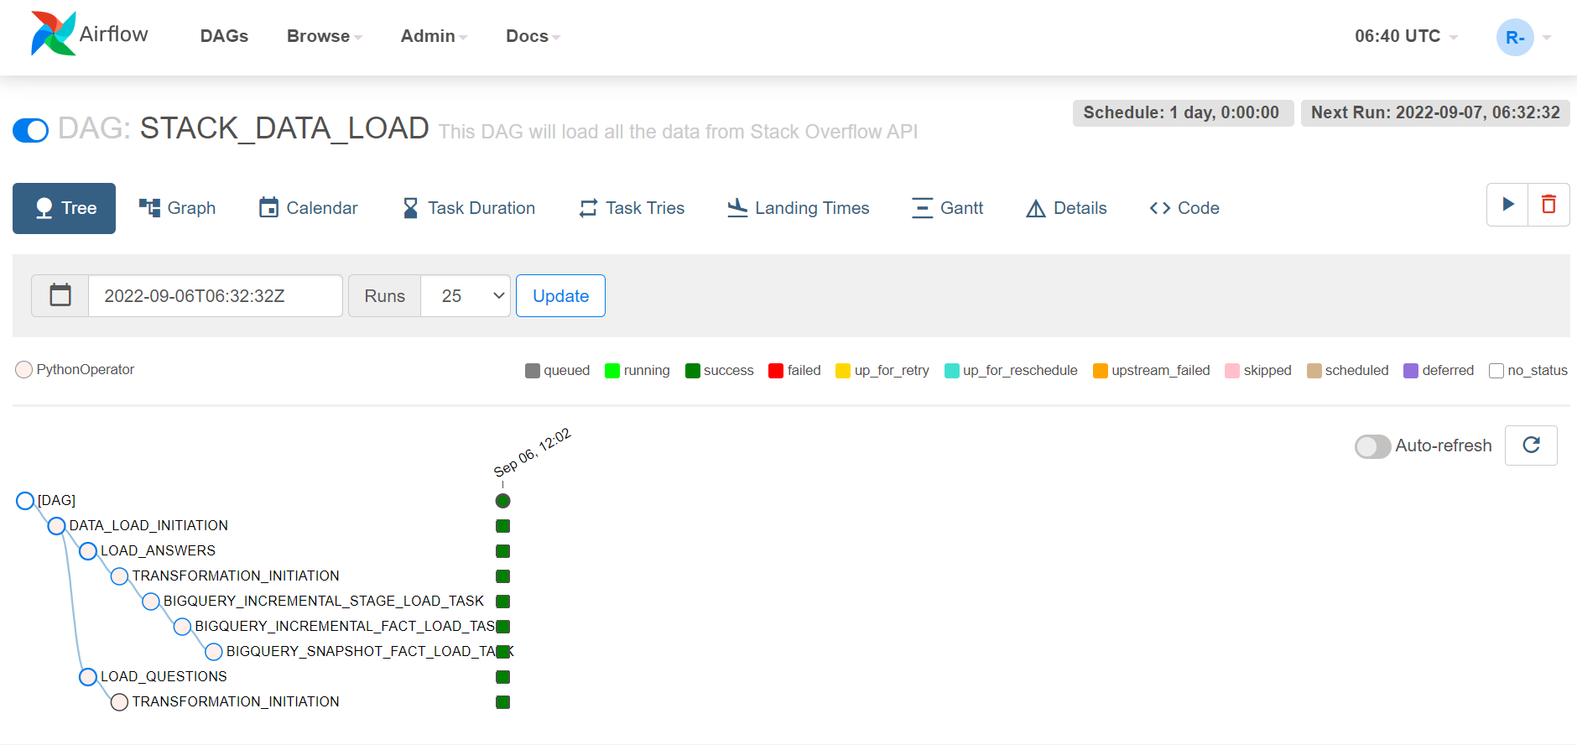
Screen Shot for Live Run

Slide 12
Conclusion
DAG is fully operational and Snapshot Tables can be used for EDA.
Since BigQuery is used a cloud data platform, it support integration with many of BI tools.
At the moment, only Questions and Answers being pulled from API, but it is possible to pull other data as well like Users etc.
Each of the tables are kept separate so that dimensions can be as granular as possible. For higher insights, these tables can be joined using common attributes but granularity will change accordingly.
Data Lineage can be tracked via Apache Airflow WebUI where each task is granular and defines a single action over the data in question.

