Slide 1
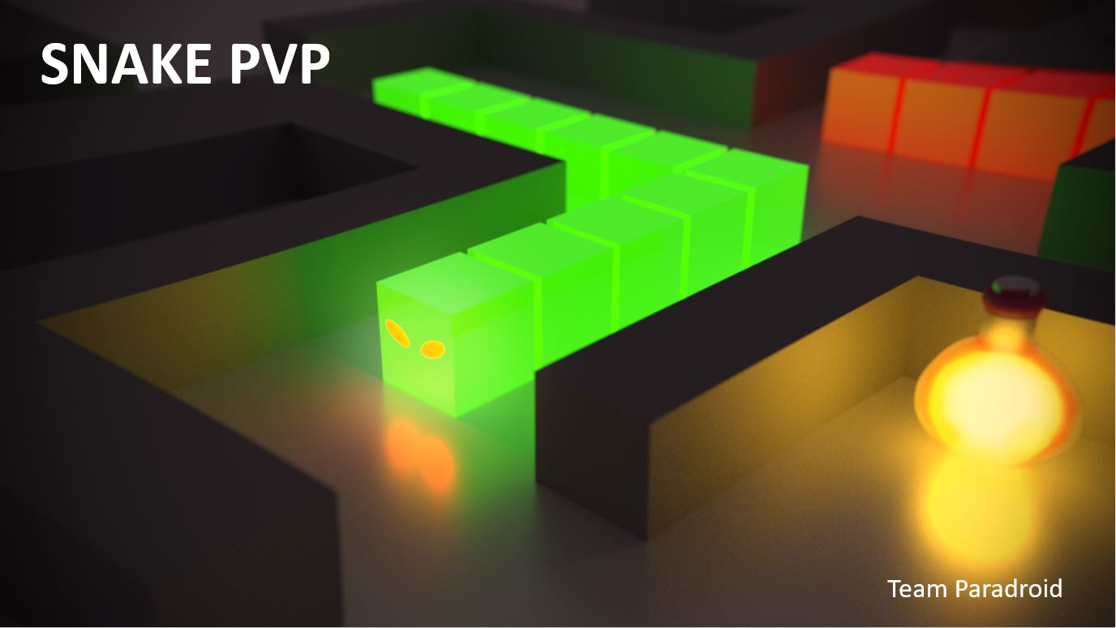

Slide 2
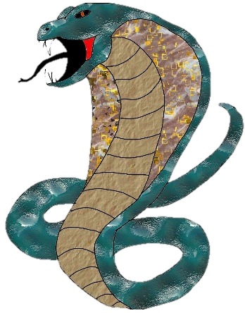
What is our game all about?
We have designed a game which is a crossover between Pac-Man and Snakes, with many additional perks.
The player’s goal is to make their enemy lose all their lives by hitting various obstacles (including themselves). This can be made easier by eating food, which will increase their length and decrease the opponent’s.
The player and the enemy (which can be AI or player-controlled) compete on a pre-made or randomly generated map.
The player is also provided with the option to buy new skins from the in-game shop in order to customize their experience.

Slide 3
What is our game all about?
Before we started programming, we understood the importance of thorough planning and preparation to yield a high quality product.
In our research, we understood that there were multiple factors which played a part in producing a successful game:
- Game goals to achieve
- Intuitive game options
- ‘Easy to use, difficult to master’
- ‘Differentiate and Innovate, Don't Imitate’
- Appeal to a wide audience
- Interesting decisions
Throughout this presentation we will refer to these points and explain
not only how we have achieved this, but how we have gone beyond!

Slide 4
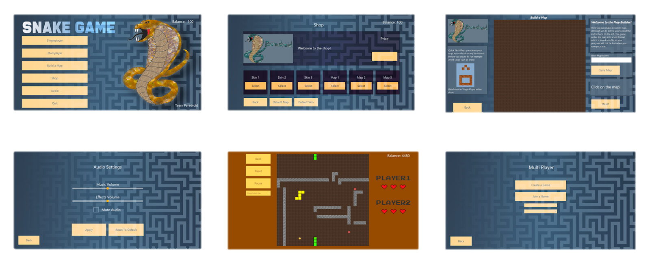
User Interface
When we first began designing the UI, we took extra consideration to ensure we implemented only the best HCI principles.
Ultimately, we wanted to achieve a clean, minimalistic looking interface which enabled the user to access any component of the game with ease.
All of our buttons are clearly labelled, easily accessible and consistent. They are responsive to mouse hover/click and very well contrasted with the background. This use of contrast and our choice to use a minimalistic aesthetic ensures that the users’ cognitive load is reduced.
The buttons are also forgiving: the user is easily able to backtrack if a mistake was made.

Slide 5
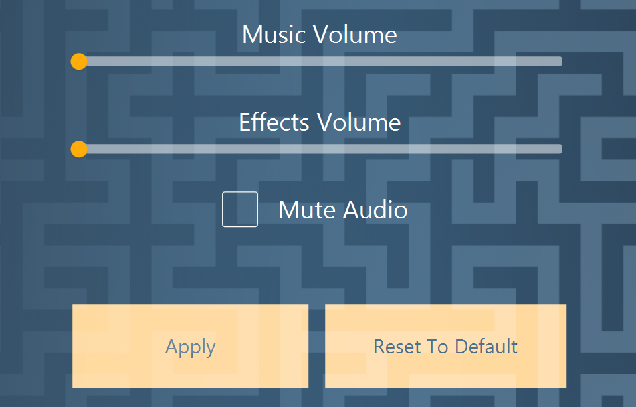
Audio
We believe our audio is completely compatible for our game:
It is impactful and enhances the players’ experience, yet it does not distract from the game itself.
We believe our audio helps to tell a story: one of a snake conquering competitors to finally accomplish the main goal of purchasing all items in the shop.
Our game also incorporates sound effects to further aid interactions with the user.
The audio is completely adjustable, so a player can make their own choices.

Slide 6
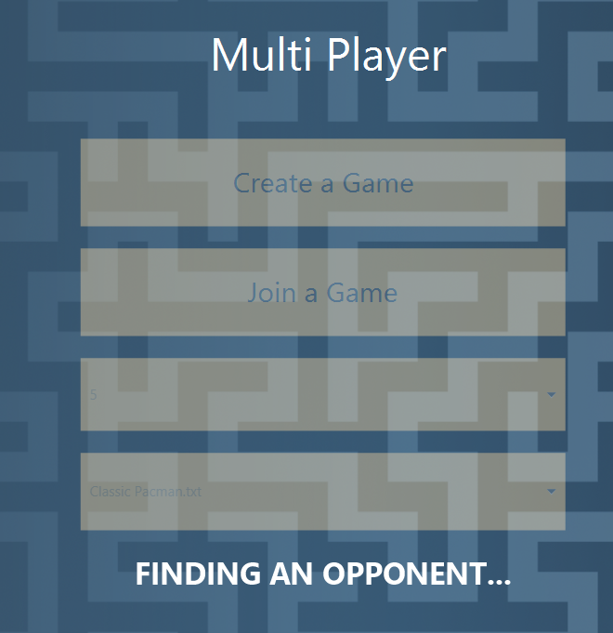
Networking
In our final product, we believe we have created a robust and reliable Multiplayer game mode which uses a Client-Server model.
Extra effort was made to ensure each player, whether the Host or the Client, would be able to play with their preference of Map Skin/ Snake Skin.
Our multiplayer mode includes the best of both worlds. Players are able to play with all the features in single player mode but are also given the freedom to play against a player of their choice. They also have the option to choose a custom map, perhaps made by one of the players. This results in not only enjoyable competitive games, but an added personal touch.

Slide 7
Gameplay
In our game we wanted to include customisation as well as game goals to create a personal experience.
We explored many game options, but agreed on a Single Player mode in which the user has the choice between ‘Easy’, ‘Medium’ or ‘Hard’ mode where the mode is determined by the intelligence of the AI Snake.
Alongside game models such as Pac-Man and Snake, we were inspired by the following quote: ‘Differentiate and Innovate, Don't Imitate’. Whilst we didn’t want to reinvent the wheel, we believe we improved these classic games through combining features and adding supporting features such as power-ups, our Map Builder and in-game Shop.
We feel our game is easy to use according to our user feedback, so we can say with confidence we have achieved our goal of reaching out to a wide audience.

Slide 8
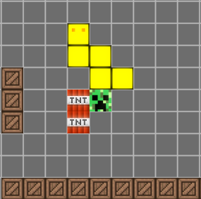
AI
A major component for the success of our game is our AI implementation
The intelligence of the AI snake is determined by the effectiveness of the pathfinding, where in easy mode and medium mode the path finding is limited to within the boundaries of the map, but in hard mode the AI snake is able to cut through opposing ends of the map to maximise efficiency in obtaining a fruit
By providing a player with these options, they can play in any game mode. The easier game mode only adds 10 to the balance, medium mode adds 25, and finally, 50 is added in the harder game mode
We feel that we have optimised the difficulties, allowing for a rewarding progression through the game. From feedback, we learned that players felt like they gradually improved, using the easier levels to develop their skills and eventually succeed in the harder game mode.

Slide 9
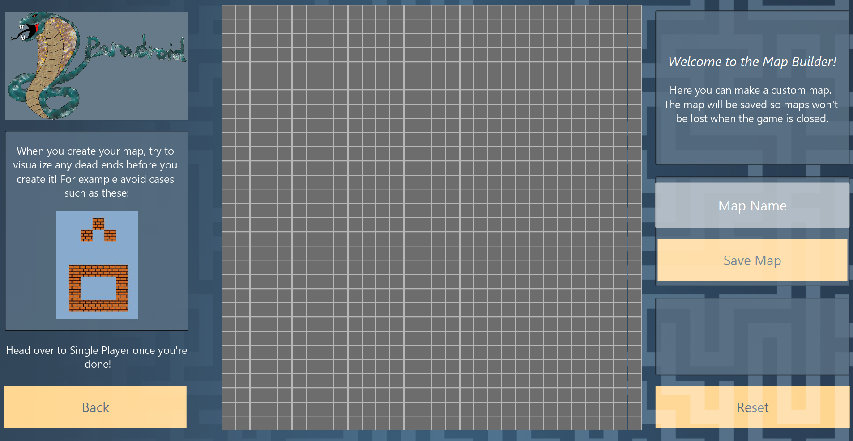
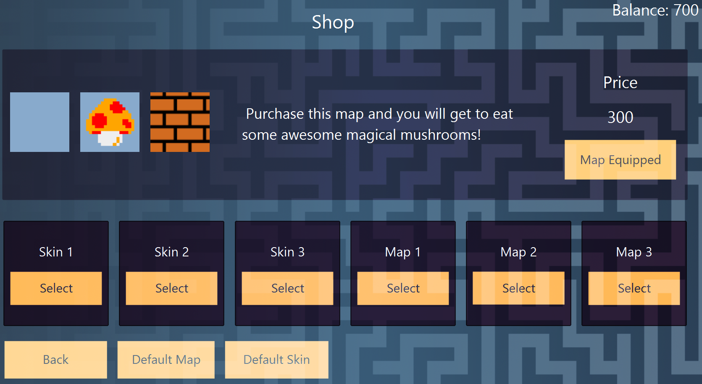
Extra Features
Map Builder:
The map builder feature allows our players to create and customise their own maps.
Linked to our shop, the purchases, such as snake and map skins, can be applied to these maps.
Everything is encoded onto a text file which means that all progress is saved. This protects our players from the disappointment of losing game progress.
Shop:
We have included a shop to add an extra dimension of challenge and thus, reward. While the items (snake and map skins), are difficult to earn, they are rewarding and increase motivation to play the game.
The snake and map skins are particularly rewarding as they add to the tailored experience we provide.

Slide 10
Conclusion
Overall, we believe our game in its entirety is a success.
We would like to finish with a quote from our report which we believe sums everything up very well:
‘The team project has turned out to be quite successful, in our opinion. The game logic is solid, the networking is very good, the AI is exceptional, and the user interface that connects all parts of the game is remarkable and aesthetically pleasing. The game is up to the team’s standards and has achieved all set out goals, all thanks to the high level of commitment of the team and their previous programming experience.’

