Slide 1
LESS IS MORE. POWER OF 3.
SPEAK 3 POINTS
ASK QUESTIONS ON AFTER EVERY 3 POINTS
ARE WE CLEAR WITH ALL THE THREE POINTS
CHANGE YOUR AGENDA IN 3-3 POINTS

Slide 2
Getting started with C# 9.0
Shipped with .NET 5 in upcoming November 2020
Preview version available from May 20
Prerequisite
Visual Studio version 16.6 or higher
.NET SDK installed

Slide 3
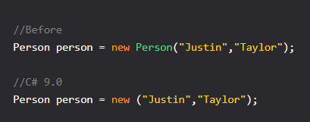
Target-typed "new"
Expression doesn't need to say type it will come from context like below:

Slide 4
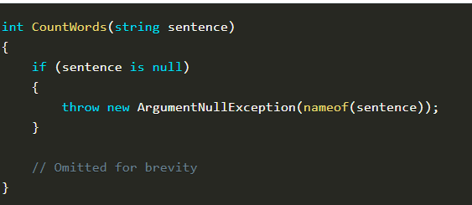
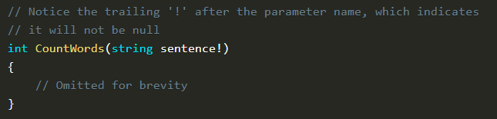
Null Checks No More
This proposal aims to eliminate the need for explicit null checking by allowing an operator ! to be added to a parameter to indicate to the compiler that a given value will not be null.

Slide 5
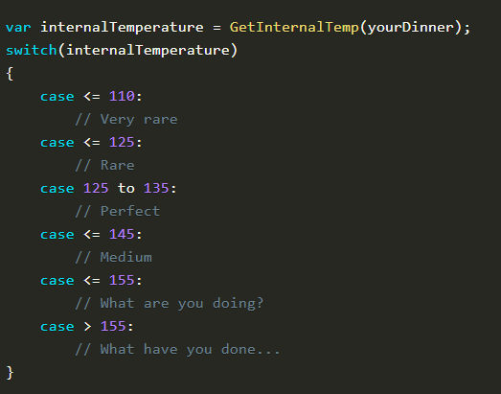
Switching It Up ... Visual Basic Style?
Despite C# undergoing nearly nine entire revisions, support for comparison operations within switch statement was never supported (although pattern matching comes close), this proposal aims to remedy that.

Slide 6
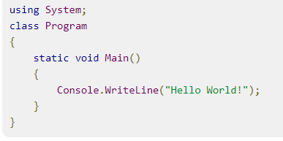
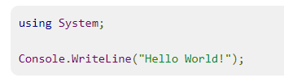
Top-level programs
Writing a simple program in C# requires a remarkable amount of boilerplate code:
In C# 9.0 you can just choose to write your main program at the top level instead:

Slide 7
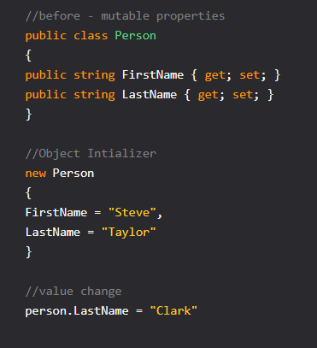
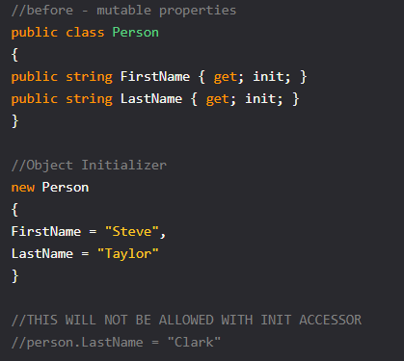
Init-only properties
Object initializers allows to create an object in a very flexible and readable format
"The one big limitation today is that the properties have to be mutable for object initializers to work" Init-only properties fix that!
Note: init-only properties are also useful to make individual properties immutable.

Slide 8
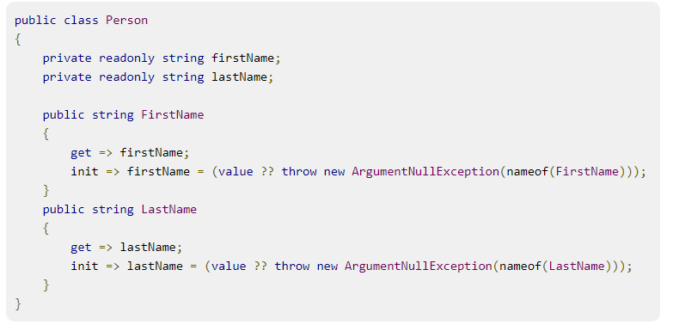
Init accessors and readonly fields
Because init accessors can only be called during initialization, they are allowed to mutate readonly fields of the enclosing class, just like you can in a constructor.

Slide 9
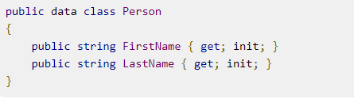
Records
Records are a new, simplified declaration form for C# class and struct types that combine the benefits of a number of simpler features. It can represent data as a Database record or some model entity
Records, for declaring a whole object to be immutable and have it behave like a value. Records are intended to be seen more like data and less like objects.
The data keyword on the class declaration marks it as a record. This imbues it with several additional value-like behaviors, which we’ll dig into in the following. Generally speaking, records are meant to be seen more as “values” – data! – and less as objects.
Read-only properties => Immutable Type Equality implementations => Structural equality Pattern-matching support = is pattern, switch pattern etc.

Slide 10
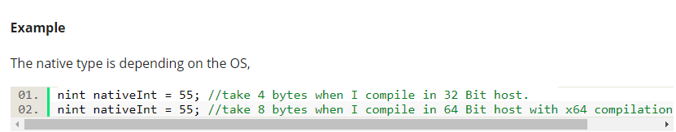
Native Ints
Introduces a new set of native types (nint, nuint) the ‘n’ for native. The design of the new data types is planned to allow a one C# source file to use 32 naturally- or 64-bit storage depending on the host platform type and the compilation settings.

