Slide 1
Vault-X
B K BIRLA HACKATHON
One Platform, Infinite Possibilities
THEME-
ARTIFICIAL INTELEGENCE IN SECURITY
TEAM NAME-
Team Cyber

Slide 2
Vault-X
PROBLEM
B K BIRLA HACKATHON
One Platform, Infinite Possibilities
THEME-
ARTIFICIAL INTELEGENCE IN SECURITY
TEAM NAME-
Team Cyber
With vast amount of sensitive data stored in the cloud, organizations struggle to maintain privacy while meeting regulatory requirements. The challenge is to integrate encryption,role-based access control, and real-time threat detection to protect confidential information without affecting cloud efficiency and scalability

Slide 3
PROBLEM
Saas Service For Organizations
B K BIRLA HACKATHON
Vault-X
INTRGRATE ENCRIPTION
With vast amount of sensitive data stored in the cloud, organizations struggle to maintain privacy while meeting regulatory requirements. The challenge is to integrate encryption,role-based access control, and real-time threat detection to protect confidential information without affecting cloud efficiency and scalability
One Platform, Infinite Possibilities
ROLE BASED ACCESS
THEME-
ARTIFICIAL INTELEGENCE IN SECURITY
TEAM NAME-
Team Cyber
REAL TIME THREATH DETECTION

Slide 4
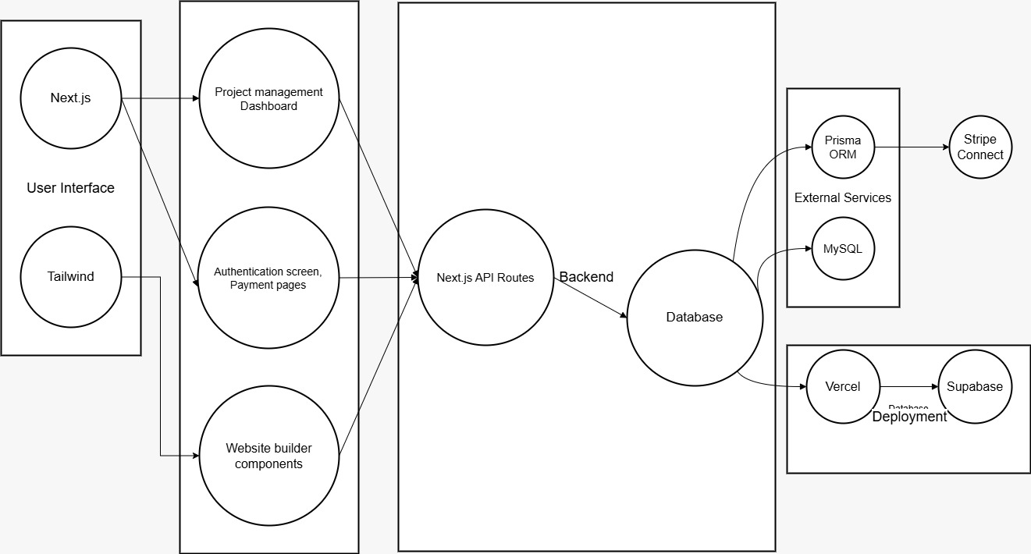
Saas Service For Organizations
INTRGRATE ENCRIPTION
ROLE BASED ACCESS
REAL TIME THREATH DETECTION
METHODOLOGY
PROBLEM
USER INTERACTION LAYER
Next.js
Tailwind
API LAYER
Next.js API routes
Authentication and Authorization
NextAuth.js
Database Layer
Prisma ORM
MySQL
With vast amount of sensitive data stored in the cloud, organizations struggle to maintain privacy while meeting regulatory requirements. The challenge is to integrate encryption,role-based access control, and real-time threat detection to protect confidential information without affecting cloud efficiency and scalability
Payment Processing
Stripe
Deployment and Hosting
Vercel
Supabase

Slide 5
METHODOLOGY
FEASIBILITY AND VIABILITY
Saas Service For Organizations
USER INTERACTION LAYER
Next.js
Tailwind
API LAYER
INTRGRATE ENCRIPTION
Next.js API routes
ROLE BASED ACCESS
Authentication and Authorization
NextAuth.js
Payment Processing
Stripe
Database Layer
Deployment and Hosting
Prisma ORM
MySQL
Vercel
Supabase
High Market Potential – Strong demand for a simple website builder with project management.
Scalability Risks – Requires optimized APIs, caching, and database management.
Security & Compliance – Protect user data with authentication and secure payments.
Competition Challenge – Differentiate with better UI and unique features.
Real-Time Updates – Use WebSockets or Firebase for smooth collaboration.
Cost Control – Optimize hosting and database queries to reduce expenses
REAL TIME THREATH DETECTION

Slide 6
FEASIBILITY AND VIABILITY
IMPACT AND BENEFITS
METHODOLOGY
USER INTERACTION LAYER
High Market Potential – Strong demand for a simple website builder with project management.
Scalability Risks – Requires optimized APIs, caching, and database management.
Security & Compliance – Protect user data with authentication and secure payments.
Competition Challenge – Differentiate with better UI and unique features.
Real-Time Updates – Use WebSockets or Firebase for smooth collaboration.
Cost Control – Optimize hosting and database queries to reduce expenses
Next.js
Tailwind
Next.js API routes
NextAuth.js
Prisma ORM
MySQL
Empowers Businesses – Easy website creation for startups and creators.
Affordable – Reduces web development costs.
Secure & Private – Integrates encryption and role-based access for data protection.
Real-Time Security – Detects threats instantly for safer operations.
Eco-Friendly – Reduces paper use and promotes sustainability.
Improves Collaboration – Enhances teamwork with real-time tools.
Stripe
Vercel
Supabase

Slide 7
IMPACT AND BENEFITS
FEASIBILITY AND VIABILITY
RESEARCH AND REFRENCES
Empowers Businesses – Easy website creation for startups and creators.
Affordable – Reduces web development costs.
Secure & Private – Integrates encryption and role-based access for data protection.
Real-Time Security – Detects threats instantly for safer operations.
Eco-Friendly – Reduces paper use and promotes sustainability.
Improves Collaboration – Enhances teamwork with real-time tools.
High Market Potential – Strong demand for a simple website builder with project management.
Scalability Risks – Requires optimized APIs, caching, and database management.
Security & Compliance – Protect user data with authentication and secure payments.
Competition Challenge – Differentiate with better UI and unique features.
Real-Time Updates – Use WebSockets or Firebase for smooth collaboration.
Cost Control – Optimize hosting and database queries to reduce expenses
TO BE CONTINUED

Slide 8
RESEARCH AND REFRENCES
THANKYOU
IMPACT AND BENEFITS
TO BE CONTINUED
Vault-X
Empowers Businesses – Easy website creation for startups and creators.
Affordable – Reduces web development costs.
Secure & Private – Integrates encryption and role-based access for data protection.
Real-Time Security – Detects threats instantly for safer operations.
Eco-Friendly – Reduces paper use and promotes sustainability.
Improves Collaboration – Enhances teamwork with real-time tools.
One Platform, Infinite Possibilities

Slide 9
THANKYOU
RESEARCH AND REFRENCES
Vault-X
One Platform, Infinite Possibilities
TO BE CONTINUED

