Slide 1

2023 2nd International Conference for Advancement in Technology (ICONAT 2023)
Autonomous Drone Navigation using Monocular
Camera and Light Weight Embedded System
Paper ID: 361
Rahul H Kumar, Anil M Vanjare, Dr. S N Omkar
Indian Institute of Science, Bangalore

Slide 2

Outline
Introduction
Prior Literature
Background
Obstacle Localization Algorithm
Path Planning Based On Bug 0 Algorithm
Light Weight Embedded System Architecture
Experiments and Results
Conclusion
References

Slide 3
Introduction
Autonomous drones are robots that can navigate without any human interference. They path plans such that the right goal location is reached while avoiding obstacles actively.
The applications of autonomous drones is growing across industries like mining, agriculture, defense, security, logistics etc.
This paper proposes a full stack architecture for autonomous navigation using monocular vision intending to overcome the drawbacks mentioned before.

Slide 4
Introduction (cont)
The paper achieves these objectives in the following manner:
• Implementing connection between flight controller and microprocessor using MAVLink protocol to gain real-time flight data feedback.
• A UDP (user datagram protocol) connection is established between the light weight embedded system on the drone and a remote client which can handle more computationally extensive algorithms.
• A combination of both monocular cues and machine learning data is used to estimate depth of obstacles with reasonable accuracy to avoid collision.
• A modified bug algorithm for decision making of autonomous drone such that the traversal of the robot is most efficient in terms of traversal length and time both is used.

Slide 5
Prior Literature
Existing methods for these robots rely on bulky, sophisticated hardware such as stereo vision camera, lidar, depth camera etc. that are also expensive.
The embedded control system required for existing methods have high computational capabilities as they use intensive algorithms like Simultaneous localization and mapping (SLAM) for autonomous navigation.
Monocular cameras on the other hand are much more scalable, as it is much more durable, lighter and inexpensive.
Existing methods using monocular vision based navigation use Mono-SLAM, rate of change of SIFT features and monocular cues for depth estimation. However these methods have scalability and hardware compatibility issues that this paper aims to overcome.

Slide 6
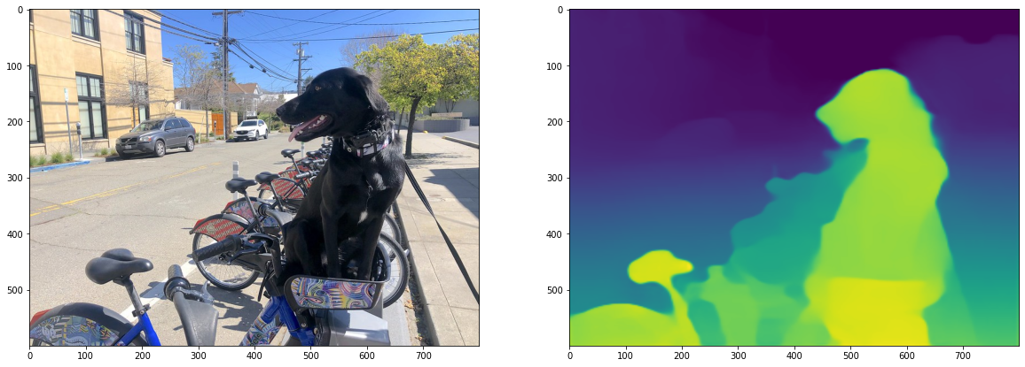
Background
Midaset
MiDas-Net is used to compute depth from a single monocular image.
MiDaS was trained on 10 datasets (ReDWeb, DIML, Movies, MegaDepth, WSVD, TartanAir, HRWSI, ApolloScape, BlendedMVS, IRS) with multi-objective optimization.
Model has support on pytorch, tensorflow, android and ROS1.

Slide 7
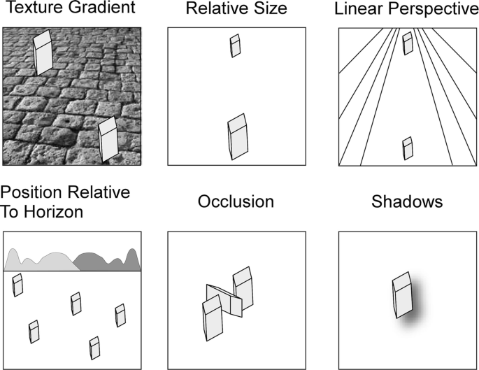
Background
Monocular depth cues
Monocular depth cues [14] serve as signals to estimate depth of an obstacle in the camera’s field of view. There are various monocular depth cues that can be used to mimic the human behaviour of depth estimation and obstacle avoidance:
Relative size
Texture gradient
Linear perspective
Interposition

Slide 8
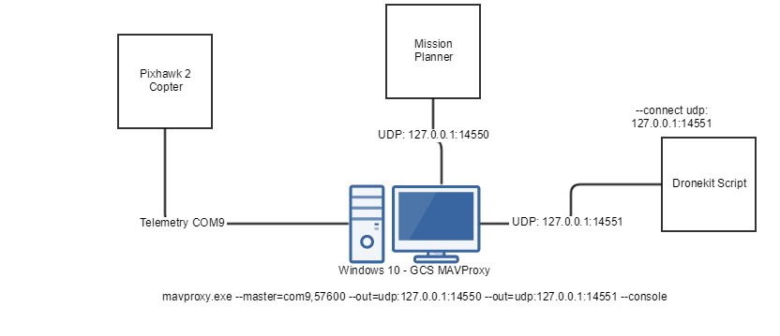
Background
Dronekit-Python
Dronekit provides python APIs to communicate with vehicles over MAVLink, which is a lightweight messaging protocol for communicating with drones.
The dronekit API along with MAVLink protocol is compatible with various companion computers such as Raspberry PI, Jetson Nano, Odroid-XU4, Intel NUC etc.

Slide 9
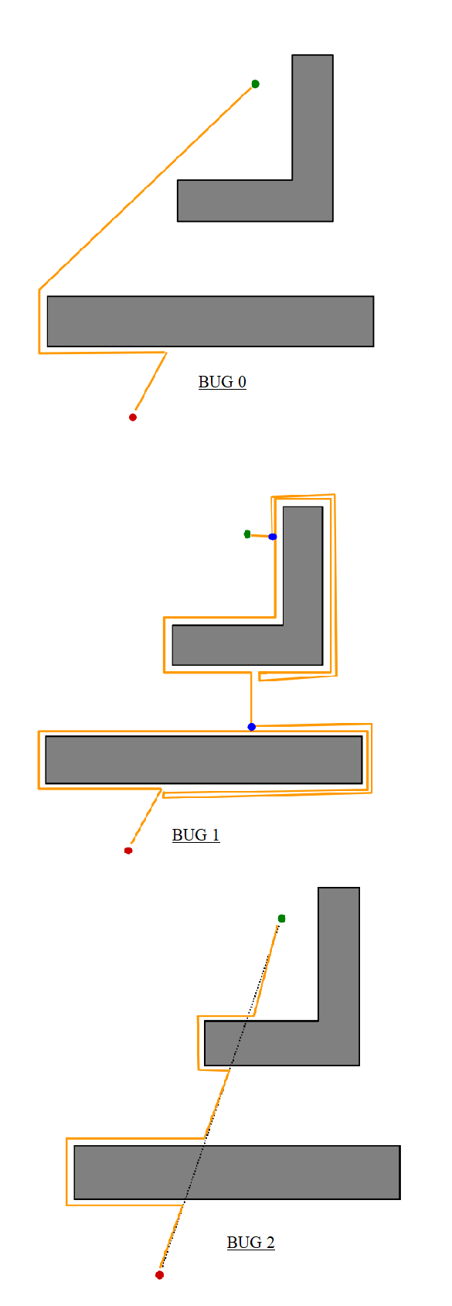
Background
Bug algorithms
Bug algorithms are a set of path planning algorithms in two dimensional maps that helps robots deal with autonomous motion planning.
There are three types of bug algorithms and all of them initially head in the direction of a straight line drawn between the start point and goal called the m-line.

Slide 10
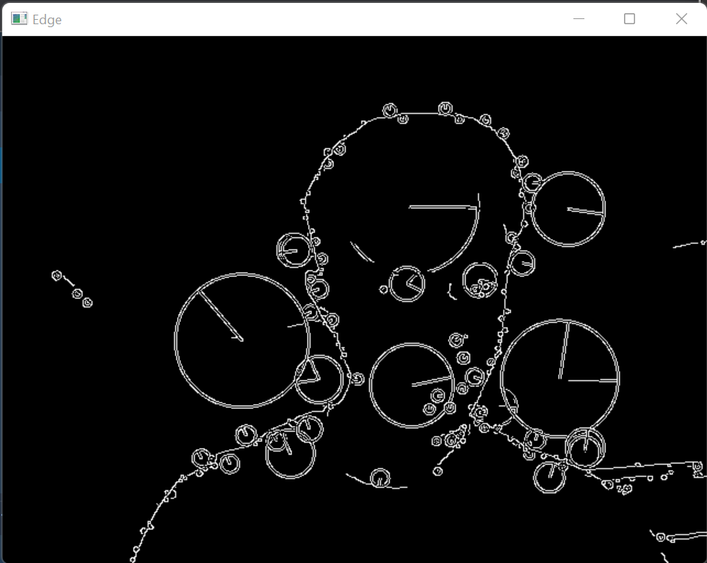
Obstacle Localization Algorithm
This paper uses two algorithms for depth estimation and hence obstacle localization, and finally takes the weighted average of the two algorithms to perceive the location of the object.
Firstly, monocular cues are used to estimate depth of the obstacle in front of the drone’s camera.

Slide 11
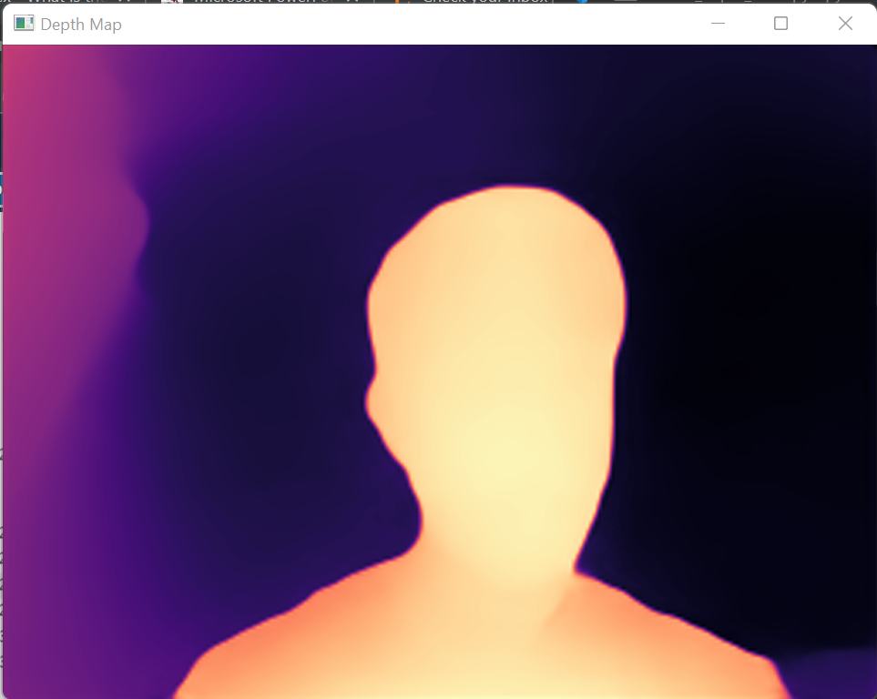
Obstacle Localization Algorithm (cont.)
A second algorithm with higher weightage is implemented with midas machine learning model.
Finally the video frame is divided into a 3x3 grid and the count of pixels above the set threshold is taken for each part of the grid. This counted value is termed as NPC (near pixel count).

Slide 12
Path Planning Based On Bug 0 Algorithm
For the robot to successfully reach it’s goal point, a modified bug 0 algorithm approach is used. Firstly, a global plan is created by an on-ground mission planner or the dronekit API.
The algorithm is modified using the before mentioned obstacle localization. Instead of having a fixed turning direction, the path planning takes advantage of the higher number of degrees of freedom offered by aerial vehicles and goes in the direction guided by the part of the grid with least NPC value.

Slide 13
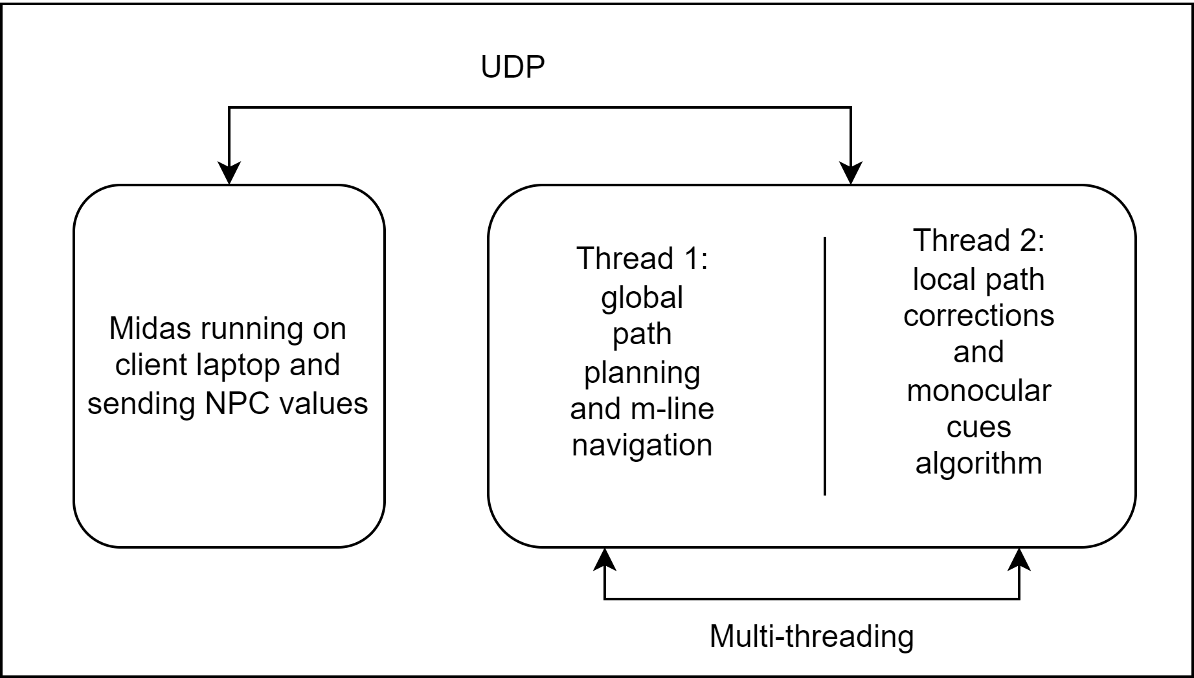
Light Weight Embedded System Architecture
Two threads on companion processor and one remote client ensures that the algorithm works on any light weight embedded system.

Slide 14
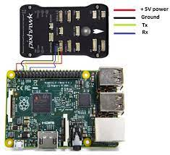
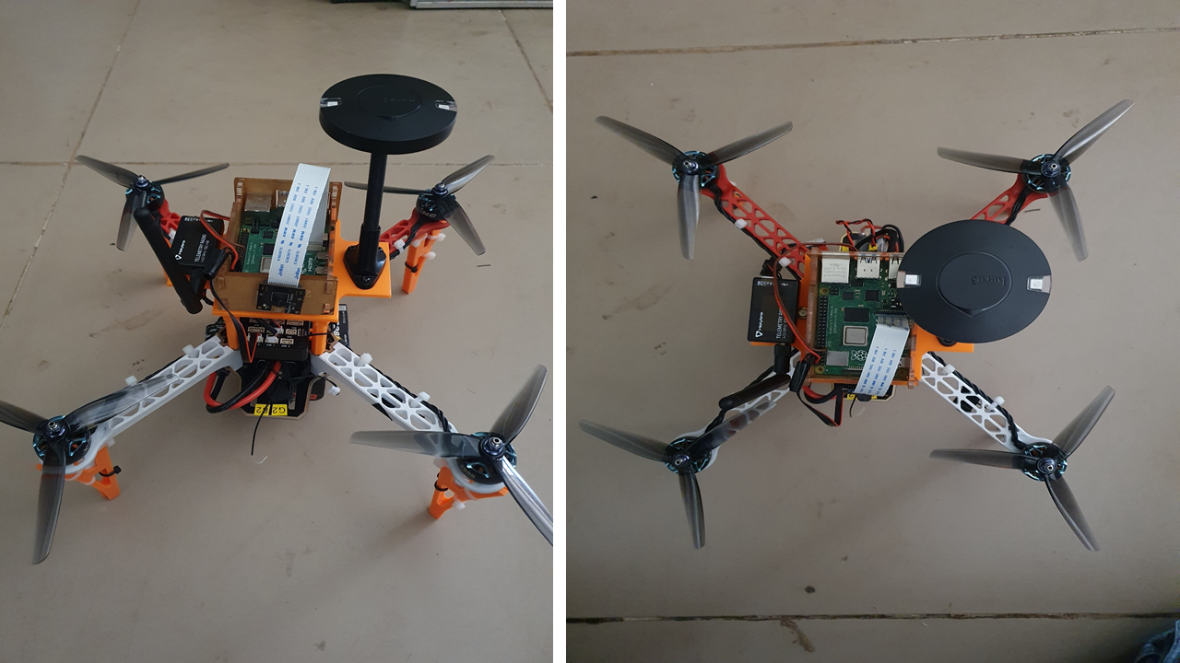
Experiments And Results
To demonstrate the working of autonomous navigation on light weight embedded system using monocular camera, a drone was built using pixhawk cube flight controller.
A serial/UART TTL connection was established [21] with Raspberry Pi 4 Model B at the appropriate baud rate using the mission planner.

Slide 15
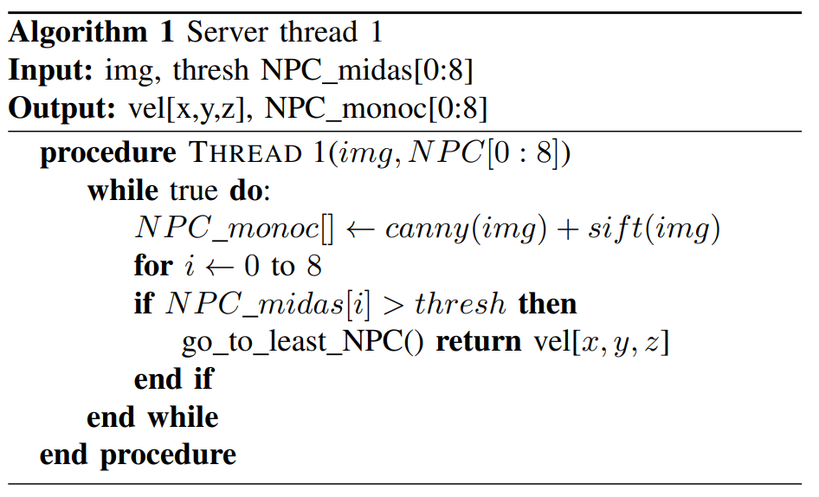
Experiments And Results
The following three algorithms were implemented according to light weight embedded system model shown in the previous slide.

Slide 16
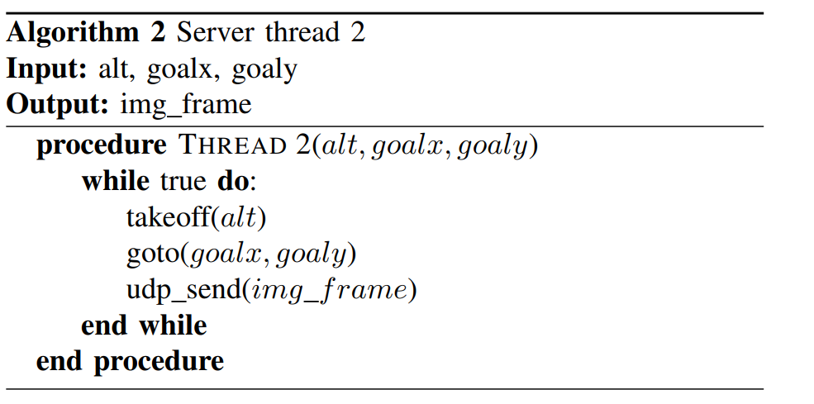
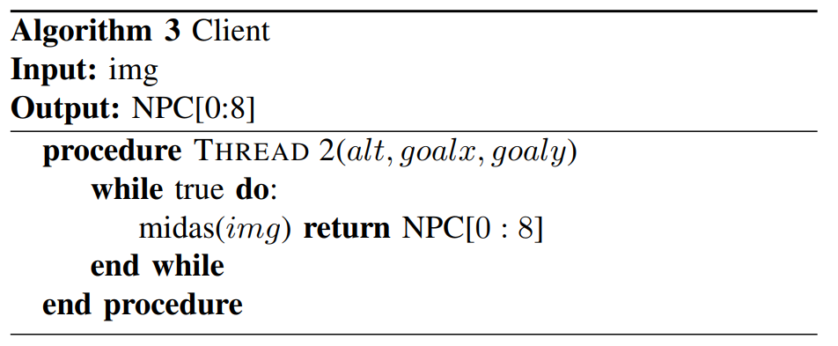
Experiments And Results
The following three algorithms were implemented according to light weight embedded system model shown in the previous slide.

Slide 17
Conclusion
In this paper, an autonomous navigation stack for drones using only monocular camera is proposed and tested on pixhawk based quad-copter with raspberry pi flight computer.
Depth estimation using both monocular cues and midas machine learning model is predicted and depth maps are generated for local path planning in autonomous traversal.
In the future, mapping task can be implemented simultaneously using visual odometry methods to navigate in GPS denied environments.
Additionally, if multiple monocular cameras or a single monocular camera on a rotating mechanism is used, the efficiency of bug algorithm for path planning can also increase.

Slide 18
Reference
[1] Zaheer, Z., Usmani, A., Khan, E., & Qadeer, M. A. (2016, July). Aerial surveillance system using UAV. In 2016 thirteenth international conference on wireless and optical communications networks (WOCN)
(pp. 1-7). IEEE.
[2] Murugan, D., Garg, A., & Singh, D. (2017). Development of an adaptive approach for precision agriculture monitoring with drone and satellite data. IEEE Journal of Selected Topics in Applied Earth Observations
and Remote Sensing, 10(12), 5322-5328.
[3] Benarbia, T., & Kyamakya, K. (2021). A literature review of drone-based package delivery logistics systems and their implementation feasibility. Sustainability, 14(1), 360.
[4] Xin, C., Wu, G., Zhang, C., Chen, K., Wang, J., & Wang, X. (2020, February). Research on indoor navigation system of uav based on lidar. In 2020 12th International Conference on Measuring Technology and
Mechatronics Automation (ICMTMA) (pp. 763-766). IEEE.
[5] Lategahn, H., Geiger, A., & Kitt, B. (2011, May). Visual SLAM for autonomous ground vehicles. In 2011 IEEE International Conference on Robotics and Automation (pp. 1732-1737). IEEE.
[6] Davison, A. J., Reid, I. D., Molton, N. D., & Stasse, O. (2007). MonoSLAM: Real-time single camera SLAM. IEEE transactions on pattern analysis and machine intelligence, 29(6), 1052-1067.
[7] Al-Kaff, A., Meng, Q., Mart´ın, D., de la Escalera, A., & Armingol, J. M. (2016, June). Monocular vision-based obstacle detection/avoidance for unmanned aerial vehicles. In 2016 IEEE intelligent vehicles symposium
(IV) (pp. 92-97). IEEE.
[8] Tareen, S. A. K., & Saleem, Z. (2018, March). A comparative analysis of sift, surf, kaze, akaze, orb, and brisk. In 2018 International conference on computing, mathematics and engineering technologies (iCoMET) (pp.
1-10). IEEE.

Slide 19
THANK YOU

