Slide 1
CHEMISTRY
A PROJECT ON
“ELEMENTS AND COMPOUNDS”

Slide 2
AVNIKA JAIN
CLASS: 6-B.
SUBJECT: CHEMISTRY.
TOPIC: ELEMENTS AND COMPOUNDS.
SCHOOL: CITY MONTESSORI SCHOOL.
BRANCH: ALIGANJ-CAMPUS 2.

Slide 3
INDEX
S.NO | TOPIC | PAGE NO. | TEACHER’S SIGN.
1 | ELEMENTS | 1
2 | COMPOUNDS | 2
3 | WATER | 3
4 | CARBON | 4
5 | SULPHUR | 5
6 | SULPHURIC ACID | 6
7 | CARBON DIOXIDE | 7
8 | HYDROGEN | 8
9 | NITROGEN | 9
10 | SALT | 10
12 | CARBONIC ACID | 12
13 | AMMONIA | 13
14 | BIBLIOGRAPHY | 14

Slide 4
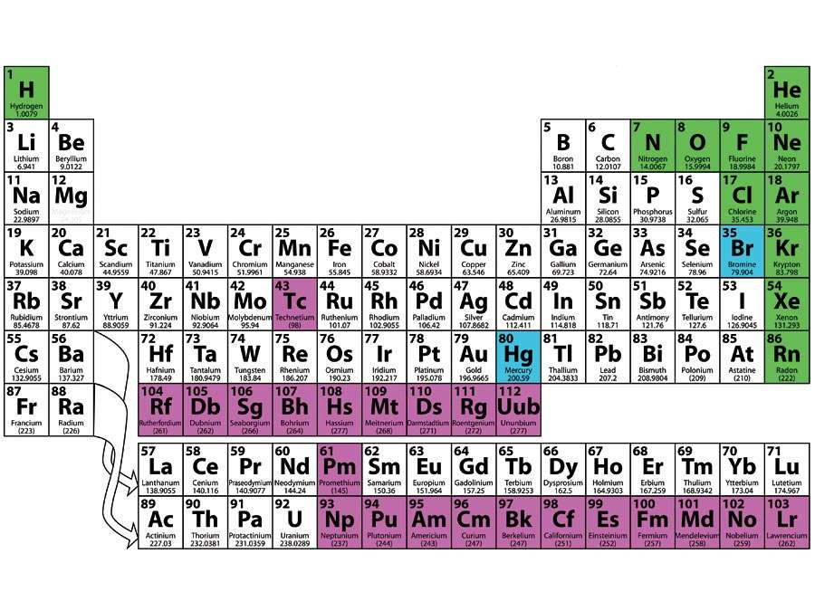
ELEMENTS AND COMPOUNDS.
ELEMENTS:
An element is a pure substance that is made from a single type of atom. Elements are the building blocks for all the rest of the matter in the world. Examples of elements include iron, oxygen, hydrogen, gold and helium. An important number in an element is the atomic number.

Slide 5
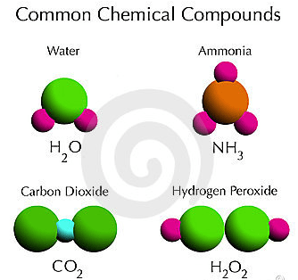
ELEMENTS AND COMPOUNDS.
COMPOUNDS:
A compound is a substance formed when two or more chemical elements are chemically bonded together…………Water: Two hydrogen atoms bonded to an oxygen atom. The type of bonds holding elements together in a compound can vary: Two common types are covalent bonds and ionic bonds.

Slide 6
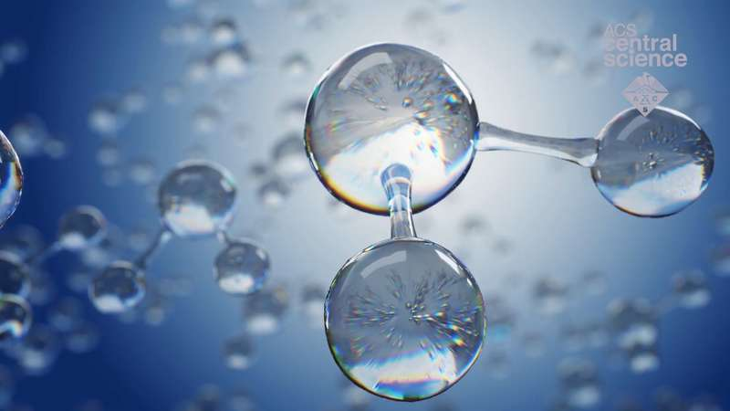
WATER
Water is a compound because it is composed of two different elements, hydrogen and oxygen which cannot be separated by physical methods….The physical and chemical properties of hydrogen and oxygen are different from the properties of water.

Slide 7
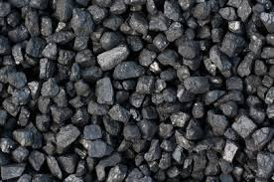
CARBON
Carbon is an extraordinary element. It occurs in more different forms than any other element in the periodic table….Coal, soot and diamonds are all nearly pure forms of carbon. Carbon also occurs in a form, discovered only recently, known as fullerenes or buckyballs.

Slide 8
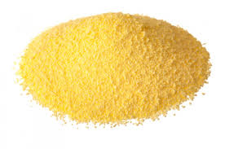
SULPHUR
Sulphur is a chemical element with the symbol ‘S’ and atomic number 16. It is abundant, multivalent, and non-metallic. Under normal conditions, sulphur atoms form cyclic octatomic molecules with a chemical formula S8. Elemental sulphur is a bright yellow, crystalline solid at room temperature.

Slide 9
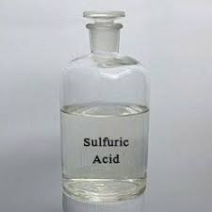
SULPHURIC ACID.
Sulphuric acid, H2SO4 is a chemical compound made up of two hydrogen atom, on sulphur atom and ‘four oxygen atoms. Sulphuric acid is a strong acid, soluble in water, very polar and is an excellent solvent. Its application include the production of fertilizers and detergent.

Slide 10

CARBON DIOXIDE.
Carbon Dioxide is a compound as it is composed of more than one element. It has one carbon atom and two oxygen atoms.

Slide 11

HYDROGEN
Hydrogen gas(H2)is a molecule, but not a compound because it is made of only one element.

Slide 12
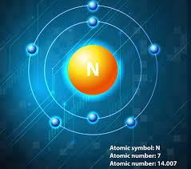
NITROGEN
Nitrogen is an element. It is found in nature as nitrogen gas, also called dinitrogen with the chemical formula N2 makes up 78% of the atmosphere. It is a diatomic element because it is composed of two nitrogen atoms chemically bonded.

Slide 13
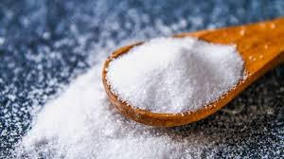
SALT
Salt is made up of sodium and chlorine. Its chemical name is sodium chloride and molecular formula is Nacl. Obviously salt is a compound not an element because its consist of two elements i.e; sodium and chlorine in its molecular structure.

Slide 14
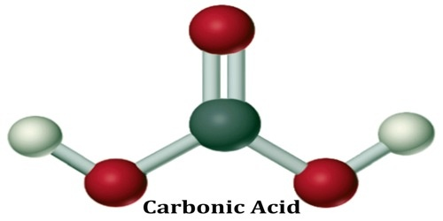
CARBONIC ACID.
Carbonic acid(H₂CO3), a compound of the elements hydrogen, carbon, and oxygen. It is formed in small amounts when its anhydride, carbon dioxide(CO₂), dissolves in water.

Slide 15
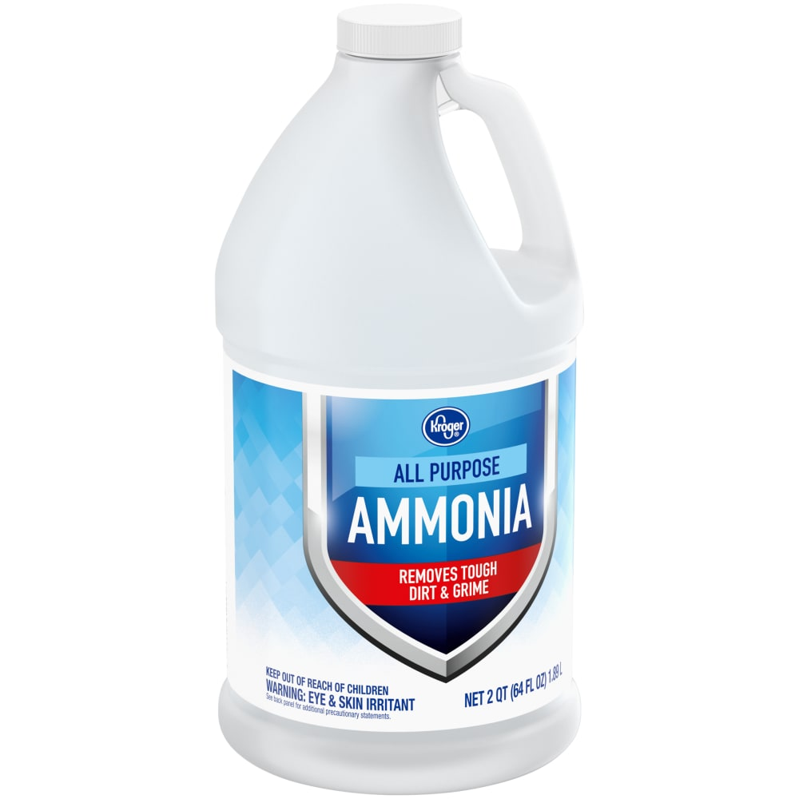
AMMONIA.
Ammonia is formed by the combination of nitrogen and three hydrogen atoms or molecules. The combination of nitrogen and hydrogen gases gives out Ammonia gas. Therefore, Ammonia is a compound which is formed using two elements.

Slide 16
BIBLIOGRAPHY.
Google.com
Wikipedia.org
ChemistryGod.com
KhanAcademy.org
New Simplified Middle School Chemistry For Std. VI by Dr Viraf J Dalal published by Allied Publishers Pvt Ltd.

