Slide 1
ENGLISH LANGUAGE.
ENGLISH LANGUAGE PROJECT.

Slide 2
AVNIKA JAIN.
CLASS: 6-B.
SUBJECT: ENGLISH LANGUAGE.
SCHOOL: CITY MONTESSORI SCHOOL.
BRANCH: ALIGANJ-CAMPUS 2.

Slide 3
INDEX
S.NO | TOPIC | PAGE NO. | TEACHER’S SIGN.
1 | WHAT IS PICTURE COMPOSITION | 1
2 | FEATURES OF PICTURE COMPOSITION. | 2
3 | PICTURE | 3
4 | PICTURE COMPOSITION | 4
5 | PICK ANY THREE TO FOUR SYNONYMS AND ANTONYMS FROM THE PC. | 5
6 | ILLUSTRATE TWO SENTENCES ALONG WITH MENTIONING THE PREPOSITIONS USED IN THE PC. | 6
7 | CONSTRUCT SENTENCES FROM ANY THREE ADJECTIVES USED IN THE PC. | 7
8 | GIVE EXAMPLES OF THE KINDS OF SENENCES USED IN THE PC. | 8
9 | MAKE A TABLE ON THE DIFFERENT NOUNS AND PRONOUNS USED IN THE PC. | 9
10 | CONCLUSION | 10
11 | BIBLIOGRAPHY | 11

Slide 4
WHAT IS A PICTURE COMPOSITION
Picture composition is the starting point for creating visually compelling images. Aim to arrange different subjects and visual elements into a well balanced and attractive form within the picture frame.

Slide 5
FEATURES OF PICTURE COMPOSITION
Features of picture composition are-
Opening sentence = topic + approach.
Ideas connected to the opening sentence.
Details about those ideas.

Slide 6
COMPOSITION AND GRAMMER SECTION

Slide 7
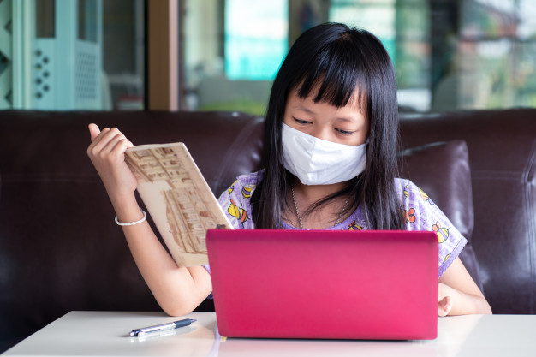
Picture of Picture Composition

Slide 8
PICTURE COMPOSITION.
Online classes going in this corona virus pandemic are very beneficial for the students. They are studying well and their studies are unaffected to a great extent due to lockdown. Thanks to online classes, The syllabus is getting completed on time. Our teacher’s are working very hard. I would like to thank them for conducting online classes for students so that their studies don’t suffer. Wow! Online classes are effecting the children very much. Because of lockdown, nowadays, the children are not allowed to go anywhere and so, they are studying online. Children as well as adults are getting to know much about technology.
In the picture shown in the previous slide, the pretty girl is also studying online, holding a book in her another hand. We are able to attend online classes using apps such as Google Meet or Zoom app. It is very much important to pay attention during the classes so that we are able to learn very well. Masks are very important for us to wear in this corona virus period. The girl in the previous slide is also wearing masks as they keep us safe from corona virus pandemic. The online classes let the children to sit at a place and attend the meetings because in schools they have to go through their vehicles. Online classes are really very helpful for children. I would always like to study in online classes.

Slide 9
PICK ANY THREE TO FOUR SYNONYMS AND ANTONYMS FROM THE PC.
SYNONYMS:
ONLINE CLASSES: Online learning.
PANDEMIC: Prevalent.
BENEFICIAL: Advantageous.
TECHNOLOGY: Machinery.
ANTONYMS:
ONLINE CLASSES: Ofline
PANDEMIC: Endemic.
BENEFICIAL: Disadvantageous.
TECHNOLOGY: Nonsystem.

Slide 10
ILLUSTRATE TWO SENTENCES ALONG WITH MENTIONING THE PREPOSITIONS USED IN THE PC.
IST SENTENCE: ONLNE CLASSES GOING IN THIS CORONA VIRUS PANDEMIC ARE VERY BENEFICIAL FOR THE STUDENTS.
PREPOSITION: IN
2ND SENTENCE: THE SYLLABUS IS GETTING COMPLETED ON TIME.
PREPOSITIONS: ON TIME.

Slide 11
CONSTRUCT SENTENCES FROM ANY THREE ADJECTIVES USED IN THE PC.
3 ADJECTIVES USED IN THE PICTURE COMPOSITION:
HARD.
PRETTY
HELPFUL
SENTENCE 1(HARD): OUR TEACHER’S ARE WORKING VERY HARD.
SENTENCE 2(PRETTY): IN THE PICTURE SHOWN IN THE PREVIOUS SLIDE, THE PRETTY GIRL IS ALSO STUDYING ONLINE, HOLDING A BOOK IN HER ANOTHER HAND.
SENTENCE 3(HELPFUL): ONLINE CLASSES ARE REALLY VERY HELPFUL FOR CHILDREN.

Slide 12
GIVE EXAMPLES OF THE KINDS OF SENENCES USED IN THE PC.
AN ASSERTIVE SENTENCE: Online classes are really helpful for children.
AN INTERROGATIVE SENTENCE: No such interrogative sentence.
AN IMPERATIVE SENTENCE: No such imperative sentence.
EXCLAMATORY SENTENCE: Wow! Online classes are effecting the children very much

Slide 13
MAKE A TABLE ON THE DIFFERENT NOUNS AND PRONOUNS USED IN THE PC.
NOUNS | PRONOUNS
STUDENTS | WE
CHILDREN | I
GIRL | US
BOOK | OUR
MASK | THEY

Slide 14
CONCLUSION
WHILE DOING THIS PROJECT, I LEARNT THAT WE SHOULD WEAR MASKS AND GLOVES DURING THIS GLOBAL PANDEMIC. WE SHOULD ALWAYS PAY ATTENTION DURING OUR ONLINE CLASSES SO AS TO ENSURE OUR PROPER LEARNING AND EFFECTIVENESS OF ONLINE CLASSES. THE TEACHERS ARE DOING VERY HARD WORK SO THAT OUR EDUCATION IS NOT AFFECTED AND WE MUST NOT WASTE THEIR EFFORTS. I LEARNT HOW TO WRITE PICTURE COMPOSITION. THIS IMPROVED MY ENGLISH LANGUAGE SKILLS.

Slide 15
BIBLIOGRAPHY
GOOGLE.COM
WIKIPEDIA.COM
KHANACADEMY.ORG

