Slide 1
ENGLISH LITERATURE
A PROJECT ON
“THE ANT AND THE CRICKET”

Slide 2
Avnika Jain
CLASS: 6-B. SUBJECT: ENGLISH LITERATURE. TOPIC: THE ANT AND THE CRICKET. SCHOOL: CITY MONTESSORI SCHOOL. BRANCH: ALIGANJ-CAMPUS 2.

Slide 3
INDEX
S.NO | TOPIC | PAGE NO. | TEACHER’S SIGN
1 | WHAT IS A FABLE | 1
2 | WHO WAS AESOP | 2
3 | TITILES FOR 5 FABLES OF AESOP. | 3
4 | A BRIEF SUMMARY ON ANY ONE OF THE AESOP FABLE’S. | 4
5 | MORAL OF THE STORY. | 5

Slide 4
6 | FIGURES OF SPEECH IN THE POEM WITH DEFINATION AND EXAMPLE. | 6
7 | CONCLUSION | 7
8 | BIBLIOGRAPHY. | 8

Slide 5
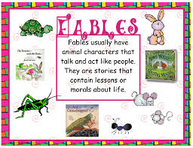
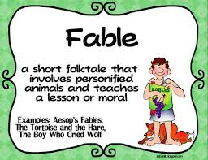
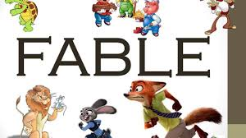
WHAT IS A FABLE
A fable is a type of story which shows something in life or has a meaning to a word. A fable is a funny story but may teach a lesson or suggest a moral from it. A fable starts in the middle of the story, that means, jumps into the main event without detailed introduction of characters.

Slide 6
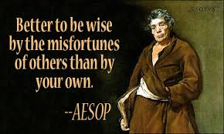
WHO WAS AESOP
Aesop was a Greek fabulist and storyteller credited with a number of fables now collectively known as Aesop's Fables. Scattered details of Aesop's life can be found in ancient sources, including Aristotle, Herodotus, and Plutarch.

Slide 7
TITLES FOR 5 FABLES OF AESOP
The Belly and the Members.
The Dog in a Manger.
Mercury and the Woodman.
The Fox and the Grapes.
The Spendthrift and the Swallow.

Slide 8
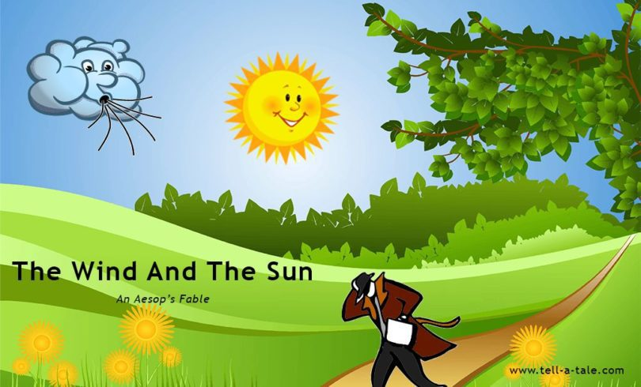
A BRIEF SUMMARY OF ANY ONE OF AESOP FABLE’S
The Wind And The Sun:
There was once an argument between the wind and the sun about who was stronger than the other. They argued for a long time but neither of them emerged the winner. It wasn’t too long before they spotted a man walking on the road. Looking at the man wearing a coat, an idea struck them both.
They challenged each other that the one who succeeded in removing the coat from the man’s back was the strongest.
The wind volunteered to try first. It began to blow hard, raising gusts of air and making it harder for the man to take a step further.
But, the man clutched his coat tight around him and resumed walking with great difficulty.
The wind continued blowing harder and harder, but the man held on to his coat tighter and tighter. And continued his journey forward. Finally, the wind was exhausted and gave up. His efforts had been futile.
It was now the turn of the sun. He looked at the man and began to gently shine upon the path the man was walking on.
The man looked up at the sky surprised at the change in weather.
The sun did not spend much energy, neither did he apply any effort. He just continued shining upon the man;s head gently.
Soon the man was huffing and puffing, and sweating profusely.
Unable to bear the rising heat, the man finally took off his coat and headed to a nearby tree to rest for a while under its shade.
Moral: Sometimes gentle persuasion is mightier than the strongest force.

Slide 9
MORAL OF THE STORY
Moral: Sometimes gentle persuasion is mightier than the strongest force.

Slide 10
FIGURES OF SPEECH IN THE POEM WITH DEFINITION AND EXAMPLE
DEFINITION: A figure of speech or rhetorical figure is an intentional deviation from ordinary language, chosen to produce a rhetorical effect.
EXAMPLE: Personification And Metaphor.
PERSONIFICATION: When human characters are given to animals or non-living things, it is called Personification. The Ant And The Cricket are personified as humans as they are talking and thinking like humans.
METAPHOR: It is the comparison of two things. In the last line “ Some Crickets have four legs, and some have but two”, the poet compares lazy and careless people with the Cricket.

Slide 11
CONCLUSION
The sun was the winner as finally he was succeeded in removing the coat from the man.

Slide 12
BIBLIOGRAPHY
Google.Com
Wikipedia.Com
KhanAcademy.Com
New trends in English Reader by Anita Arathoon published by Evergreen Publications.

