Slide 1
GEOGRAPHY
A PROJECT ON
“LANDFORMS OF THE EARTH”

Slide 2
AVNIKA JAIN
CLASS: 6-B
SUBJECT: GEOGRAPHY.
TOPIC: LAMDFORMS OF THE EARTH.
SCHOOL: CITY MONTESSORI SCHOOL.
BRANCH: ALIGANJ-CAMPUS 2.

Slide 3
INDEX.
S.NO | TOPIC | PAGE NO. | TEACHER’S SIGN.
1 | LANDFORMS OF THE EARTH | 1
2 | TYPES OF FORCES | 2-4
3 | MOUNTAINS | 5
4 | TYPES OF MOUNTAINS | 6-13
5 | PLATEAUS | 14
6 | TYPES OF PLATEAUS | 15-18
7 | PLAINS | 19
8 | TYPES OF PLAINS | 20-23
9 | BIBLIOGRAPHY. | 24

Slide 4
LANDFORMS OF THE EARTH.
A landform is a natural or artificial feature of the solid surface of the Earth or other planetary body. Landforms together make up a given terrain, and their arrangement in the landscape is known as topography. Mountains, hills, plateaus, and plains are the four major types of landforms. Minor landforms include buttes, canyons, valleys, and basins. Tectonic plate movement under the Earth can create landforms by pushing up mountains and hills.

Slide 5
Types of forces
The landforms have been created and developed by two types of FORCES. They are-
Endogenic forces.
Exogenic forces.

Slide 6
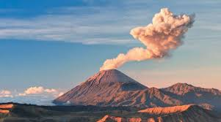
Endogenic forces.
The horizontal and vertical movements caused by the forces coming from the origin of the earth is known as endogenic forces. The origin of endogenic force is caused by the contraction and expansion of rocks due to variation in thermal conditions and temperature inside the earth.

Slide 7
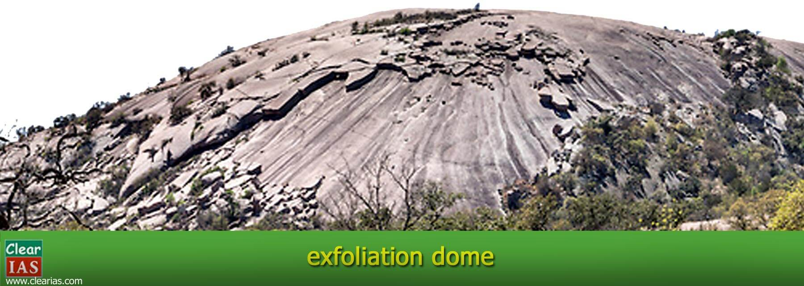
Exogenic forces.
The processes which occur on earth's surface due to the influence of exogenic forces are called as exogenic processes or exogenic geomorphic processes. Weathering, mass wasting, erosion, and deposition are the main exogenic processes. A process is a force applied on earth materials affecting the same.

Slide 8
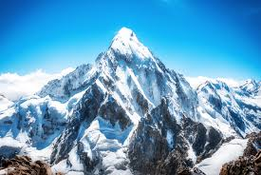
Mountains.
A mountain is a large landform that rises above the surrounding land in a limited area, usually in the form of a peak. A mountain is generally considered to be steeper than a hill. Mountains are formed through tectonic forces or volcanism. These forces can locally raise the surface of the earth.

Slide 9
Types of mountains.
There are 3 types of MOUNTAINS. They are:
Fold mountains
Block mountains.
Volcanic mountains.

Slide 10
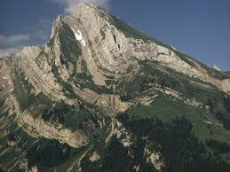
Fold mountains.
Fold mountains are mountains that form mainly by the effects of folding on layers within the upper part of the Earth's crust. Before either plate tectonic theory developed, or the internal architecture of thrust belts became well understood, the term was used for most mountain belts, such as the Himalayas.

Slide 11
Types of fold MOUNTAINS.
There are 2 types of FOLD MOUNTAINS. They are:
Young fold mountains.
Old fold mountains.

Slide 12
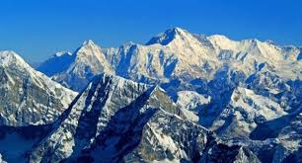
Young fold mountains.
Young fold mountains are also mountains that are less than 100 million years old. Where the old fold mountains are more than 500 million years old young fold mountains are comparably younger in age. However, young fold mountains also have ridges, volcanoes, valleys, and major-fault- block ranges.

Slide 13
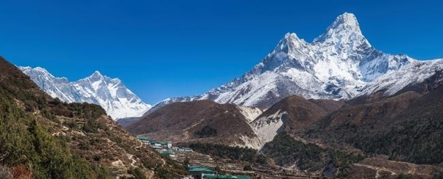
Old fold mountains.
The Himalayas, the Andes and the Rockies mountains are some examples of young fold mountains. The Aravali Range, the Appalachian and the Ural Mountains are some examples of old fold mountains.

Slide 14
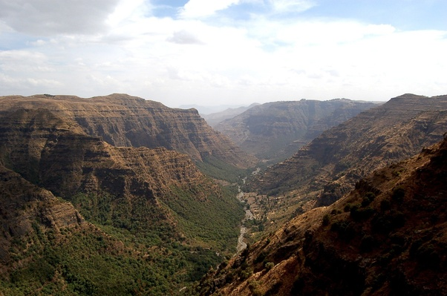
Block mountains.
Block mountains are also called fault-block mountains since they are formed due to faulting as a result of tensile and compressive forces.

Slide 15
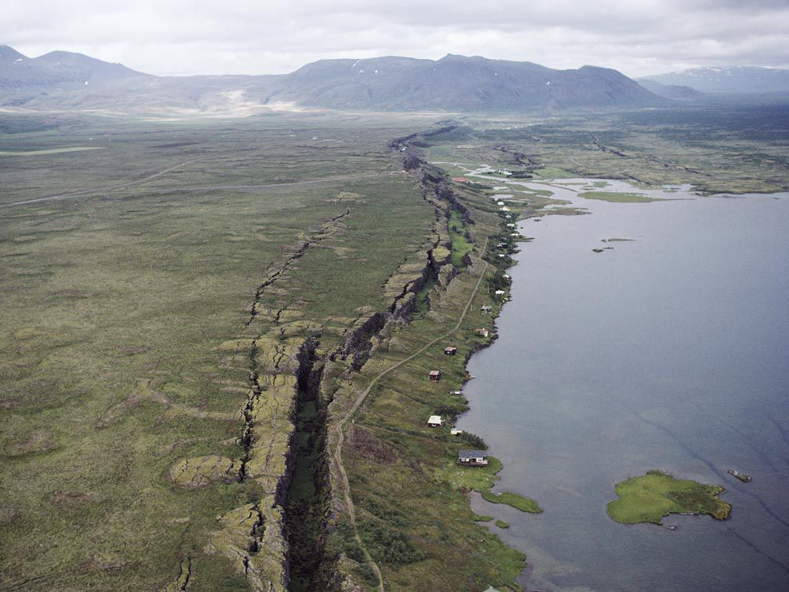
Rift valleys.
A rift valley is a linear shaped lowland between several highlands or mountain ranges created by the action of a geologic rift or fault. A rift valley is formed on a divergent plate boundary, a crustal extension or spreading apart of the surface, which is subsequently further deepened by the forces of erosion.

Slide 16
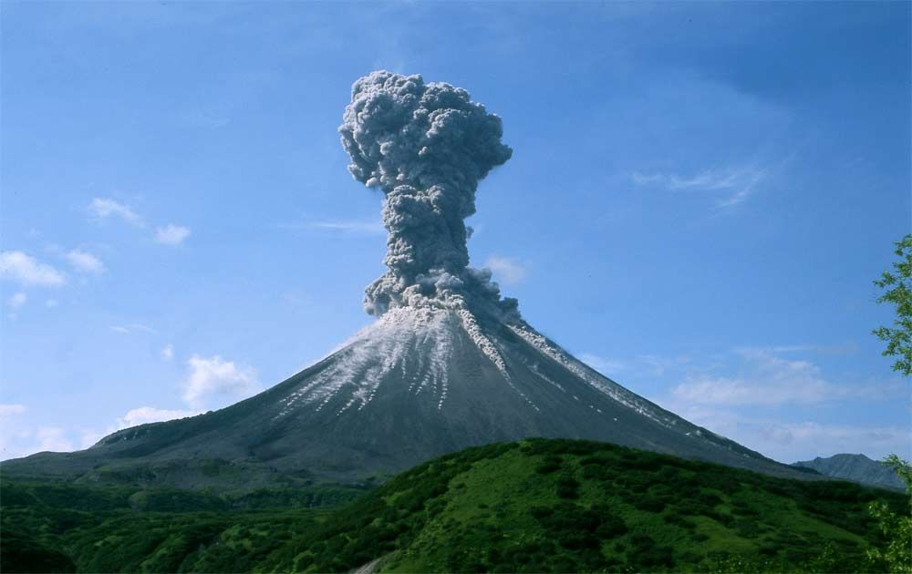
Volcanic mountains.
Volcanic Mountains are formed when molten rock (magma) deep within the earth, erupts, and piles upon the surface. Magna is called lava when it breaks through the earth's crust. When the ash and lava cools, it builds a cone of rock. Rock and lava pile up, layer on top of layer.

Slide 17
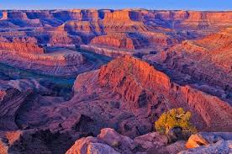
Plateaus
A plateau is a flat, elevated landform that rises sharply above the surrounding area on at least one side. Plateaus occur on every continent and take up a third of the Earths land. They are one of the four major landforms, along with mountains, plains, and hills.

Slide 18
Types of pleateus.
There are 3 types of plateaus. They are:
Continental plateaus.
Intermontane plateaus.
Lava plateaus.

Slide 19
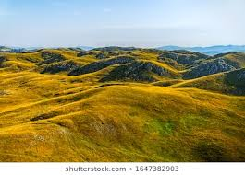
Continental plateaus.
Continental plateaus are bordered on all sides by plains or oceans, forming away from the mountains. An example of a continental plateau is the Antarctic Plateau in East Antarctica.

Slide 20
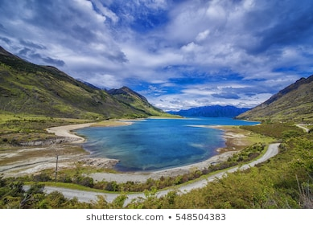
Intermontane plateaus.
The Intermontane Plateaus of the Western United States is one of eight U.S. Physiographic regions of the physical geography of the contiguous United States. The region is composed of intermontane plateaus and mountain ranges.

Slide 21
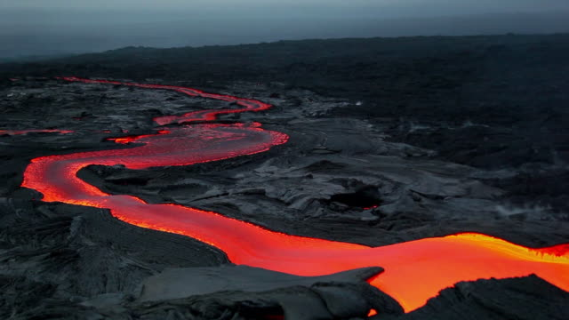
Lava plateaus.
Lava plateaus are extensive areas of flood basalt which are formed by the extensive eruption of basaltic lava over a large area. Rifting of the continental crust is often responsible as the crust thins and allows magma from the mantle to erupt over an extensive area of fissures.

Slide 22
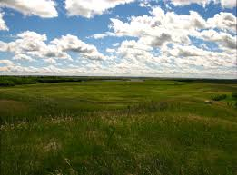
Plains.
A plain is a flat, sweeping landmass that generally does not change much in elevation. Plains occur as lowlands along valleys or on the doorsteps of mountains, as coastal plains, and as plateaus or uplands.

Slide 23
TYPES OF PLAINS.
There are 3 types of plains. They are:
Structural plains
Erosional plains
Depositional plains.

Slide 24
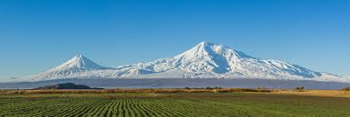
Structural plains.
Structural plains are relatively undisturbed horizontal surfaces of the Earth. They are structurally depressed areas of the world that make up some of the most extensive natural lowlands on the Earth's surface.

Slide 25
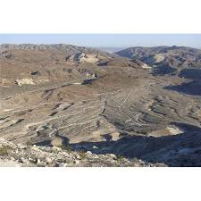
Erosional plains.
Erosional plains are developments on the Earth's surface caused by natural weathering of glacier activity, wind movement or water (sea, river & stream) torrent and are subdivided on the basis of the type of erosional agent.

Slide 26
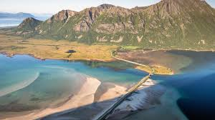
Depositional plains.
Depositional Plains: formed by the deposition of materials brought by various agents of transportation such as rivers, wind, waves, and glaciers. Their fertility and economic relevance depend greatly on the types of sediments that are laid down.

Slide 27
bibliography
Google.com
En.Wikipedia.org
KhanAcademy.org
Around The World by R.K. Jain published by Ratna Sagar.

