Slide 1
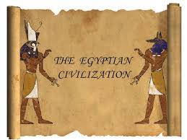
HISTORY
A PROJECT ON
“EGYPTIAN CIVILIZATION”

Slide 2
AVNIKA JAIN
CLASS: 6-B.
SUBJECT: HISTORY
TOPIC: EGYPTAN CIVILIZATION.
SCHOOL: CITY MONTESSORI SCHOOL.
BRANCH: ALIGANJ-CAMPUS 2.

Slide 3
INDEX
S.NO | TOPIC | PAGE NO. | TEACHER’S SIGN
1 | EGYPTIAN CIVILIZATION. | 1
2 | SOURCES | 2
3 | ORIGIN | 3
4 | PERIODS | 4
5 | SOCIAL CLASSES. | 5
6 | LIFE OF THE PEOPLE | 6
7 | RELIGION | 7
8 | OCCUPATIONS | 8
9 | TRADE AND COMMERCE | 9
10 | MAJOR ACHIEVEMENTS | 10
11 | DECLINE | 12
12 | BIBLIOGRAPHY | 13

Slide 4
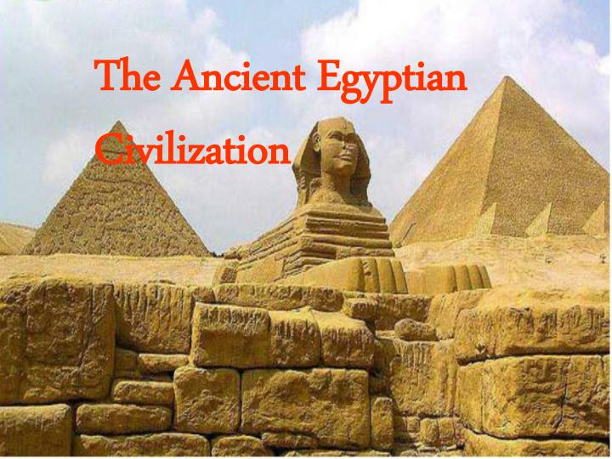
EGYPTIAN CIVILIZATION
Ancient Egypt was a civilization of ancient North Africa, concentrated along the lower reaches of
the Nile River, situated
in the place that is now
the country Egypt.

Slide 5
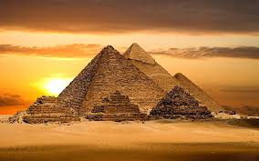
SOURCES OF EGYPTIAN CIVILIZATION
The Ancient Egyptians were literate. By five thousand years ago, they were keeping records of all kinds of information. For the Age of the Pyramids, there are many
good written sources of information.
A few of these sources are stelae,
tomb biographies, letters, papyri,
and pyramid texts.

Slide 6
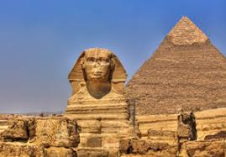
ORIGIN OF EGYPTIAN CIVILIZATION
Starting around 5500 BCE two major kingdoms developed along the Nile. Historians call them Upper Egypt and Lower Egypt. Around 3200 BCE, Egypt was brought together under one rule King Narmer (sometimes called Menes). This is recognized as the beginning of the Egyptian civilization.

Slide 7
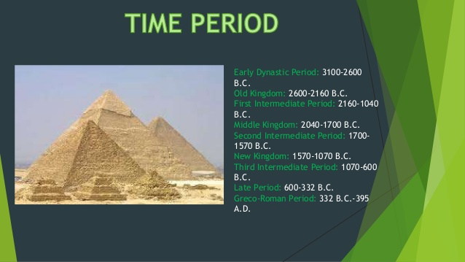
PERIODS OF EGYPTIAN CIVILIZATION
The history of ancient Egypt is divided into three main periods: the Old Kingdom (about 2,700-2,200 B.C.E.), the Middle Kingdom (2,050-1,800 B.C.E.), and the New Kingdom (about 1,550-1,100 B.C.E.).

Slide 8
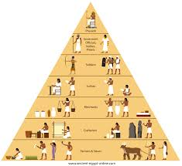
SOCIAL CLASSES OF EGYPTIAN CIVILIZATION
Ancient Egypt had three main social classes- upper, middle, and lower. The upper class consisted of the royal family, rich landowners, government officials, important priests and army officers, and doctors. The middle class was made up chiefly of merchants, manufacturers, and artisans.

Slide 9
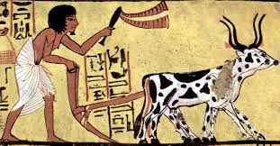
LIFE OF THE PEOPLE IN EGYPTIAN CIVILIZATION
The people of ancient Egypt built mudbrick homes in villages and in the country. They grew some of their own food and traded in the villages for the food and goods they could not produce. Most ancient Egyptians worked as field hands, farmers, craftsmen and scribes. A small group of people were nobles.

Slide 10
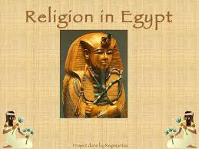
RELIGION OF EGYPTIAN CIVILIZATION
When the Greeks and the Romans conquered Egypt, their religion was influenced by that of Egypt. Ancient pagan beliefs gradually faded and were replaced by monotheistic religions. Today, the majority of the Egyptian population is Muslim, with a small minority of Jews and Christians.

Slide 11
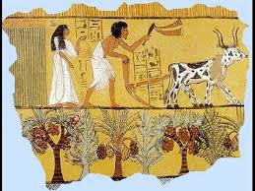
OCCUPATIONS OF EGYPTIAN CIVILIZATION
Jobs included bakers, priests, noblemen, soldiers, farmers, merchants, fishermen, hunters, craftsmen, artists, and scribes. There were many professions in ancient Egypt, most of which were inherited. For the most part, whatever job your father had, you had.

Slide 12
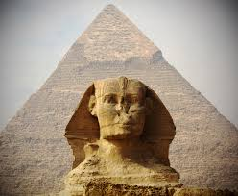
TRADE AND COMMERCE OF EGYPTIAN CIVILIZATION
Economy and Trade. The ancient Egyptians were wonderful traders. They traded gold, papyrus, linen, and grain for cedar wood, ebony, copper, iron, ivory, and lapis lazuli (a lovely blue gem stone.) Ships sailed up and down the Nile River, bringing goods to various ports.

Slide 13
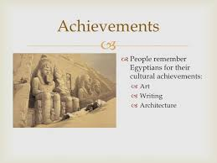
MAJOR ACHIEVEMENTS OF EGYPTIAN CIVILIZATION
The many achievements of the ancient Egyptians include the quarrying, surveying and construction techniques that supported the building of monumental pyramids, temples, and obelisks; a system of mathematics, a practical and effective system of medicine, irrigation systems and agricultural production technique.

Slide 14
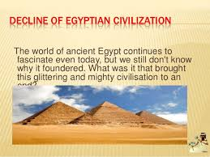
DECLINE
After Ramses III, Egypt went into an age of decline. Sometime after 1100 BC, Egypt split into two Kingdoms. In 728 BC, the Nubians, a people the Egyptians had once partially conquered, attacked Egypt from the south and conquered the Egyptians. In 525 BC, the Persians, from Asia, conquered Egypt.

Slide 15
BIBLIOGRAPHY
Google.com
Wikipedia.org
KhanAcademy.com
Past and Present by H.R. Yadav published by Ratna Sagar.

