Slide 1
A project on ‘matter’

Slide 2
Avnika jain
CLASS: 6-B.
SUBJECT: PHYSICS.
TOPIC: MATTER.
SCHOOL: CITY MONTESSORI SCHOOL.
BRANCH: ALIGANJ-CAMPUS 2.

Slide 3
S.NO | TOPIC | PAGE NO. | TEACHER’S SIGN.
1 | MATTER | 1
2 | CHARACTERISTICS OF MATTER | 2-4
3 | COMPOSITION OF MATTER | 5
4 | INTERMOLECULAR SPACE | 6
5 | INTERMOLECULAR FORCE OF ATTRACTION | 7
6 | STATES OF MATTER | 8-11
7 | PROPERTIES OF SOLIDS | 12-17
8 | PROPERTIES OF LIQUIDS | 18-22
9 | PROPERTIES OF GASES | 23-27
10 | BIBLIOGRAPHY | 28

Slide 4
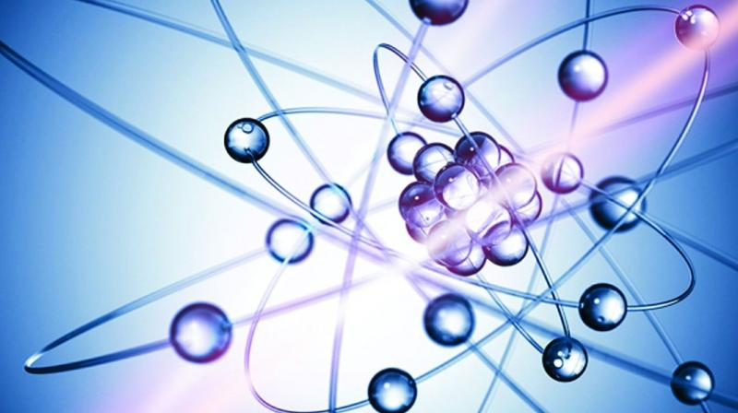
Matter
Matter is everything around you. Atoms and compounds are all made of very small parts of Matter. Those atoms go on to build the things you see and touch every day. Matter is defined as anything that has mass and takes up space. Volume is the amount of space something occupies.

Slide 5
Characteristics of matter
There are two characteristics of matter. They are:
Matter occupies space
Matter has mass

Slide 6
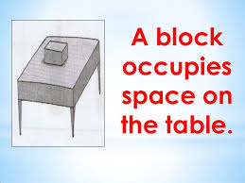
Matter occupies space
A common or traditional definition of matter is "anything that has mass and volume (occupies space)". For example, a car would be said to be made of matter, as it has mass and volume (occupies space). The observation that matter occupies space goes back to antiquity.

Slide 7
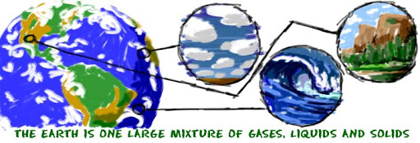
Matter has mass
Mass is a measure of the amount of matter in an object. Mass is usually measured in grams (g) or kilograms (kg). ... An object's mass is constant in all circumstances; contrast this with its weight, a force that depends on gravity. Your mass on the earth and the moon are identical.

Slide 8
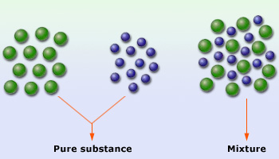
Composition of matter
a composition of matter is one of the four principal categories of things that may be patented. A composition of matter is an instrument formed by the intermixture of two or more ingredients, and possessing properties which belong to none of these ingredients in their separate state.

Slide 9
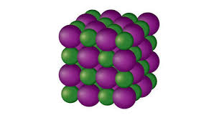
Intermolecular space
Intermolecular space is the space between two molecule or atom. In solids it is very little, in liquids is more the solids but less than liquids and in gases its the maximum. Intermolecular forces are forces of attraction or repulsion which act between neighboring particles (atoms, molecules or ions).

Slide 10
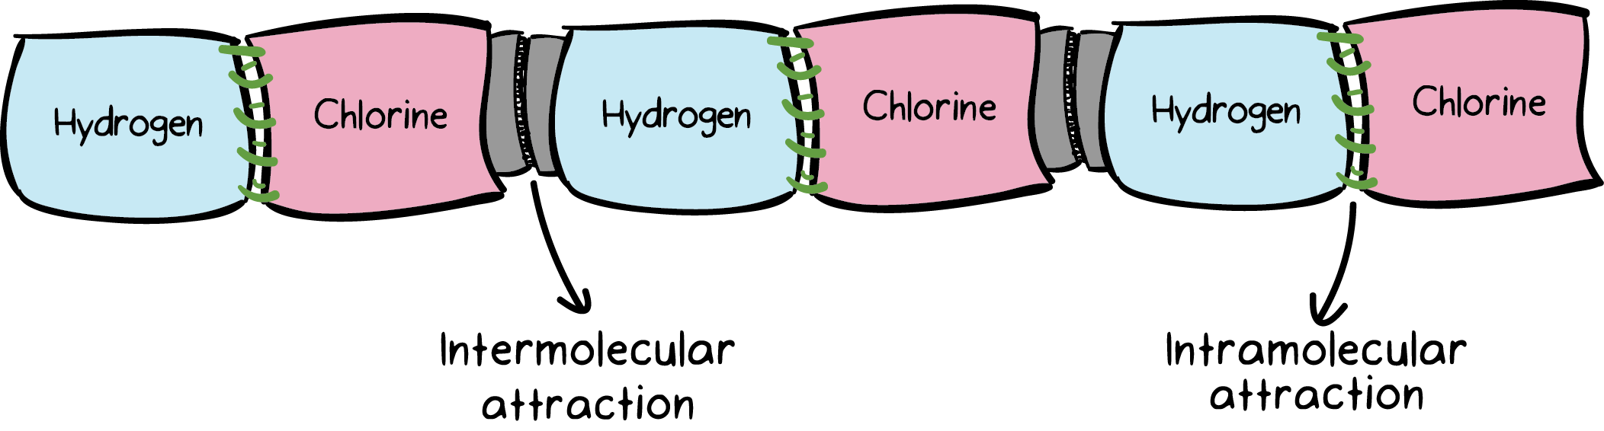
Intermolecular force of attraction
Intermolecular forces (IMF) are the forces which mediate interaction between molecules, including forces of attraction or repulsion which act between molecules and other types of neighboring particles, e.g. atoms or ions.

Slide 11
States of matter
There are three states of matter. They are:
Solids
Liquids
gases

Slide 12
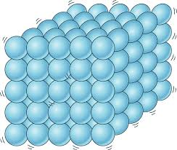
solids
In a solid, molecules are packed together, and it keeps its shape. Liquids take the shape of the container. ... Solid is one of the three main states of matter, along with liquid and gas. Matter is the "stuff" of the universe, the atoms, molecules and ions that make up all physical substances.

Slide 13
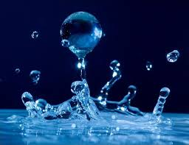
liquids
A liquid is a nearly incompressible fluid that conforms to the shape of its container but retains a (nearly) constant volume independent of pressure. As such, it is one of the four fundamental states of matter (the others being solid, gas, and plasma), and is the only state with a definite volume but no fixed shape.

Slide 14
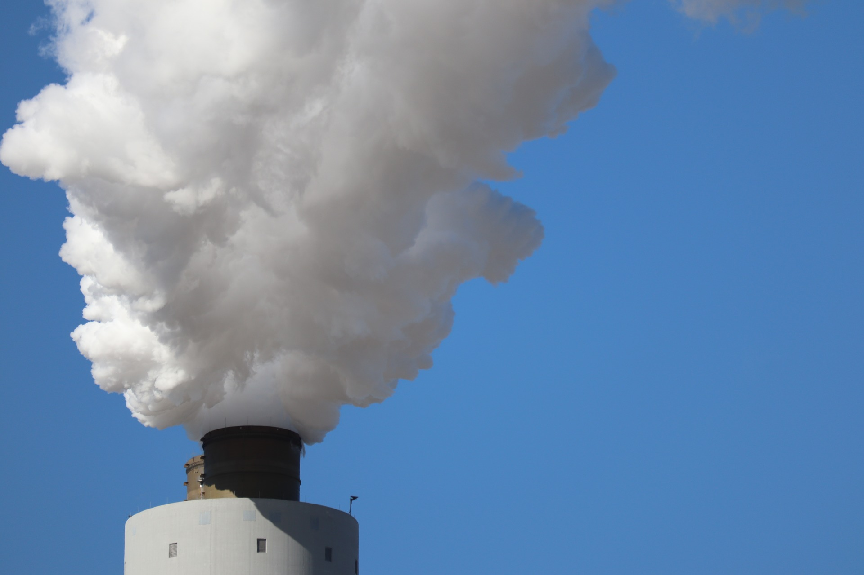
Gases
Gases are the phase of matter in which particles are usually very far apart from one another, move very quickly, and aren't particularly attracted to one another. Because the molecules in a gas are so far apart from one another, gases are much less dense than liquids or solids. Gases don't have a fixed shape.

Slide 15
Properties of solids
There are 5 properties of solids. They are:
Solids have a definite shape.
Solids have a definite volume.
Solids have a texture.
Solids have many free surfaces.
Solids are incompressible.

Slide 16
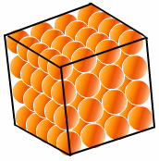
Solids have a definite shape
Any matter that is a solid has a definite shape and a definite volume. The molecules in a solid are in fixed positions and are close together. Although the molecules can still vibrate, they cannot move from one part of the solid to another part. As a result, a solid does not easily change its shape or its volume.

Slide 17
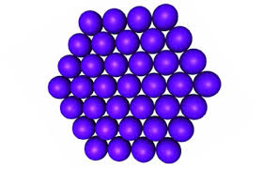
Solids have a definite volume
Any matter that is a solid has a definite shape and a definite volume. The molecules in a solid are in fixed positions and are close together. Although the molecules can still vibrate, they cannot move from one part of the solid to another part. As a result, a solid does not easily change its shape or its volume.

Slide 18
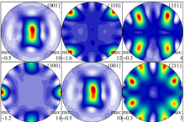
Solids have a texture
Solid textures determine the color of a surface based on the XYZ values of each point on the surface. Solid textures are, therefore, not affected by the parameterization of a surface, and do not distort (the way a surface texture does) when mapped to a surface with uneven parameterization.

Slide 19
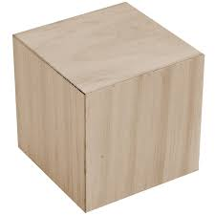
Solids have many free surfaces
Solids have infinite no of surfaces because it has infinite no of shapes and molecules are closely packed to each other and are not able to flow like fluids .

Slide 20
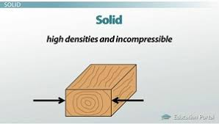
Solids are incompressible
In solids, the atoms or molecules are closely packed together. ... When we put pressure on solids, to compress them, there no space between the atoms/molecules and as a result we cannot compress them.

Slide 21
Properties of liquids
There are 4 properties of liquids. They are-
Liquids do not have a definite shape, but have a definite volume.
Liquids have a tendency to flow(fluidity).
Liquids cannot be compressed much.
Liquids have a free surface.

Slide 22
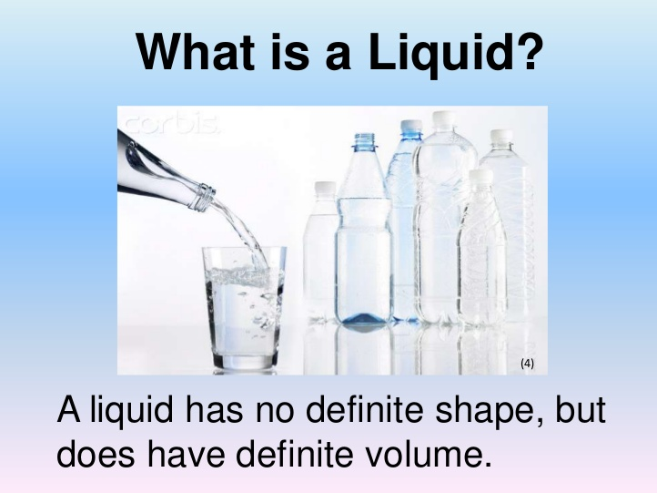
Liquids do not have a definite shape but have a definite volume
Liquids have a fixed volume but no fixed shape. This is because the particles in a liquid are further apart than the particles in a solid, allowing them to easily slide past each other. Solids have a fixed shape because their molecules are so tightly packed they cannot do much more than vibrate against each other.

Slide 23
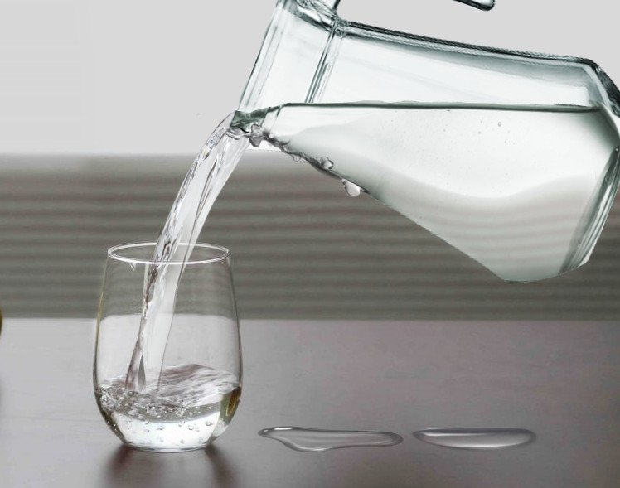
Liquids have a tendency to flow(fluidity)
Liquids are fluid, able to flow and take any shape. This occurs due to the weak intermolecular bonding that allows the molecules to slide past each other freely.

Slide 24
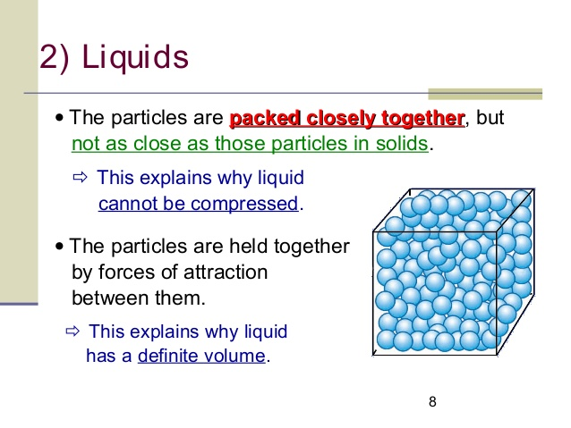
Liquids cannot be compressed much
Because the particles can move, liquids don't have a definite shape, and they can flow. Because the particles are still packed close together, liquids can't easily be compressed and keep the same volume.Apr 7, 2020

Slide 25

Liquids have a free surface
Liquid contain only one free surface because force of attraction is less between the atom which do not allow it have more than one free surface.Jun 21, 2019

Slide 26
Properties of gases
There are 4 properties of gases. They are-
Gases have neither a definite shape nor a definite volume.
Gases have maximum fluidity, or capacity to flow.
Gases are highly compressible.
Gases have no free surface.

Slide 27
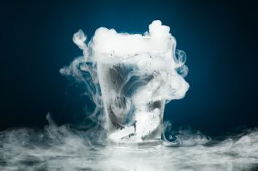
Gases have neither a definite shape, nor a definite volume
A gas is a substance with no definite volume and no definite shape. Solids and liquids have volumes that do not change easily. A gas, on the other hand, has a volume that changes to match the volume of its container. The molecules in a gas are very far apart compared with the molecules in a solid or a liquid.

Slide 28
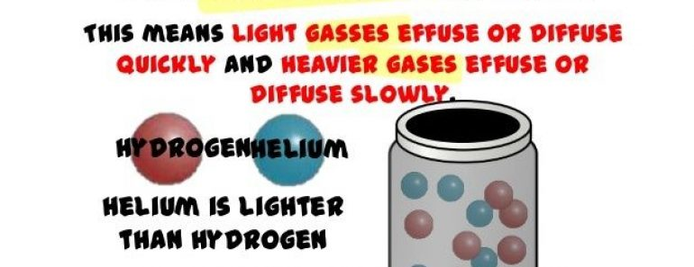
Gases have maximum fluidity, or capacity to flow
Gases possess a minimum density compared to solids and liquids. Hence, they have the maximum fluidity and compressibility.

Slide 29
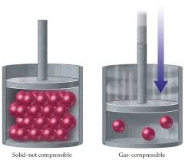
Gases are highly compressible
The atoms, ions, or molecules that make up the solid or liquid are very close together. There is no space between the individual particles, so they cannot pack together. Gases are compressible because most of the volume of a gas is composed of the large amounts of empty space between the gas particles.

Slide 30
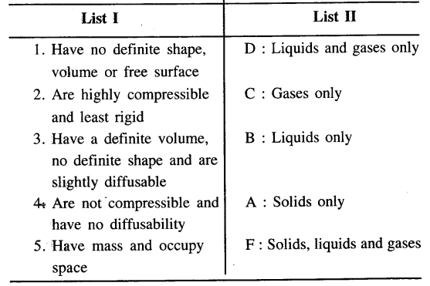
Gases have no free surface
Gases do not have free surface due to very less force of attraction between the molecules and the disperse nature of gas molecules do not allow the gases to have free surface.Since gases do not exhibit superficial tension phenomena (they have no defined shape or volume) they can not form on their own a free surface.

Slide 31
bibliography
Google.com
En.Wikipedia.org
KhanAcademy.org
SlideServe.com
Physics.StackExchange.com
Living Science Physics by Rajen K. Agarwal published by Ratna Sagar.

