Slide 1


HAND GESTURE CONTROLLED WHEELCHAIR
Objective:
Driving a “traditional wheelchair” is an effortful task for the elderly & disabled.
Our project aims to provide a user-friendly experience of wheelchair driving using simple hand gestures.
Block diagram Transmitter section:
Block diagram Receiver section:
Power Supply
Power Supply
Encoded message from the transmitter
Hand Gestures
Arduino Uno
Arduino Uno
433MHz RF Receiver
L293D
DC Motor Driver
DC Motors
ADXL335
Accelerometer
433Mhz RF Transmitter
Obstacles/Hurdles
Ultrasonic Sensor
Buzzer

Slide 2
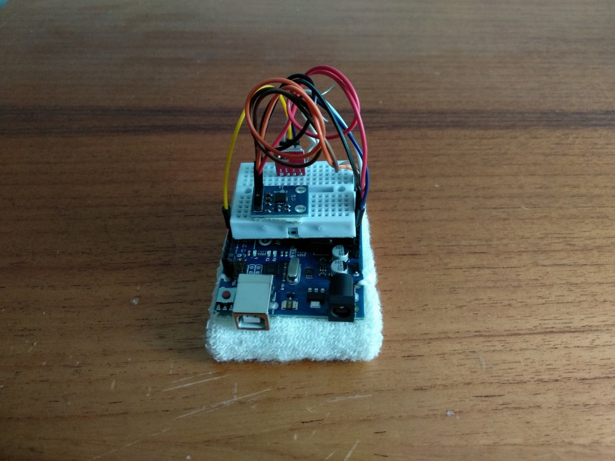
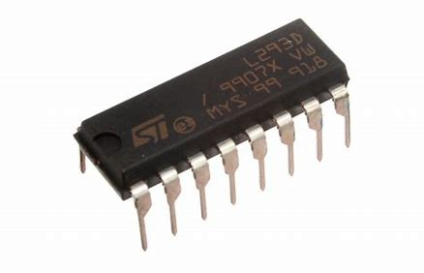
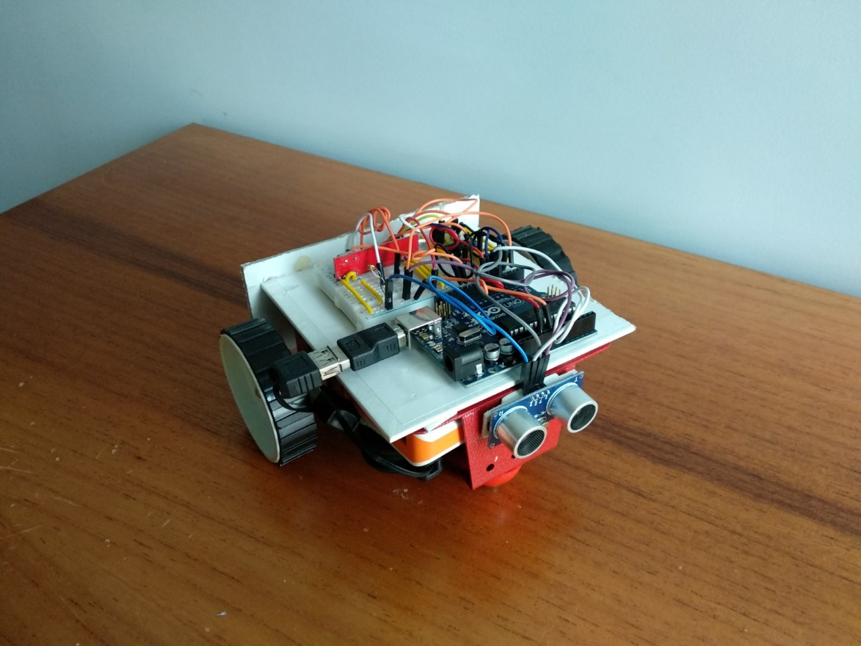
HAND GESTURE CONTROLLED WHEELCHAIR
RF Transmitter
RF Receiver
Motor driver IC
MEMS Accelerometer
Arduino Uno
Ultrasonic sensor
Arduino Uno
Some features:
The use of RF modules enables seamless wireless communication.
The ADXL335 accelerometer is compact and light weight making it easy for the user to wear the device around his wrists.
Enables the user to be independent and safe.
Result:
Range of Analog voltage output of the accelerometer:
Gesture | X-range | Y-range
Forward | 325<x<340 | 265<x<290
Backward | 325<x<340 | 365<x<395
Right | 380<x<425 | 310<x<330
Left | 205<x<350 | 310<x<330
Stop | 320<x<350 | 320<y<350

