Slide 1
Department of
ELECTRONICS AND COMMUNICATION ENGINEERING
HAND GESTURE CONTROLLED WHEELCHAIR
USING ARDUINO
GUIDE NAME: Dr. Anuradha M
TEAM MEMBERS: Rahul R K
PES1201701552 Kaushal K Hebbar
PES1201701547

Slide 2
ABSTRACT
Majority of the physically disabled and elderly people find it very tiring to control the traditional wheelchair and many a time need the assistance of another person.
Other version including the joystick based wheelchair have limitations for the hand impaired people.
Thus, to reduce the strain involved in maneuvering it, the primary objective of this project is to build the prototype of a user- friendly hand gesture based wheelchair.
This method employs specific hand gestures to control the direction of motion of the wheelchair. Any objects or sudden hurdles are also detected and the wheelchair is brought to a halt in such a situation.
This mechanism helps the user to control his wheelchair wirelessly and helps him perform his daily tasks independently and comfortably.

Slide 3
INTRODUCTION
Wheelchairs are among the most popular assistive devices in the medical field.
With the advancement of technology, there’s a rise in the demand for automated user convenient wheelchairs in the market.
Our project aims to provide not only a comfortable but also a safe user experience for the wheelchair-bound using simple hand gestures .
A Gesture is a non-verbal form of communication in which visible bodily actions are used to communicate particular messages.
In this era of automation, Micro Electro Mechanical Sensor (MEMS) based devices have gained great importance for its user-friendly nature.
Here, we use MEMS accelerometer that is highly sensitive to any kind of tilt in the 3-dimensional space as a transducer to recognize hand gestures and an ultrasonic sensor for collision avoidance.

Slide 4
LITERATURE SURVEY
Pushpendra Jha,” Hand Gesture Controlled Wheelchair”, INTERNATIONAL JOURNAL OF SCIENTIFIC & TECHNOLOGY RESEARCH VOLUME 5, ISSUE 04, APRIL 2016 .
V Sundara Siva Kumar, G.Ramesh and P Nagesh, “MEMS based Hand Gesture Wheel Chair Movement Control for Disable Persons ”, International Journal of Current Engineering and Technology, Vol.5, No.3 (June 2015).
Pei Jia., Huosheng H. Hu., Tao Lu., Kui Yuan., “ Head gesture recognition for hands-free control of an intelligent wheelchair” , An International Journal on Industrial Robot, Vol 34, No.1, pp.60-68, 2007 .
Javajji Veeraiah., P.V.N Aravind Syam,. N. Naga Durga., K. Ravi Kanth., G. Vasudha, “Accelerometer Based Gesture Recognisation for Wheel Chair Direction Control Using ZIGBEE Protocol”, International Journal of Technological Exploration and Learning (IJTEL), Vol. 2, No. 2,pp.104-108, April 2013.

Slide 5
BLOCK DIAGRAM
TRASNMISSION SECTION
Power Supply
Hand Gestures
Arduino Uno
ADXL335
Accelerometer
433Mhz RF Transmitter

Slide 6
BLOCK DIAGRAM
RECEIVER SECTION
Power Supply
Encoded message from the transmitter
Arduino Uno
433MHz RF Receiver
L293D
DC Motor Driver
DC Motors
Obstacles/Hurdles
Ultrasonic Sensor
Buzzer

Slide 7
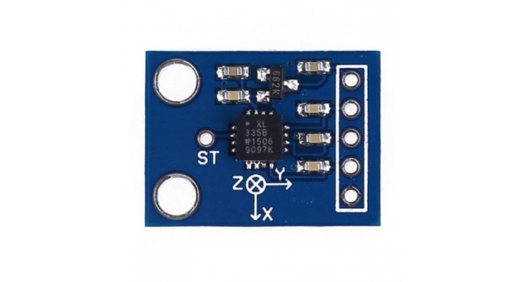
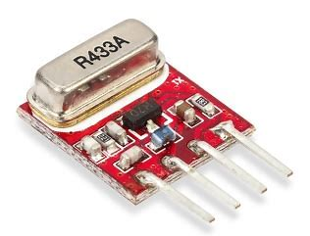
METHODOLOGY
In this project a MEMS based accelerometer ADXL335 is used to measure the variations in acceleration in X, Y& Z axis. It is a small, light weight chip integrated with mechanical elements, sensors and actuators.
When the person tilts the hand, change in acceleration is converted into corresponding analog voltage values and is sent to the Arduino to encode them.
The Arduino then feeds these signals onto the
433MHz transmitter which transmits them in the
RF range to the receiver placed on the wheelchair.

Slide 8
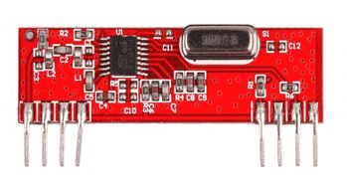
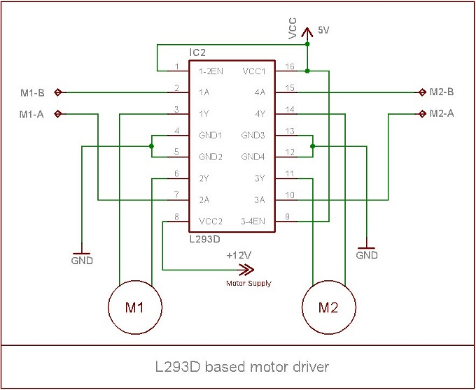
The 433MHz receiver module receives and sends the data to the Arduino for processing/ decoding.
The decoded message is then used to drive the motors using the motor driver L293D IC.
If in case there is an obstacle in front of the wheelchair, the ultrasonic sensor is used
to halt its operation even if there is a
gesture made by the user to move forward.
It sends a trigger sound pulse and
calculates the distance by taking into
account the time gap between transmission
and reception.

Slide 9
RESULT
The proper fabrication of all the components according to the circuit diagram gives us a working prototype model for the Intelligent Wheelchair based on Hand Gesture Control.
The accelerometer used here recognizes all the hand tilt gestures perfectly. The table below tabulates the reading of the accelerometer:
The ultrasonic sensor is programmed to detect objects within 20cm range. The sensor successfully triggers the buzzer and brings the wheelchair to a complete halt state.
The user is then given a chance to change the gesture.
Gesture | X-range | Y-range
Forward | 325<x<340 | 265<x<290
Backward | 325<x<340 | 365<x<395
Right | 380<x<425 | 310<x<330
Left | 205<x<350 | 310<x<330
Stop | 320<x<350 | 320<y<350

Slide 10
FUTURE SCOPE
The hand gesture based wheelchair can further be modified and can be developed by:
Adding the feature of an emergency button to give a call to their family in case of emergency using the GSM module.
Using the same, location tracking can be enables so that family members are notified when the emergency button is pressed by the wheelchair bound.
Additional IR sensors can be placed along the sides of the wheelchair to improve the function of obstacle detection.
Additional gestures can be created using the 3rd axis (z) to perform beneficial movements like lifting up the seat or positioning lumbar support and the leg rest.

Slide 11
CONCLUSION
The project implemented is just a prototype of the gesture based wheelchair.
If this is brought to the market as a commercial project then, it will surely be useful to all the disabled people who are unable to drive the normal ones on their own.
This wheelchair can replace other versions like the remote or joystick controlled ones by its user friendliness.
They can move it in the right, left, forward, and backward directions with the 3-axis accelerometer (MEMS SENSOR) which is highly sensitive and is capable of detecting the tilt.

Slide 12
THANK YOU

