Slide 1
Exa-chain
-GPORTS

Slide 2
Team Members
Nishikant KP
Sri Vijay Bhargav Noone
T Eshwar Reddy
Venkata Rahul Kancharla
Dasoju Vamshi Krishna
TVVS Naveen

Slide 3
Problem Statement
Is current scholarship process really viable?

Slide 4
An ongoing situation
28 SC students failed to obtain deserved Scholarship in NIT Andhra Pradesh (2015 batch).
They are now pressured to clear all the dues,
To be able to register for upcoming sem’s registration.

Slide 5
Is there any viable solution?
Let’s picturize our proposed solution

Slide 6
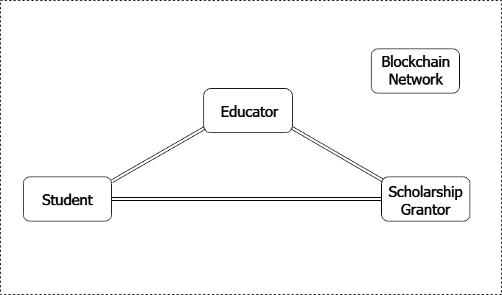

Slide 7
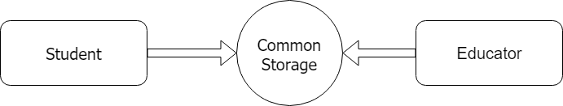
Common Storage

Slide 8
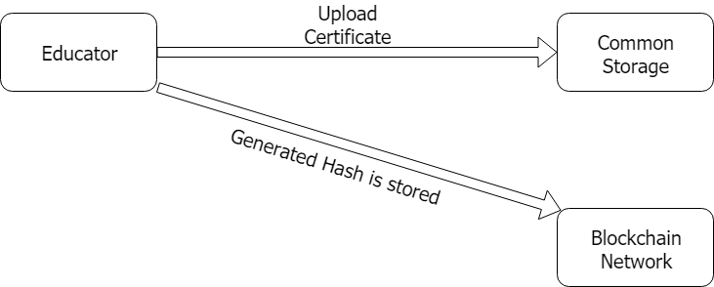
Educator Interaction

Slide 9
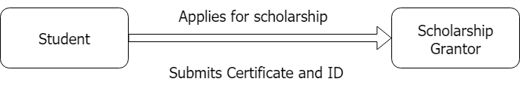
Scholarship Initiated

Slide 10

Scholarship Instructions

Slide 11
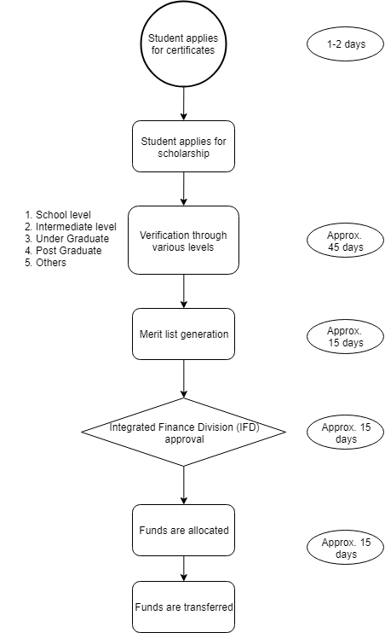
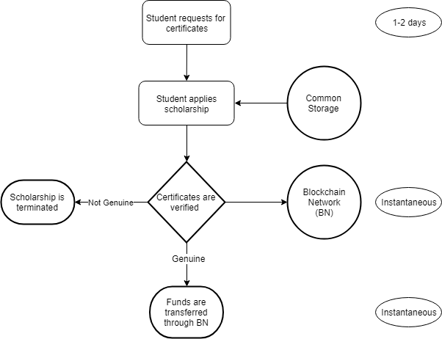

Slide 12
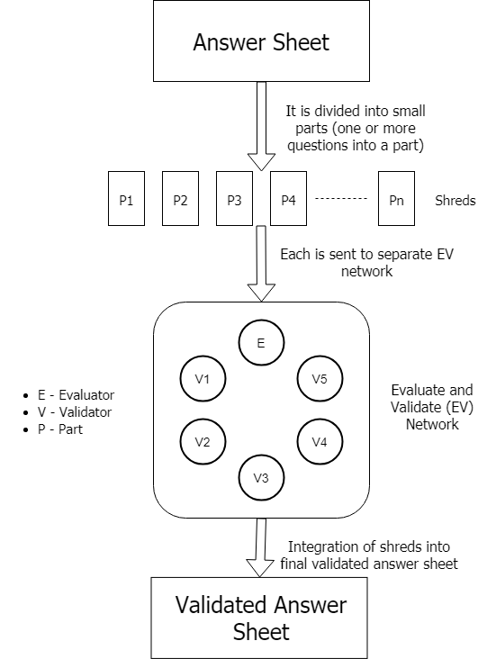
Examination process overhaul

