Slide 1
C1-02 edu-chain…
Nishikant
Bhargav
Eshwar
Rahul

Slide 2
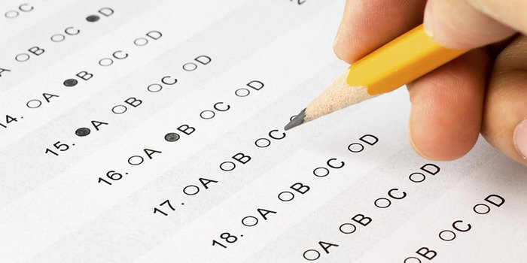
Problem- the way examinations are conducted…
Offline Examinations
No security.
Can be easily destroyed.
No transparency.
Uses centralized system to store data
Wastage of paper….

Slide 3

Online Examinations……
Centralized system for storing data.
No ultimate security.
No transparency.

Slide 4

Our Solution
Using blockchain in examination system.

Slide 5

Why Blockchain?
It provides maximum level of security.
Distributed ledger
It will be transparent.

Slide 6
