Slide 1
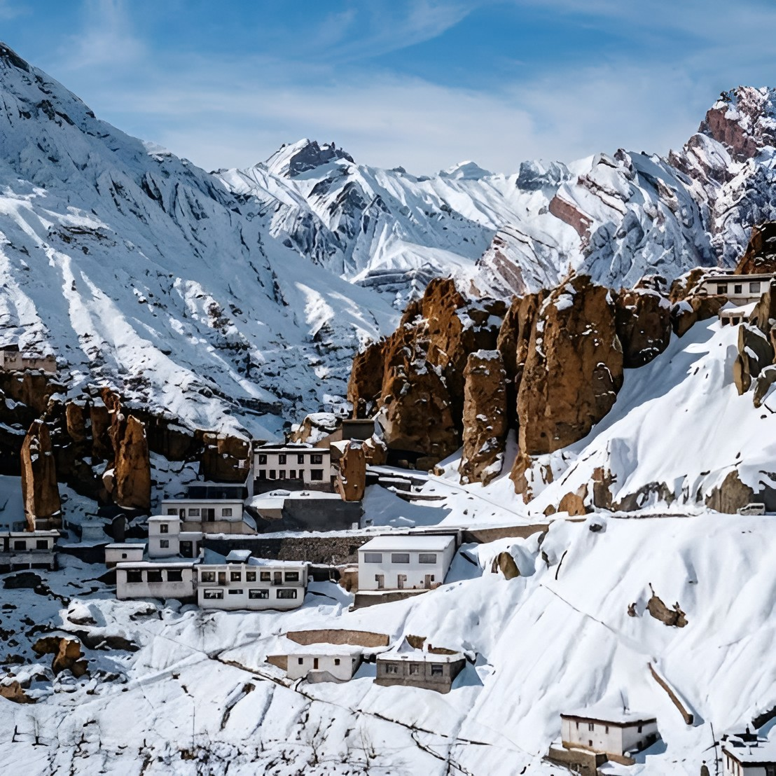
Winter Spiti Itinerary
23 Dec’ 26 – 03 Jan’ 27

Slide 2
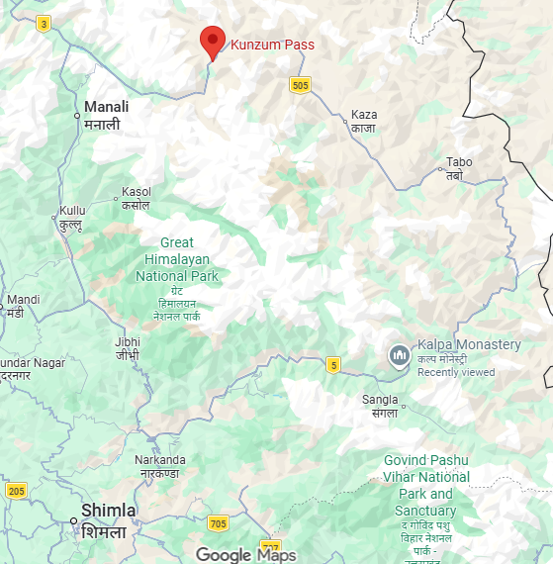
Places to halt
Kunzum Pass
Chicham bridge
De-tour / in-transit
Ke Mnstry
Langza
Komic
Kaza
Dhankar monastery
Tabo
Kasol
Nako
Khab Sangam
Kinnaur gate
Kalpa
Chitkul
Route Map
Shimla

Slide 3
Day 0
9 trains
23 Dec’ 26
Pune to Delhi (Train)
01. Paschim Exp (12925)
BDTS – 11.30 am, NZM - 10.00 am (24 Dec)
02. DEE Garibrath (12216)
BDTS - 12.00 pm, DEE– 11.00 am (24 Dec)
03. Mangladweep Exp (12617)
Panvel – 12.30 pm, NZM – 01.35 pm (24 Dec)
04. BDTS HW SF Exp (22917)
BDTS – 12.45 pm, NZM – 08.35 am (24 Dec)
05. BDTS DEE SF Exp (22949)
BDTS – 2.45 pm, DEE – 11.45 am (24 Dec)
06. BDTS SMPRK K Exp (12907)
BDTS – 5.30 pm, NZM – 10.15 am (24 Dec)
3 trains
01. Goa Exp (12779)
Pune – 4.30 am, NZM - 6.25 am (24 Dec)
02. Sampark Kranti (12629)
Pune - 9.00 am, NZM – 11.40 am (24 Dec)
03. Jhelum Exp (11077)
Pune – 05.20 pm, NZM – 08.50 pm (24 Dec)
Lesser options, probability of getting confirmed tix decreases.
Travel expenses PP – 2650/-
Day 0
Day-wise itinerary
23 Dec’ 26
Mumbai to Delhi (Train)

Slide 4
07. Golden Temple Exp (12903)
BDTS – 6.43 pm, NZM - 1.50 pm (24 Dec)
08. Punjab Mail (12137)
CSTM - 7.35 pm, NZM– 8.55 pm (24 Dec)
09. Goa Smpark K Exp (12449)
Panvel – 7.40 pm, NZM – 01.40 pm (24 Dec)
More options, probability of getting confirmed tix increases.
Apart from Punjab Mail, the timings of all other trains are perfect,. In case of delays, we still have a buffer to freshen up, eat properly and then go to Majnu ka tila to catch our bus to Shimla.
Additional travel – Pune to Mumbai (Downside)
Travel expenses PP – 3000/- to 3200/- basis the train selection (2AC + Travel to Mumbai). Maximum trains have a fare of 2350/- for 2AC
Station Codes
BDTS – Bandra Terminus
DEE – Delhi Sarai Rohilla
NZM – Hazrat Nizamuddin
CSTM – Chhatrapati Shivaji Maharaj Terminal
Day 0
Day-wise itinerary
23 Dec’ 26
Mumbai to Delhi (Train)

Slide 5
Delhi to Shimla Bus
Delhi pick up point – Majnu ka tila / ISBT Kashmere gate
Pick up time – 9.00 pm to 11.40 pm
Shimla drop off point – MC Car parking
Drop off time – 5.00 am to 8.30 am
Travel agency with good reviews –
Ram Dalal holidays & Flix Bus (rest do not have a good rating)
Travel Expense PP – 2000/- to 2500/-
Flix Bus (10.00 pm fare as of 19 Oct was 1750/- ). Also, they had a flat 15% off coupon.
Additional expenses of travel & food in Delhi PP – 1000/- to 1200/- (tentatively)
Day 1
24 Dec’ 26
Delhi to Shimla (Bus)
Day-wise itinerary

Slide 6
Day 2
/ 1
Day-wise itinerary
25 Dec’ 26
Shimla to Kalpa ( 4 x 4)

Slide 7
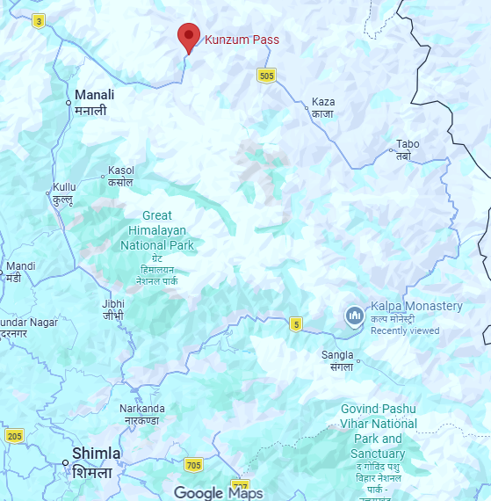
Shimla (7,250ft) to Kalpa (9,700ft)
Shimla Pick-up time – 10.00 am
Pick-up point - Near Mc Car parking
Preferred mode of travel – 4 x 4 – 3 nos.
Shimla to Kalpa distance – 237 kms
Travel Time according to Gmaps – 7 hrs 30 mins
Actual travel time – 10 to 12 hours (considering lunch,
dinner, pee – poop and sight seeing pit stops)
Kalpa drop-off time – 10.00 pm
Sight seeing Pit stop - Kinnaur Gate
Key Route map
Day 2
25 Dec’ 26
Shimla to Kalpa (4 x4)

Slide 8
Kalpa halt
Stay back in Kalpa and explore places in and around Kalpa
Spots in Kalpa
Kinnaur Kailash Viewpoint
Suicide viewpoint (on the way to Kinnaur kailash viewpoint)
Chakha meadows (round trip forest trek 4 to 5 hours)
Kalpa Monastery
Roghi village (if possible)
Leave at 8.00 am sharp, only then we will be able to cover these spots.
This includes chilling, rolling, etc. etc.
Return to the stay by 7/7.30 pm max.
Key Route map
Day 3
26 Dec’ 26
Kalpa Halt

Slide 9
Kalpa (9,700ft) to Tabo (10,700ft)
Kalpa start-of time – 11.00 am
Kept extra 2/3 hours for exploring left over places (if any)
Preferred mode of travel – 4 x 4 – 3 nos.
Kalpa to Tabo distance – 160 kms
Travel Time according to Gmaps – 4 hrs 15 mins
Actual travel time – 8 to 10 hours (considering lunch,
dinner, pee – poop and sight seeing pit stops)
Tabo drop-off time – 9.00 pm
Sight seeing Pit stop - Khab Sangam(30 mins to 45 mins max)
Nako Village (Nako Gompa, Nako lake & nearby spots)
2 to 3 hours
Key Route map
Day 4
27 Dec’ 26
Kalpa to Tabo

Slide 10
Tabo Halt
Stay back in Tabo and explore places in and around Tabo
Spots in Tabo
Tabo monastery
Tabo caves
Local sight seeing & chilling (considering this stay for majorly chilling & less of
sight seeing)
Leave at 9.00 am sharp,. Meet locals get to know about more places, chill &
Return to the stay by 7/7.30 pm max.
Key Route map
Day 5
28 Dec’ 26
Tabo Halt

Slide 11
Tabo (10,700ft) to Kaza (12,500ft) via. Dhankar Monastery
Tabo start-of time – 10.00 am
Preferred mode of travel – 4 x 4 – 3 nos.
Tabo to Dhankar monastery distance – 32 kms
Travel Time according to Gmaps – 1 hrs 30 mins
Actual travel time – 2 to 2.5 hours (considering pee – poop and sight seeing pit stops)
Dhankar Monastery drop-off time – 12.30 pm
Time span Dhankar monastery, village & Dhankar lake trek (2 kms) – 4 to 5 hours
Dhankar start-of time – 5.30 pm
Dhankar to Kaza distance – 34 kms
Travel Time according to Gmaps – 1 hrs 30 mins
Actual travel time – 2 to 2.5 hours (considering pee – poop and sight seeing pit stops)
Kaza drop off time – 8.00 pm
Key Route map
Day 6
29 Dec’ 26
Tabo to Kaza via Dhankar

Slide 12
Kaza halt
Stay back in Kaza and explore places in and around Kaza
Spots in Kaza
Kaza to Langza (1 hour)
Langza time span – 2 to 3 hours
Langza to Komic ( 30 mins)
Komic time span – 2 to 3 hours
Komic to Hikkim (20 mins)
Hikkim time span – 1.5 to 2 hours
Hikkim to Kaza (1 hour)
Leave at 8.00 am sharp only then we will be able to cover all these spots and these
spots are the heart of spiti valley and the circuit & then return to the stay by
7.30/8 pm max.
Key Route map
Day 7
30 Dec’ 26
Kaza Halt

Slide 13
Kaza to Key Monastery & Chichham Bridge (Subject to accessibility
due to snowfall)
OR
Return towards Shimla and take a de-tour to Chitkul
Stay back in Kaza and explore places in and around Kaza
Spots in Kaza
Kaza to Key Monastery (45 mins)
Time span in Key Monastery (1 to 1.25 hours)
Key Monastery to Chichham Bridge (30 mins)
Time span in Chichham Bridge (1 hour)
Leave at 7.00 am sharp only then we will be able to cover all these spots and these
spots again are the heart of spiti valley and the circuit & then return towards Shimla
& take a de-tour to Chitkul
Chichham Bridge to Chitkul distance – 277 kms
Time as per Gmaps – 9 hours
Actual time – 11 hours
Reach chitkul by 10 pm
If the weather conditions don’t permit then we can take a stay in Tabo/Nako/Kalpa
Key Route map
Day 8
31 Dec’ 26
Kaza to Chitkul

Slide 14
Chitkul Exploration & Return to Shimla
Stay back in Chitkul and explore places in and around Chitkul
Spots in Kaza
2/3 spots to be covered max 3 hours for it will be sufficient
Take a stay in Chitkul
Wake up, chill, rest, hop cafes, do whatever the fuck you want to do man
Explore near by treks, spots etc.
Happy new year 2027
Key Route map
Day 9
01 Jan’ 27
Chitkul to Shimla

Slide 15
Chitkul Exploration & Return to Shimla & Delhi
Leave at 8.00 am sharp only then we will be able to cover all the spots return
towards Shimla & take a de-tour in Rakcham (1 hour)
Chitkul to Shimla distance – 258 kms
Time as per Gmaps – 8.5 hours
Actual time – 10 hours
Reach Shimla by 6/7 pm
Take a return bus to Delhi on the evening of 2nd Jan 2027
Reach Delhi on 3rd Jan 2027 around 12pm. Rest, shop again do whatever the fuck
you want to and then take a late night or early morning flight to Pune on
4th Jan 2027.
Key Route map
Day 10 & 11
02 & 03 Jan’ 27
Chitkul to Shimla to Delhi

Slide 16
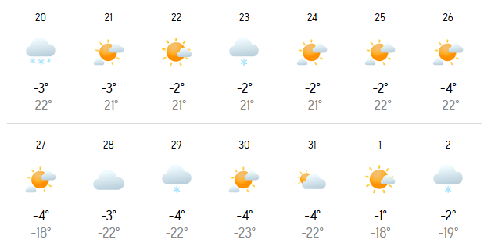
Weather conditions

Slide 17
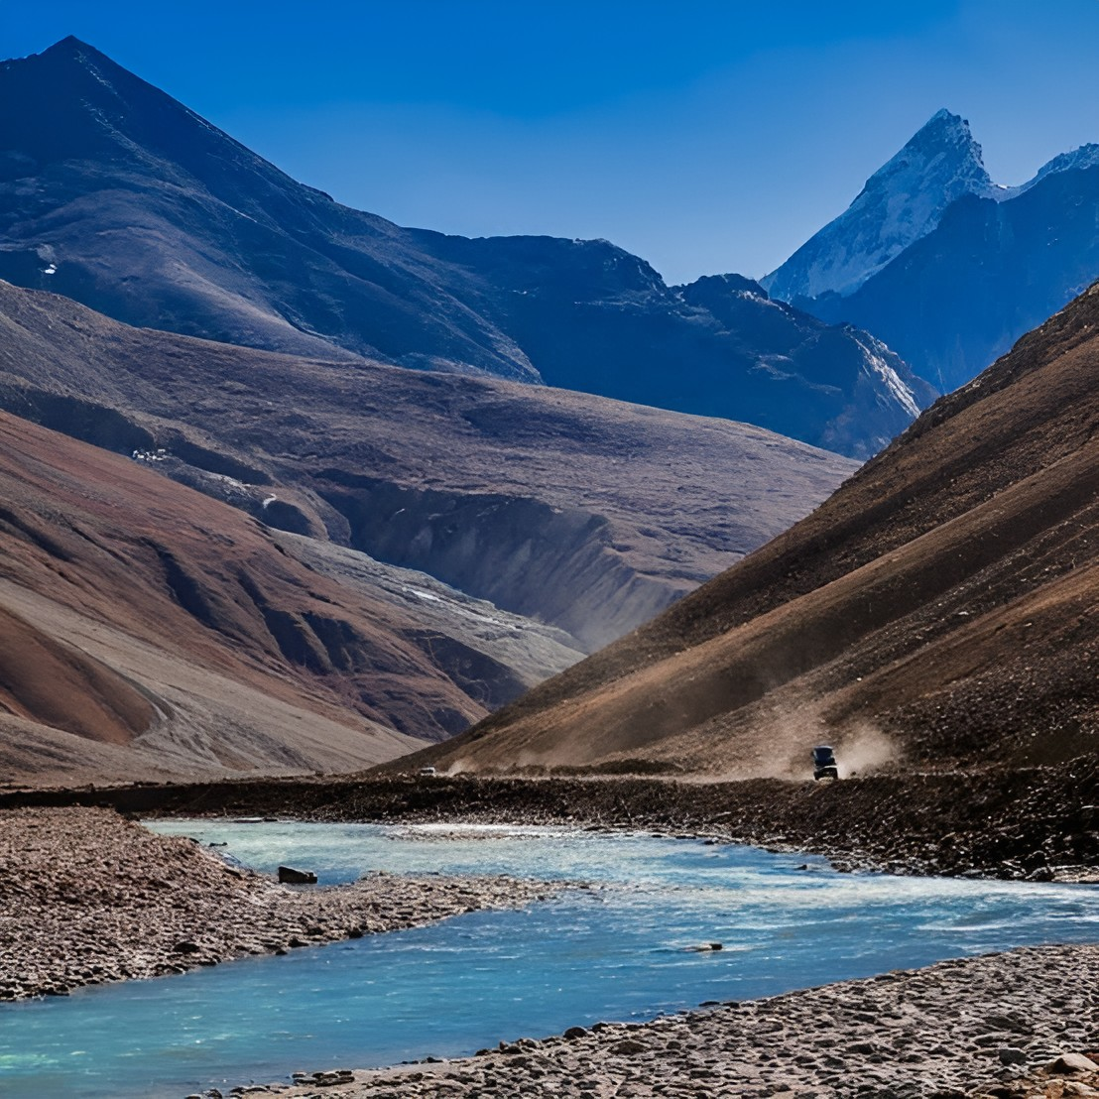
Winter Himachal
Itinerary
23 Dec’ 26 – 02 Jan’ 27
Manali – Sissu – Keylong – Jispa – Koksar - Manali

Slide 18
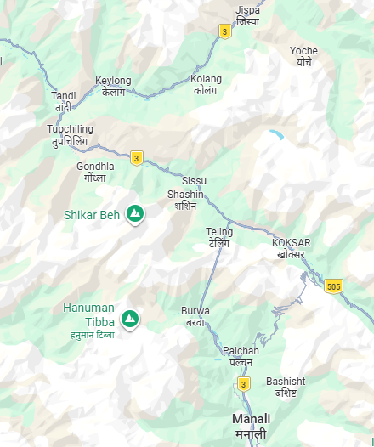
Places to halt
Jispa
De-tour place
Tandi
Keylong
Sissu
Gondhla fort
Koksar
Route Map
Manali

Slide 19
Delhi to Manali Bus
Delhi pick up point – Majnu ka tila / ISBT Kashmere gate
Pick up time – 9.00 pm to 12.00 am
Manali drop off point – Manali private bus parking
Drop off time – 7.00 am to 10.30 am
Travel agency with good reviews –
Ram Dalal holidays , Flix Bus, Deltin travels, Kheerganga Travels, Reo Pro Travels and many more
Travel Expense PP – 2500/- to 2800/-
Preferred bus agency – Deltin (travelled personally)
Additional expenses of travel & food in Delhi PP – 1000/- to 1200/- (tentatively)
Day 1
24 Dec’ 26
Delhi to Shimla (Bus)
Day-wise itinerary

Slide 20
Day 2
/ 2
Day-wise itinerary
25 Dec’ 26
Manali to Sissu (4 x 4)

Slide 21
Manali (6,750ft) to Sissu (10,350ft)
Manali Pick-up time – 12.00 pm
Pick-up point - Manali Private bus parking
Preferred mode of travel – 4 x 4 – 3 nos.
Manali to Sissu distance – 40 kms
Travel Time according to Gmaps – 1 hrs 30 mins
Actual travel time – 5 to 7 hours (considering lunch,
dinner, pee – poop and sight seeing pit stops)
Sissu drop-off time – 7.00 pm
Sight seeing Pit stop - Atal Tunnel, sports activities like paragliding, zip lining etc.
in bashisht, palchan, Snow entertainment point at north
portal of atal tunnel
Key Route map
Day 2
25 Dec’ 26
Manali to Sissu (4 x 4)

Slide 22
Sissu halt
Stay back in Sissu and explore places in and around Sissu
Spots in Sissu
Sissu waterfall (frozen at that time)
Sissu lake
Sissu monastery
Chandra river banks
Local short trek
Leave at 8.00 am sharp, only then we will be able to cover these spots.
This includes chilling, rolling, etc. etc.
Return to the stay by 7/7.30 pm max.
Key Route map
Day 3
26 Dec’ 26
Kalpa Halt

Slide 23
Sissu (10,350ft) to Keylong(11,300ft)
Sissu start-of time – 12.00 pm
Kept extra 2/3 hours for exploring left over places (if any)
Preferred mode of travel – 4 x 4 – 3 nos.
Sissu to Keylong distance – 32 kms
Travel Time according to Gmaps – 1 hr
Actual travel time – 6 to 8 hours (considering lunch,
dinner, pee – poop and sight seeing pit stops)
Keylong drop-off time – 8.00 pm
Sight seeing Pit stop – Gondhla fort & Yangla snow point
(30 mins to reach, 1.5 hours for exploration)
Tandi Chandrabhaga sangam, Tandi bridge, Tandi village
Gondhla fort to Tandi (30 mins to reach, 4 to 5 hours for
exploration, lunch, etc.)
Tandi to Keylong (30 mins to reach)
Key Route map
Day 4
27 Dec’ 26
Sissu to Keylong

Slide 24
Keylong halt
Stay back in Keylong and explore places in and around Keylong
Spots in Keylong
Shashur monastery
Viewpoint keylong
Tayul Gompa/ monastery
Local short trek
Leave at 8.00 am sharp, only then we will be able to cover these spots.
This includes chilling, rolling, etc. etc.
Return to the stay by 7/7.30 pm max.
Day 5
28 Dec’ 26
Keylong Halt

Slide 25
Keylong (11,300ft) to Jispa (10,500ft)
Keylong start-of time – 11.00 am
Preferred mode of travel – 4 x 4 – 3 nos.
Keylong to Jispa distance – 23 kms
Travel Time according to Gmaps – 40 mins
Actual travel time – 2 to 2.5 hours (considering pee – poop and sight seeing
pit stops including Gemur Gompa)
Jispa drop-off time – 1.30/2.00 pm
Check-in Jispa stay, have lunch and chill cause it’s heavy snowfall predicted on this day
In Jispa ( so snowfall ke maze lenge)
If snowfall doesn’t happen then the same day can be used to go to Darcha & Baralacha La, round trip 4 to 5 hours)
Jispa drop off time – 8.00 pm
Day 6
29 Dec’ 26
Keylong to Jispa

Slide 26
Jispa halt
Stay back in Jispa and explore places in and around Jispa
Spots in Keylong
Local treks and trails
Majorly chilling cause the next day would be a little hectic travel day
Day 7
30 Dec’ 26
Jispa Halt

Slide 27
Jispa to Koksar
Return to Koksar from Jispa stay there in the night, celebrate new year and do
whatever the fuck you want to do
Jispa to Koksar distance – 67 kms
Time as per Gmaps – 1 hrs 40 mins
Actual time – 3 Hrs
Leave at around 8.00 am from Jispa and reach by 11.00 am at Koksar, check-in,
freshen up, have lunch and explore Koksar.
Return to the stay by 8/9pm
Happy new year 2027
Day 8
31 Dec’ 26
Jispa to Koksar

Slide 28
Koksar to Manali to Delhi to Pune
Return to Manali from Koksar doing adventure activities through out the day
Koksar to Manali distance – 41 kms
Time as per Gmaps – 1 hrs 20 mins
Actual time – 8 to 10 Hrs
Leave at around 8.00 am from Koksar and reach by 6.00 pm at Manali,, freshen up,
have dinner and take a bus to Delhi on 1 jan
Reach Delhi by 11.00 am. On 2 Jan Check-in in Delhi freshen up, shop, café hop, rest as per
Personal preferences and take a late night or early morning flight to Pune on
3 Jan 2027.
Day 9 & 10
1 & 2 Jan’ 27
Koksar to Manali

Slide 29
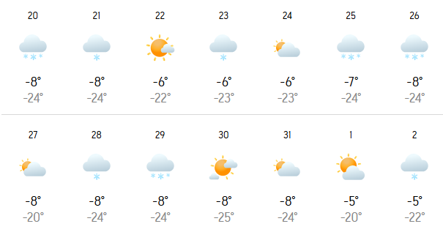
Weather conditions

Slide 30
Winter Himachal
Itinerary
23 Dec’ 26 – 02 Jan’ 27
Malana – Manikaran – Kalga – Pulga – Tosh - Kasol

Slide 31
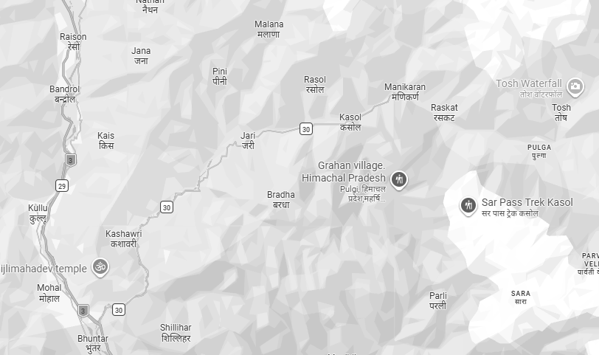
Places to halt
Malana
De-tour place
Manikaran
Tosh
Kasol
Kalga & Pulga
Bhuntar
Route Map

Slide 32
Delhi to Bhuntar Bus
Delhi pick up point – Majnu ka tila / ISBT Kashmere gate
Pick up time – 9.00 pm to 12.00 am
Bhuntar drop off point – Bhuntar By-pass
Drop off time – 7.00 am to 10.30 am
Travel agency with good reviews –
Ram Dalal holidays , Flix Bus, Deltin travels, Kheerganga Travels, Reo Pro Travels and many more
Travel Expense PP – 2500/- to 2800/-
Preferred bus agency – Deltin (travelled personally)
Additional expenses of travel & food in Delhi PP – 1000/- to 1200/- (tentatively)
Day 1
24 Dec’ 26
Delhi to Shimla (Bus)
Day-wise itinerary

Slide 33
Day 2
/ 3
Day-wise itinerary
25 Dec’ 26
Bhuntar to Malana

Slide 34
Bhuntar to Malana
Bhuntar Pick-up time – 10.30 am
Pick-up point - Bhuntar by-pass
Preferred mode of travel – tarveler
Bhuntar to Malana distance – 40 kms
Travel Time according to Gmaps – 2 hrs
Actual travel time – 3 hours (considering pee – poop and sight seeing pit stops)
Malana drop-off time – 1.30 pm
Check-in in Malana, freshen up, score good stuff, take a small trail in the evening,
chill & relax
Key Route map
Day 2
25 Dec’ 26
Bhuntar to Malana

Slide 35
Malana to Kalga
Kalga start-off time – 12.30 pm
Preferred mode of travel – tarveler
Malana to Kalga distance – 16 kms
Travel Time according to Gmaps – 1 hr
Actual travel time – 5 to 6 hours (considering pee – poop and sight seeing pit stops)
Malana drop-off time – 5.30/6.00 pm
De-tour – Manikaran Sahib (gurudwara, hot springs and village)
Trek to Kalga stay – 1/1.5 hours (Holycow stay)
Reach stay by 7/7.30 pm
Key Route map
Day 3
26 Dec’ 26
Malana to Kalga

Slide 36
Kalga Halt
Stay in Kalga
Take a trek to Kutla (4/5 hrs trek)
Explore Kalga
Chill & Relax
Start slow
Key Route map
Pulga Halt
Leave Kalga around 9.00 am on 28 dec
Reach Pulga around 11.00 am
Check-in in Pulga and explore Pulga
Chill & Relax
Go to Pulga hot spring
Day 4 & 5
27 - 28 Dec’ 26
Kalga Halt

Slide 37
Pulga to Tosh & Stay in Tosh (29 Dec)
Pulga to Tosh distance – 5 kms
Times as per Gmaps – 30 mins
Actual time – 1 hour
Reach Tosh, check-in and explore Tosh
Places to visit in Tosh:
Tosh waterfall
Trek near-by
Chill & Relax
Key Route map
Stay in Tosh & Tosh to Chalal via Kasol (30 Dec)
Tosh to Kasol distance – 20kms
Travel time as per Gmaps – 1 hrs 30 mins’
Actual Travel time – 3 hrs
Departure from Tosh – 3.00 pm
Reach Kasol – 6.00pm
Trek to Chalal and reach stay by 7.00 pm
Day 6 & 7
29 – 30 Dec’ 26
Tosh To Chalal

Slide 38
Chalal and near by sight seeing (31 dec)
Stay in Chalal in Café Fusion
Wake & Bkae - Get a hash brownie baked and a hash oil joint rolled
Chill and relax
Evening – Small trek near and around
Night – Rave in Kasol
Happy New Year
Key Route map
Rest in Chalal on 1 Jan 2027
Trek down to kasol from Chalal on 1 Jan 2027
Take a bus from Kasol to Delhi on 1 Jan 2027
Reach Delhi on 2 Jan 2027 around 11.00 am.
Check-in in Delhi freshen up, shop, café hop, rest as per
Personal preferences and take a late night or early morning flight to Pune on
3 Jan 2027.
Day 8 & 9
31 Dec’ 26 – 1 Jan ‘ 27
Chalal Halt & Kasol rave

Slide 39
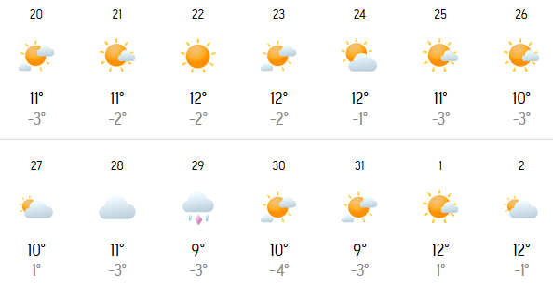
Weather conditions

Slide 40
Must Haves to Carry
Sunglasses UV Rated
Sunscreen 50+ SPF
Wet Wipes
Toilet Paper / Pee buddy (for girls)
Good Waterproof Shoes
Torch (optional)
Plenty of snacks, chocolates, dry fruits (emergency ration)
Keep sufficient drinking water handy
Clothes rated to -20 Degree Celsius
At least 2-3 Inner warmer
Medicine kit as per every individual & a cumulative kit
Bags should be pittu bags / Rucksack, trolley bags would be very inconvenient to carry
Note : Let’s consider that we have a buffer day for any unforeseen circumstances like
landslide/snowfall/travel delays etc. so be prepared mentally that we might have to skip
spots if required.
Must Haves

