Slide 1
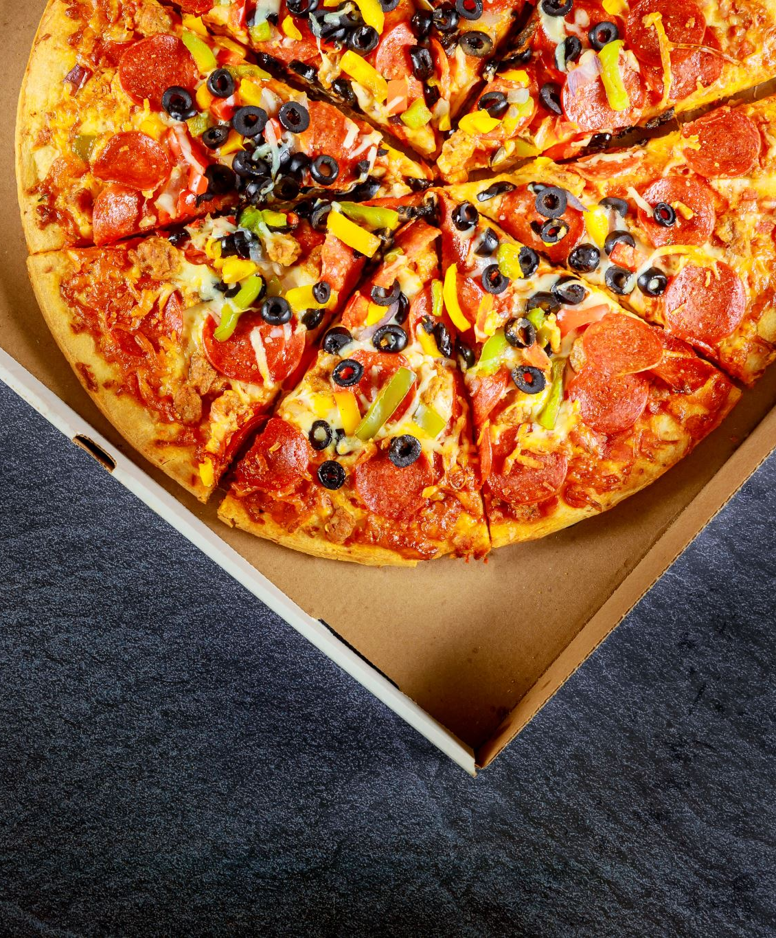
Foodlicious
Rahul Ashok Kodate- 002772254
Nishant Patel- 002796854
Anuja Kale- 002700699
Aseem Deshmukh- 002743798
Udaykumar Shelke - 002727131

Slide 2
Introduction
Foodlicious is an online food ordering system that allows customers to order a variety of foods directly from the website. The system is built using React, which provides a modern and user-friendly interface for customers to place their orders. The system supports different cuisines, such as Italian, Mexican, Chinese, and more, giving customers a wide range of food options to choose from.
The system also allows customers to track their order status and receive real-time updates on their delivery status. The admin interface allows the business owner to manage their menu, set pricing, and monitor order fulfillment for all the different food options available.
Overall, Foodlicious is a convenient and easy-to-use food ordering system that simplifies the ordering process for customers, while providing the business owner with a powerful platform to manage their operations for all types of food options.

Slide 3
Features
User Authentication
Common Payment Gateway Integration
Paying Amount with Stripe
Placing Orders
Store Orders in the Database
Retrieve Orders to User Profile
User Dashboard
Admin Dashboard
Manage Users, Products, Orders in Admin Panel
Add to Cart Feature
Update Quantity in Cart
Delete Products from the Cart

Slide 4




Tech Stack Used
React
mongoDB
Express.js
Node.js

Slide 5
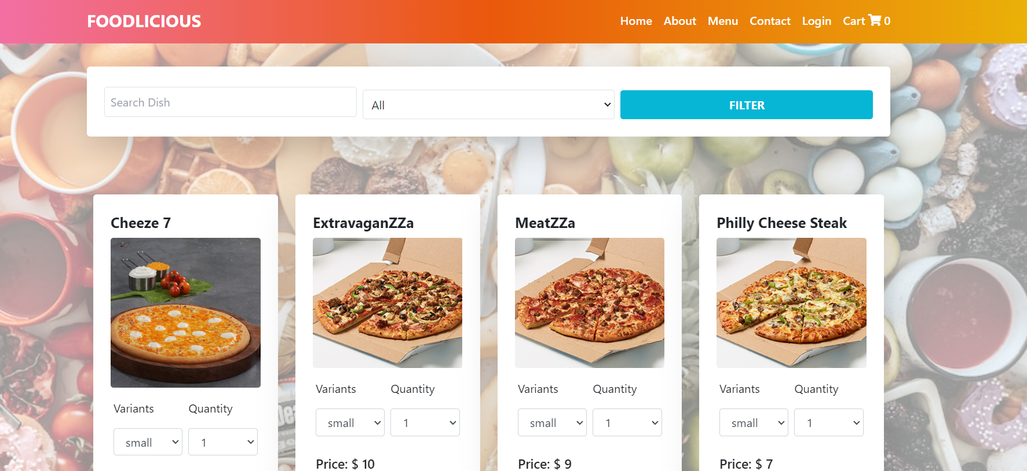
Links
Heroku
https://foodlicious.herokuapp.com/
Github
https://github.com/RahulKodate/Web-Design-Group-10/tree/main

Slide 6
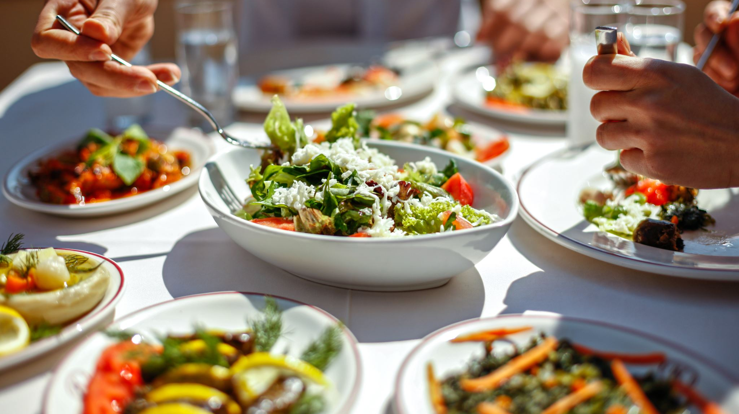
Thank You!

