Slide 1
VoiceBox
Project training I
Final Presentation
MAITRE Robin, VAILLANT Yann, XIAO KAI, FENG Changhong, SUN Hao, Yuyi

Slide 2
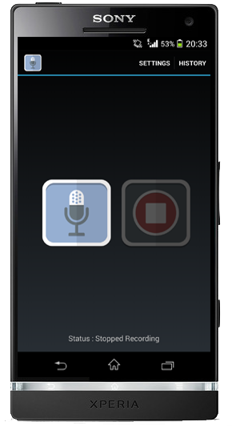
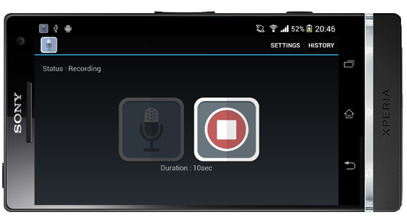
Main view
Record / Stop (it’s a service)
Call other view (settings / history)
Landscape
Duration

Slide 3
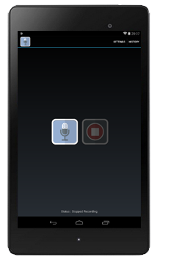
Main view 7 inches
Interface compatible for 7” devices
Google nexus 7

Slide 4
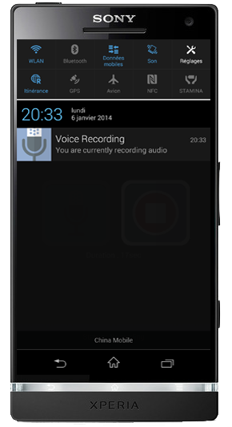
Notification during record
A notification appear during the record

Slide 5
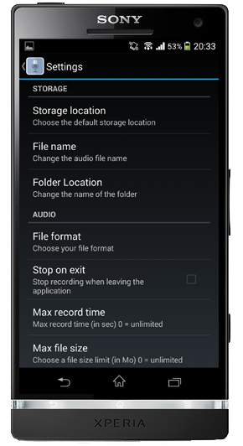
Settings view
Settings available:
Storage in phone or SD card
File name
Folder name
File format
Stop on exit application
Max record time
Max file size
Default theme

Slide 6
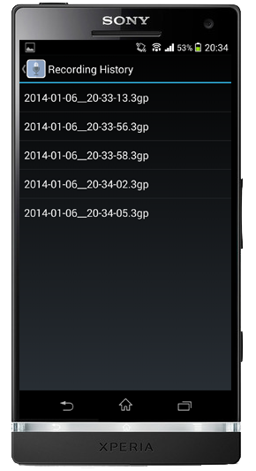
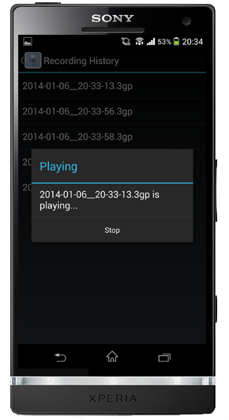
History
Simple touch
Record list
Play view

Slide 7
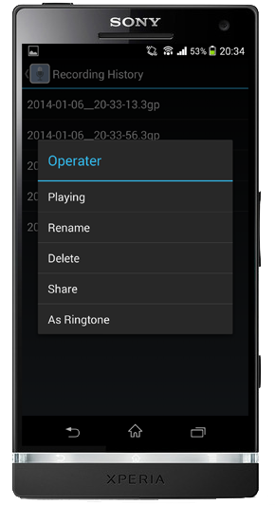
History
Long touch
Record list
Manage file view

Slide 8
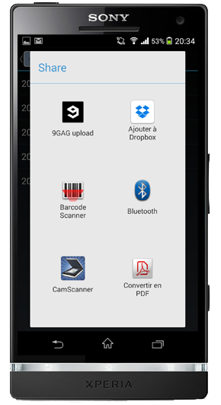
Share
Share your better record
Additional feature
Shake for share

Slide 9
Thanks
谢谢
Merci
感謝

