Slide 1
Project Training I
User story & Diagrams
MAITRE Robin, VAILLANT YANN, XIAO KAI, FENG Changhong, SUN Hao, Yuyi

Slide 2
Story cards
Story card Title : Record Estimate : 1 day Priority : 1
User Story: Record sounds with the device microphone.
Acceptance Test criteria : Record work Clear audio Small file size
Note : Limitation at 1 minute. Notification if you leave the record.

Slide 3
Story cards
Story card Title : Interface Estimate : 3 day Priority : 2
User Story: Multi-device layout (tablet 7 inch and mobile phone)
Acceptance Test criteria : Layout work on all device (own device) Reactivity User Friendly
Note : Easy access to basic functions. 3 layouts.

Slide 4
Story cards
Story card Title : Manage / storage Estimate : 1 day Priority : 3
User Story: Store the record on the SD card. You can choose where and different format.
Acceptance Test criteria : File on the SD card or phone memory. Manage file (delete, move, copy…) Play records files
Note : Store the file in different formats, rename it, delete it and choose where you want store it. You can call a media player for play the file.

Slide 5
Story cards
Story card Title : Share Estimate : 4 day Priority : 4
User Story: The record file can be share with another device.
Acceptance Test criteria : The file can be share and receive by another device.
Note : The file can be send by mail, Bluetooth….

Slide 6
Additional features
Shake the phone for call a function
Passwords
NFC for share
GPS remember where you record

Slide 7
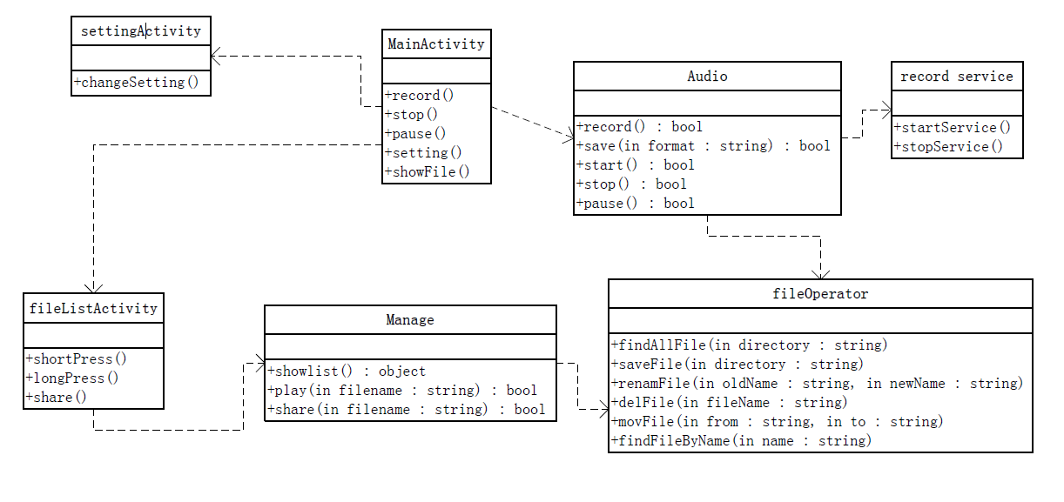
Class diagram

Slide 8
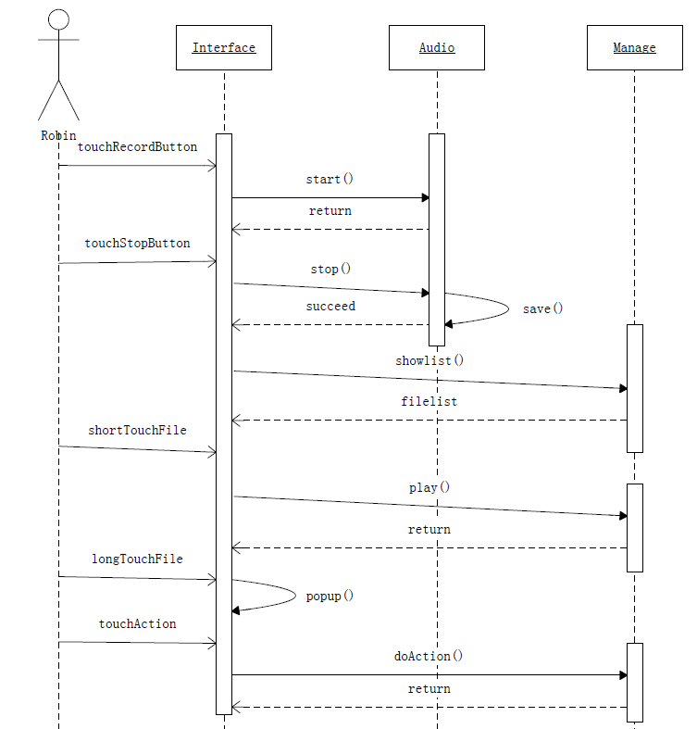
Sequence diagram

