Slide 1
Food Supply Prediction Using Satellite Imagery

Slide 2
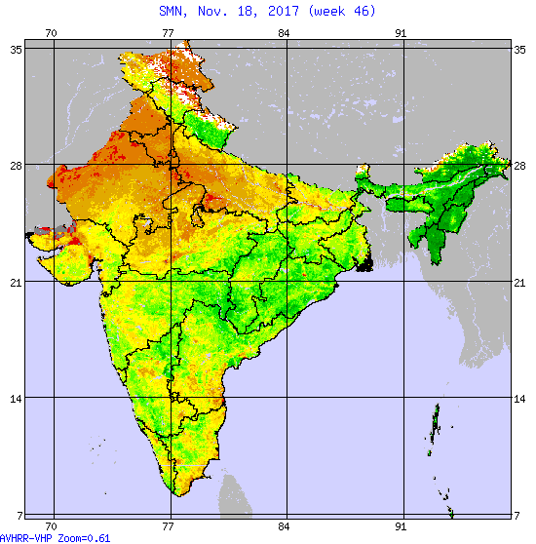
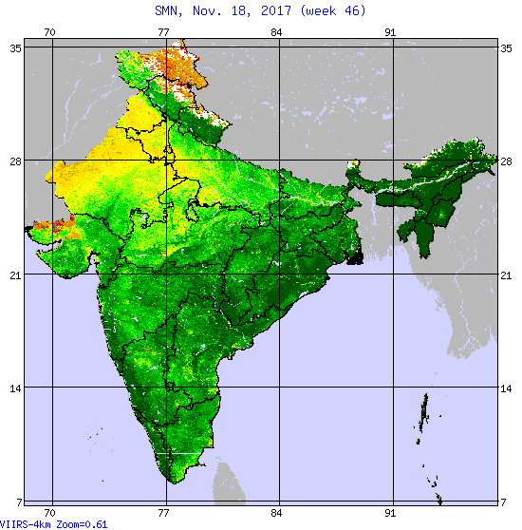
DATA SET: AVHRR-VHP vs VIIRS-4Km

Slide 3
Extracting indexes of india from one image

Slide 4
Extract NDVI Data from NDVI Images

Slide 5
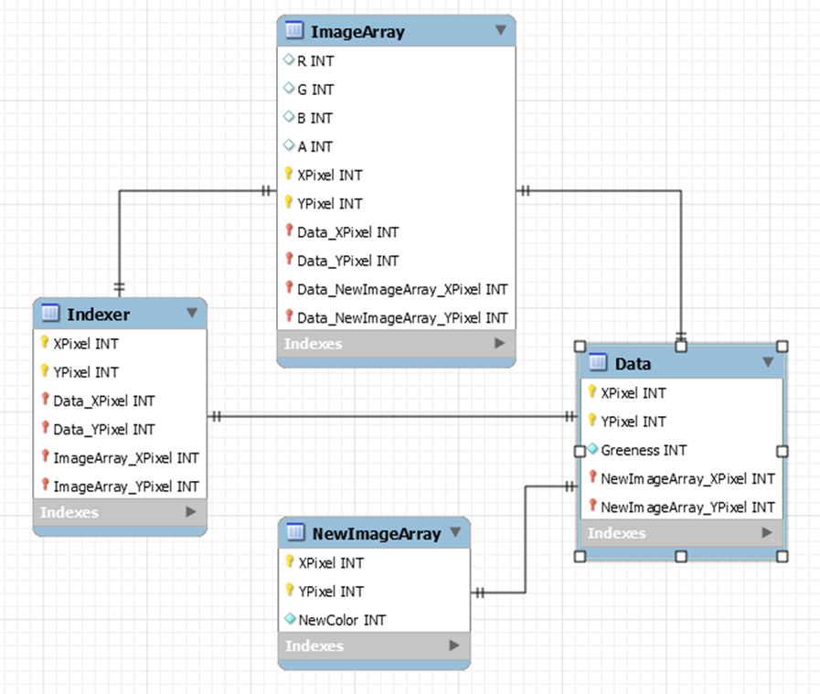
ER DIAGRAM

Slide 6
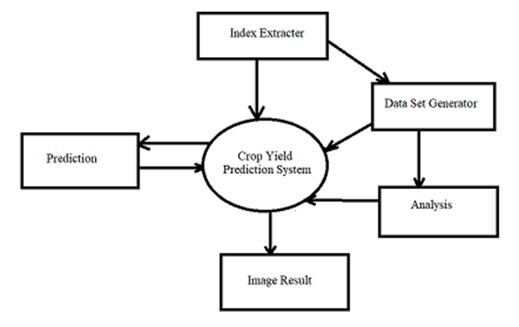
DFD of the system

Slide 7
DOAWNLOAD Production data & form a csv file from all the relevant data

Slide 8
Define a model for training
Possibly a linear regression model

Slide 9
Technologies used
Python, numpy, Scikit-image, Python Imaging Library, Pycharm, SciPy, Scikit-learn

Slide 10
CONCLUSION AND FUTURE WORK

