Slide 1
Predictive Analysis On Revenue Per Available Room
The AirBnB Approach
Team 21
Anto Frederic Henry Mohan dass
Gautam Raghu
Rahul Kunku
Sai Mona Duvvapu
Notes:
Good day, everyone. Today, I am excited to share our project on "Predictive Analysis On Revenue Per Available Room. This project represents a significant stride in understanding and optimizing the revenue streams in the hospitality industry, particularly for platforms like Airbnb.

Slide 2
Agenda
01
Introduction
04
Model Training
Marketshare, Value chain
Linear/Logistic Regression
02
Model Validation
Problem Statement & Data
05
Results, Train/Test, Specificity, Sensitivity
Summary Statistics
03
Preprocessing
06
Implications
Data Cleaning, Feature Selection, Imputation
Real-world meaning and value

Slide 3

Introduction
4 Million
Hosts
Users
150 Million
Revenue
Market share
$3.3 Million
30%
Notes:
In our fast-evolving world, the hospitality industry, especially platforms like Airbnb, plays a pivotal role. With over 4 million hosts and 150 million users, generating $3.3 million in revenue, Airbnb has carved a substantial 30% market share. Our project aims to delve into this thriving ecosystem and provide predictive insights that can revolutionize how hosts optimize their strategies.

Slide 4
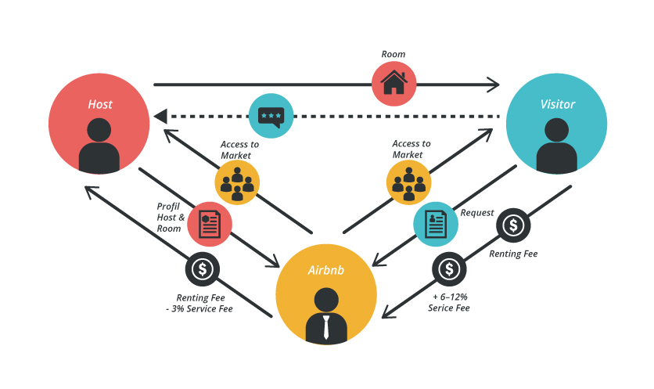
Value Chain
Platform Business

Slide 5
Problem Statement
Aim
Objective
Significance
Develop a predictive model using the Airbnb Dallas Dataset
Empower hosts with actionable insights for informed decisions and proactive adjustments.
Accurately predict RevPAR to empower hosts in optimizing strategies
Notes:
The core of our project is to develop a predictive model using the Airbnb Dallas Dataset. Our objective is clear: to empower hosts with actionable insights for informed decisions and proactive adjustments. By accurately predicting the Revenue per Available Room (RevPAR), we aim to enable hosts to fine-tune their strategies for maximum efficiency and profitability.

Slide 6
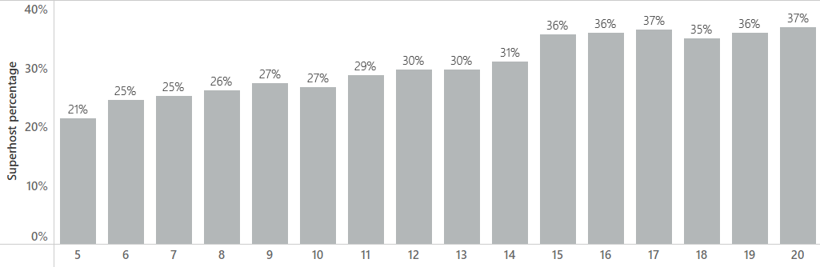


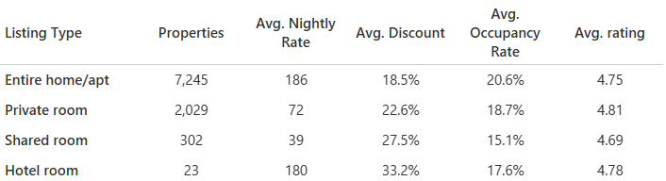

About the Dataset
Dallas, TX
4,490
9,599
Notes:
Thanks Anto for the introduction. Coming to the dataset… we’ve picked the data for Dallas city. In the overall dataset over the given timeperiod, we’ve 4.5k unique hosts. 9.6k unique properties.
Host and Property Identifiers: Includes unique IDs for Airbnb hosts and properties.
Location Details: City, neighborhood, and census tract details, along with latitude and longitude for precise geographic referencing.
Listing Characteristics: Information about property type (e.g., apartment, house), listing type (e.g., entire home, private room), number of bedrooms and bathrooms, maximum guest capacity, and amenities like pet allowance and instant booking.
Pricing and Availability: Includes nightly rates, cleaning fees, minimum stay requirements, and availability and booking details for current and previous periods.
Superhost Status: The dataset tracks the Superhost status of hosts across different periods.
Performance Metrics: Reviews, ratings, occupancy rates, and revenue generated, both current and historical, provide insights into the listing's performance.
Demographic Context: Census tract data offers racial composition and total population.
Looking at the superhost percentage data which is basically the proportion of superhosts out of all hosts in each period. We see that this percentage has gone up significantly over time.
We also looked at the revenue contribution of superhosts out of all hosts and there was no particular trend.
We have another important attribute that’s listing type. We have four types as can be seen here. Based on the number of properties, entire home made up the majority followerd by private room next.
In terms of avg. nightly rate, we see the entire homes priced the highest on average and shared rooms priced the lowest on average which makes sense. Discount is basically the difference between the rate and what the rooms were booked or made available at. Lowest for entire homes which suggests they’re the highest in demand which is supported by the fact that the average occupancy rate is the highest for the entire homes. No particular thing to infer from

Slide 7
RevPAR?
01
Performance Benchmarking
5
04
Dynamic Pricing
Strategy
02
Pricing Strategy Optimization
Reasons WHY
05
Predictive Maintenance and Property Upkeep
Occupancy Rate Insights
03
Notes:
Revenue Per Available Room, or RevPAR, a pivotal metric in the hospitality industry, especially for businesses like hotels and Airbnb hosts. Let's delve into why RevPAR isn't just a number—it's a compass that guides strategic decisions.
Firstly, RevPAR is integral for performance benchmarking. It allows us to set a standard, compare against past data, and gauge our competitive position in the market
Secondly, it's about pricing strategy optimization. RevPAR combines elements of both pricing and occupancy, providing insights into whether our pricing strategy aligns with market demand
The third reason is the occupancy rate insights it offers. RevPAR sheds light on our property’s utilization, revealing how often our rooms are filled. It's not just about having guests; it's about having a consistently high occupancy rate that drives revenue efficiency.“
Next, RevPAR influences our dynamic pricing strategy.By analyzing trends in RevPAR, we can adjust prices in real-time, capitalizing on high-demand periods and enticing bookings during slower times
Lastly, RevPAR helps in predictive maintenance and property upkeep. Understanding revenue flows enables us to plan better for maintenance, renovations, and upgrades. Investing back into the property at the right time can enhance guest satisfaction and, in turn, our RevPAR.
In summary, RevPAR is not just a metric; it's a multi-faceted tool that informs several strategic layers of the hospitality business. It helps us make informed decisions that balance guest satisfaction with revenue optimization

Slide 8





Data Preprocessing
EDA
Exploratory Data Analysis
Handling Missing Values
Imputation by using mean, median to handle missing values
Handling Outliers
Standardize the range of value by using Standard Deviation
Data Partition
Partition data into Train and Test 60:30:10
Data Transformation
Log Transformation
Notes:
In the critical stage of data preprocessing, we begin with Exploratory Data Analysis or EDA to understand patterns and anomalies. Next, we handle missing values using imputation techniques like mean or median substitution to ensure data integrity. We then tackle outliers, standardizing our dataset to mitigate the impact of extreme values. The data is partitioned into a 60:30:10 split for training and testing, setting the stage for robust model validation. Finally, we apply a log transformation, a key step to normalize our data and improve model performance. Each of these steps is vital to prime our data for accurate analysis and prediction

Slide 9





Feature Selection
Secondary Features
01
Host & Evaluation Period
Primary Features
02
Revenue
Removal of redundant features
03
Availability
Notes:
Turning to feature selection, a crucial step to enhance our model's precision. We start by distinguishing between secondary and primary features. Primary features, including Host and Evaluation Period, Revenue, and Availability, are selected for their direct impact on our target variable. Secondary features, while supportive, provide additional context and depth to our analysis. These are evidently important in defining and setting up our data. We look to include both of these in for further processing. We then streamline the model by removing redundant features, ensuring that every variable included provides unique and valuable insight, thus optimizing the model's complexity for better performance and interpretability.

Slide 10
Missing Values
Missing Primary column values
i.e, revenue, available days
Host & Year Dependent
Median based on Host ID
Median Based on Neighbourhood
Drop rows, Check for rows with same base statistic
Median based on Host ID & Year
Host Statistic
Neighbourhood Statistic
Leftover Revenue Missing Values
Zero
Notes:
Thank you, Rahul. Due to the number of attributes in the data, we performed a variable selection to determine absolutely important variables. After Feature Selection, it was time for us to fill in the missing values. With a lot of data comes, an increasing amount of inconsistent data. And not all of this data could be genericly filled in with the mean or median of the whole dataset. So, we assessed the variables we chose, decided to handle them with a tunnel vision. First, in case of primary rows where the revenue or the availability was 0, it was absolutely necessary for us to drop those rows due to their 0 value addition as per our assumption. Second, for variables like num_cancel_pastyear, it was important to look at a number that related to the particular host and thay particular year. So we took a median based on the year if the value was filled for that host for the very year. But if this was not the case, we looked at the median for that particular variable across years. Incase, all of those were not filled, we looked at the median for that neighbourhood. And then, at the end, there were still few rows with revenue as nan and we replaced those with 0.

Slide 11

Outliers
Activity
01 | Data | Data after filling in the missing values
02 | Outliers 1 | Filtered values that are above 99 percentile
03 | Outliers 2 | Removed values that are beyond the maximum and minimum bound based on boxplot
04 | Outliers 3 | Removed values that are beyond +3 and -3 Standard Deviation from the mean
Processed Data
Notes:
After filling in the missing values, we uploaded the dataset in SAS EM due to its easy removal of outliers. The conditions for removal of the outliers are as given:

Slide 12
Aggregation of Data: Host & Evaluation Period
Data aggregated at host level for each evaluation period before modelling
By Mean
By Sum
Binning
rating_ave_pastYear
numCancel_pastYear
numReviews_pastYear
prop_5_StarReviews_pastYear
available_days_aveListedPrice
booked_days_avePrice
Bedrooms
Bathrooms
Number of Photos
Nightly Rate
Number of Reviews
Rating Overall
occupancy_rate
superhost_period_all
numReserv_pastYear
available_days
booked_days
Cleaning Fee (USD)
revenue
Listing Type
Maximum Guests
Minimum Stays
Notes:
Now comes the interesting part, since we were calculating RevPAR, essentially grouping against each Host ID and evaluation period, it was important for us to look at how to group the variables we chose to use for our analysis. The three methods we chose were mean, sum and binning. For variables where we could think in terms of average in general, we took the mean.
But for variables where the sum played a major role in terms of host and the property they held, we took the sum. For example, for variables like available_days, cleaning and revenue, seasonality, and the whole sum plays a major role. And then, for variables where we could not average or take sum, like Maximum guests, we binned the data and created dummy variables. And that’s how we handled the aggregation of data.

Slide 13
Modelling
Regression
01 | 02 | 03
Polynomial Regression | Polynomial Regression | Polynomial Regression
Stepwise without log transformed variables | Without step-wise but on log transformed variables | With Stepwise on log transformed variables

Slide 14

Results
Bathrooms*_1_2_Guests: 0.819
_7__Guests*superhost_percentage: 0.0229
num_properties_private*num_properties_private: 0.6363
Number_of_Reviews*Rating_Overall: 0.00154
available_days_aveListedPrice*num_properties_private: 0.0405
Number_of_Reviews*available_days_aveListedPrice: 0.00059

Slide 15
Implications
Operational Efficiency
Resource Allocation
Competitive Analysis
Identify peak and off-peak periods
Justify investments in the resources
To identify market trends
01
02
03
04
05
Loyalty Programs
Hosts
Investor and Stakeholder Relations
To repeat customers
Performance Indicator
Notes:
Thank you, Gautam for those wonderful insights. Now We’ve reached the most exciting part of this presentation. I’ll explain the real-world implications of the insights from our model.
With accurate predictions of RevPAR, Airbnb hosts and managers can make informed decisions about investments, renovations, or expansions. They can identify which properties are more profitable and focus resources accordingly.
By comparing their performance with market averages and trends, property owners can benchmark their success and identify areas for improvement.
Property owners can use this model to set dynamic pricing that maximizes revenue. By understanding demand patterns, they can adjust prices for peak and off-peak seasons, special events, or even days of the week.
Let's remember the core message: Embracing predictive analytics is not just a competitive advantage; it's becoming an essential component in the evolving market of short-term rentals.
Thank you!

Slide 16
THANK YOU

Slide 17
What is RevPAR?
Mathematically calculated as:
Total Revenue
Available Rooms

Slide 18
Selected Features
'rating_ave_pastYear’
'numCancel_pastYear’
'numReviews_pastYear'
'prop_5_StarReviews_pastYear’
'available_days_aveListedPrice'
'booked_days_avePrice’
'Bedrooms’
'Bathrooms’
'Number of Photos'
'Nightly Rate’
'Number of Reviews’
'Rating Overall’
'occupancy_rate'
numReserv_pastYear' 'available_days'
'booked_days’
'Cleaning Fee (USD)’
'superhost_percentage’
'num_properties_home’
'num_properties_hotel'
'num_properties_private’
'num_properties_shared’
'num_properties_stay_1-2_days’
'num_properties_max_3-10_days’
'num_properties_max_10+_days'

Slide 19
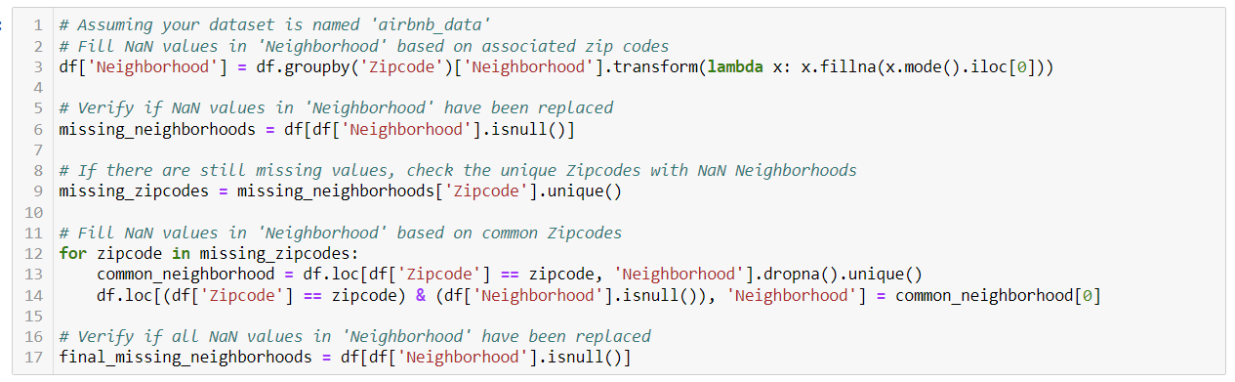
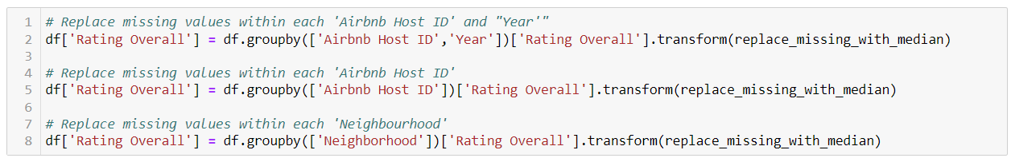
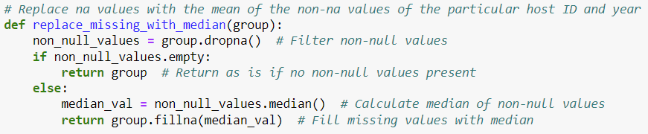
Code Snippets – Missing Variables

Slide 20
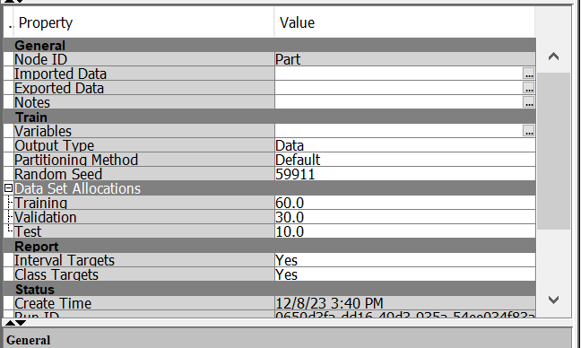
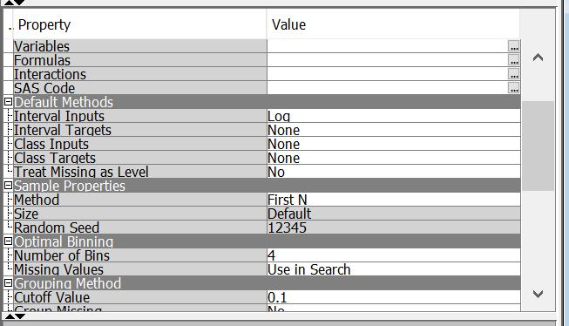
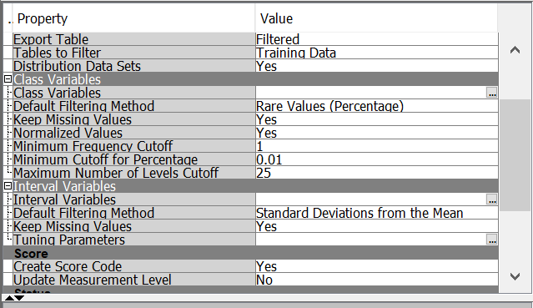
Code Snippets – SAS EM

Slide 21
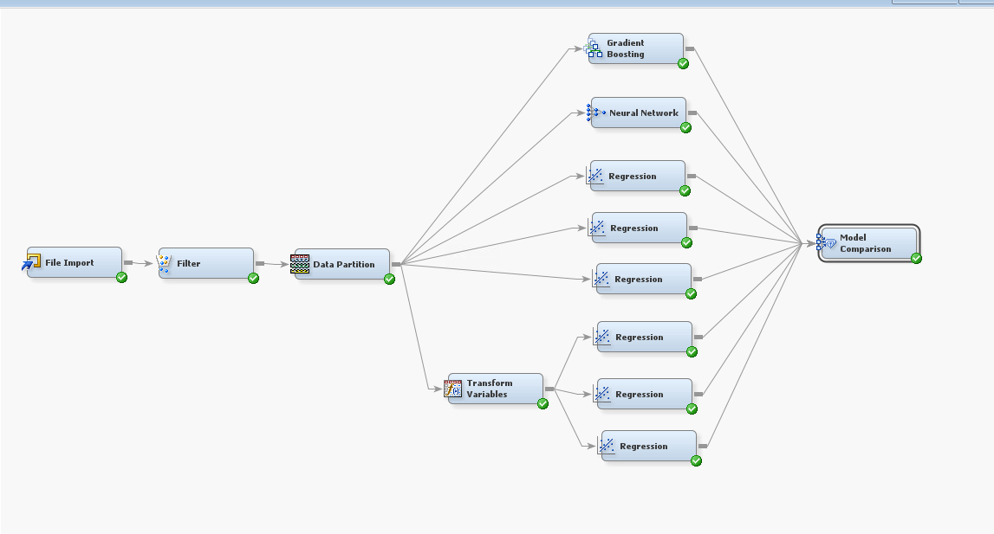
Results
R-squared value: 79.43%

Slide 22
References
https://6sense.com/tech/reservation-and-online-booking/airbnb-market-share
https://bmtoolbox.net/stories/airbnb/
https://www.investopedia.com/
https://chat.openai.com/

