Slide 1

Predicting Consumer Tastes with Big Data at Gap
MGMT 590 – Web Data Analytics
Group 8
Seonkyu Kim
Karan Karnik
Rahul Kunku
Shubhankar Sharma

Slide 2
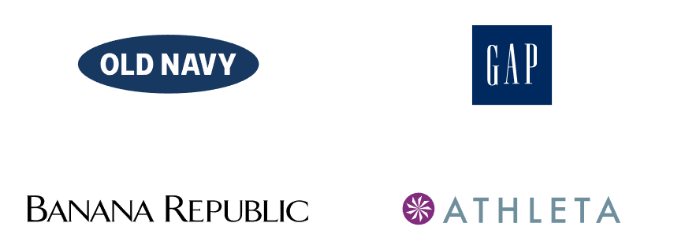
GAP Inc. as a company
CEO: Art Peck
Fast Fashion
Mass specialty
High-end specialty
Fitness apparel

Slide 3
Way forward for GAP Inc.
CEO of GAP Inc. is looking to replace the Creative Directors with a big-data driven creative process
The company hopes that this approach can perform well in predicting the future fashion trends and reduce lead times in bringing new designs to the market
If and how art or science should lead the company’s fashion development approach

Slide 4
Is Big Data approach the right way?
We believe So.
Data analytics can provide valuable insights for informed pricing, marketing, and development decisions
Increased adaptability to changing market dynamics and customer demands
Identification of new market opportunities
Recognizing consumer trends and preferences

Slide 5
Web data to support the data-driven creative process at GAP
Consumer Sentiment Analysis
Competitor Analysis
Fashion Trends and Influencer Data
Demographic and Geographic Data
Economic Indicators

Slide 6

Consumer Sentiment Analysis Examples
Sentiment Analysis: Use Natural Language Processing (NLP) tools to analyze sentiment. For example, Tweets 1 and 3 are positive, while Tweets 2 and 4 are negative.
Influencer Mentions: Identify mentions by fashion influencers. If influential figures are praising Gap products, it can be leveraged in marketing campaigns.
Competitor Comparison: Compare sentiment data with competitors to see how Gap stacks up in terms of customer sentiment.

Slide 7
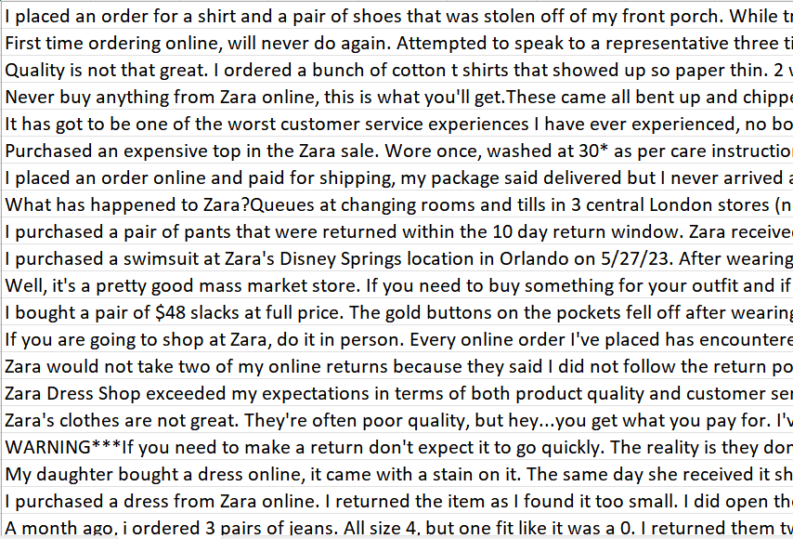
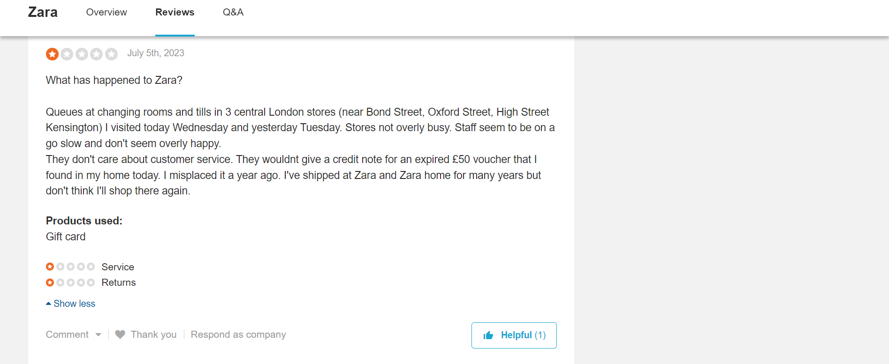
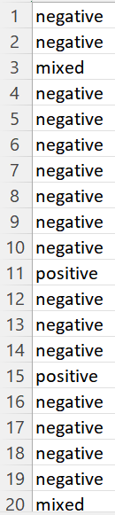

Sample sentiment analysis that can be used to improve customer satisfaction, identify areas for improvement, and potentially highlight positive aspects in their marketing campaigns.
Online Review
Data Extraction
Review Sentiment

Slide 8
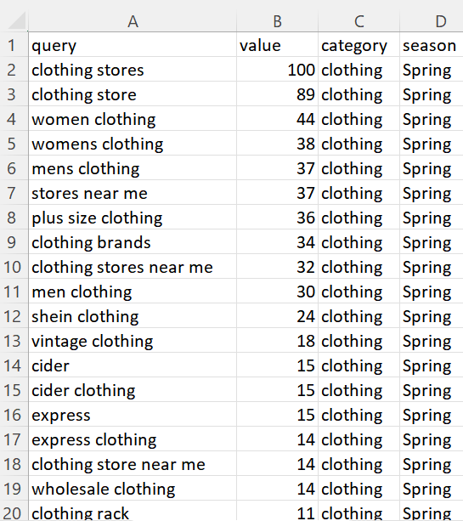
Google Trends Analysis
Search Interest Over Time: It shows the popularity of a search term over a specified period, allowing you to see how interest has changed over time.
Regional Interest: It highlights the geographic regions where a search term is most popular, providing insights into regional trends and preferences.
Related Queries: It displays related search terms and topics, helping you discover related keywords and understand search intent.
Trending Searches: It showcases currently trending search queries, giving you real-time insights into what's currently popular on Google.
Comparison of Multiple Terms: You can compare the search interest of multiple terms to see how they stack up against each other in terms of popularity.

Slide 9
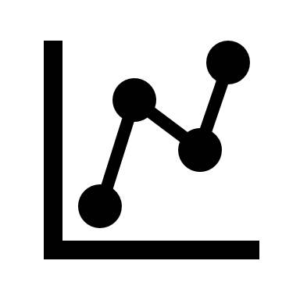
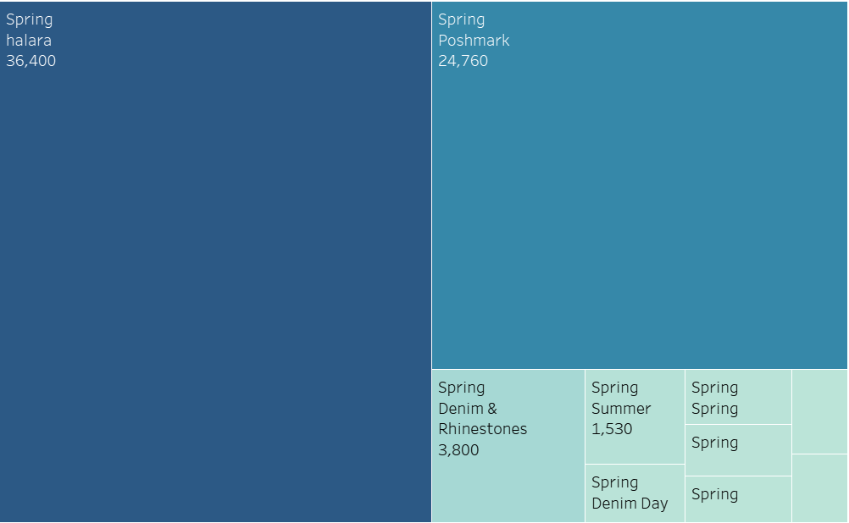
Using Google Trends for SEO Optimization and Competition Analysis
- Google Trends data can be utilized to identify trending search terms throughout different seasons.
- It also enables us to determine which company garners the most search interest.
- This information can then be leveraged to enhance website rankings for frequently searched keywords, thereby boosting the potential for increased website traffic.
- Furthermore, it aids in understanding the types of clothing people seek during different seasons, offering opportunities to enhance operational efficiency and refine marketing strategies.

Slide 10
Since "Halara" is a trending topic in spring fashion, it's a great opportunity to perform a competitor analysis with Halara to identify potential product categories Gap should explore:
Halara Best Sellers:
  Analyze Halara's best-selling products, such as casual and active wear. Determine which specific items within these categories are popular.
Gap's Product Comparison:
  Compare Gap's existing product offerings in these categories with Halara's best sellers.
  Identify any gaps in Gap's product line, such as missing styles, colors, or features that are in demand according to the search trends.
Pricing and Quality Comparison:
  Compare the pricing and quality of Gap's products with Halara's. This will help Gap position itself competitively.
Marketing Strategies:
  Investigate how Halara is marketing its products during the summer season. Are there marketing tactics or campaigns that Gap can learn from or adapt?
Customer Reviews and Feedback:
  Analyze customer reviews and feedback for Halara's products to understand what customers like and dislike. Gap can use this information to improve its own offerings.

Slide 11
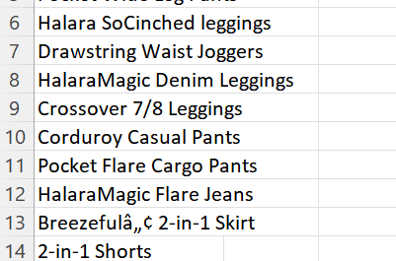
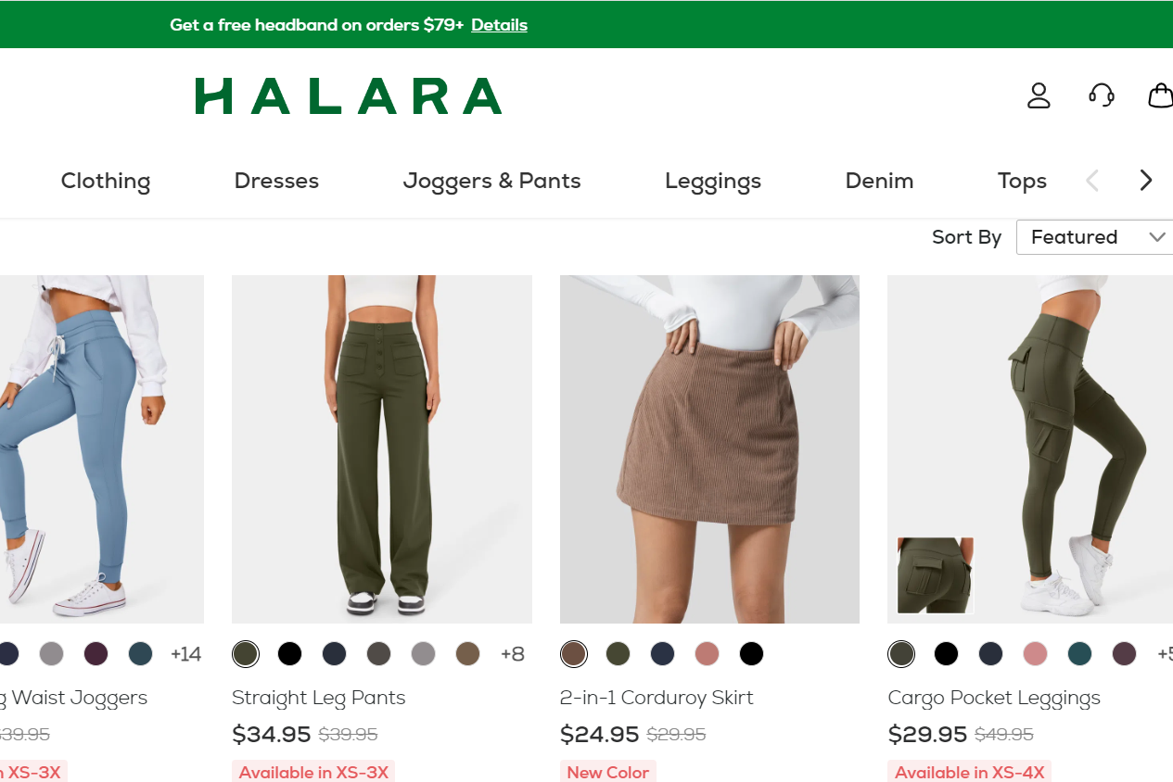
By conducting this competitor analysis, Gap can gain insights into the specific products and strategies that are driving Halara's success during the spring season. This data-driven approach will help Gap make informed decisions about which products to develop or promote to capitalize on emerging fashion trends and boost sales.
Remember that this analysis is just a starting point, and Gap should continuously monitor trends and consumer preferences to stay ahead in the fashion industry.

Slide 12
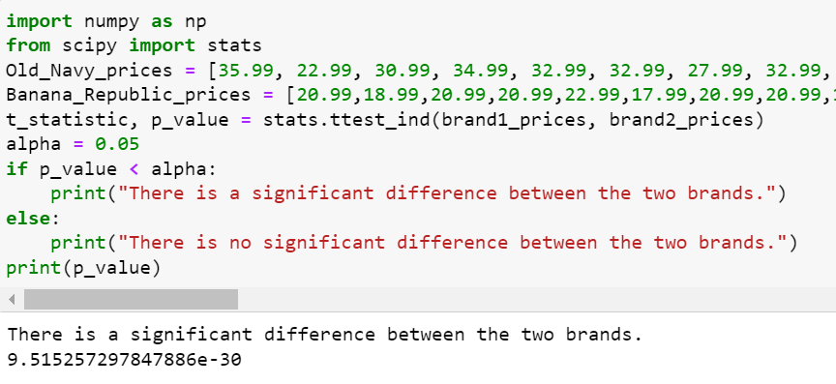
If brands will behave differently
We’d like to substantiate that the sub-brands are inherently different and hence, would behave differently after the move
We’ve scraped though a website for prices of products for the brands in question (Old Navy and Banana Republic) to compare using a two-sample t-test
H₀ : Prices between the two brands are similar
H_{A} : Prices are different and hence the brands would behave differently
The p-value is quite small, and this tells us that the brands are quite different.

Slide 13
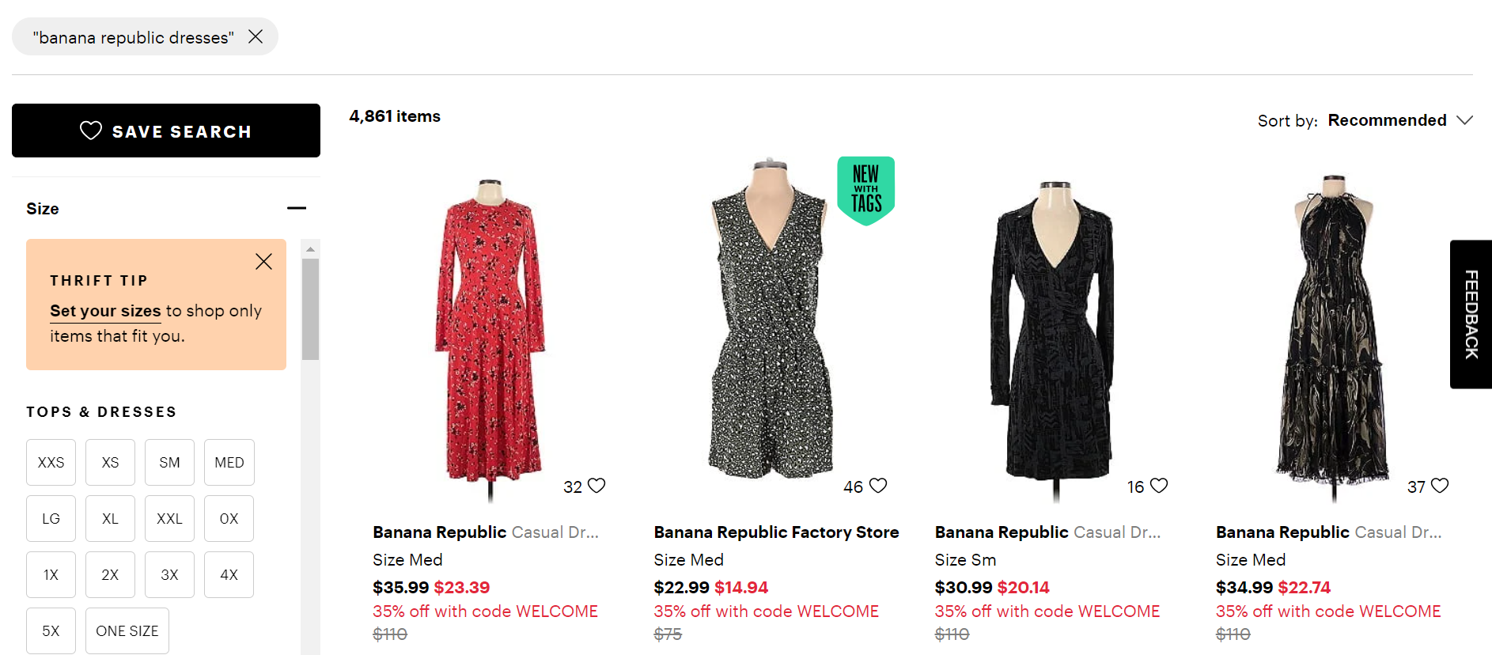
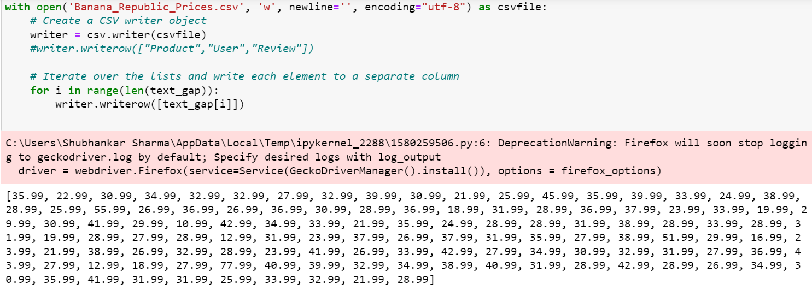

Slide 14
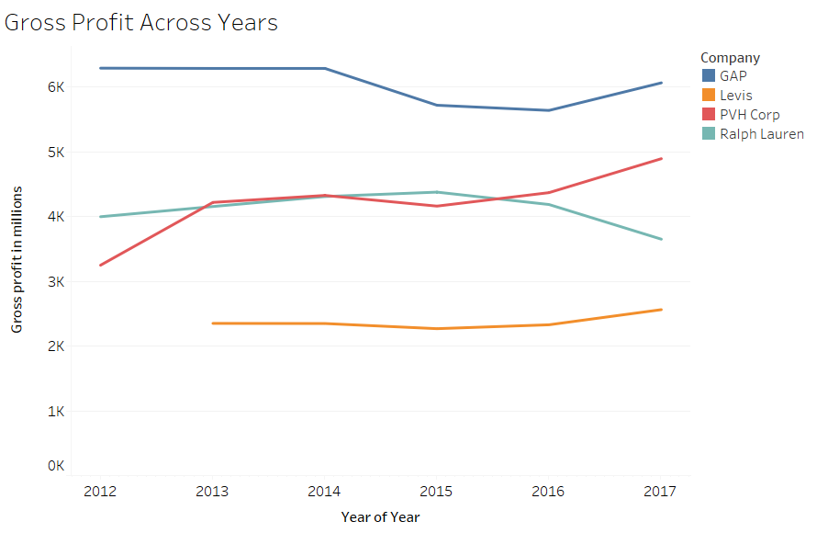
Insights from 10K Files
From the 10K forms, significant financial details about the company's fiscal health can be extracted
PVH Corp adopted big data in its business model during the early 2010s. During this period, some other leading brands did not fully embrace big data.
PVH Corp experienced an upward trend in its gross profit margin. This improvement suggests better performance compared to its competitors.
The increased use of big data and analytics by PVH Corp is a likely contributing factor. This strengthens the credibility of using big data and analytics in the fashion industry.

Slide 15
- Sales fluctuate significantly across various geographic regions, it's crucial to adapt marketing strategies accordingly to effectively target untapped markets
- These numbers suggest that either the marketing has not been very effective in regions other than USA and Canada or the company wants to focus primarily on USA and Canada
- In either case, there is a lot of scope to expand in Europe, Asia and Other regions
Insights from 10K Files
Year | Brand | U.S.A | Canada | Europe | Asia | Other regions
2015 | Gap Global | 3303 | 348 | 726 | 1215 | 159
2015 | Old Navy Global | 5987 | 467 | 0 | 194 | 27
2015 | Banana Republic | 2211 | 229 | 71 | 112 | 33
2016 | Gap Global | 3113 | 368 | 630 | 1215 | 129
2016 | Old Navy Global | 6051 | 490 | 0 | 220 | 53
2016 | Banana Republic | 2052 | 223 | 59 | 109 | 28
2017 | Gap Global | 3065 | 398 | 626 | 1117 | 112
2017 | Old Navy Global | 6570 | 547 | 0 | 50 | 71
2017 | Banana Republic | 2017 | 225 | 15 | 96 | 27
Data shows sales in millions

Slide 16
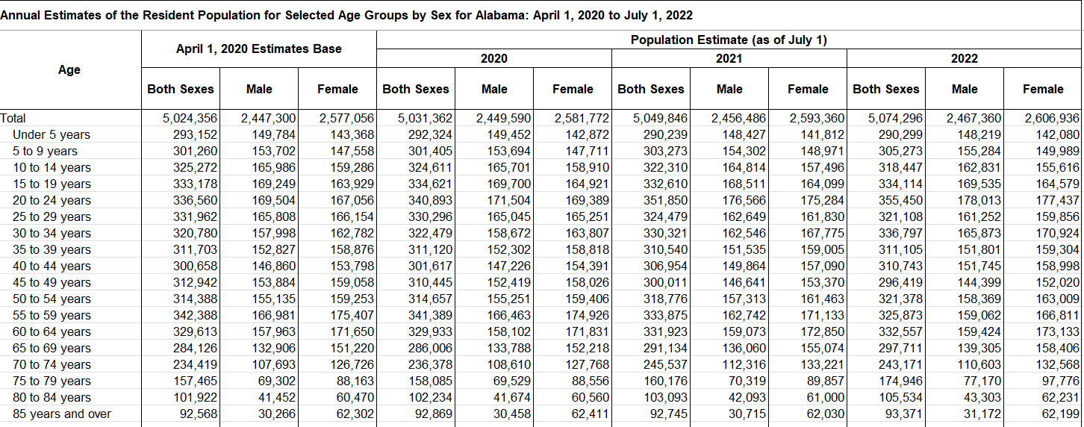
Demographic Data
Population data from US Census
Gap will gain insights about target consumers for each state by analyzing the proportion of age/sex groups

Slide 17
Old Navy Vs. Banana Republic
Since Old Navy is fast-fashion based, moving to the data-driven approach would really benefit the overall sales of the brand. As it makes up majority of the sales of GAP Inc., the firm would profit from this move. Overall, GAP and Old Navy may rely more heavily on data-driven strategies to serve their broader customer base
However, Banana Republic is more focused on high-end consumers. The brand would benefit more from a creative approach as the typical customers of this brand would be looking to find unique apparel. Hence, the brand may require a stronger creative direction to cater to its upscale clientele.

Slide 18
Big Data in Marketing
Customer Segmentation can help in highly targeted marketing campaigns
Personalization can lead to increased customer engagement and loyalty
Customer journey mapping to optimize each stage for a seamless experience
Demand Forecasting helps with inventory management, pricing strategies, and stock replenishment
A/B testing allows marketers to experiment with different creative elements, messaging, and strategies to determine what resonates best with the audience
For online advertising, predictive analytics can optimize ad targeting, bidding, and placement to maximize ROI.
Content Optimization: To analyze which types of content perform best, guiding content creation and distribution strategies.

Slide 19
Where Big Data falls behind
Creative Ideation: While data can inform creative decisions, it's less effective at generating entirely new and innovative ideas. The initial spark of creativity often requires a human touch.
Brand Identity and Storytelling: Establishing a brand's identity and crafting compelling brand stories may rely more on art than science. Emotional connections with consumers often depend on creative storytelling.
Crisis Management: During PR crises or sensitive situations, immediate responses should focus on empathy and brand values, which may not be solely data-driven.
Long-Term Brand Building: Building a brand's reputation and equity over time requires consistent messaging and creative strategies that may not rely solely on data-driven insights.

Slide 20
Art Vs. Science in Marketing
In an ideal world, we would look to strike a perfect balance in the usage between art and science in marketing
Art rules when:
Creativity and emotional connection are crucial for the brand's identity and messaging.
The marketing strategy involves storytelling and building brand loyalty.
Need to stand out in a competitive market through unique and innovative campaigns.
Managing crises and sensitive situations
Science rules when:
Data is abundant and can provide actionable insights.
Decisions need to be based on quantifiable metrics, such as ROI and conversion rates.
Personalization and targeting are essential.
Testing and experimentation are required to optimize campaigns.

Slide 21
Balancing Art and Science
Achieving the right balance between art and science in marketing is crucial. The two should complement each other:
Start with Art: Creative ideas and brand identity should provide the foundation. Develop compelling stories and visuals that resonate with your audience.
Enhance with Science: Use data and analytics to refine your creative strategies. Measure performance, segment your audience, and personalize content based on insights.
Iterate: Continuously iterate and refine your marketing approach. Use data to inform creative updates, but never lose sight of the emotional connection that art can foster.
Successful marketing often combines the art of creativity with the science of data-driven decision-making. The key is to recognize when each element should take the lead and when they should work in harmony to achieve marketing goals.

Slide 22
Art & Science at GAP Inc.
Data Collection and Analysis:
  Gather data, understanding customer behavior, and customer segmentation
Art and creative aspects
  Reflect Gap's unique style and values, and resonate with its target audience
  Content creation and A/B testing
Science and Data-Driven Decision-Making
  Personalization, ROI measurement, conversion rate optimization
Integration of Art and Science
  Cross-functional collaboration to enable data-driven creativity
Customer Feedback
  Feedback loop to refine both creative and data-driven marketing strategies
Continuous Improvement
  Iterate and Experiment

Slide 23
Limitations of our Analysis and Approach
Data Quality and Reliability: The quality and reliability of the data you collect can be a significant limitation. If the data sources contain errors, inconsistencies, or biases, it can lead to inaccurate conclusions.
Limited Data Sources: Depending solely on web scraping and online sources limit the scope of our analysis. Important data, such as internal sales and customer data, are not accessible through online sources.
Selection Bias: The data you collect might not be representative of the entire customer base or market. If you're only collecting data from certain websites or sources, it may not accurately reflect the broader consumer sentiment or behavior.

Slide 24

THANK YOU!

