Slide 1


DEPARTMENT OF INFORMATION TECHNOLOGY
Galgotias College of Engineering and Technology, Gr. Noida(U.P.)
DIABETES PREDICTION USING DIFFERENT MACHINE LEARNING TECHNIQUES
Group No. – 23IT709
Under the Mentorship of
Ms. ANAM KHAN
PRESENTED BY:
Rahul Kumar Sachdeva -2000970130088
Rahul Lodhi-2000970130089
Prakhar Kumar Singh-2000970130078

Slide 2

TABLE OF CONTENTS
Introduction
Objective
Methodology
Requirements
Workflow
Result
References

Slide 3
INTRODUCTION
Diabetes is a chronic condition characterized by high levels of blood glucose, which can lead to serious health complications. Early prediction and management are crucial to mitigate its adverse effects.
Early prediction of diabetes can enable timely intervention and lifestyle adjustments, potentially preventing the onset or progression of the disease. This can significantly reduce healthcare costs and improve patient quality of life.
Machine learning techniques have emerged as powerful tools for analyzing large datasets and identifying patterns that can predict diabetes. These methods can enhance the accuracy and efficiency of diabetes prediction compared to traditional statistical approaches.
By implementing and evaluating different machine learning models, this project seeks to develop a robust predictive model that can assist healthcare professionals in early detection and proactive management of diabetes.

Slide 4
OBJECTIVE
This project aims to explore and compare various machine learning algorithms to predict diabetes, using a comprehensive dataset.
The goal is to identify the most effective models for accurate prediction.
Improve the accuracy and reliability of diabetes risk prediction to facilitate early intervention, better management, and ultimately enhance patient healthcare outcomes.
Create user-friendly tools or applications that leverage these predictive models, making diabetes risk assessment more accessible to a broader population.
Develop models that can streamline the diabetes diagnosis process, reducing the need for frequent diagnostic visits and lowering associated healthcare costs.

Slide 5
METHODOLOGY
Description of the dataset: The data originates from “Pima Indian Diabetes Dataset”, acquired from “UCI repository”.
Data Preprocessing: Data preprocessing is vital to address missing values and impurities, ensuring the accuracy and effectiveness of machine learning techniques. This process enhances data quality, thereby improving the accuracy and reliability of predictive models for diabetic outcomes.
Data Selection: The study begins with data selection from the UCI repository, addressing missing values, inconsistencies, and erroneous information.
Data Preparation: Subsequently, databases in Excel and text formats are split into training and testing datasets, with 80% and 20% allocation respectively.
Machine Learning: The techniques of Machine learning such as Naïve Bayes, SVM, and KNN are then employed for prediction, constituting a crucial stage in achieving research objectives. This methodical approach ensures data integrity and enables accurate predictions through diverse machine learning techniques.

Slide 6
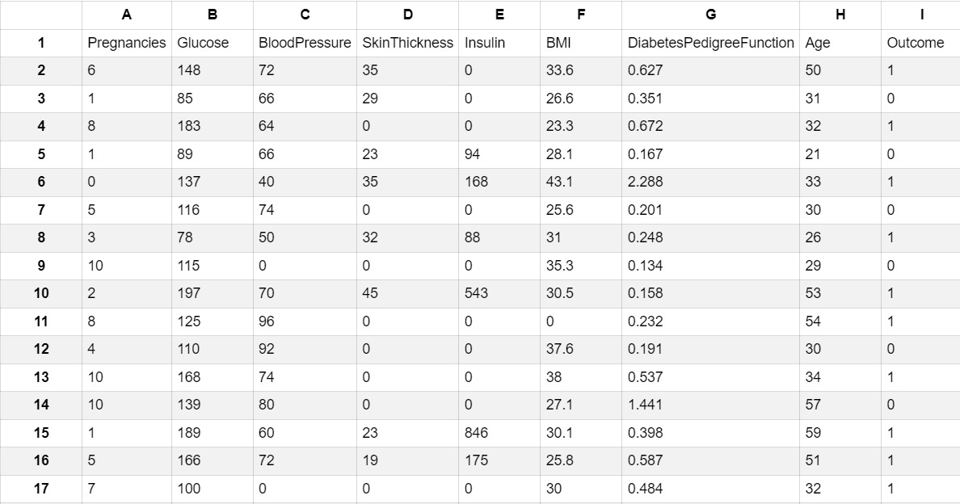
DATASET

Slide 7
REQUIREMENTS
Hardware Requirements-
Processor: Any Processor above 500 MHz.
RAM: 4 GB
Hard Disk: 4 GB
Input Device: Standard Keyboard and Mouse
Output Device: VGA and High Resolution
Software Requirements-
Operating System: Windows 7 or higher
Programming: Python 3.6 and related libraries

Slide 8
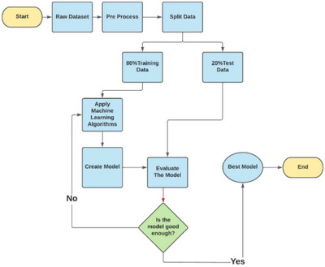
WORKFLOW

Slide 9
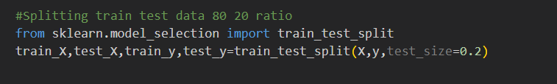
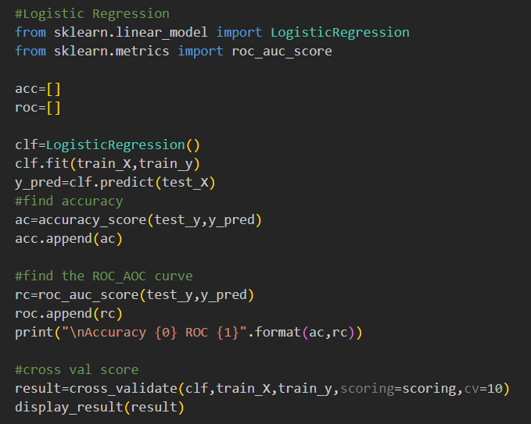
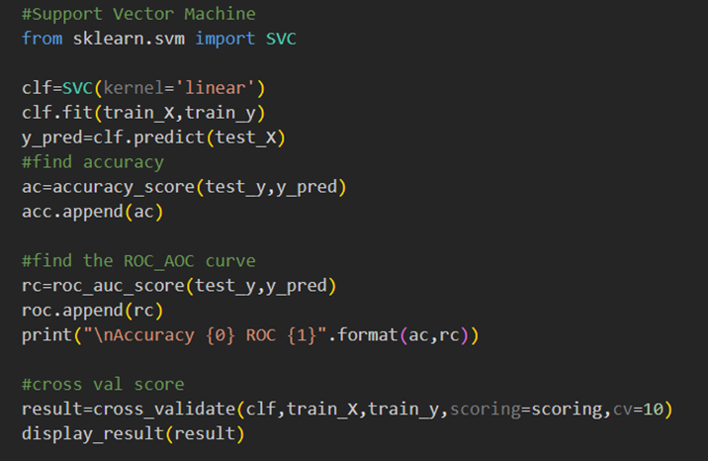
Split – Train and Test data
Training model

Slide 10
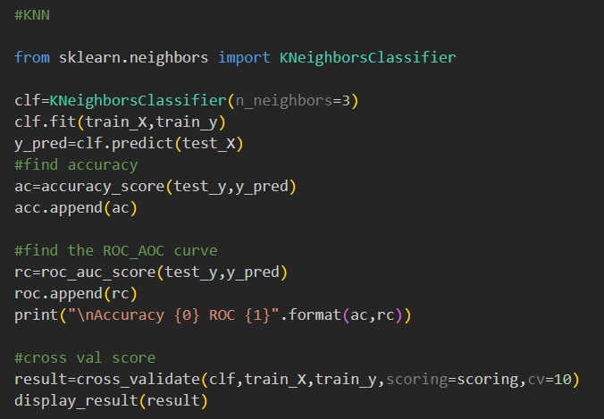
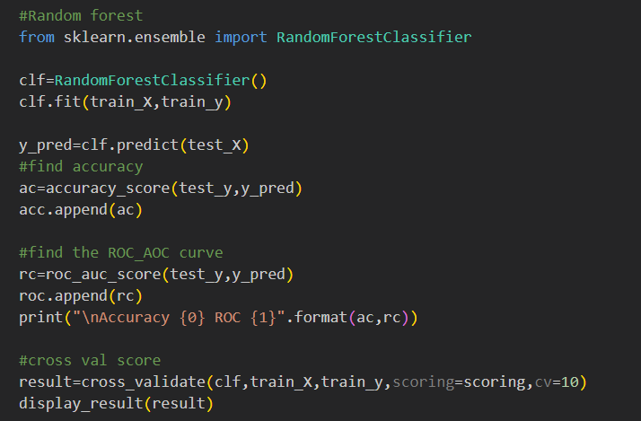
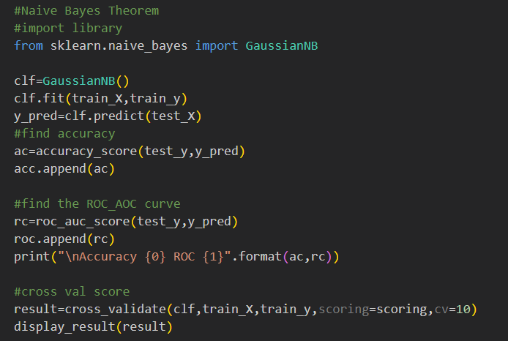
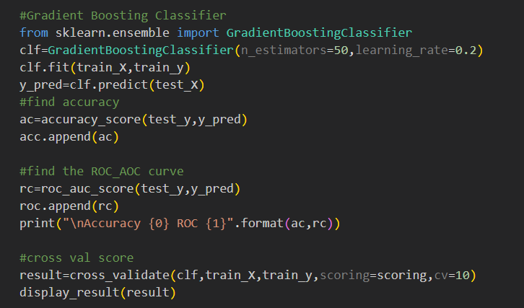

Slide 11
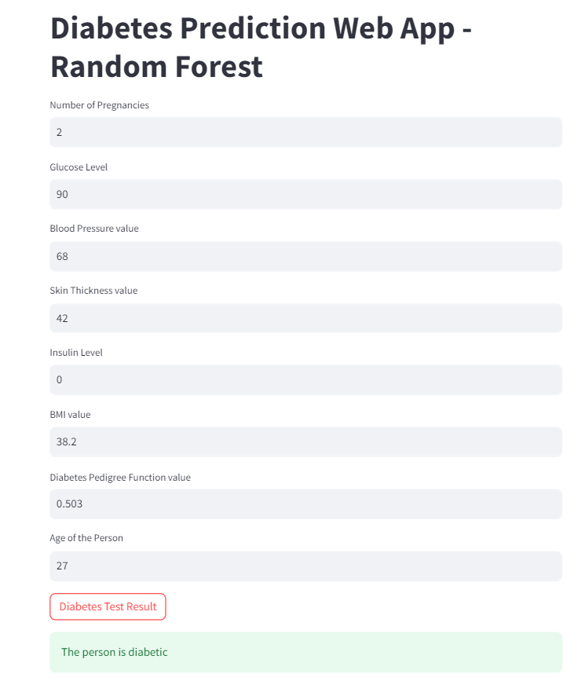
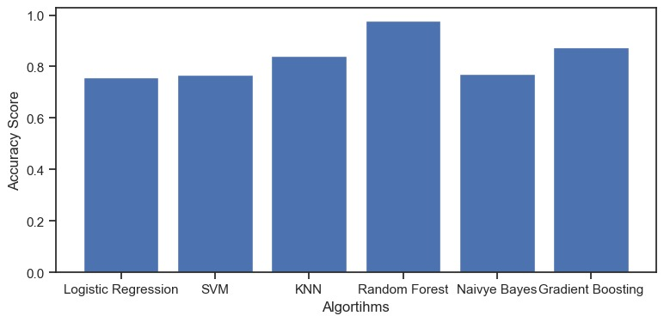
RESULT

Slide 12
REFERENCES
Nai-Arun N, Moungmai R. Comparison of classifiers for the risk of diabetes prediction. Procedia Comput Sci.2015:69:132–42.
Saravananathan K, Velmurugan T. Analyzing diabetic data using classification algorithms in data mining. Indian J Sci Technol. 2016:9:1–6.
K. Anandha Kumar. A survey on diabetes mellitus prediction using machine learning techniques
S. V. K. R. Rajeswari and P. Vijayakumar. Prediction of diabetes mellitus using machine learning algorithm
Shafi S, Ansari GA. Early prediction of diabetes disease &classification of algorithms using machine learning approach.
Sadhu A, Jadli A. Early-stage diabetes risk prediction: A comparative analysis of classification algorithms.

Slide 13
THANK YOU!

