Slide 1



CYBER GYAN VIRTUAL INTERNSHIP PROGRAM
Centre for Development of Advanced Computing
CDAC, Noida (UP) India
File upload vulnerabilities
Identification, Exploitation and potential mitigation strategies
Submitted by
Rahul Mahto
Project Trainee(July-August) 2024
Mentored By :
Kajal Kashyap (CDAC)

Slide 2
INTRODUCTION
File upload functionality is a common feature in many web applications, allowing users to upload files such as images, documents, and videos. While convenient, this feature also introduces potential security risks if not properly secured. Unrestricted or poorly managed file uploads can serve as an entry point for attackers to compromise systems.
1.2 Importance of Securing File Uploads
Securing file uploads is critical because attackers can exploit vulnerabilities to upload malicious files, such as scripts or malware, leading to server-side attacks, data breaches, or unauthorized access. Implementing strict validation, proper file handling, and access control can mitigate these risks, protecting both the application and its users from exploitation.
Utt

Slide 3
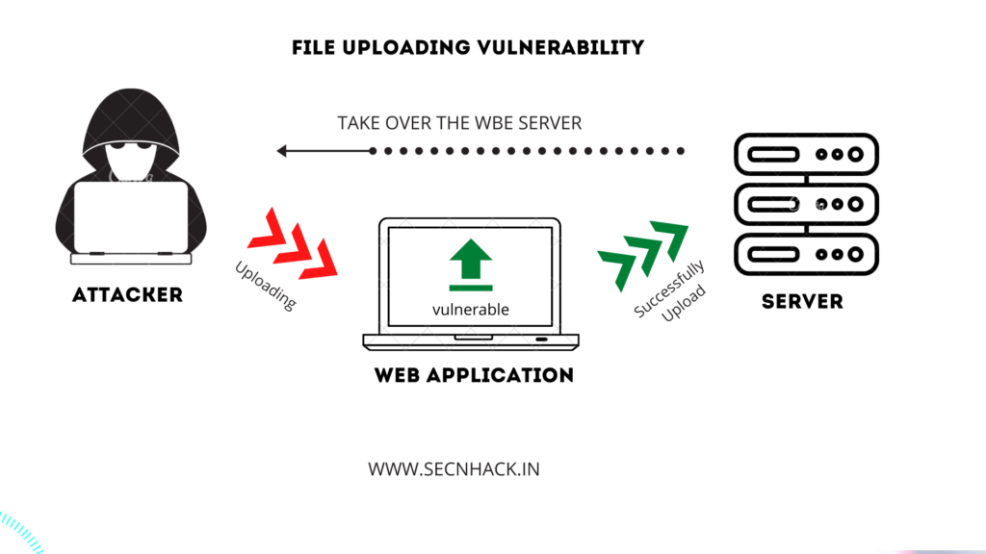
INTRODUCTION
Utt
Fig: This diagram shows the demonstration of Attack on Server using FIle Upload Vulnerability

Slide 4
Problem Statement
The project focuses on securing file upload functionalities in web applications, which are prone to vulnerabilities
Remote Code Execution (RCE). The goal is to identify, exploit, and mitigate these vulnerabilities to protect the system from malicious file uploads and
It’s Identification, Exploitation Potential mitigation strategies
Utt

Slide 5
IMPLEMENTATION
MIME stands for Multi-purpose Internet Mail Extensions. MIME types form a standard way of classifying file types on the internet.
A MIME type consists of two parts: a type and a subtype.
Common MIME types:
multipart/form-data
text/xml
text/csv
text/plain
application/xml
application/zip
application/pdf
Example: application/vnd.api+json

Slide 6
IMPLEMENTATION
Approach: Remote code execution via web shell upload
This Attack contains a vulnerable image upload function. upload a basic PHP web shell and use it to exfiltrate the contents of the file /home/carlos/secret. You can log in to your own account using the following credentials: UserName: wiener & Password: peter
Web Application Link: https://0a1c003d03a150fb802330b300a7004b.web-security-academy.net/my-account?id=wiener

Slide 7
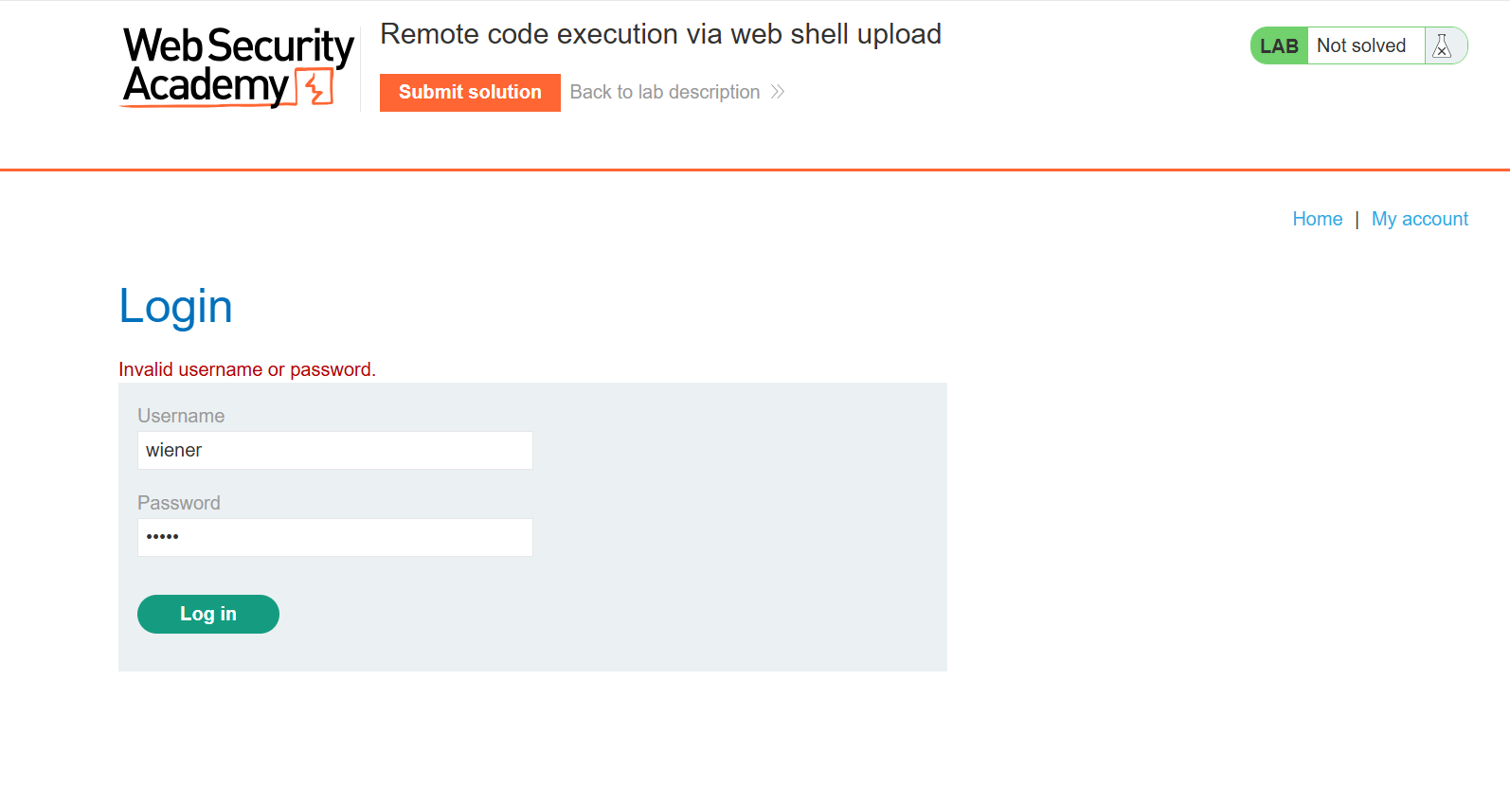
Implementation
Login to this Web App using above credentials
Utt

Slide 8
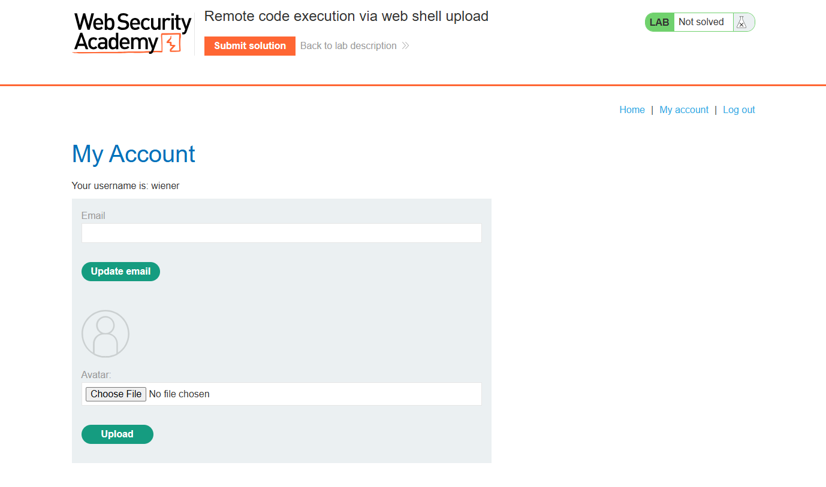
Implementation
After Login, An Interface appears having file upload feature and email input
Utt

Slide 9
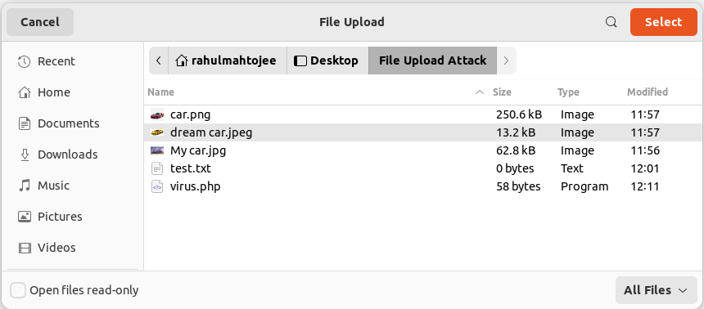
Implementation
Utt

Slide 10
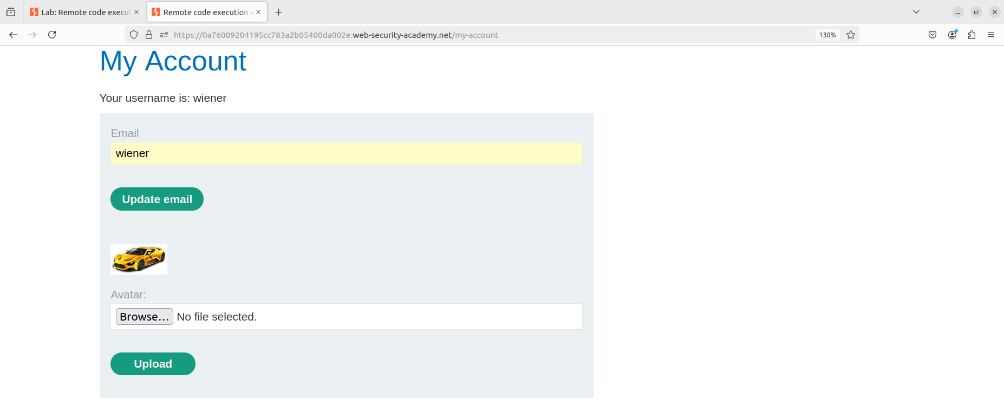
Implementation
Utt
Uploaded image file in web application (car.png)

Slide 11
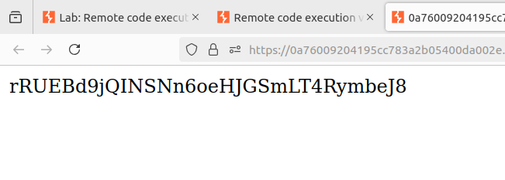
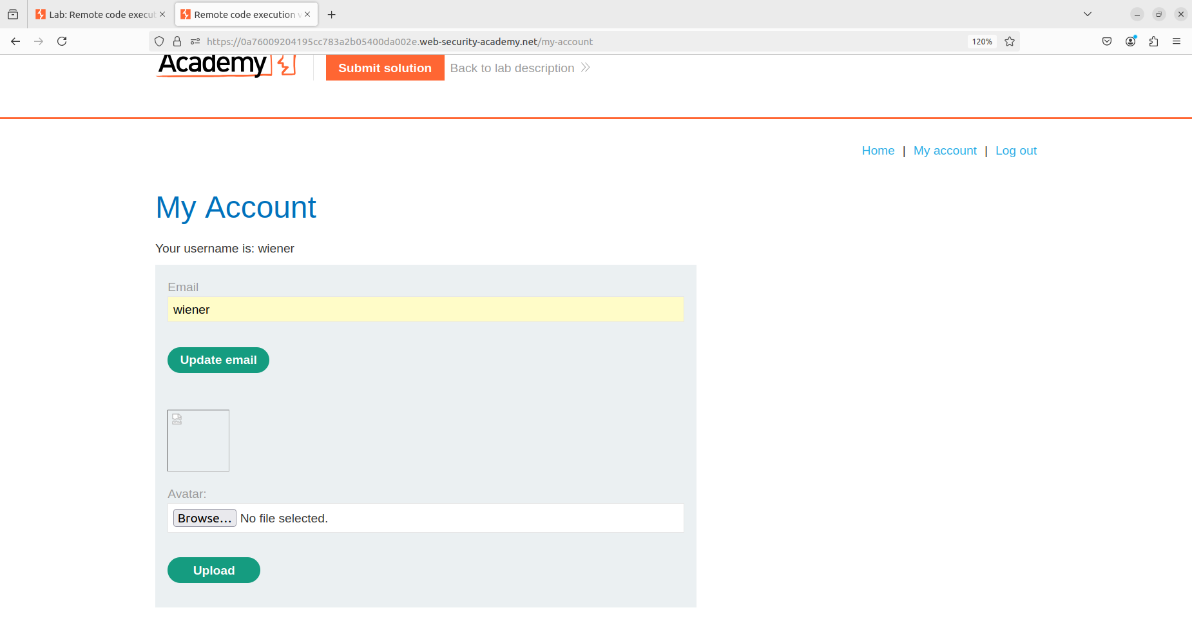
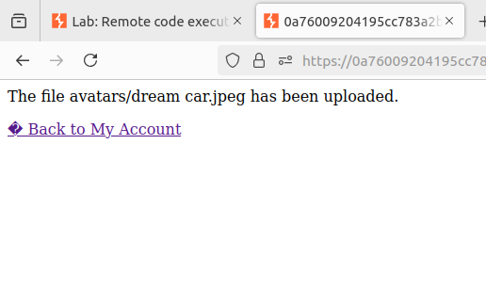
Implementation
Utt

Slide 12
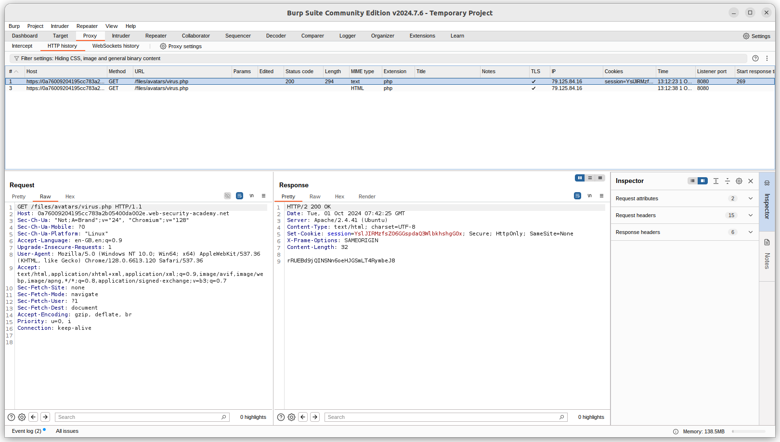
Implementation
Burp suite
Utt

Slide 13
TECHNOLOGY/TOOLS TO BE USED
Linux (Operating system)
Portswigger(Web Application Tools)
Burp Suite
Used PHP script

Slide 14
REASONS BEHIND THE ATTACKS
Key reasons behind these attacks include:
Lack of validation: Not verifying file type, size, or content allows attackers to upload harmful files like scripts or executables.
Improper file storage: Storing uploaded files in publicly accessible directories can lead to unauthorized access.
Inadequate security checks: Insufficient checks on file metadata (e.g., MIME type) allow attackers to bypass filters.
Execution permissions: Allowing uploaded files to be executed on the server can lead to remote code execution.
Preventing these attacks requires strict validation and secure file storage practices.

Slide 15
MITIGATION STRATEGY
1. File Validation:
Whitelist allowed file extensions (e.g., .jpg, .pdf).
Validate MIME types on the server-side using reliable libraries.
Inspect file content to ensure it matches the declared file type.
2. Sanitizing File Names:
Remove special characters (e.g., ../) to prevent path traversal.
Normalize paths to keep files within the intended directory.
3. File Size Limits:
Set file size limits and implement rate-limiting to prevent resource abuse.
4. Disable File Execution:
Configure the web server to block file execution in upload(.php, .exe, .sh).

Slide 16
CONCLUSION
File upload vulnerabilities present a serious threat to web applications. Malicious actors can exploit weak file validation mechanisms to execute arbitrary code, carry out denial of service attacks, or manipulate sensitive data. By implementing proper validation, securing file storage, and monitoring uploads, developers can mitigate these risks effectively. Following the mitigation strategies discussed in this report can greatly enhance the security of file upload functionality in any application.

Slide 17
REFERENCES
[1] File Upload Bypass Techniques: Understanding and Mitigating Security Risks https://infosecwriteups.com/file-upload-bypass-techniques-understanding-and-mitigating-security-risks-cebc363779b4
[2] OWASP - Unrestricted File Upload https://owasp.org/www-community/vulnerabilities/Unrestricted_File_Upload
[3] NIST - Guidelines on File Upload Security
[4] CWE - Common Weakness Enumeration (Unrestricted File Upload)
[5] Introduction to File MIME Types | Baeldung on Linux
[6] Lab: Remote code execution via web shell upload | Web Security Academy (portswigger.net)

Slide 18
Thank You!

