Slide 1

FOREIGN KEY Constraint
Establishing relationships between tables by enforcing referential integrity using the FOREIGN KEY constraint.
By Dipal Paneri.

Slide 2

What is Foreign Key ?
Foreign keys create an association between two tables by linking them together on the database layer and help to ensure referential integrity. a foreign key always points to the primary keys of another table. Foreign keys are optional and are only used when we need to associate two tables on the database layer.
A FOREIGN KEY is a field (or collection of fields) in one table, that refers to the PRIMARY KEY in another table.
What is a Primary Key?
A primary key is a column in a table that is used as a unique identifier for each row. It functions a bit like the row’s address, and is used for the table’s primary index.

Slide 3

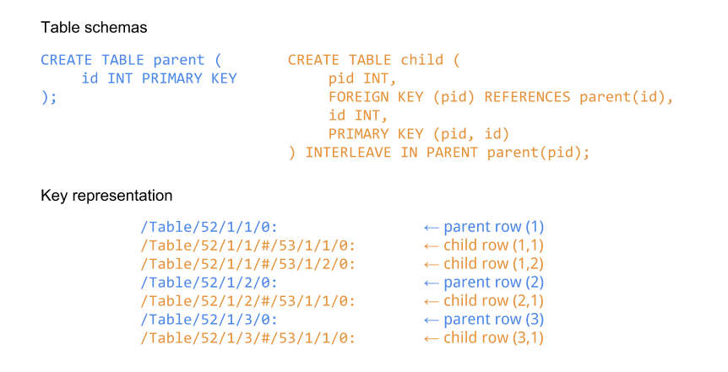
A Foreign Key (FK) Constraint in SQL is a way to enforce referential integrity between two tables. It ensures that the values in a column (or columns) of one table match the values in another table's primary key or unique constraint.
The Syntax of A Foreign Key (FK) Constraint in SQL with Parent Child Relationship in tables.

Slide 4
🎯 Purpose of Referential Integrity 🎯
Refrential Integrity
Data Accuracy
Data Consistency
Preventing Orphaned Recors
Data Integrity
Enhanced Data Quality
Data Accuracy: Ensures that relationships between tables remain valid, preventing the insertion of inconsistent or invalid data.
Data Consistency: Guarantees that changes made to data in one table are accurately reflected in related tables, maintaining consistency across the database.
Prevents Orphaned Records: Ensures that every foreign key value in one table matches a primary key value in another table, preventing the creation of orphaned records.
Maintains Data Integrity: Prevents the creation of relationships that could result in inconsistent or invalid data, thus maintaining the overall integrity of the database.
Simplified Data Management: Helps in maintaining and managing data more effectively by automatically handling the integrity of the database, reducing the risk of errors.
Enhanced Data Quality: Improves the overall quality of the data by ensuring that only valid and consistent data is stored in the database.

Slide 5

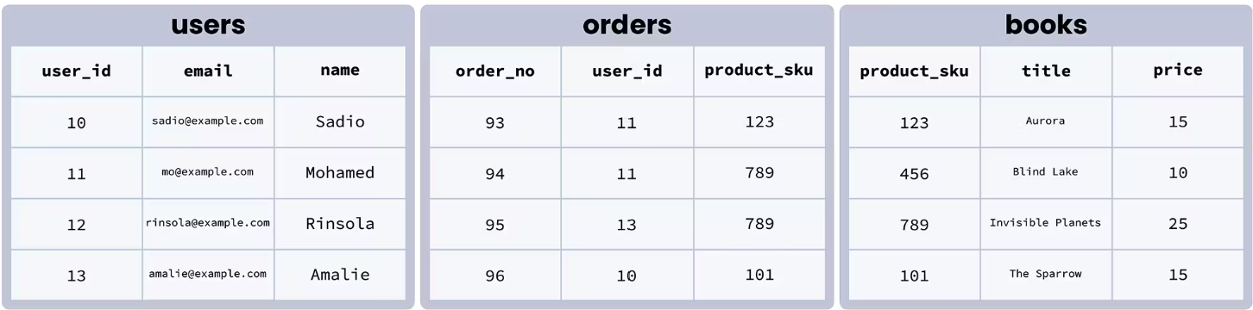

Slide 6
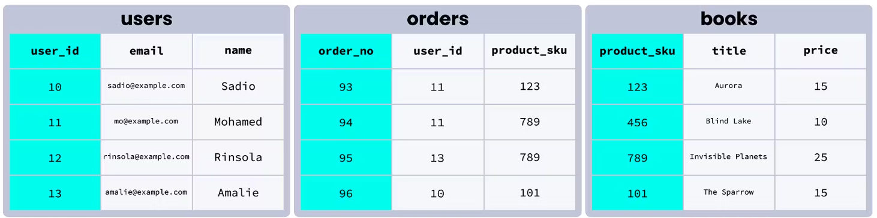

Slide 7
PRIMARY KEY of Table Books
PRIMARY KEY of Table Users
FOREIGN KEY of Table Users IN Table Orders
FOREIGN KEY of Table Books IN Table Orders

Slide 8
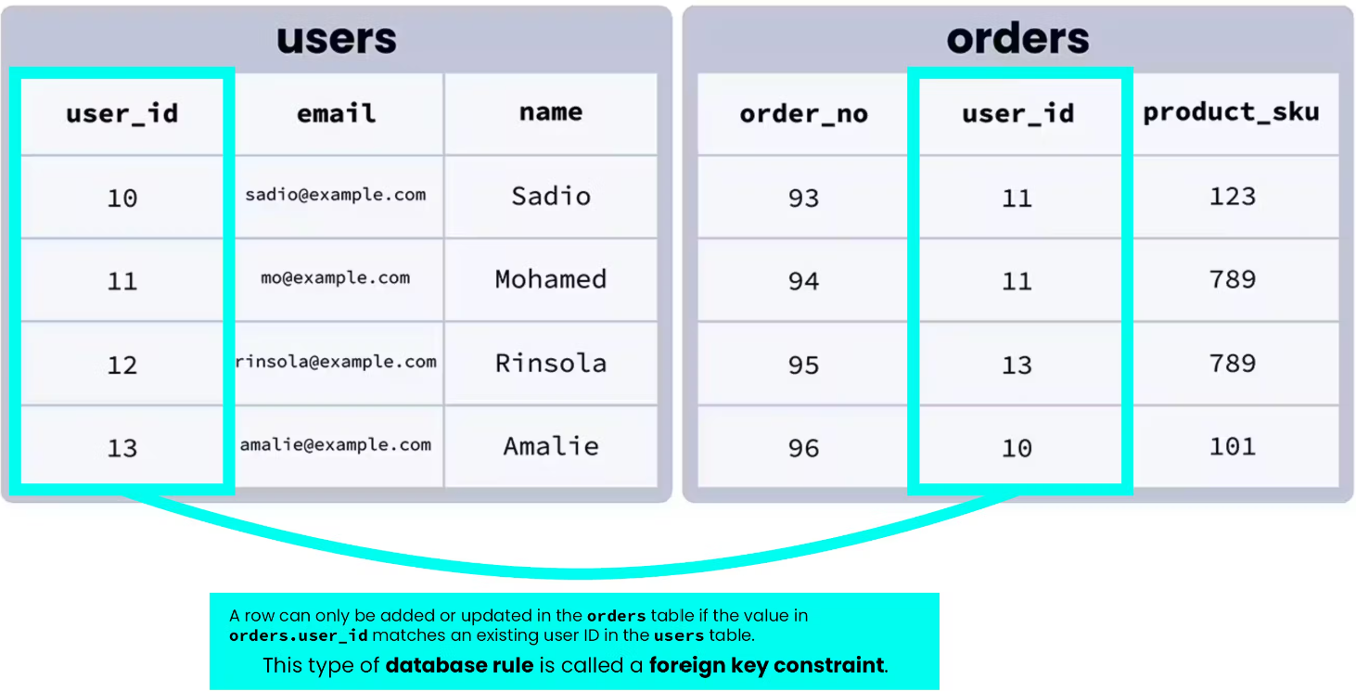
A row can only be added or updated in the Orders table if the value in Orders.user_id matches on the existing user ID in the users table.
This type of database rule is called a FOREIGN KEY CONSTRAINT

Slide 10
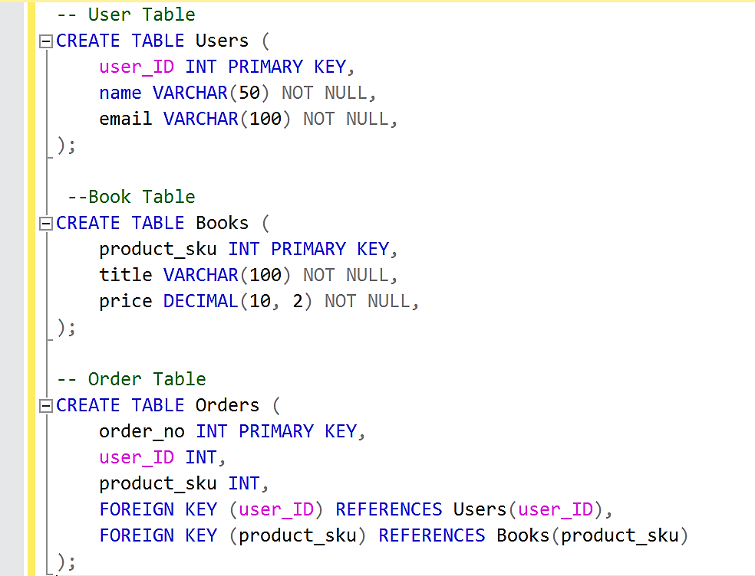
PRIMARY KEY of Users
Where user_ID is Interger and assigned as Primary key where Entity Integrity Constraint is applicable.
PRIMARY KEY of Books table Where product_sku is Integer and assigned as Primary key where Entity Integrity Constraint is applicable.
PRIMARY KEY of Books table Where product_sku is Integer and assigned as Primary key where Entity Integrity Constraint is applicable.
FOREIGN KEY of Table Users IN Table Orders
FOREIGN KEY of Table Books IN Table Orders

Slide 11
Thank You
By Dipal Paneri
Topic From @Mentorness

