Slide 1

Chatbot For Mental Health Support
Project Members
Attar Imran Basha - AP21110011384
Gorla Murali krishna - AP21110011388
Tatiparthi Charitha Sree - AP21110011389
Mahanthi Rahul - AP21110011393
Project Mentor
Dr.Sanjay kumar

Slide 2
01
Introduction
02
Technologies Used
03
System Features
04
Architecture
Contents
05
Demo
06
Challenges Faced
07
Future Enhancement
08
Conclusion

Slide 3
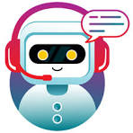
Introduction
The "Mental Health Care System" is a comprehensive solution designed to provide mental health support and management for patients, doctors, and administrators. It aims to streamline the process of seeking mental health assistance, managing patient records, and facilitating communication between patients and healthcare providers. Provide a user-friendly platform for patients to book appointments, interact with healthcare providers, and access mental health resources. Enable doctors to efficiently manage patient appointments, view patient records, and provide personalized care. Empower administrators to oversee the entire system, manage user accounts, and ensure smooth operation of the healthcare facility.

Slide 4

Technologies Used
Frontend: HTML, CSS, JavaScript
HTML, CSS, and JavaScript were used to create the user interface.
They provide the foundation for the website's structure, styling, and interactive elements.
Frontend Framework: Bootstrap
Bootstrap was utilized to enhance the frontend design and responsiveness of the website.
It offers a collection of CSS and JavaScript components for creating a modern and user-friendly interface.
Backend: Django
Django was chosen for its robustness, scalability, and built-in security features.
It provides a powerful framework for developing web applications, including authentication, ORM for database interactions, and URL routing.

Slide 5
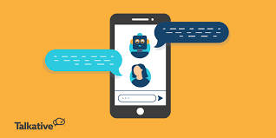
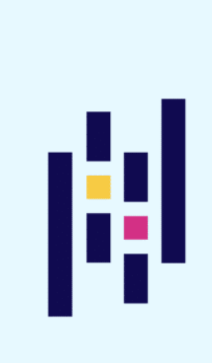
Database: SQLite
SQLite was selected for its simplicity and compatibility with Django.
It offers lightweight, serverless, and self-contained database functionality, suitable for small to medium-scale applications.
Chatbot: Botpress
Botpress was integrated to provide a chatbot for mental health support.
It offers a flexible and customizable platform for building and deploying chatbots with natural language processing capabilities.

Slide 6
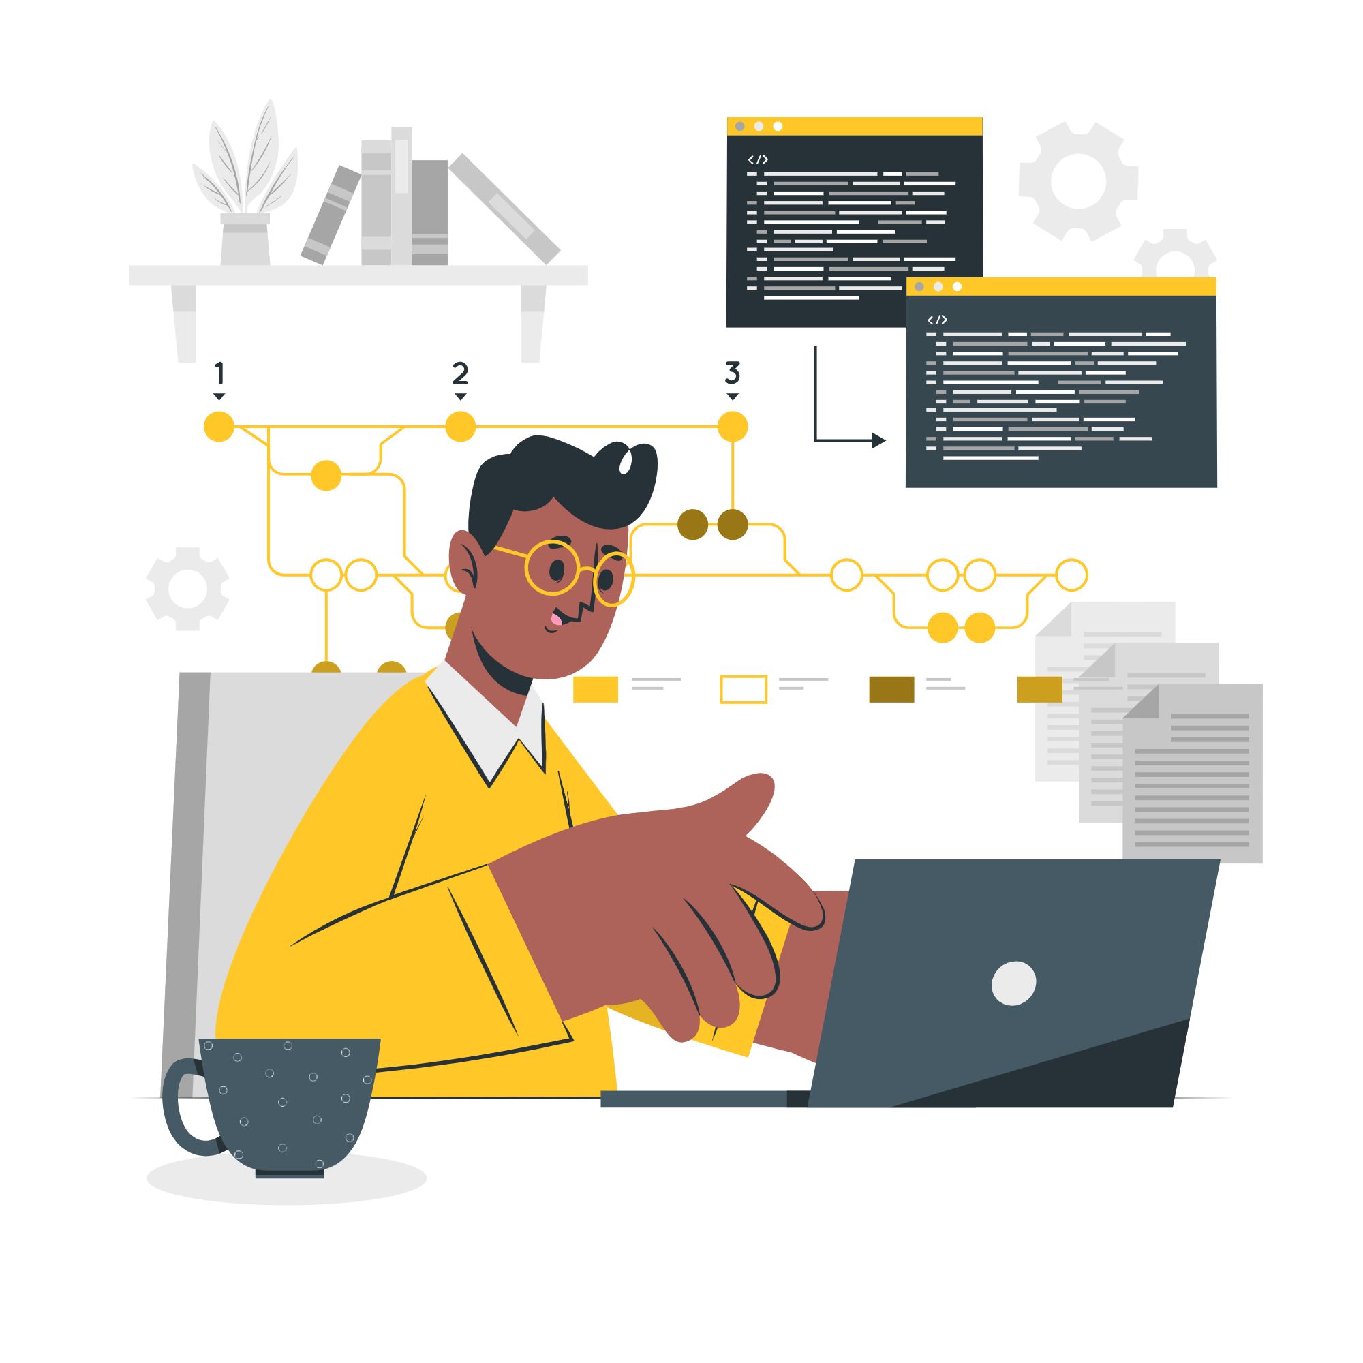
System Features
User Registration and Login:
Users can register and login to their accounts as Admin, Doctor, or Patient.
Approval is required from the admin for Doctor and Patient accounts.
Admin Features:
Register, view, approve, reject, and delete doctors.
Admit, view, approve, reject, and discharge patients.
Generate and download invoices in PDF format based on treatment details.
View, book, and approve appointments requested by patients.
Doctor Features:
Apply for a job in the hospital (approval required).
View assigned patient details (symptoms, name, mobile).
View list of discharged patients.
View appointments booked by admin.
Delete appointments after attending them.

Slide 7
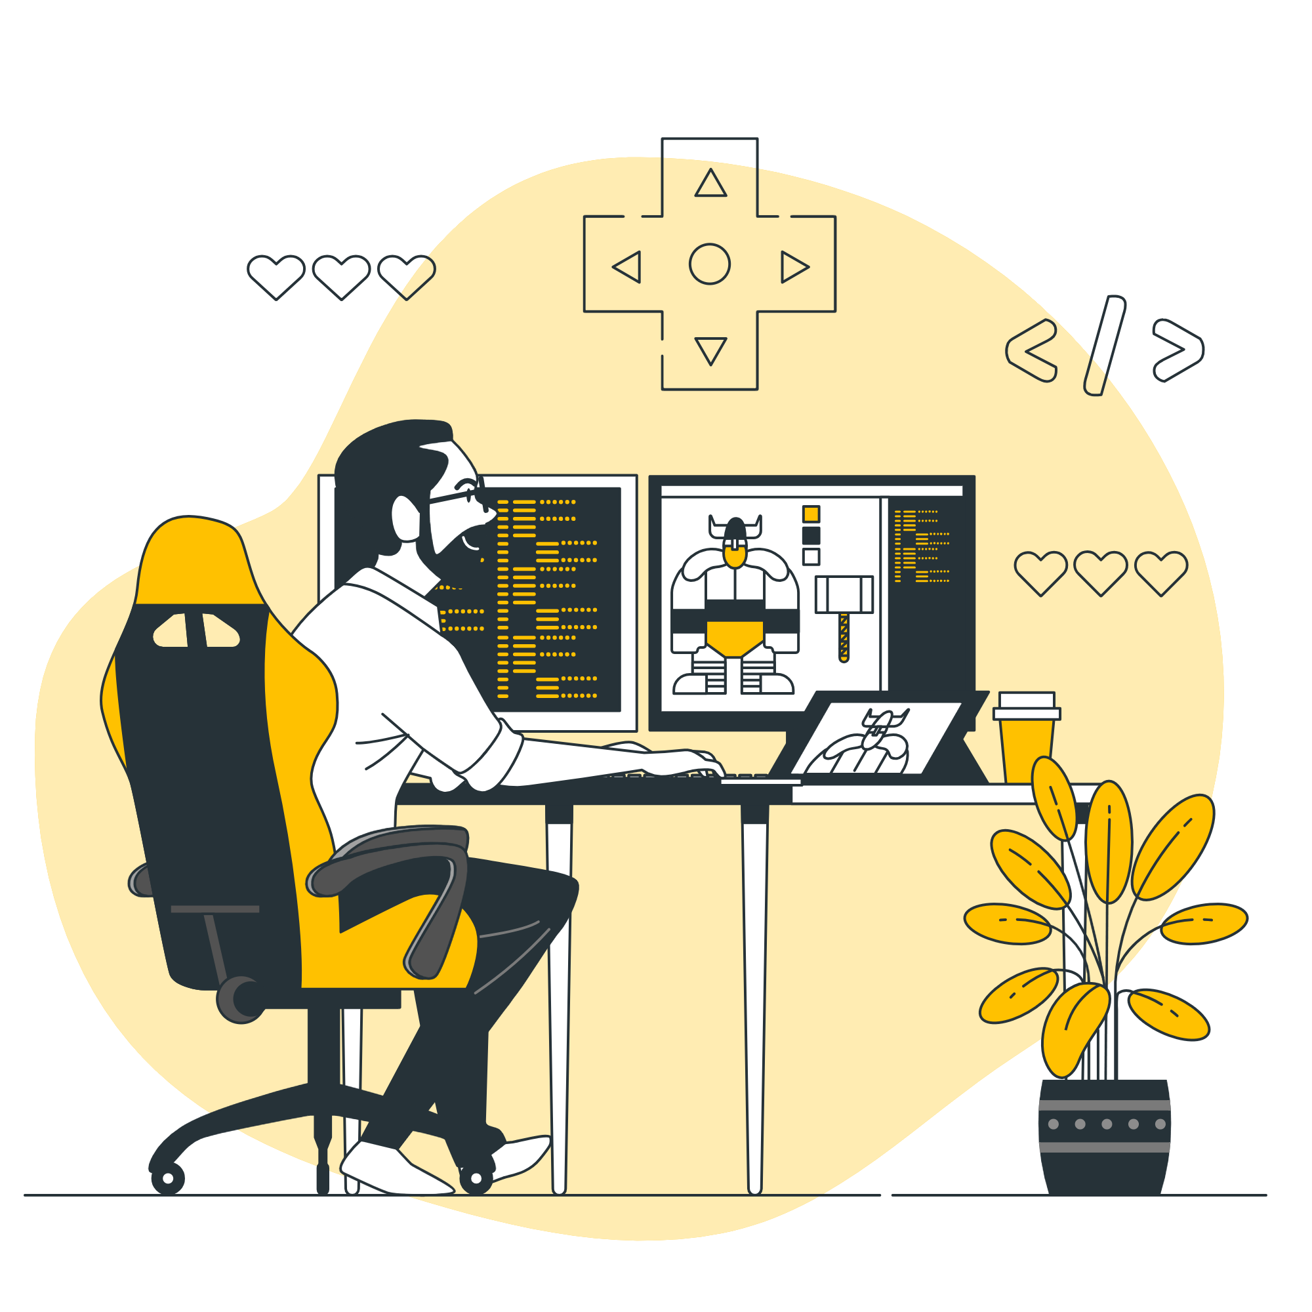
Patient Features:
Create account for hospital admission (approval required).
View assigned doctor's details (specialization, mobile, address).
View booked appointment status (pending/confirmed).
Book appointments (approval required).
View/download invoice in PDF format after discharge.
Chatbot for Mental Health:
Implement a chatbot using Botpress to provide mental health support.
Chatbot should be accessible to patients for assistance and guidance.

Slide 8
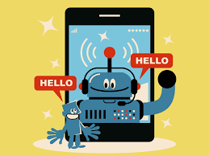
Architecture
Overview:
The system follows a client-server architecture.
The frontend is built using HTML, CSS, JavaScript, and Bootstrap, which interacts with the backend.
Django serves as the backend framework, handling user requests, database operations, and business logic.
Components:
Frontend: HTML, CSS, JavaScript, Bootstrap
Backend: Django
Database: SQLite
Chatbot: Botpress
Interactions:
Frontend communicates with the backend via HTTP requests, handling user interactions and displaying data.
Django manages the database operations, authentication, and routing.
Botpress is integrated with the frontend to provide the chatbot functionality.

Slide 9

Demo
User registration and login process.
Admin functionalities like managing doctors, patients, and appointments.
Doctor features such as viewing patient details and managing appointments.
Patient features including booking appointments and accessing invoices.
Chatbot interface for mental health support.

Slide 10
Challenges faced
Integration of Chatbot:
Integrating Botpress with the frontend and ensuring seamless communication posed challenges.
Overcame by carefully configuring the integration and testing extensively to ensure proper functionality.
User Roles and Permissions:
Implementing user roles (Admin, Doctor, Patient) and managing permissions required careful planning.
Overcame by defining clear roles and permissions and implementing robust authentication mechanisms.
UI/UX Design:
Designing a user-friendly interface that meets the needs of both patients and healthcare providers was challenging.
Overcame by conducting user testing and incorporating feedback to improve the design

Slide 11
Scalability:
Ensuring that the system is scalable to accommodate a growing number of users and data was a concern.
Overcame by designing the system with scalability in mind and utilizing Django's scalability features.

Slide 12
Future Enhancements
Telemedicine Integration:
Integrate telemedicine features to allow for remote consultations between doctors and patients.
Enable video conferencing and chat capabilities within the application.
Advanced Analytics:
Implement advanced analytics to provide insights into patient trends, treatment outcomes, and resource utilization.
Use data visualization techniques to present this information in an accessible format.
Enhanced Chatbot Functionality:
Improve the chatbot's natural language processing capabilities to provide more personalized and effective mental health support.
Integrate machine learning algorithms to enhance the chatbot's ability to understand and respond to user queries.
Mobile Application:
Develop a mobile application version of the system to allow users to access the platform from their smartphones.
Ensure that the mobile application offers a seamless and intuitive user experience.

Slide 13
Conclusion
The "Mental Health Care System" project aims to provide a comprehensive solution for mental health support and management.
By leveraging technologies like Django, SQLite, HTML, CSS, JavaScript, Bootstrap, and Botpress, we have created a robust and user-friendly platform.
The system offers features such as user registration and login, admin functionalities, doctor and patient features, and a chatbot for mental health support.
Future enhancements include telemedicine integration, advanced analytics, enhanced chatbot functionality, and a mobile application.

Slide 14
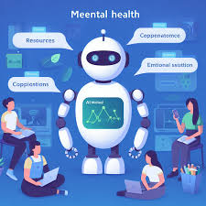
Thank You

