Slide 1


Flood Rehabilitation Project ASD LAB Mini Project Team Members: Muhzin Nasser Nandakishor Rahul Mahesh

Slide 2


Hello!
We the group 5 have created our project keeping in mind one of the worst things that had happened during the rehabilitation works during the Kerala Floods in 2018 and 19.
As of our thinking if such a project has been implemented more valuable time could be saved and efficiency of the whole process could be improved.

Slide 3
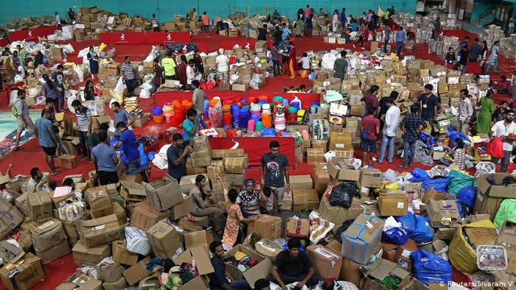
The soul of our idea came form here.

Slide 4
During the rehabilitation works of the last two years, most of the items needed by the rehabilitation camps had been done mainly through WhatsApp and using Phone Calls. The efficiency of such methods in the more complicated process like in the Rehabilitation works are much important. So, we together are putting forward an proposal to implement such a system having specific modules for user of each and every type and also connected with a centralised database that could be accessed by all of the users.
IDEA BEHIND THE PROPOSAL

Slide 5

Steps of Implementation
The administrator registers the users into the system and then provides credentials to them.
The users of the system gives the requests or orders.
The users login with their provided credentials.

Slide 6

1.Login Module
At the beginning of the operation of such a system admin, who’s a Officer himself add or register other Officers or Rehabilitation Camps or Public Users etc.
Then the registered users are provided with their own usernames and passwords.
And with these provided credentials they could log-in into the system and could perform their needed operations.

Slide 7
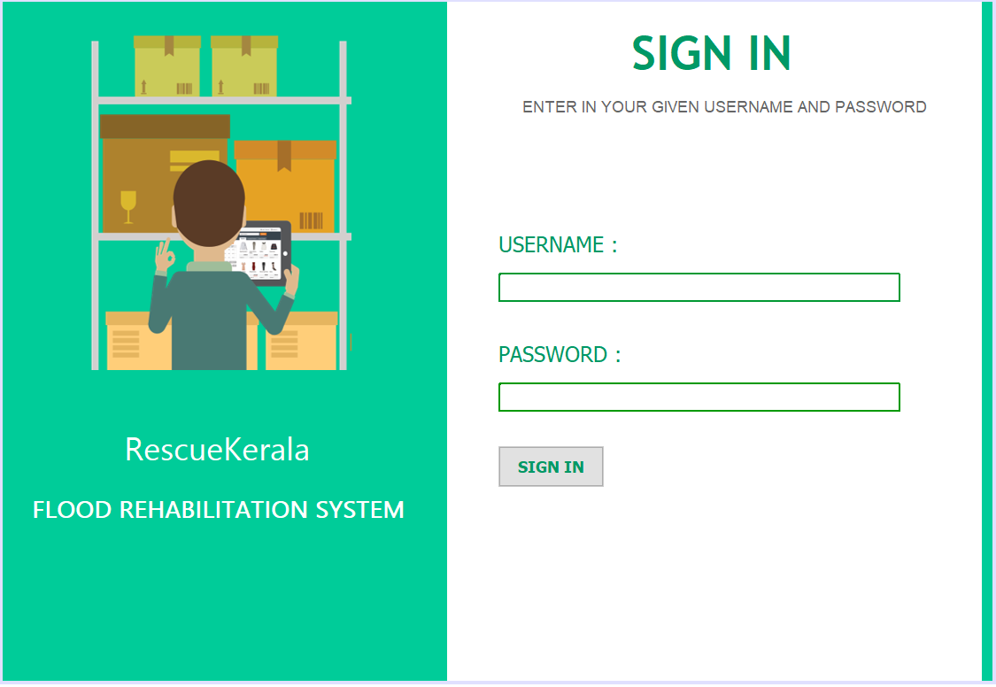

Log-In Module
Administrator of the system registers each user and provides credentials.
Later these users could login through this module.

Slide 8
2.Register Module
The Administrator could register new officers as well as new Rehabilitation Camps as well as new users.
Upon completion of this process a username and a password is generated and this data is given to the respected users.
Only the Administrator could access this module.

Slide 9
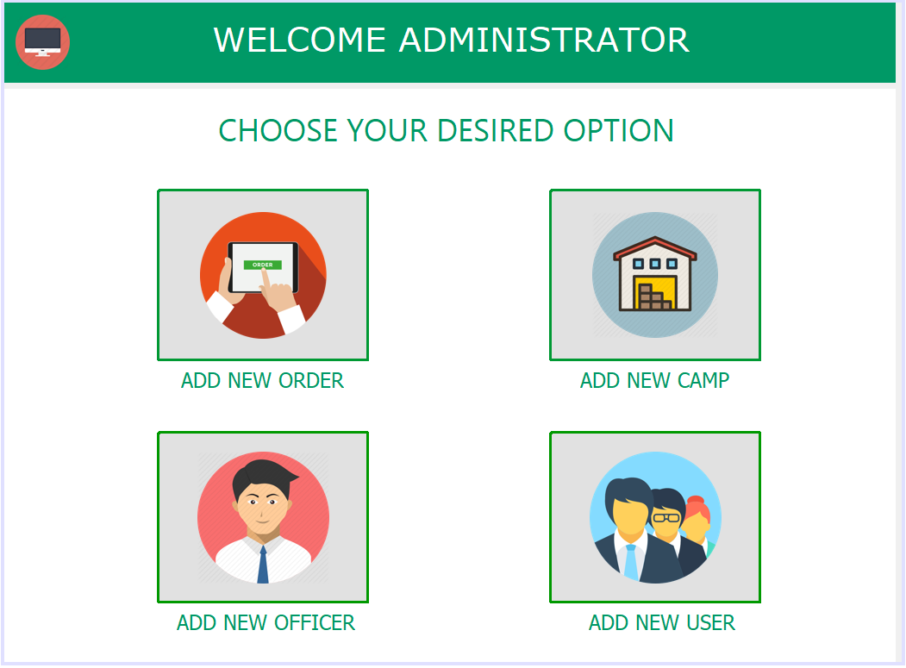
Admin Option Selector
The Administrator could choose any option that he/she wants.
The various options are to place an order himself, add or register new and required officers/camps/users.

Slide 10
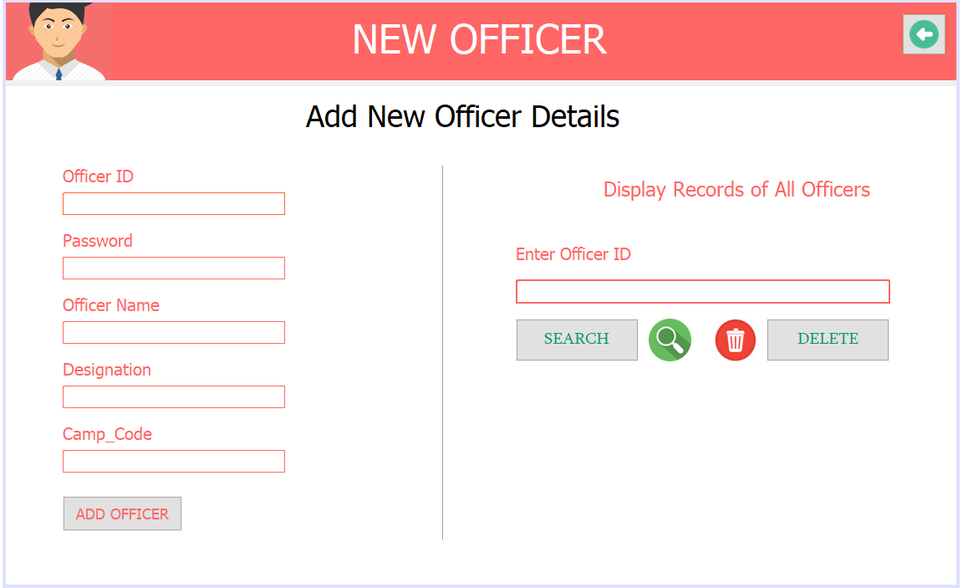
Add New Officer
New Officer could be added or generated by the Administrator by providing the required details.
Then a new officer could login with this username and password.

Slide 11
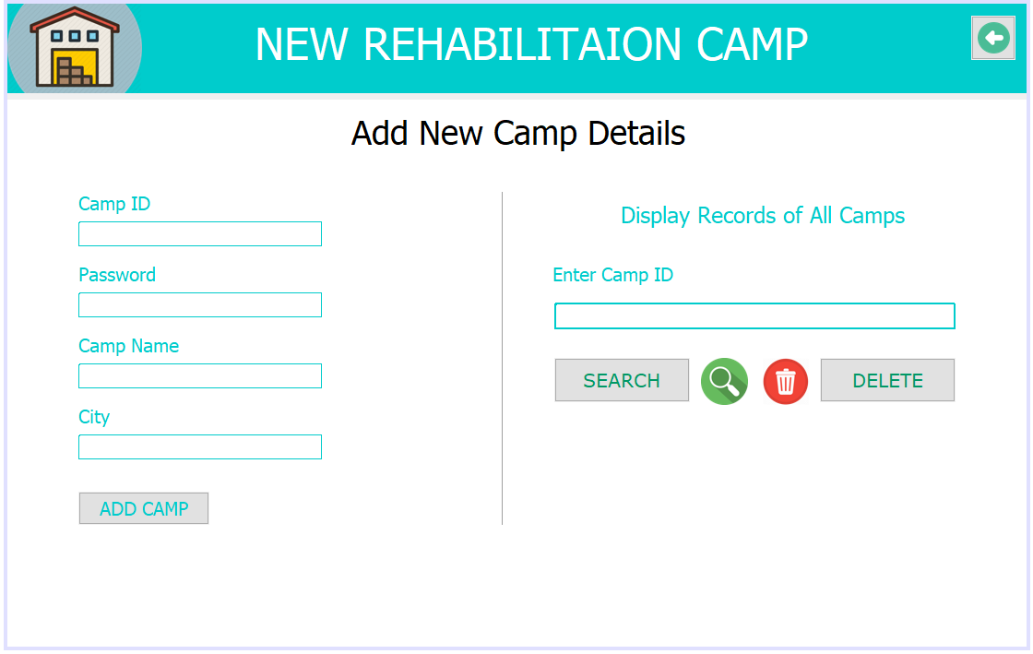
Add New Camp
New Camp could be added or generated by the Administrator by providing the required details.
Then a new camp could login with this username and password.

Slide 12
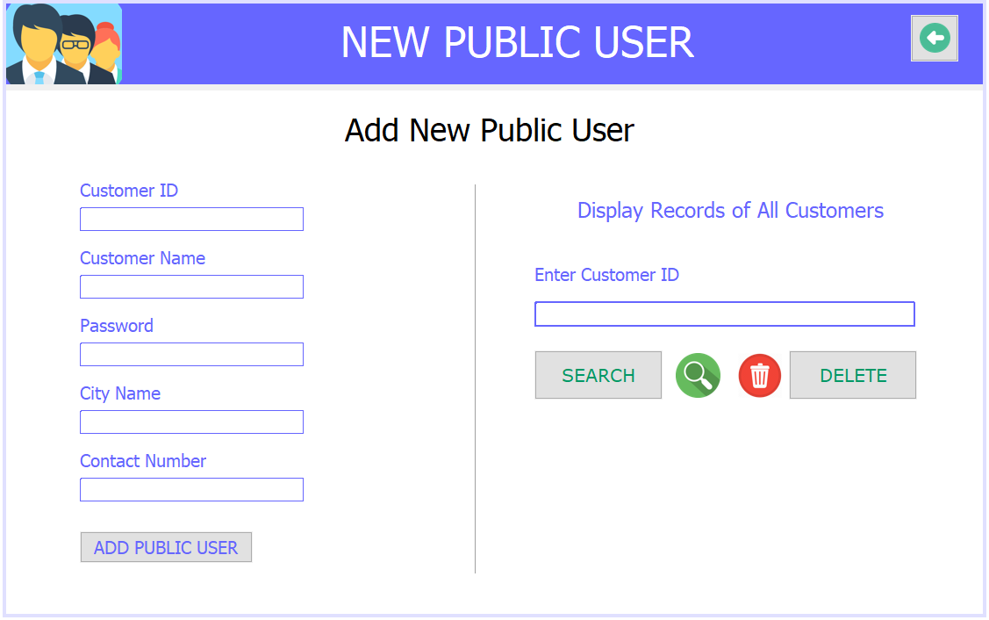
Add New Public User
New Public User could be added or generated by the Administrator by providing the required details.
Then a new public user could login with this username and password.

Slide 13
3.Order Module
Used to give requests or orders of the items needed by the users.
This module can be accesses by the Officers, Camps as well as the public or common users.
Also an option has been provided to view the requested orders given using a specific module by a specific user.

Slide 14
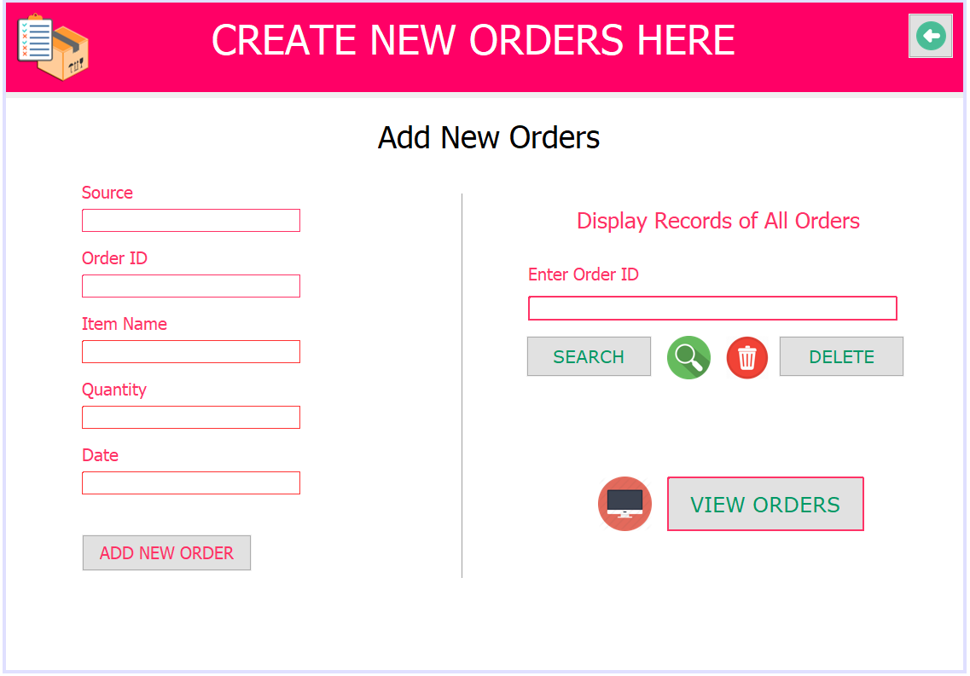
Order Module
This module serves as the main component of our project. And this module can be used by all users of our project.
Can be used to request or place the required orders.

Slide 15
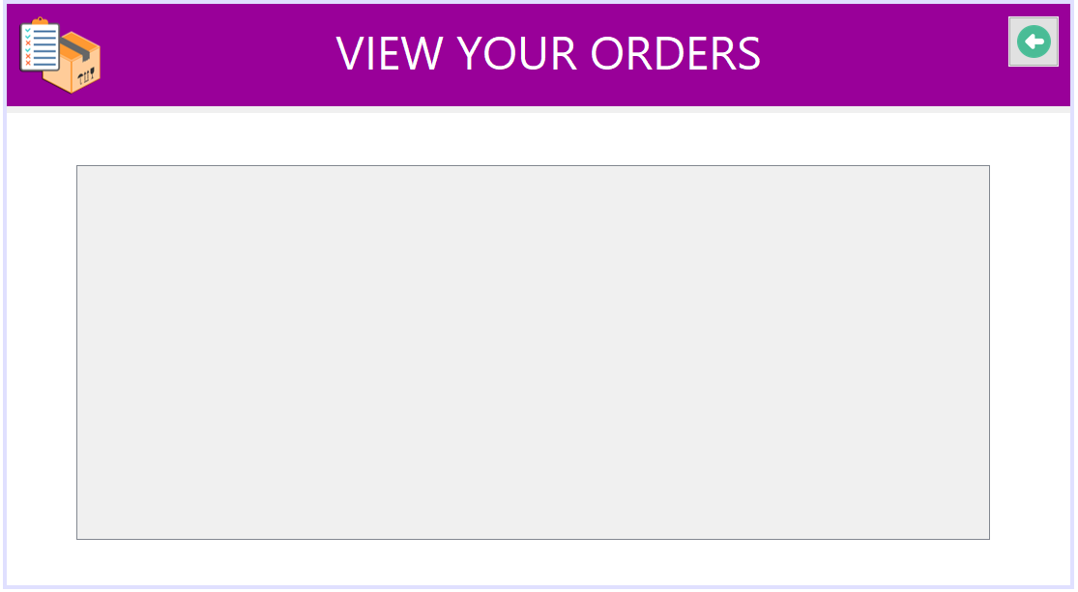
View Orders Module
This module can be used to view the orders that has been requested.
And this view of the orders changes from user to user based on his protocol.

Slide 16

Thanks!
We hereby thank all of them who have helped us in a way or the other through out the project..

