Slide 1
Battle of Neighbourhoods : Mumbai

Slide 2
Introduction
In India, many working professionals who hail from different parts of the country, have to shift to metro cities for work and this project aims to help these people in exploring the neighborhoods so that they can make wise choice while relocating. Many factors should be looked at when exploring neighborhoods such as Super market, medical shops, grocery shops, mall, theatre, hospital, like minded people, ease of accessing to Cafe, etc.
This Project aim to create an analysis of features for a people migrating to Mumbai to search a best neighborhood as a comparative analysis between neighborhoods.

Slide 3
Data
Data Link: https://en.wikipedia.org/wiki/List_of_neighbourhoods_in_Mumbai
Will use Mumbai Areas table which can be scraped from above link. Dataset consists of latitude and longitude, Area and Location.
Foursquare API Data:
The data retrieved from Foursquare contained information of venues within a specified distance of the longitude and latitude of the postcodes. The information obtained per venue as follows:
1. Neighborhood
2. Neighborhood Latitude
3. Neighborhood Longitude
4. Venue
5. Name of the venue e.g. the name of a store or restaurant
6. Venue Latitude
7. Venue Longitude
8. Venue Category

Slide 4
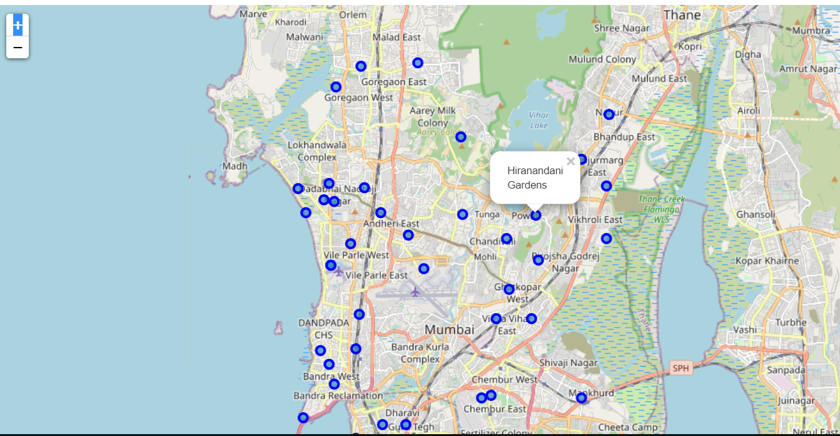
Map of Neighbourhoods in Mumbai

Slide 5
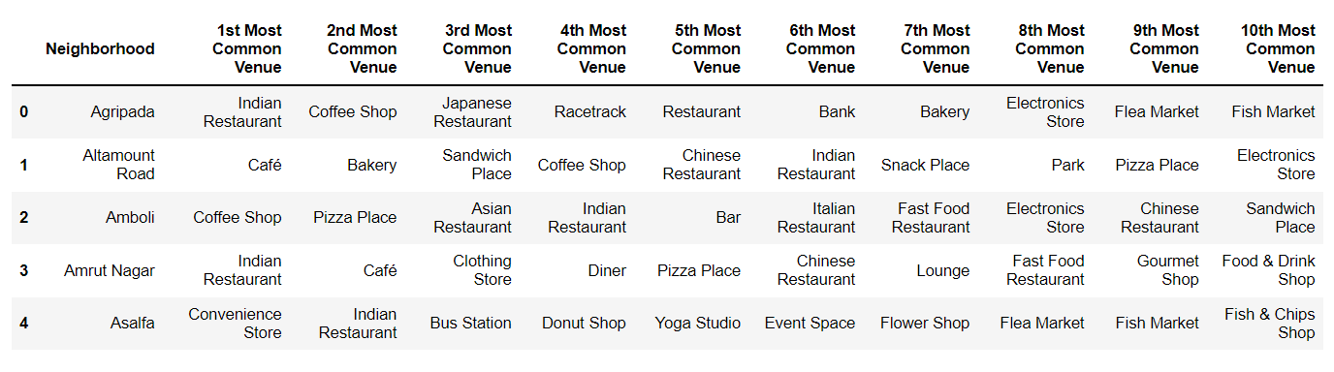
Top Nearby venues in each Neighbourhood

Slide 6
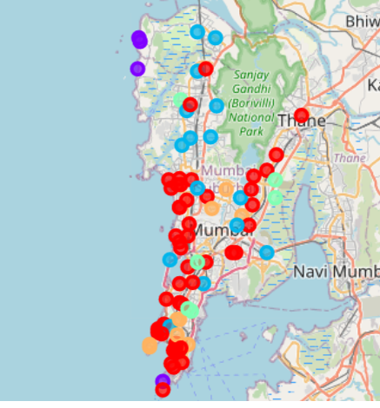
Clustering of Neighbourhoods

Slide 7
Conclusion
In this project, using k-means cluster algorithm I separated the neighborhood into five different clusters which have very-similar neighborhoods around them.
So a person shifting to Mumbai and searching for a place can get an idea looking at the clusters about which neighborhoods offer similar nearby facilities and then he can decide based on budget and other details where he wants to reside.

Slide 8
THANK YOU

