Slide 1
Cascading Style Sheets (CSS)
Prajjwal Mishra
1st Year , B Tech – CSE
NIT Andhra Pradesh

Slide 2
Introduction
A style sheet language used for describing the look and formatting of a document written in a mark-up language.
It basically adds style to your html code.

Slide 3
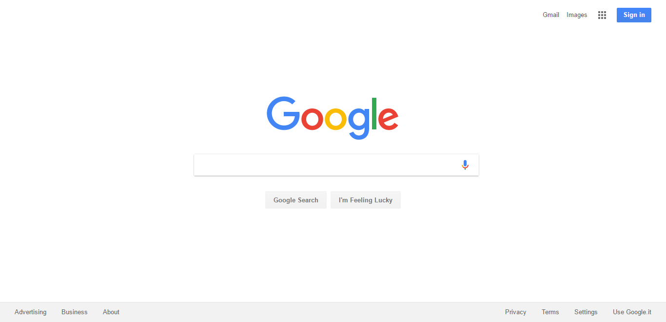
Google’s Home-page with CSS

Slide 4
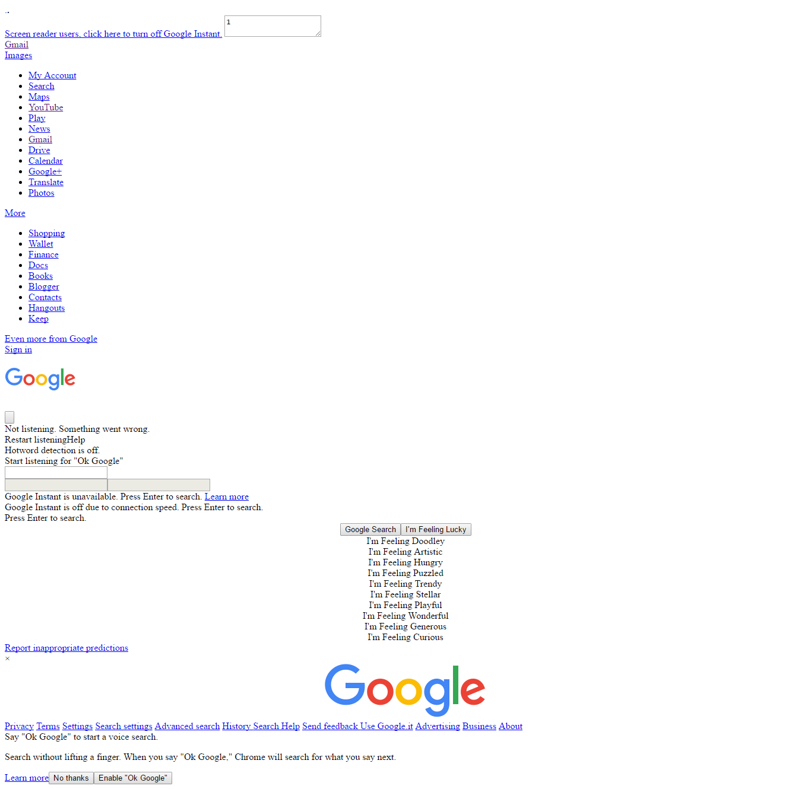
Google’s Home-page without CSS

Slide 5
How and where to include CSS?
3 methods
1. Inline CSS
eg. <h1 style=“color: blue;font-size=10px;”>
This is Inline css</h1>
2. Embedded CSS
eg. <head>
<style type=“text/css”>
h1{
color:blue;
}
</style>
</head>

Slide 6
3. External CSS
Use of <link> element.
Include this in html –
<head>
<link type=“text/css” href=“......“>
</head>
Create another file with .css extension.
Example :
*{
margin-left:10px;
}
h1{
color: red;
}

Slide 7
Style Rules
CSS comprises of style rules that are interpreted by the browser and then applied to the corresponding elements in your document.
3 parts – Selector , Property and Value.
Syntax-
selector{
property: value;
}

Slide 8
Selectors
1. Type selector- html element(s) of same name. Eg. H1
2.Universal selector- Selects all elements on a page.Denoted by *.
3.ID selector – Declared using # and followed by the ID name.
4.Class selector – Declared with a dot(.) followed by the class name.

Slide 9
Descendant combinator – Combines 2+ selectors for more specificity.
Example :
CSS HTML
#container .box{ <body>
float: left; <div id=“container”>
padding-bottom: 15px; <div class=“box”>
} </div>
<div class=“box1”>
</div>
</div>
<div class=“box”></div>
</body>
Only the box within container is affected.

Slide 10
6. Attribute selector – It targets elements based on the value of attributes.
Declared using square brackets.
Example:
input[type=“text”]{
}
7. Pseudo-class – It uses a colon character to identify a pseudo-state that an element might be in.
8. Grouping Selector – To select more than one element at a time.
Eg : h1 , h2 , h3{
}

Slide 11
Margin and Padding
Padding – Generate space around an element’s content , inside of any defined borders.
Margin – Create space around elements , outside of any defined borders.

Slide 12
Borders
CSS border properties allow us to specify the style , width and color of an element’s border.
Example:
p {
border-style: dotted;
border-width: 10px;
border-color:yellow;
}

Slide 13
Background Image
background-image – Location of the image
Eg. h1{ background-image:url(‘.......’);}
background-color , background-repeat , background-position

Slide 14
Floats
In CSS , float property places an element on the left or right of its container , allowing text and inline elements to wrap around it.
Example:
img{
float: right;
}

Slide 15
Thank You

