Slide 1
Attention Residual U-Net (ARU-Net)
Presented by: Rahul Mishra

Slide 2
Problem statement
Irregular tumor shapes and sizes
Information loss during encoder-decoder transitions
Multi-modal data integration (T1, T1ce, T2, FLAIR)
Gradient vanishing in deep networks

Slide 3
Dataset used
BraTS 2018, 2019, and 2020 datasets were used for training and evaluation.
These datasets are part of the Multimodal Brain Tumor Image Segmentation Benchmark (BraTS).
Each dataset includes:
Pre-operative MRI scans: T1, T1ce, T2, and FLAIR modalities.
Manual expert annotations for:
Enhancing Tumor (ET)
Tumor Core (TC)
Whole Tumor (WT)
Patient types: High-Grade Glioma (HGG) and Low-Grade Glioma (LGG).
Format: NIfTI (.nii).

Slide 4
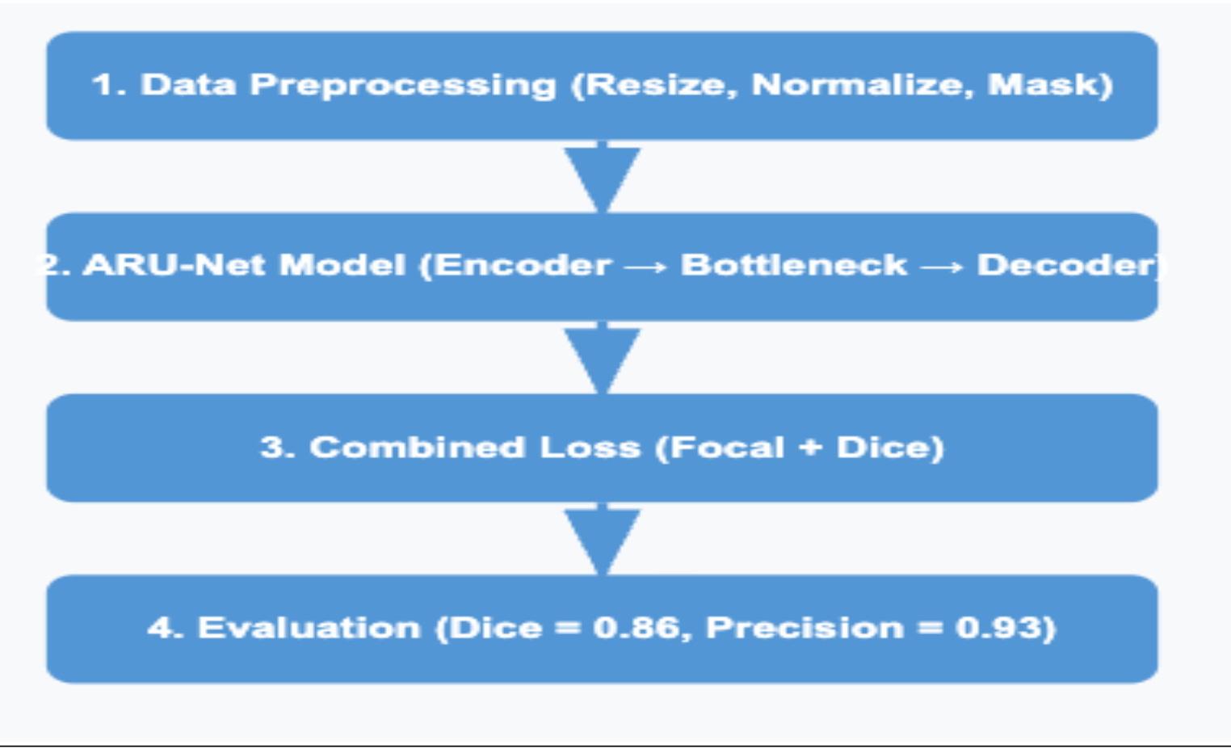
Workflow diagram

Slide 5
Data Preprocessing
1. Load NIfTI Image
Read .nii.gz file
Extract middle axial slice from 3D MRI volume
2. Brain Masking
Compute 5th percentile threshold on non-zero pixels
Create binary brain mask
Remove background, skull, and scanner artifacts
3. Intensity Normalization
Outlier Removal: Clip to [1st, 99th] percentile
Z-Score Normalization: Standardize brain voxel intensities
Min-Max Scaling: Rescale pixel values to [0, 1]
4. Batch Processing
Process 4 MRI modalities: FLAIR, T1, T2, T1ce
Apply all preprocessing steps to each slice
Save processed slices as .npy arrays

Slide 6
Data Preprocessing
5. Segmentation Mask Handling
Extract same slice from segmentation mask
Remap labels: 0: Background
1: Core
2: Edema
3: Enhancing Tumor
6. Quality Control & Assembly
Skip patients with <50 tumor pixels

Slide 7

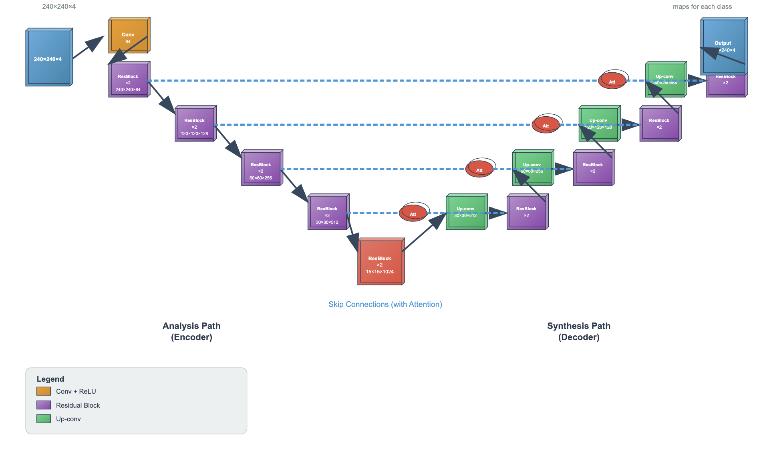
Architecture of Aru-net
U-Net backbone: Encoder-decoder structure with skip connections
Residual learning: Enhanced gradient flow and feature learning
Attention mechanisms: Focused feature selection and refinement
Regularization: Dropout and batch normalization for stability

Slide 8
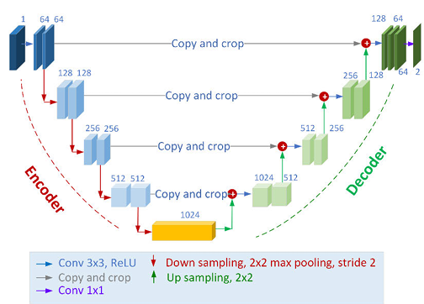
U-Net Architecture
Used for image segmentation
U-shaped encoder-decoder
structure
Skip connections for better accuracy
Effective with small datasets
Produces detailed segmentation maps

Slide 9
Key Points:
Encoder Path: Extracts hierarchical features through downsampling
Decoder Path: Reconstructs spatial resolution for pixel-wise prediction
Skip Connections: Preserve fine-grained details during upsampling
Multi-scale Learning: Captures both local textures and global context

Slide 10
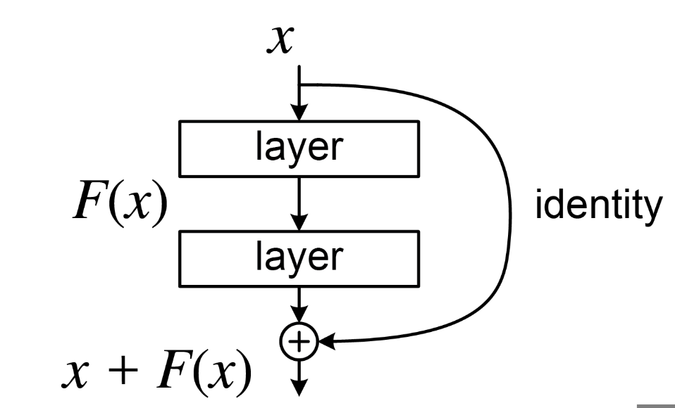
Residual Learning
Problem: Deep networks suffer from vanishing gradients Solution: Residual connections allow gradients to flow directly
Adaptive shortcuts (learned 1×1 conv)
Progressive dropout for deeper regularization Benefit: Enables effective training of deep architectures

Slide 11
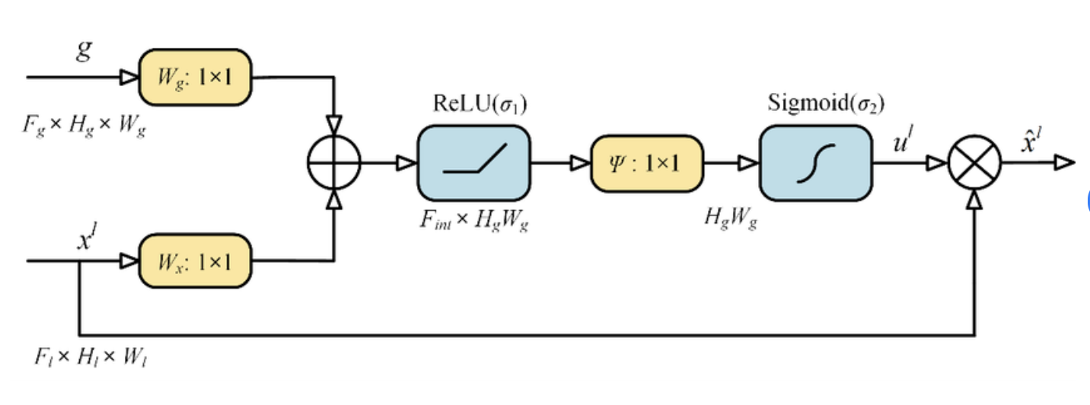
Attention Gates
Goal: Focus the model on relevant tumor regions, ignore background.
Inputs:
x: Feature map from encoder
g: Gating signal from decoder
Why It Works:
Learns where to look, not just what features to use
Suppresses false positives, especially in healthy tissue
Improves localization of small or fuzzy tumor areas

Slide 12
Regularization
Regularization Techniques Used
Dropout:
Randomly deactivates neurons during training.
Batch Normalization:
Normalizes layer inputs, stabilizing and speeding up training.
Offers a subtle regularization effect by adding noise.
Early Stopping:
Monitors validation performance (Dice Coefficient).
Stops training when performance plateaus, preventing overfitting.
Data Augmentation:
Artificially expands the training dataset (rotations, flips, shifts, zooms).
Enhances model generalization and reduces overfitting.

Slide 13
Adam OPtimizer
Adaptive Learning Rates: Automatically adjusts learning rates for each parameter.
Efficient Convergence: Combines momentum and RMSprop for faster, stable training.

Slide 14
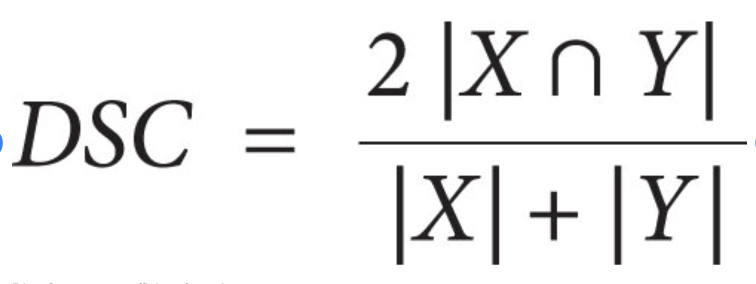

Loss function
1.Dice Loss:
Purpose: Focuses on tumor overlap, handles class imbalance
A: Ground truth tumor pixels
B: Predicted tumor pixels
ε: Smoothing factor (1e-6) prevents division by zero
Range: 0 (perfect overlap) → 1 (no overlap)
2.Focal Loss:
Purpose: Focuses on hard pixels, reduces background bias
α = 0.25: Balances positive/negative class importance
γ = 2.0: Down-weights easy examples, emphasizes hard cases
p: Predicted probability for correct class
Effect: Easy pixels (high p) → low loss, Hard pixels (low p) → high loss
3.Combined Loss:
Combined Loss = 0.5 * Dice Loss + 0.5 * Focal Loss

Slide 15
Why This Combination Works
1. Class Imbalance Handling - Dice ignores background dominance -Focal down-weights easy (non-tumor) pixels 2. Complementary Optimization -Dice Loss → Captures overall tumor shape -Focal Loss → Refines local edges
3. Small Tumor Sensitivity -Dice ensures global overlap -Focal highlights tiny/low-contrast lesions
4. Clinical Boundary Precision -Dice encourages full coverage -Focal sharpens uncertain/tough boundaries
5. Stable & Robust Training -50–50 weighted loss prevents one from dominating

Slide 16
Evaluation methods
1. Dice Score (DSC)
Formula- DSC = 2×TP / (2×TP + FP + FN) - Measures spatial overlap accuracy - Range: 0 (bad) to 1 (perfect)
2. Hausdorff Distance (HD)
Formula- HD=max{d(A,B),d(B,A)} -Measures boundary precision

Slide 17
Evaluation methods
3. Precision & Recall
Formula- Precision = TP / (TP + FP) & Recall = TP / (TP + FN) -Precision = Accuracy of predicted tumors -Recall = Ability to detect all actual tumors
4. Jaccard Index (IoU)
Formula- IoU = |A ∩ B| / |A ∪ B| - Stricter than Dice -Used as a secondary overlap metric
5. F1 Score
Formula-F1 = 2 × (Precision × Recall) / (Precision + Recall) -Harmonic mean of Precision & Recall -Good for imbalanced data

Slide 18
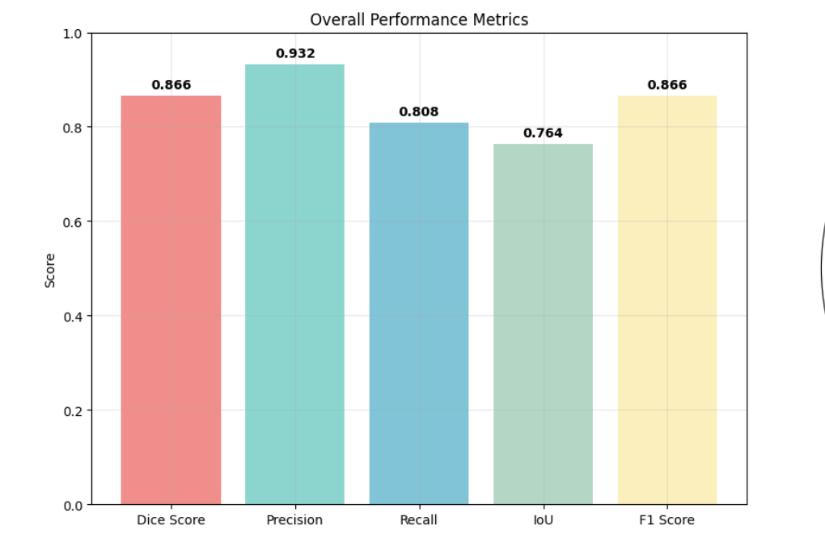
Results of Brats 2020

Slide 19
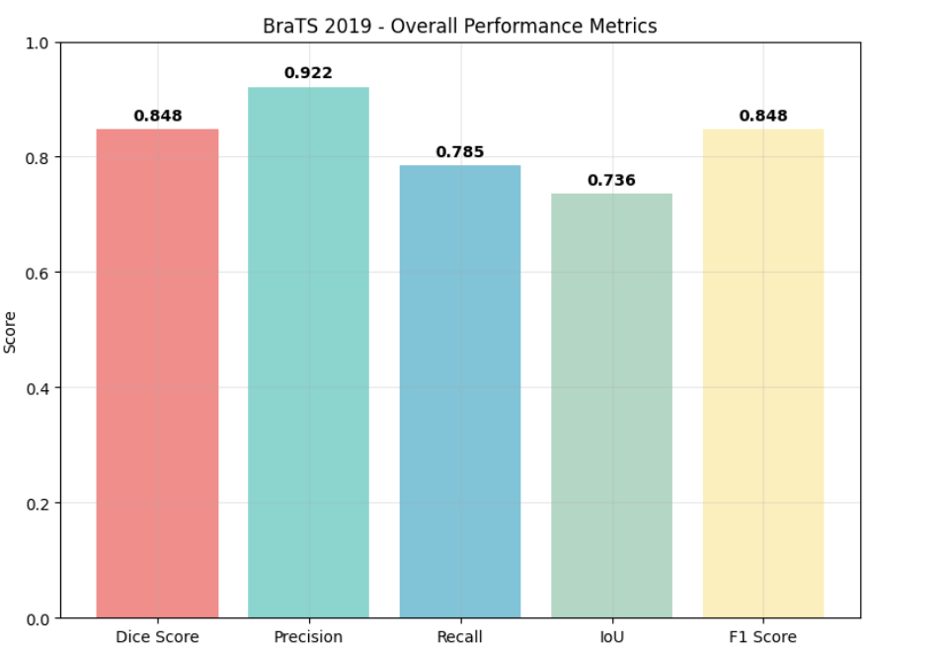
Results of Brats 2019

Slide 20
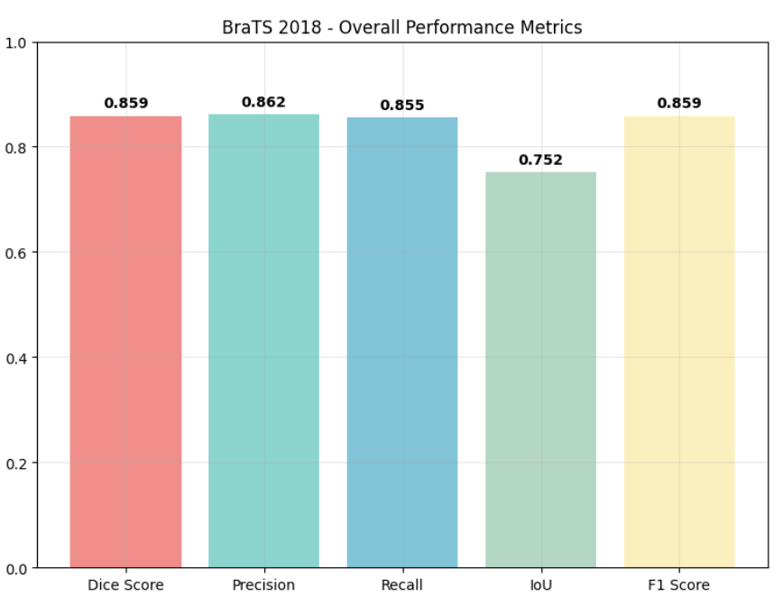
Results of Brats 2018

Slide 21
Thank You

