Slide 1
U-Net: Convolutional Network for Segmentation
Presented by: Rahul Mishra

Slide 2
Introduction
U-Net is one of the most widely used CNN-based models for biomedical semantic image segmentation.
Known for its high performance on medical and biological image data.
The main advantage of U-Net is its ability to extract both local and global features.
Effectively captures information at multiple scales, enhancing segmentation accuracy.
Performs well even with limited annotated datasets, making it ideal for biomedical applications.

Slide 3
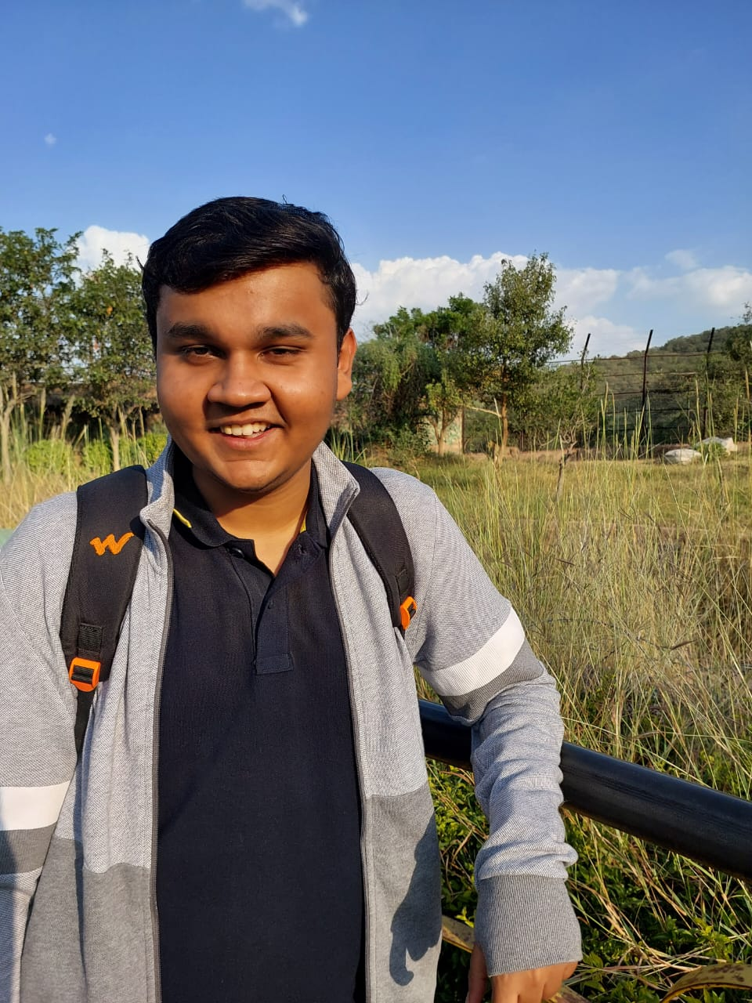
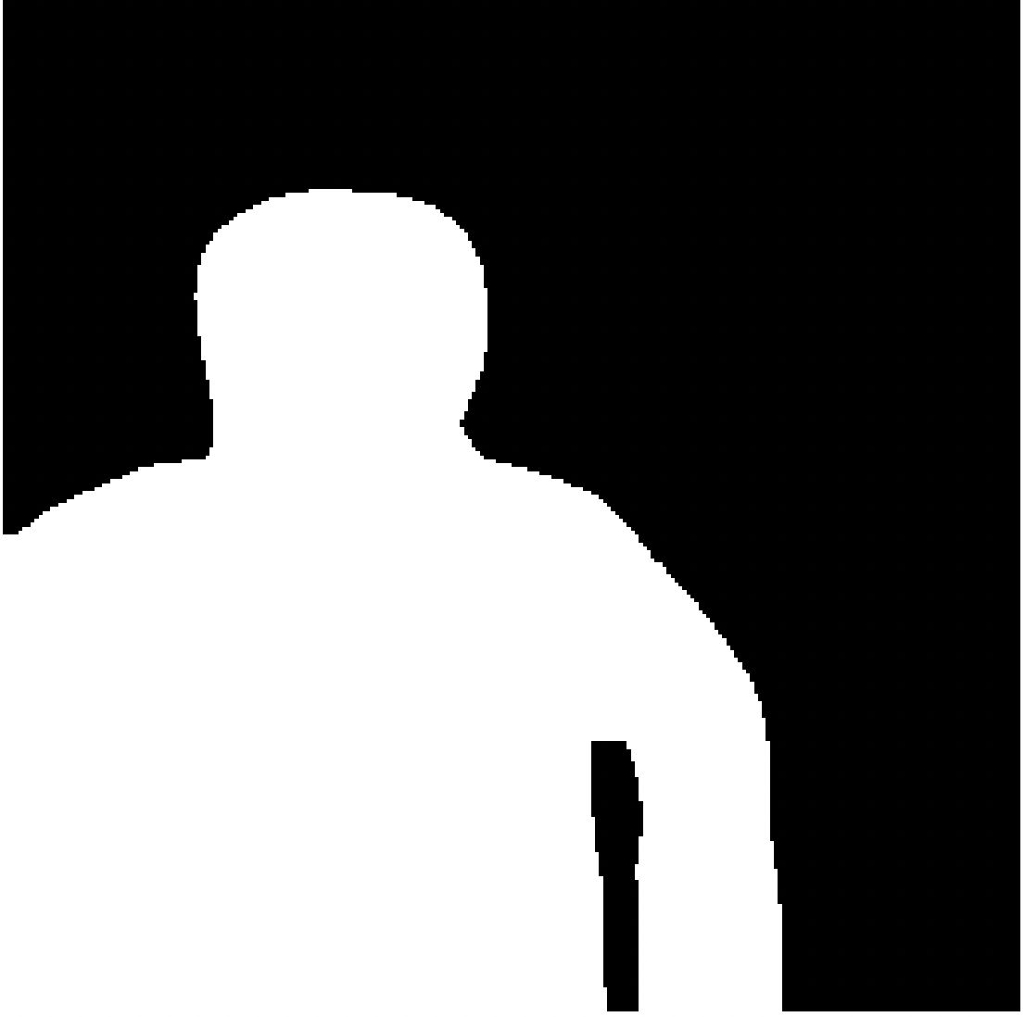
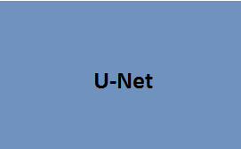
What does a U-Net do?
Input Image
Output Segmentation Map

Slide 4
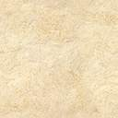
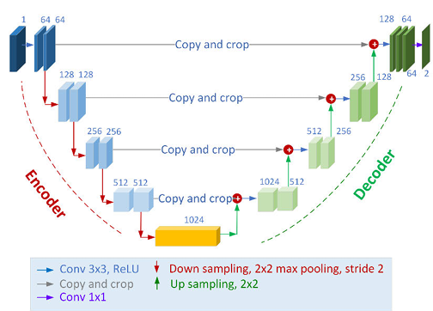
U-Net Architecture
Used for image segmentation
U-shaped encoder-decoder
structure
Skip connections for better accuracy
Effective with small datasets
Produces detailed segmentation maps

Slide 5
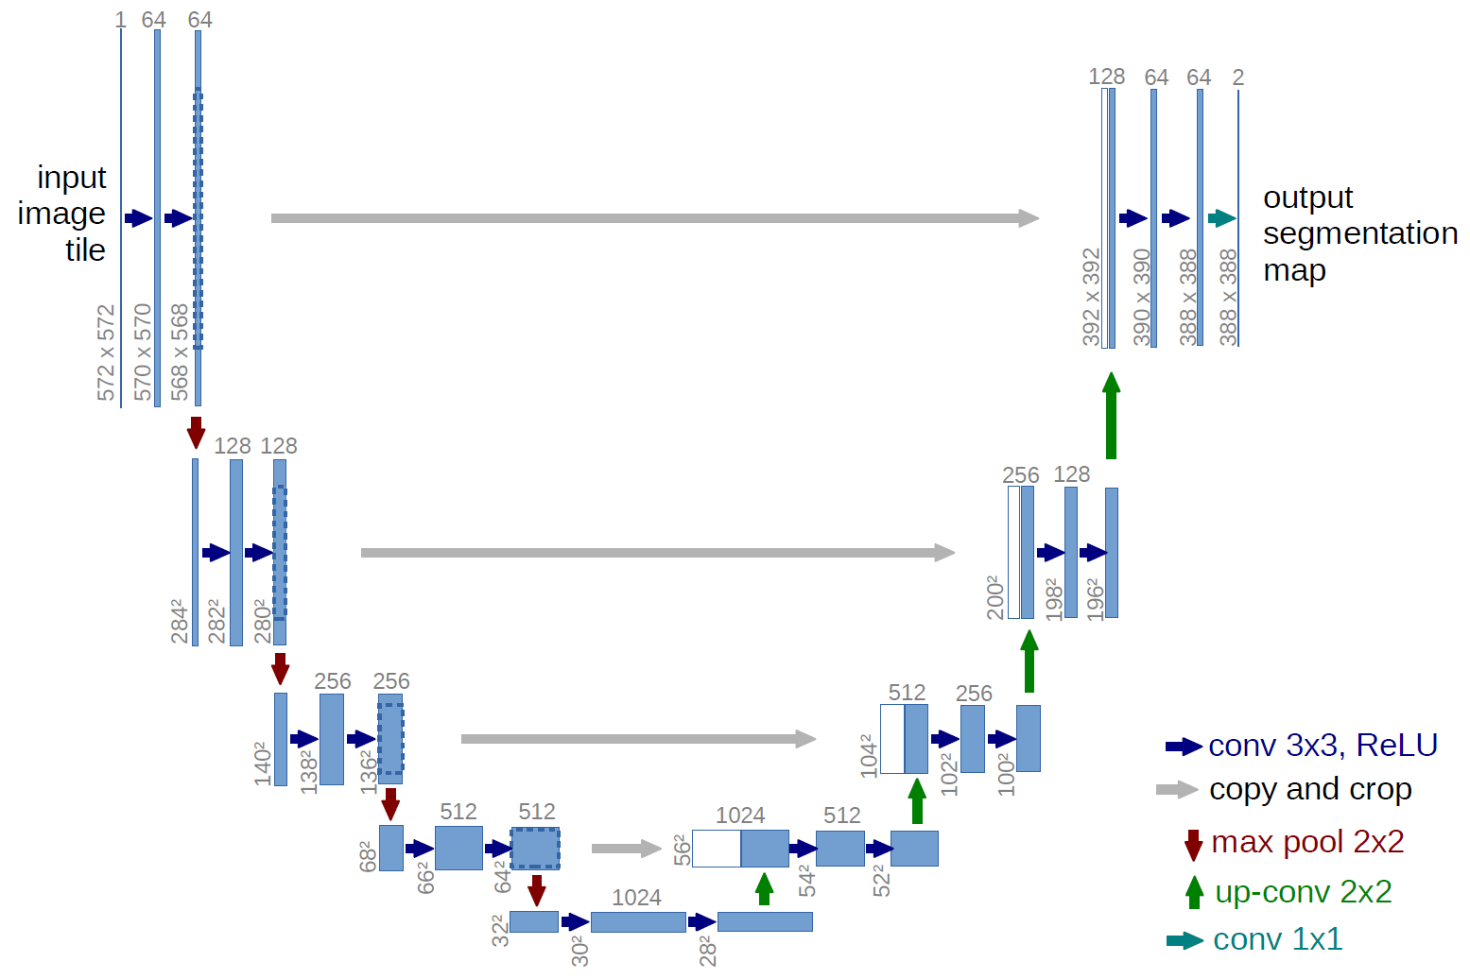
downsampling phase(Encoder)
Structure:
Repeated blocks of:
Two 3×3 convolutional layers (without padding)
Each followed by a ReLU activation
Then a 2×2 max pooling layer with stride 2 for downsampling
Feature Expansion: After each downsampling step, the number of feature channels is doubled.

Slide 6
Bottleneck layer
Contains the highest number of feature channels
Captures global context with the widest receptive field
Implements two 3×3 convolutions with ReLU activations
Creates compressed yet information-rich representation

Slide 7
upsampling phase(Decoder)
Structure:
Each step includes:
Upsampling of the feature map
Followed by a 2×2 up-convolution (transposed convolution) that halves the number of feature channels
Concatenation with the correspondingly cropped feature map from the contracting path via skip connections
Then, two 3×3 convolutions, each followed by a ReLU activation

Slide 8
skip connection
Combine high-resolution features with upsampled outputs
Essential for precise boundary delineation
Allow network to recover spatial hierarchies
Connect corresponding layers between contracting and expansive paths

Slide 9
Final Layer
1×1 convolution maps feature vectors to desired number of classes
Total of 23 convolutional layers in the original architecture
No fully connected layers (fully convolutional network)

Slide 10
Overlap-Tile Strategy
Enables seamless segmentation of arbitrarily large images
Divides large images into smaller overlapping tiles for processing
Extrapolates missing context by mirroring input at borders
Overcomes GPU memory limitations for large images
Uses only valid parts of each convolution

Slide 11
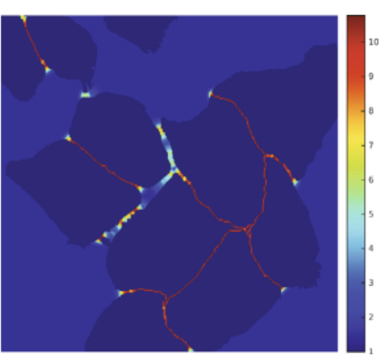
Loss Function and Weight Map
Pixel-wise soft-max with cross entropy loss
Custom weight map: w(x) = wc(x) + w0·exp(-(d1(x)+d2(x))²/2σ²)
Emphasizes separation borders between touching cells
Compensates for class frequency imbalance

Slide 12
Data Augmentation
Deformations generated using random displacement vectors on a coarse 3×3 grid
Displacements sampled from Gaussian distribution with 10 pixels standard deviation
Drop-out layers provide implicit data augmentation
Teaches shift and rotation invariance for microscopy images
Enables training with very few annotated images (only 30 for EM segmentation)
Final solution averaged predictions over 7 rotated versions of input data

Slide 13
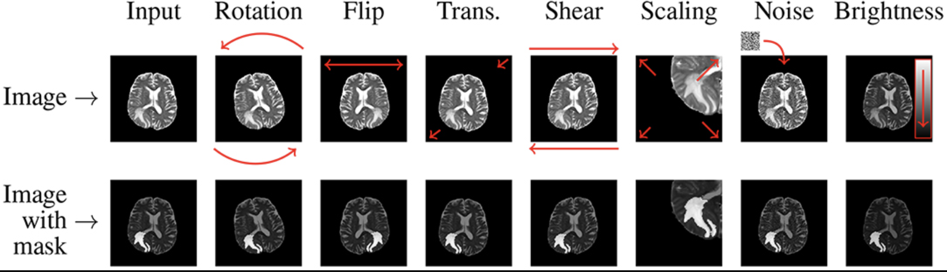
Common Data Augmentation Techniques for Medical Imaging

Slide 14
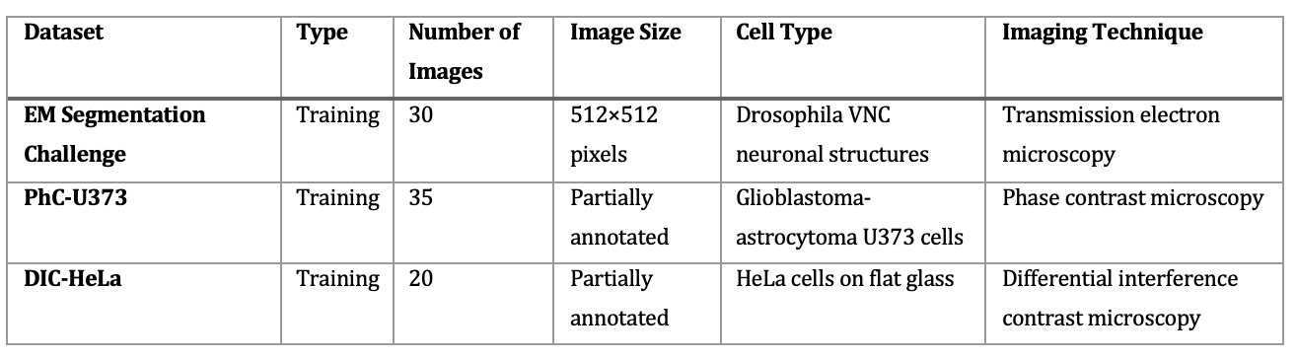
Datasets used

Slide 15
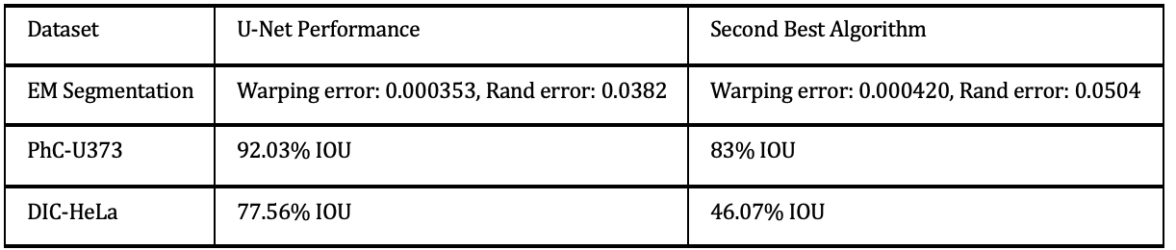
Results

Slide 16
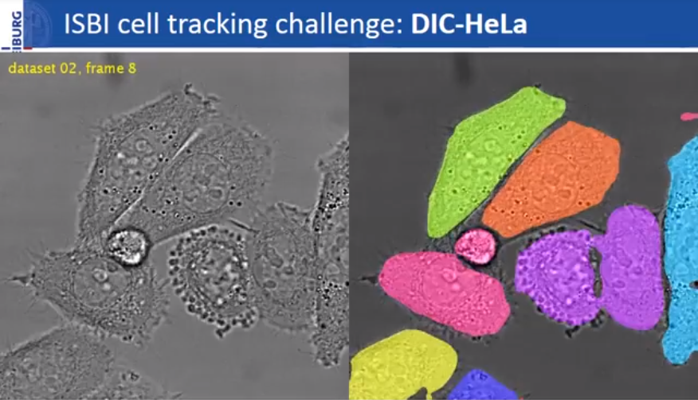
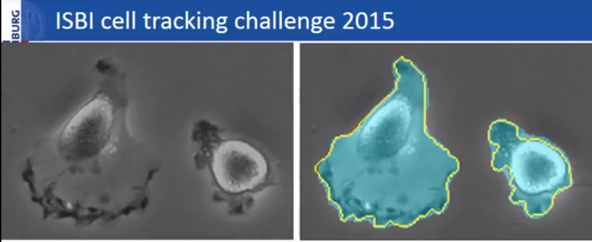
Author Results
Ronneberger et al. (2015) ISBI cell tracking challenge

Slide 17
Thank You

