Slide 1
Assignment Solution
Prepared By : Rahul Nagial

Slide 2
Contents
Initial Setup
Methodology
Feature Engineering
K-Means Model Fitting
Insights
Future Improvements

Slide 3
Initial Setup
I loaded the raw data in data frame df.
There were no duplicate rows and no null values in df.
All 30 customers had equal number of transactions (i.e., 552).
All 12 products had equal frequency (i.e., 1380).

Slide 4
Methodology
Used a modified RFM (Recency, Frequency, Monetary) approach to segment customer as per transactional behaviour.
‘Frequency’ variable captures number of items bought, and ‘Monetary’ variable captures total amount spent by customer.

Slide 5
Methodology
Generated ‘Continuity’ variable to measure how consistently customers are buying across product classes and used it instead of standard ‘Recency’ metric used in RFM analysis.
Segmented customers using K-means algorithm and ‘Continuity’, ‘Frequency’ and ‘Monetary’ variables.

Slide 6
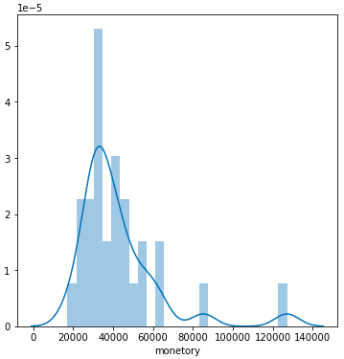
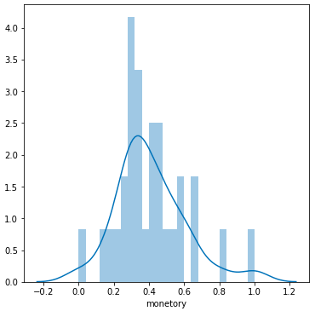
Feature Engineering
Variables ‘Monetary’/ ‘Frequency’ are right-skewed and non symmetric. Thus, I log-transformed them.
I rescaled the variable using MinMaxScaler to negate scale related effects.

Slide 7
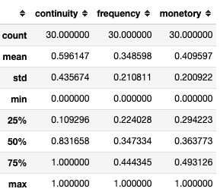
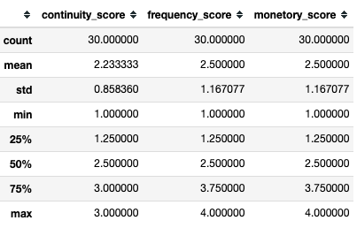
Feature Engineering
I assigned scores to variables based on their quantile. Idea was to increase interpretability of results.
If variable was in first quantile, then score was 1. If it was in second quantile, then score was 2 and so on.

Slide 8
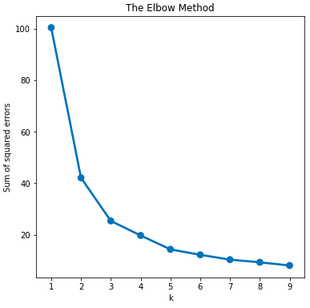
K-Means Model Fitting
Narrowed down the optimal numbers of cluster as 3, 4 or 5. Used sum of squared error (SSE) values and elbow method as governing criteria.

Slide 9
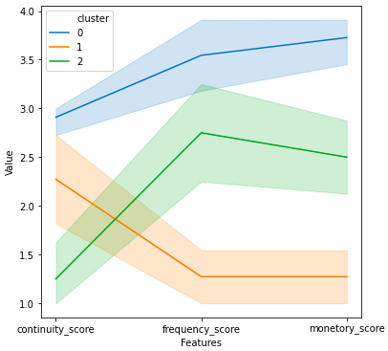
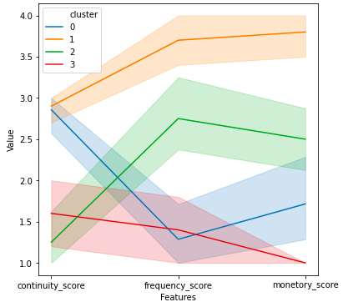
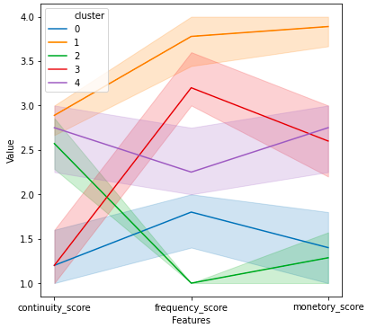
K-Means Model Fitting
Determined model with 3 clusters as the best choice with the help of ‘snakeplot’. Higher cluster number lead to overlapping/complex segmentation.

Slide 10
Insights
The following customer segments were identified:
Cluster 0 : C1, C2, C4, C5, C7, C8, C10, C11, C14, C15, C16
Cluster 1 : C3, C6, C9, C12, C13, C18, C19, C20, C24, C27, C29
Cluster 2 : C17, C21, C22, C23, C25, C26, C28, C30

Slide 11
Insights
Cluster 0
Represents the best customer for our business.
This group is buying items across different product types consistently.
The number of items they are buying and the overall money they are spending with the business is also high.

Slide 12
Insights
Cluster 0
New, expensive product launches can be aimed at this sub-group as they are the highest spending and most loyal customer base.
Also, it doesn't make sense to spend too much marketing and advertisement budget on this group as they are already happy with our business.
It makes sense to redirect these funds on other groups to maximize profit for our company. Whatever is being done to engage this group of customers so far is working.

Slide 13
Insights
Cluster 1
Customers in this segment are buying items fairly continuously across different product types.
However, in these purchases they are buying few items and these items are not of really high price and therefore, the total positive monetary input they are having for our business is relatively small.

Slide 14
Insights
Cluster 1
I would suggest that we should have targetted Ad campaigns for this group and we can give them discounts on certain higher priced products to pique their interest and drive their overall spending at our business.
Also, we can incentivise purchase of more item numbers by providing offers like buy 2 get 1 free etc.
There is a lot of untapped growth potential in this segment and marketing efforts should be put in to materialize the same.

Slide 15
Insights
Cluster 2
Customers in this segment are not buying continuously across different product options.
One way to influence this behaviour for the benefit of the company would be to incentivise these customers to buy across different products consistently by giving discounts/coupons for more diversified product-type buying behaviour.
Also, these customers seem to be buying more of lower valued items (apparent from higher frequency score but not so high monetary score).

Slide 16
Insights
Cluster 2
Therefore, to build customer trust we can offer them higher priced items at highly discounted prices for some time.
Once the customer uses those higher priced products for some time, they will appreciate their quality/usefulness.
Later we can withdraw the discount schemes and hopefully, customer would start buying those higher priced products at their original (high) price, thus driving profit for our business.

Slide 17
Future Improvements
Density based clustering techniques (like DBSCAN) can be implemented to see if it yields better results.
Bottom-up hierarchical clustering can also be tried.
Importance can be given to product type by calculating a weighted ‘Continuity’ score, where customers are penalized more/less depending on the product type.

